Slide 1
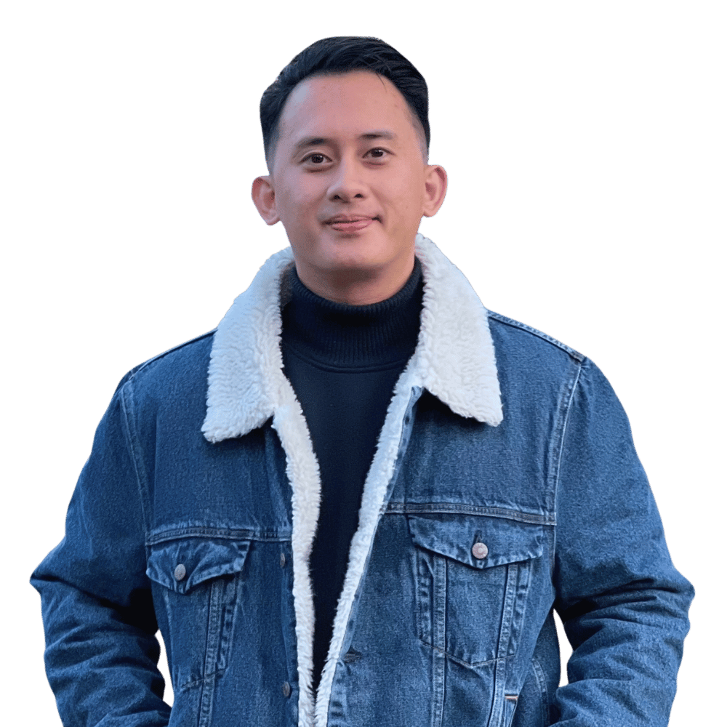
Mark Renzo
Five ways to
make your mark
Personal brand & logo directions
October 2026
Notes:
Source: User brief and screenshot provided 2026-10-09. Actual portrait reused with user authorization from https://markrenzo.com/assets/markrenzosquare-B7T_EDH4.png . Current positioning verified from https://markrenzo.com/ . This deck presents five proposed directions for selection before the website build.

Slide 2
The same human in every direction
Creative
technologist.
AI specialist.
Human curiosity
Your projects and personal life give the
site something real to talk about.
Practical usefulness
The AI helps visitors explore your work
and imagine what you could build for them.
Friendly quirks
Photo stickers, playful copy and touchable
objects make room for a little surprise.
Mark Renzo / Brand directions
02
Notes:
Brand foundation is a design interpretation of the user brief. Creative Technologist & AI Specialist is the current website positioning at https://markrenzo.com/ . Personal life and project knowledge, draggable stickers, AI website control and a build preview are requested future behavior, not a claim that the new site exists.

Slide 3
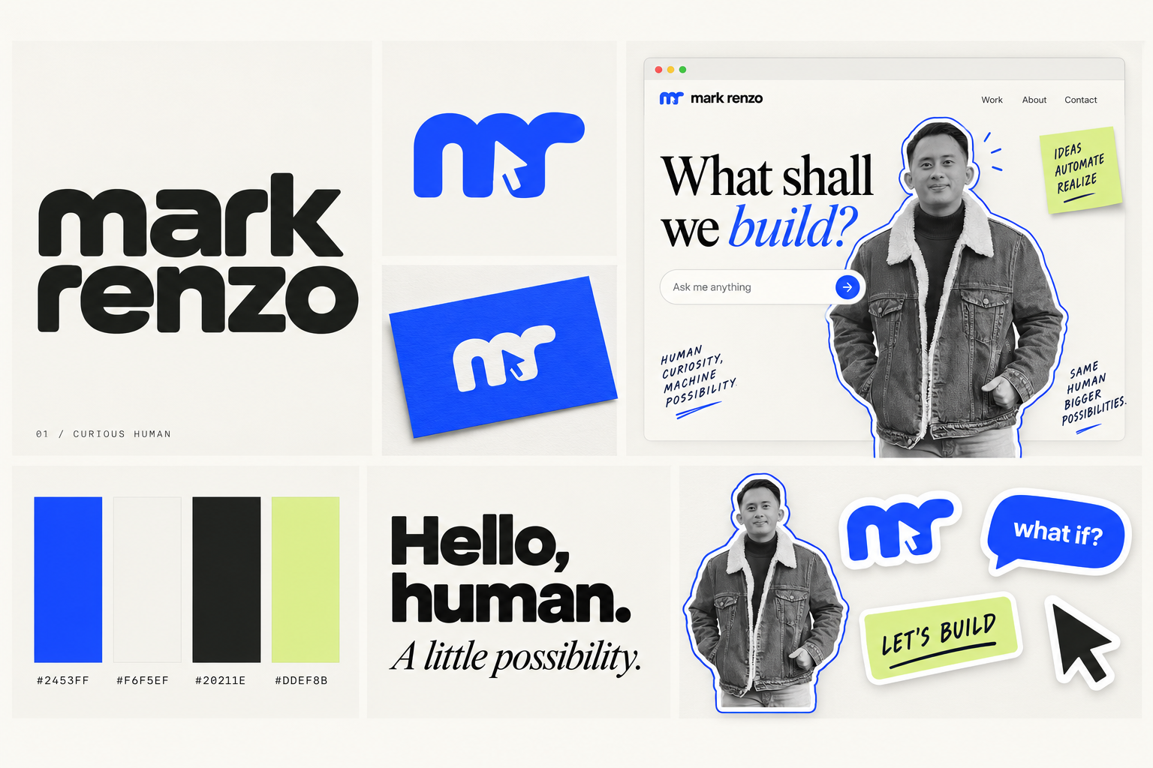
01 Curious Human
Identity concept
Notes:
Direction 01: Curious Human. Artwork generated for this user’s brand exploration from the user brief. Source image: /Users/markrenzo/Documents/ChatGPT/markrenzodotcom/branding/concepts/01-curious-human.png. The board contains concept logo artwork, not final vector logo files. Font pairings elsewhere in this deck are proposed production choices, not claims about exact typefaces drawn in generated artwork. Colors and typography require final refinement after direction selection.

Slide 4
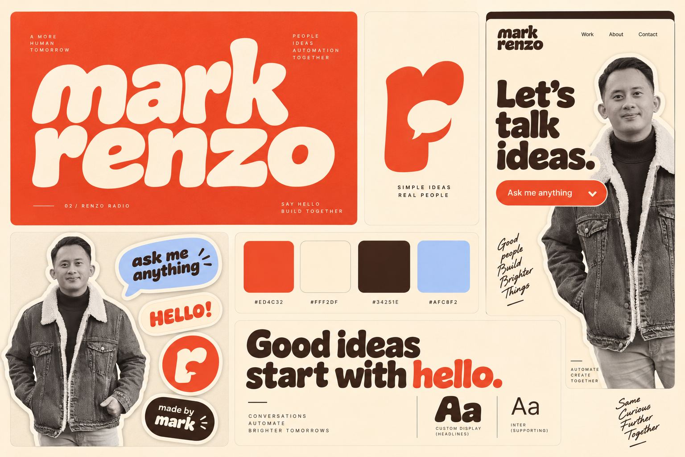
02 Renzo Radio
Identity concept
Notes:
Direction 02: Renzo Radio. Artwork generated for this user’s brand exploration from the user brief. Source image: /Users/markrenzo/Documents/ChatGPT/markrenzodotcom/branding/concepts/02-renzo-radio.png. The board contains concept logo artwork, not final vector logo files. Font pairings elsewhere in this deck are proposed production choices, not claims about exact typefaces drawn in generated artwork. Colors and typography require final refinement after direction selection.

Slide 5
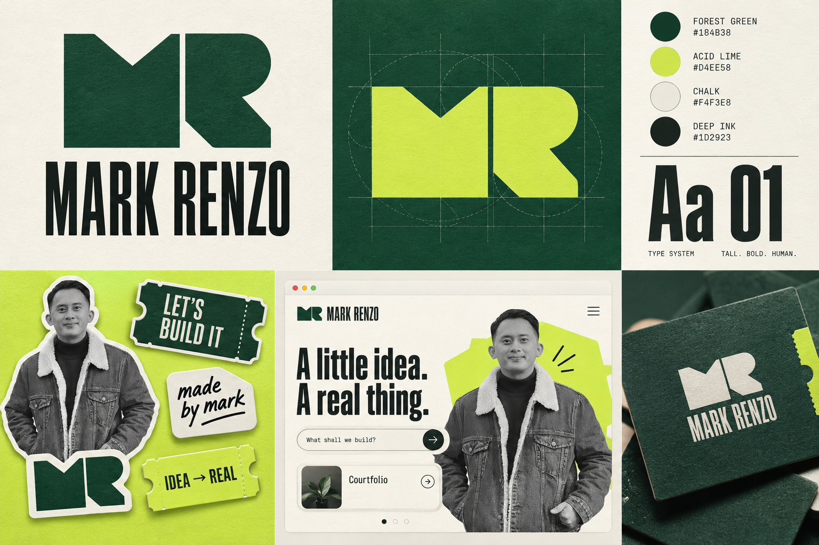
03 Build Club
Identity concept
Notes:
Direction 03: Build Club. Artwork generated for this user’s brand exploration from the user brief. Source image: /Users/markrenzo/Documents/ChatGPT/markrenzodotcom/branding/concepts/03-build-club.png. The board contains concept logo artwork, not final vector logo files. Font pairings elsewhere in this deck are proposed production choices, not claims about exact typefaces drawn in generated artwork. Colors and typography require final refinement after direction selection.

Slide 6
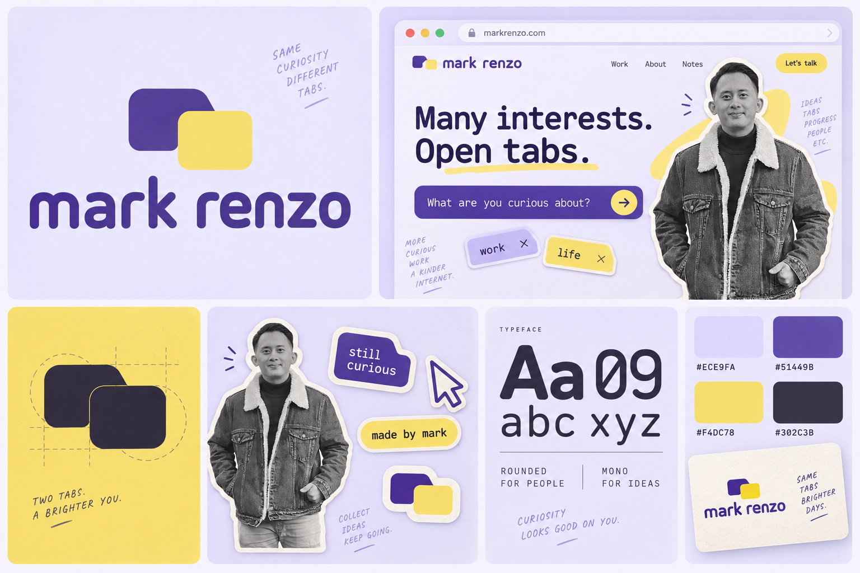
04 Open Tabs
Identity concept
Notes:
Direction 04: Open Tabs. Artwork generated for this user’s brand exploration from the user brief. Source image: /Users/markrenzo/Documents/ChatGPT/markrenzodotcom/branding/concepts/04-open-tabs.png. The board contains concept logo artwork, not final vector logo files. Font pairings elsewhere in this deck are proposed production choices, not claims about exact typefaces drawn in generated artwork. Colors and typography require final refinement after direction selection.

Slide 7
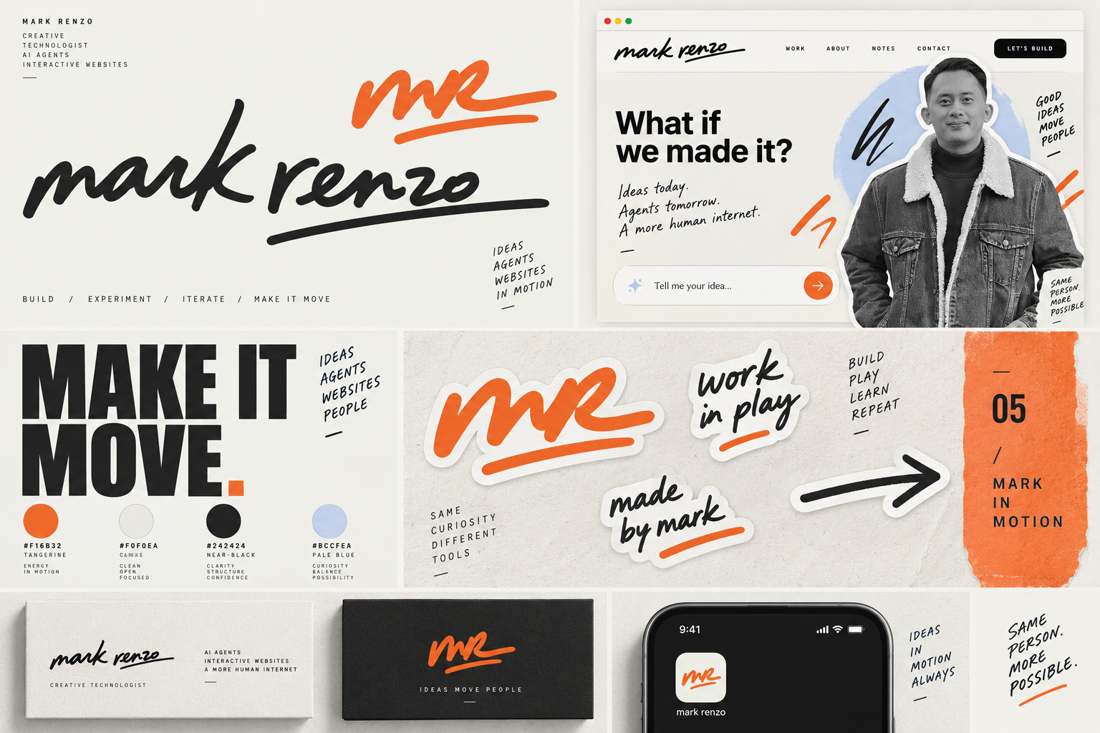
05 Mark in Motion
Identity concept
Notes:
Direction 05: Mark in Motion. Artwork generated for this user’s brand exploration from the user brief. Source image: /Users/markrenzo/Documents/ChatGPT/markrenzodotcom/branding/concepts/05-mark-in-motion.png. The board contains concept logo artwork, not final vector logo files. Font pairings elsewhere in this deck are proposed production choices, not claims about exact typefaces drawn in generated artwork. Colors and typography require final refinement after direction selection.

Slide 8
Five visual systems
Color specifications and proposed type pairings
DIRECTION | PALETTE (HEX) |  |  |  | TYPE PROPOSAL
01 Curious Human | 2453FF | F6F5EF | 20211E | DDEF8B | General Sans DM Serif Display
02 Renzo Radio | ED4C32 | FFF2DF | 34251E | AFC8F2 | Fraunces (Soft) DM Sans
03 Build Club | 184B38 | D4EE58 | F4F3E8 | 1D2923 | Barlow Condensed DM Sans
04 Open Tabs | 51449B | ECE9FA | F4DC78 | 302C3B | Space Grotesk IBM Plex Mono
05 Mark in Motion | F16B32 | F0F0EA | 242424 | BCCFEA | Archivo Black DM Sans
Fraunces uses its Soft variation. These are font proposals for the final system.
Mark Renzo / Brand directions
08
Notes:
Palette values are authored design proposals. Proposed typefaces verified from primary sources: General Sans https://www.fontshare.com/fonts/general-sans ; DM Sans and DM Serif Display https://github.com/googlefonts/dm-fonts ; Fraunces https://fraunces.undercase.xyz/ (SOFT axis and Soft instances) ; Barlow Condensed https://fonts.google.com/specimen/Barlow+Condensed ; Space Grotesk https://fonts.google.com/specimen/Space+Grotesk ; IBM Plex Mono https://www.ibm.com/design/language/typography/typeface/ ; Archivo Black https://fonts.google.com/specimen/Archivo+Black . Typeface names are editable text labels. The presentation itself uses Helvetica Neue and Georgia.

Slide 9
A brand you can play with
Planned website behavior
01
A personal guide
Ask about Courtfolio. The AI scrolls to its
project and triggers a relevant animation.
02
Projects on their own
Browse clear project stories without
starting a conversation.
03
A living sticker desk
Drag photo stickers, rearrange objects
and let them snap into playful places.
04
A small preview of an idea
Describe a dashboard or automation.
See a basic preview, then contact Mark.
05
A direct line to the human
Unknown answers go to Mark on Telegram.
His reply answers the visitor and updates the KB.
Mark Renzo / Brand directions
09
Notes:
All behavior on this slide is planned and unimplemented. Source: user brief 2026-10-09. User named Courtfolio (also spelled cortfolio in their example). No unsupported project capabilities are implied. Telegram is a planned human-in-the-loop answer channel. Functional website implementation, credential configuration, knowledge-base publishing rules and integration testing are future work after brand direction selection.

Slide 10
Five distinct personalities
DIRECTION | STRONGEST FIT | TRADEOFF
01 Curious Human | Clear project stories with a personal, playful edge. | Needs distinctive photo stickers and a recognizable voice.
02 Renzo Radio | Warm and conversational. The AI feels like a friendly host. | Technical project stories need structure beside the retro style.
03 Build Club | Hands-on maker energy. A strong invitation to build together. | Personal photos keep it feeling like Mark rather than an agency.
04 Open Tabs | A natural home for work, life and a personal knowledge base. | Too many tabs can compete with the work itself.
05 Mark in Motion | An expressive personal signature. The most freedom for motion. | Needs quiet reading moments and a reduced-motion mode.
Mark Renzo / Brand directions
10
Notes:
Qualitative comparison reflects design judgment based on the supplied screenshot and user brief, not measured market performance or trademark clearance. Each option should remain a coherent identity rather than mixing unrelated logos.

Slide 11
My recommendation
01 Curious Human
The closest match to your reference,
with room for your real personality.
Borrow the warmth of Renzo Radio for the voice and sticker copy.
Keep one logo family, one core palette and a consistent type system.
Which direction feels most like you?
Choose 01–05, or name the specific elements you want to combine.
Notes:
Recommendation is design judgment: Curious Human most closely follows the cream, ink, cobalt, generous typography and personal sticker sensibility in the supplied screenshot. Renzo Radio contributes warmth through tone and supporting sticker copy only. Final logo construction and a coherent production identity follow the user’s selection. No final vector logo or finished website is represented by this concept deck.

