Slide 1
DAA Hackathon – Problem 61
Warehouse Robot Navigation
Finding the best path for a robot using A*, BFS and Dijkstra
Team Members
Manthan Mahadev Biradar(25MVCSMR0512)
Yashvardhan Singh Gaur(25MVCSMR0540)
Biswajit Behera(25MVCSMR0472)
Jampala Purnasena(25MVCSMR0491)
Domain: Robotics & Path Finding

Slide 2
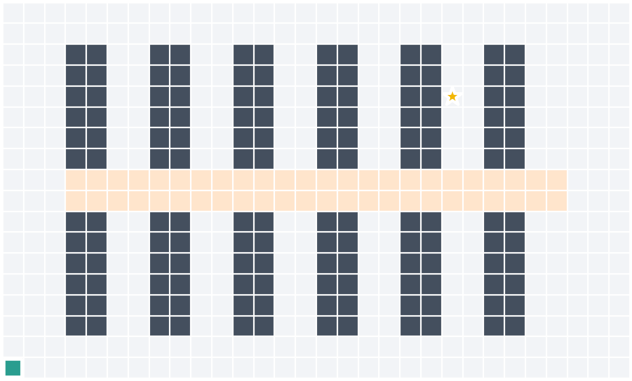
The Problem
Problem
A robot must reach a pickup point in a warehouse
It must avoid shelves and obstacles
Why it matters
Shorter path = faster delivery
Less battery is used
Challenges
Sample warehouse map
Many shelves, some crowded aisles

Slide 3
Our Idea
Run 3 path-finding algorithms on the same map and compare which one works best.
Key Features
Compares BFS, Dijkstra and A* side by side
Shows which cells each algorithm checked
Crowded aisles cost more, so the robot avoids them
User can change the map, start and pickup point

Slide 4
How It Works
Input
Warehouse map
Processing
Map → grid graph
Algorithm
BFS / Dijkstra / A*
Output
Best path shown
User Steps
Open map → Set start and pickup → Click Run → See the result

Slide 5
Technology & Algorithms
Tools Used
Algorithms
Python
Pygame
Streamlit
Algorithm | What it does | Complexity
BFS | Path with fewest moves | O(V + E)
Dijkstra | Cheapest path | O(E log V)
A* | Cheapest path, but faster | O(E log V)
V = cells, E = connections between cells

Slide 6
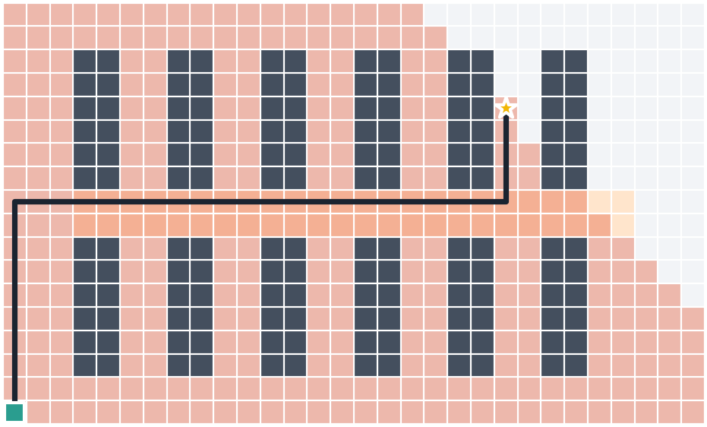
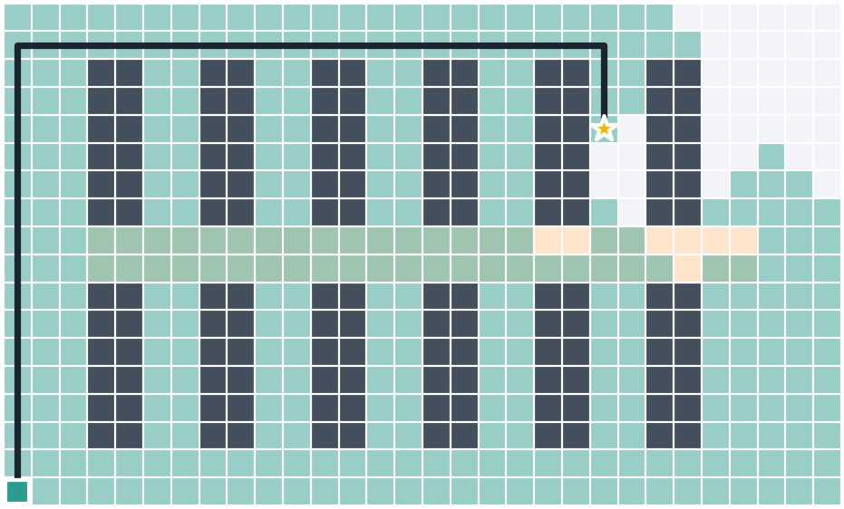
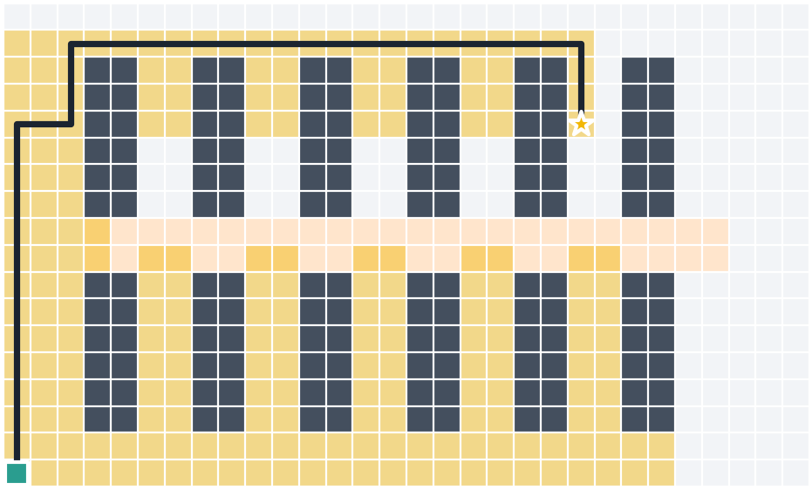
Demo & Results
BFS
Dijkstra
A*
 | BFS | Dijkstra | A*
Moves | 34 | 40 | 40
Path cost | 110 | 40 | 40
Cells checked | 322 | 351 | 213
Result: A* finds the cheapest path while checking the fewest cells.

Slide 7
Conclusion & Future Scope
Conclusion
Future Scope
Built and compared 3 algorithms
A* gives the best path with least effort
Moving obstacles
Multiple robots
Real warehouse robots
Thank You!

