Slide 1
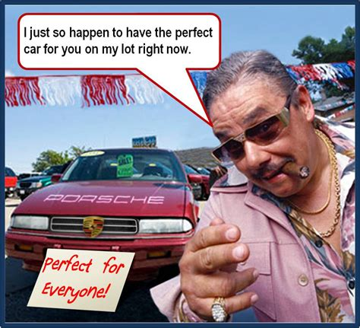

Slide 2


2014 Used Cars
USED CARS SALESPEOPLE
Reena A.
Jam P.
Beichen W.
Alejandra S.

Slide 3
Back End Process of the Project
Get used car data from SQL
automobile.sql
Clean up 1:
Use VIN to get consistent make, model, year for each vehicle
get
vpic.nhtsa.dot.gov
response
Append MSRP:
Use VIN to get MSRP and append to analysis data frame
parser
searchquarry.com
soup
parser
Append Lat/Lon:
Use city & State to obtain geo-code info
get
Openweathermap.com
response
Create Flask Application (app.py) to server information on website
PostgreSQL and SQLite

Slide 4
Front End Process of the Project
Home Page: index.html
Makes.html
Plot.html
Plot samples of vehicle’s depreciation
Filter and Display information based on user selection
app.js
bonus.js
bonus1.js
bonus2.js
Display Updated Results and plots

Slide 5
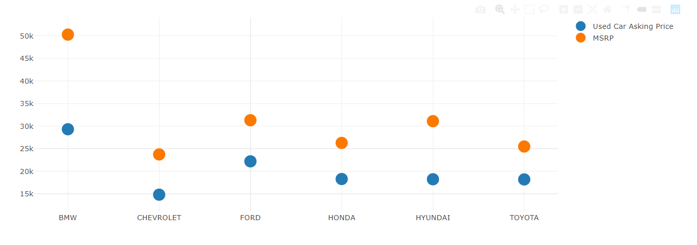
MSRP V Asking Price linkE)
Notes:
BMW luxury car has most deprecation in dollars. Largest distance between MSRP and asking price
Toyota has the least depreciation.
This is the perception of what brand is able to sustain the highest value

Slide 6
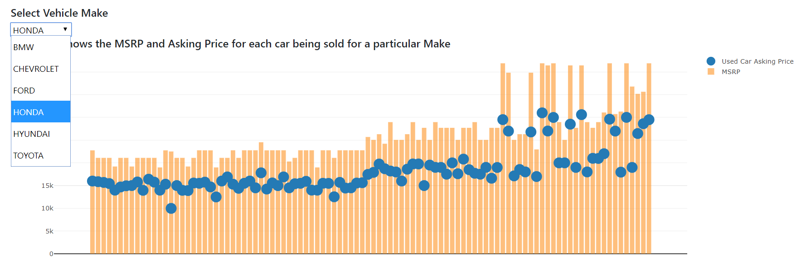
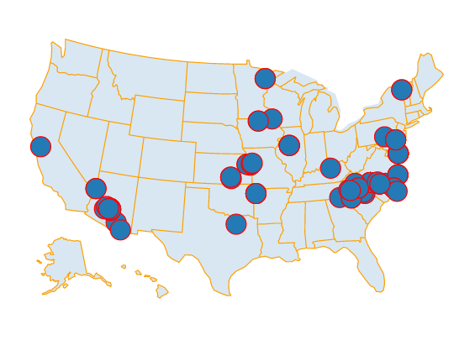
Pricing for Specific Makes
Notes:
Highest value cars, show largest deprication. Buy used cars for higher value cars because the prices goes down durastically compared to the 30k and less
Higher priced chevy have less depreciation
Toyota buyers upgrade a lot – add ons
Maps
Where all the cars are being sold. It shows the different prices throughout the country

Slide 7
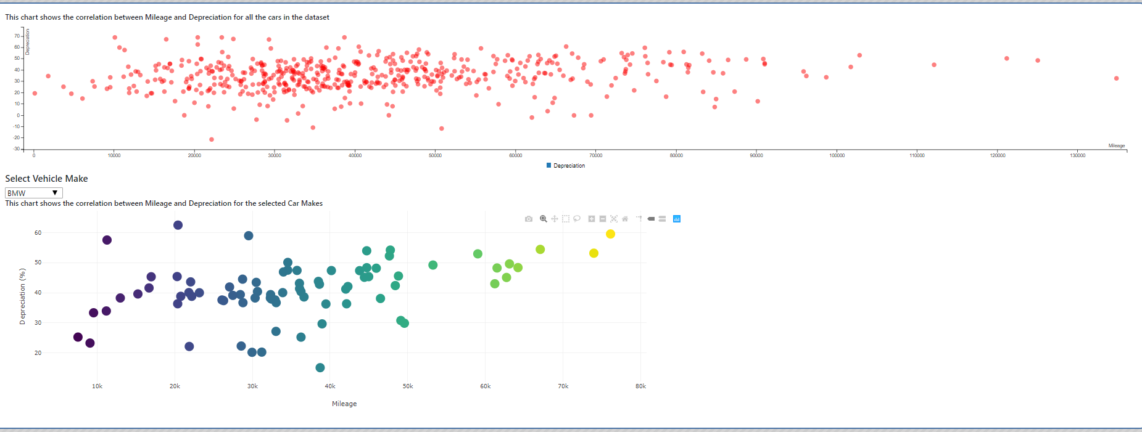
Depreciation Scatter Plot
Notes:
Scatter plot shows that there is no depreciation with the miles, generally across all brands
For ford it does (filtered)
Database is SQL
ETL – had to expand due to new project requirements

Slide 8


Questions?

