Slide 1

Analyses on Fuel-Related Aircraft Accidents
Julien Amrhein

Slide 2

Problem Description
High Octane Unleaded Aviation Gasoline gained approval for use
Will be replacing 100 Low Lead fuel
Goal: To analyze fuel-related accidents with the old fuel to create a foundation for studying the new fuel.

Slide 3
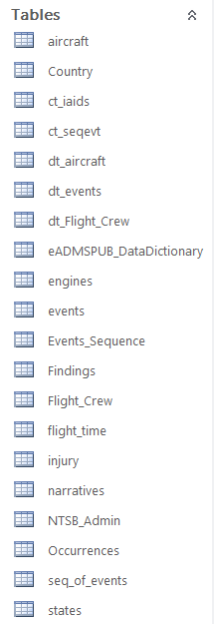

DataseT
The Census for US Civil Aviation Accidents from the National Transportation Safety Board (1982 - present)
Over 17,000 accidents after filters

Slide 4
Dependent Variable
‘fuel_rel’ – fuel-related accidents
aircraft systems - fuel system
engine fuel and control
fluids/misc hardware – fuel
fluids/misc hardware – fuel additive

Slide 5
Dependent Variable
‘fuel_rel’ – fuel-related accidents
aircraft systems - fuel system
engine fuel and control
fluids/misc hardware – fuel
fluids/misc hardware – fuel additive
~9.4% of total accidents

Slide 6
Dependent Variable
‘eng_rel’ – engine-related accidents
‘fuel_rel’ variable
aircraft power plant
fluids/misc hardware – oil & coolant
fluids/misc hardware – oil additive

Slide 7
Dependent Variable
‘eng_rel’ – engine-related accidents
‘fuel_rel’ variable
aircraft power plant
fluids/misc hardware – oil & coolant
fluids/misc hardware – oil additive
~17.5% of total accidents

Slide 8
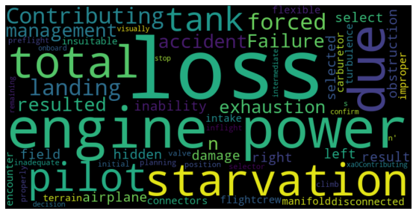
Word Cloud for Fuel Problems

Slide 9
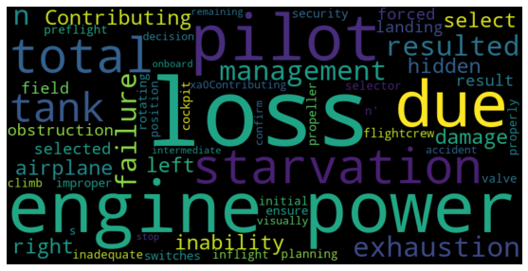
Word Cloud for Engine Problems

Slide 10
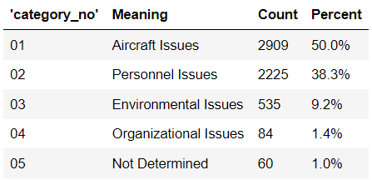
Types of Fuel Problem Classifications

Slide 11
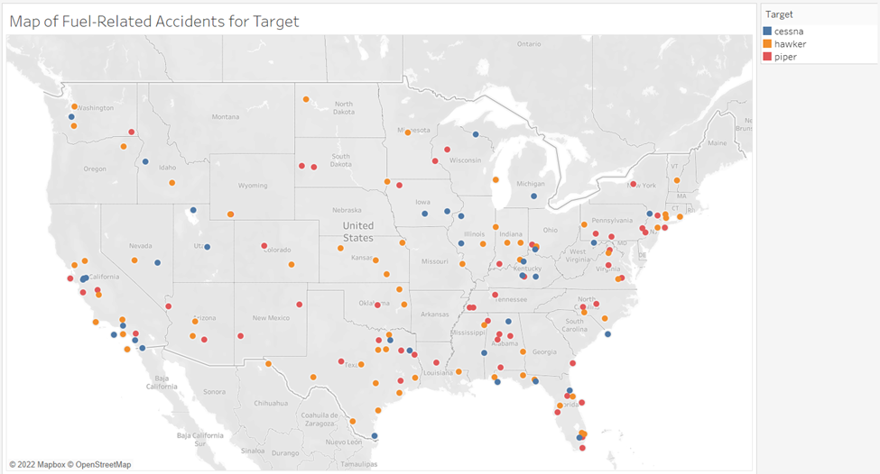
Fuel Problems in Target Aircraft

Slide 12
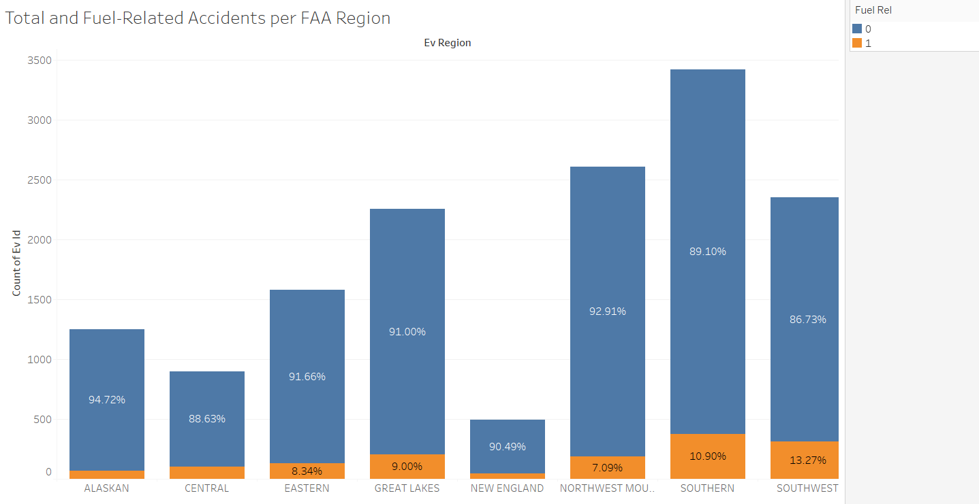
Fuel Problems across FAA Regions

Slide 13
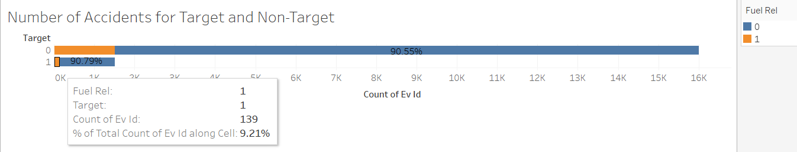
Modeling on Only the Target is not Feasible

Slide 14
Features for Modeling
Event type
Homebuilt?
Carburetor or fuel-injection engine?
Multiple engines?
Distance traveled
Gross weight
Highest level injury
Light conditions
Temperature
Wind velocity
Damage to aircraft
Type of flight
Engine type
And more!!

Slide 15
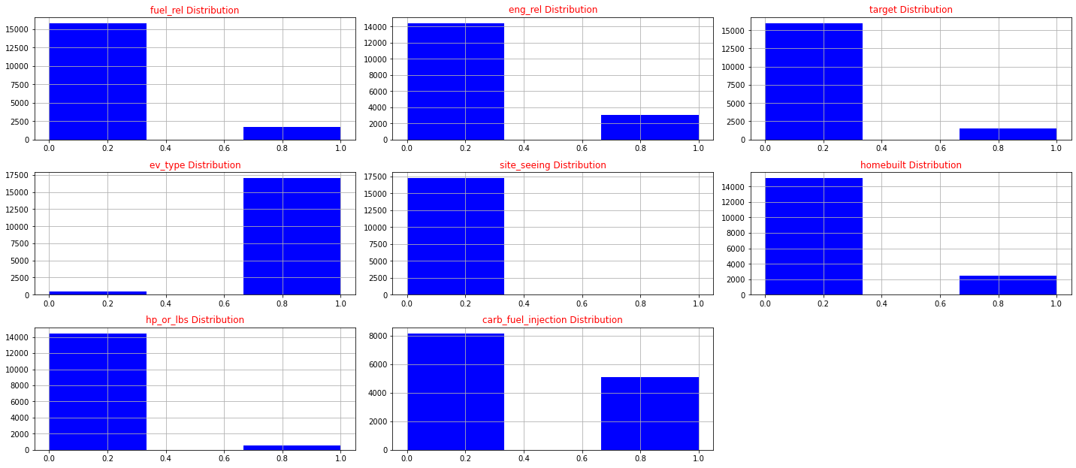
Binary Variables

Slide 16
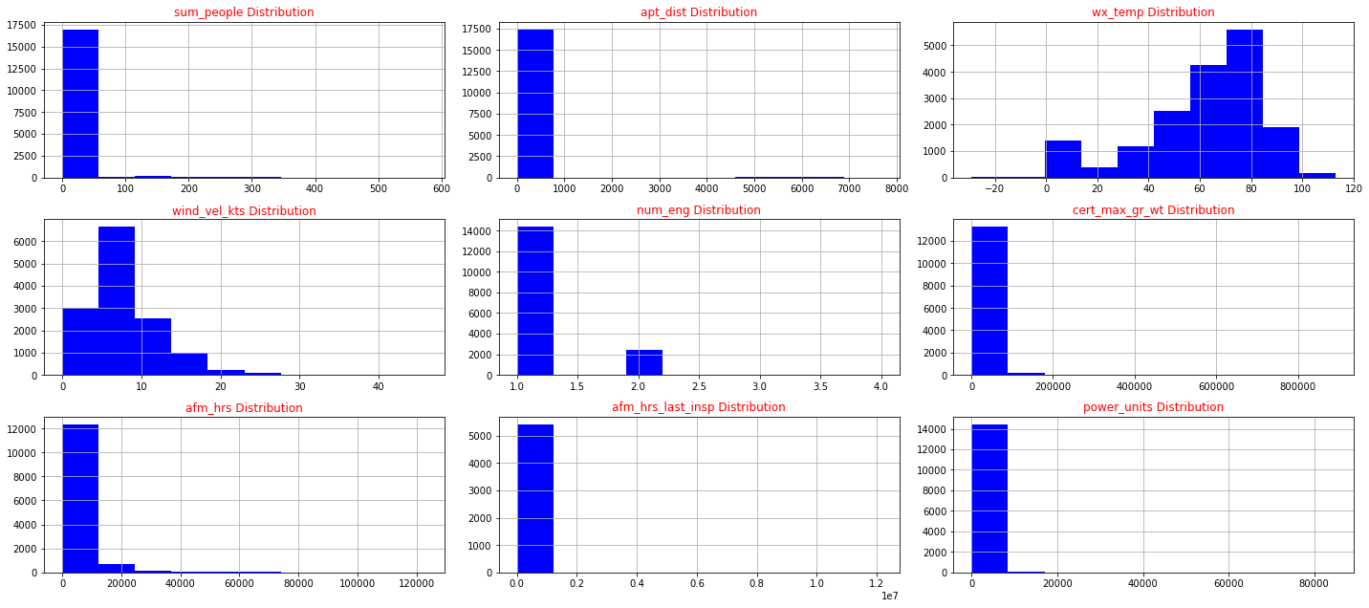
Continuous Variables

Slide 17
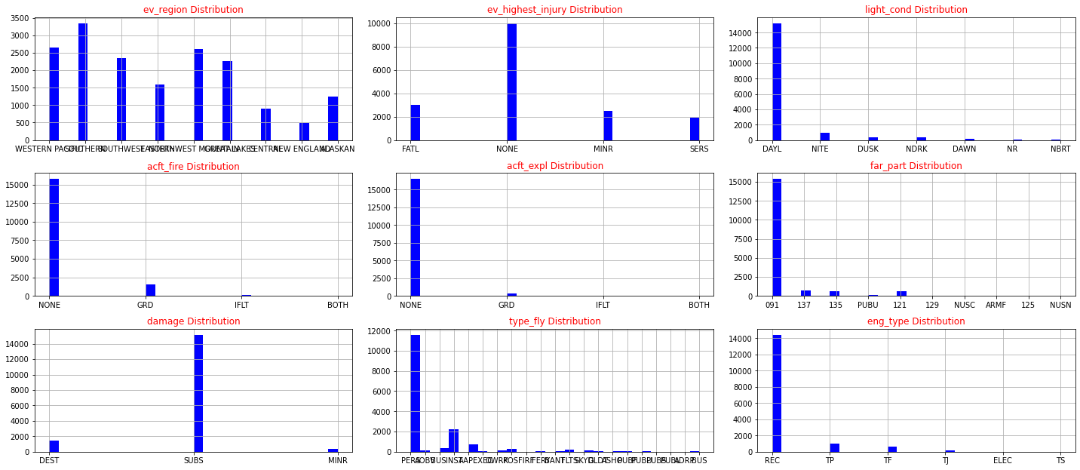
Categorical Variables

Slide 18

Predictive Model Types
Logistic Regression
Decision Tree
Random Forest
90 features after creating dummy variables

Slide 19
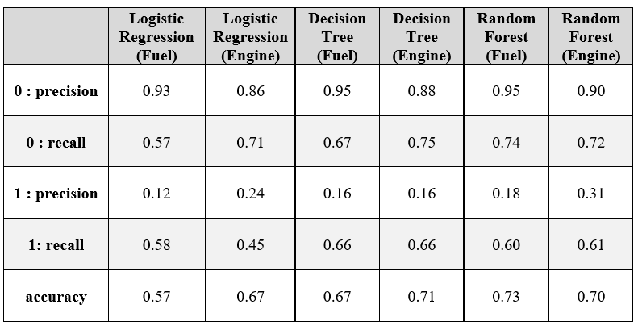
Predictive Modeling Results

Slide 20
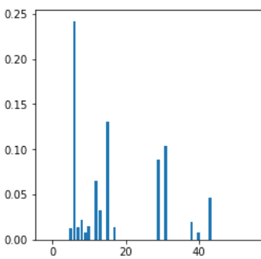
Feature Importances
Fuel Problems
‘apt_moved’ – 24.2%
‘power_units’ – 13.0%
‘damage_SUBS’ – 12.9%
‘ev_highest_injury_NONE – 10.3%
Engine Problems
‘apt_moved’ – 26.8%
‘afm_hrs_last_insp’ – 16.7%
‘ev_highest_injury_MINR’ - 8.4%
‘power_units’ – 7.1%

Slide 21
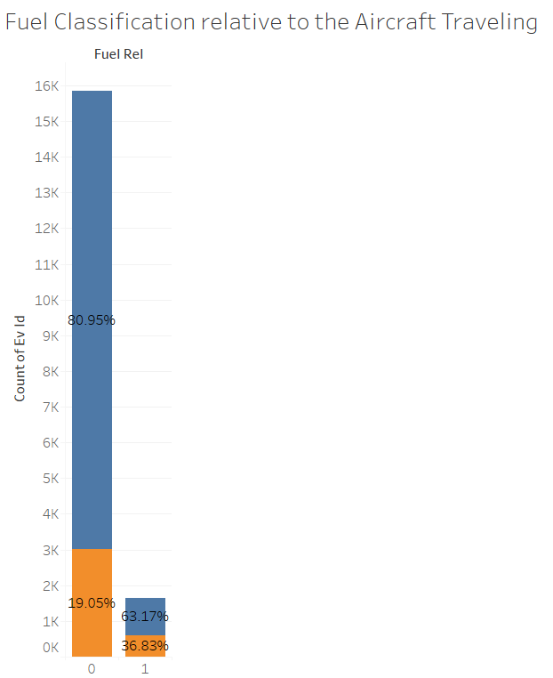
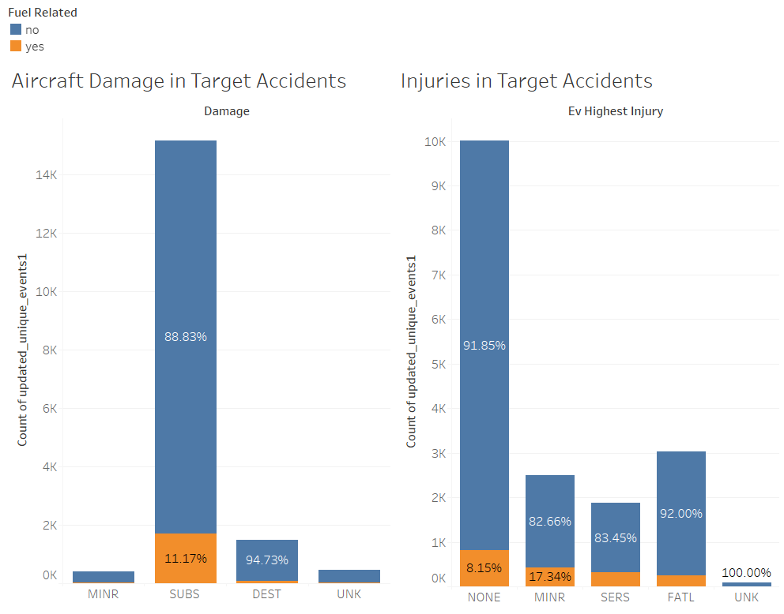
Visualizations of Important Features

Slide 22

Future Considerations
Unpacking aircraft/engine manufacturers
Analyze occurrence orders
Build more foundational knowledge on the aircraft, as that would allow more fine tuning of the variables
Analyze scrapes of forums discussing the implementation

