Slide 1
Syncing LDAP and RTC LDAP2RTCSync Utility March 2017
IBM Confidential
Notes:
IoT is about data. Data fuels… insights. Process / workflow optimization. New products and services. Supply chain disruptions
data sources are accelerating, as more and more of the world’s activity is expressed digitally by billions of interconnected devices - - mobile phones, interconnected devices and sensors, connected cars and appliances – plus components of machines - - like jet engines or oil rig drills.
- Interconnection is a critical element - instrumented objects communicating with each other and with people to generate massive amounts of data that can yield new insights, transactions and social connections, shared across countless networks, applications and data centers.
- and of course - - where the true potential lies - - intelligence. Having the ability to filter through that data, establish relevance, make it actionable, apply it to your business or organization, and use the resulting insights to optimize inventory or coordinate shipments or accurately predict industry trends or improve your customer’s experience of your brand.
This is the Internet of Things. - To take advantage of the IoT – we need to talk about how data, cloud, and engagement converge. And… as Marc pointed out…. Security is a constant
Before we do….

Slide 2
Agenda
LDAP2RTCSync Status Update
LDAP to RTC User Synchronization Requirements
Updated Design
Demo
Questions
Next Steps
IBM Confidential

Slide 3
Current Status
Requirements reviewed
LDAP and JNDI exploration completed
RTC Plain Java API exploration completed
Design updated and documented
Use LDAP RACF to define groups and members, and a separate configuration file for RTC configuration
Reuse existing LDAP user synchronization for server users and their repository permissions
Application coding in progress
Initial implementation targeted for end of March
Syncing users and repository permissions is complete (uses existing repotools_syncUsers)
Syncing administrators and members of a project area is complete

Slide 4
Requirements
LDAP (RACF backend only) groups and members used to specify RTC user configuration information
Server users, repository permissions, name and email updates are handled by existing repotools_userSync
Command line app LDAP2RTCSync used to update RTC project area user configuration from LDAP
Add/remove users to/from project or team areas
Add/remove process roles to/from user or groups of users
Assign/unassign client access license to/from user
Use LDAP Groups to organize collections of users with similar needs and apply the group to project or team areas, add process roles or assign licenses to everyone in the group.
Encrypt passwords in JSON file if any
Where ever an LDAP group can be specified, allow specification of multiple LDAP groups

Slide 5
Design (updated)
LDAP RTC configuration is required, see Managing users by using LDAP
Additional Project and Team Area configuration information is in a JSON configuration file
Configuration UI:
Uses existing LDAP admin tools for LDAP groups and members
Uses JSON configuration file for Project Area configuration (Administrators, Members, Process Roles)
Supports multiple RTC servers

Slide 6
RTC configuration in a separate JSON
TDS/RACF is used to manage corporate users and groups using existing LDAP-JTS userSync
RTC configuration is in a separate JSON file
No additional LDAP server is needed and no changes to TDS/RACF are needed
Minimal initial investment costs, but possibly higher incremental usage cost (editing JSON)
RTC configuration file is edited with a text editor
Requires a mapping between LDAP groups and RTC project and team areas, process roles and client access licenses that must be maintained
Maintenance of configuration file is eased though simplifying assumptions (see next chart)

Slide 7
Assumptions for scalability
If there’s only one server:
A small number of RACF groups could be used for JazzAdmins, JazzUsers, etc.
A group for each client access license type would likely be sufficient.
That could be as few as 5 and as many as around 12 RACF groups depending on the number of client access licenses that are installed on the server.
If all the project areas have the same administrators and members, or there’s a small set of RACF
groups that define typical members and the members always play the same roles:
RACF groups could be created to define the Administrators and Members
A RACF group could be created for each process role, and the same group used for all project and team areas.
That could be around 6 RACF groups per project area depending on the number of process roles in the process description. This also assumes the same RACF groups could be used for project and team areas.

Slide 8
Example configuration file
{"LDAPConnection": {
"URI": "ldap://mvs255.rtp.raleigh.ibm.com",
”userId": "racfid=BGREEN,profiletype=USER,CN=RACF255,O=IBM,C=RTC",
”password": "rtc2fun"},
"RTCServers": [{
"serverURI": "https://rtceerb.rtp.raleigh.ibm.com:9443/ccm",
"admin": "BGREEN",
"password": "rtc2fun",
"Licenses": [{
"Rational Team Concert - Developer (Trial)": "racfid=RTCFLT,profiletype=GROUP,CN=RACF255,O=IBM,C=RTC"}],
"Project Areas": [{
"name": "Pet Store",
"Administrators": "racfid=JAZPADMN,profiletype=GROUP,CN=RACF255,O=IBM,C=RTC",
"Members": "racfid=JAZZGRP,profiletype=GROUP,CN=RACF255,O=IBM,C=RTC",
"Process Roles": [
{"Analyst": "racfid=APETK,profiletype=GROUP,CN=RACF255,O=IBM,C=RTC"},
{"Developer": "racfid=OPETK,profiletype=GROUP,CN=RACF255,O=IBM,C=RTC"},
{"Project Manager": "racfid=APETK,profiletype=GROUP,CN=RACF255,O=IBM,C=RTC"},
{"Tester": "racfid=TPETK,profiletype=GROUP,CN=RACF255,O=IBM,C=RTC"}]}]}]}

Slide 9
Open Questions
What is the RACF DN for the user’s name? racfprogrammername? Do all users have this attribute? – This is actually handled by repotools_userSync and not an issue with LDAP2RTDSync
Does Rabobank use Team Areas? Yes
Do all user sync operations need to be logged, or just errors and warnings? Just errors and warnings need to be logged.
Should a —simulate option be supported to log what will be done without making the changes in RTC? Yes, especially if a configuration mapping file is required to debug the file.

Slide 10
Backup

Slide 11
The following charts are based on the previous design
All configuration is in LDAP
There is no configuration file
Existing LDAP – JTS user sync is still required

Slide 12
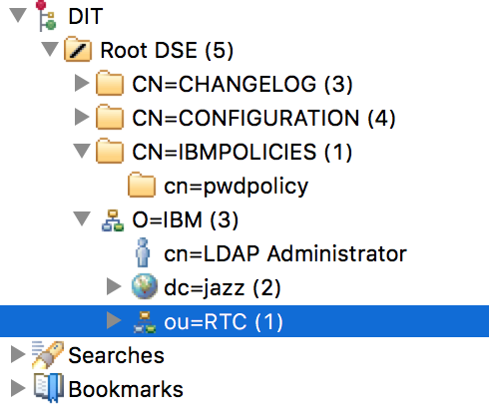
RTC configuration organizationalUnit
z/OS LDAP server to RACF and TMDB backends

Slide 13
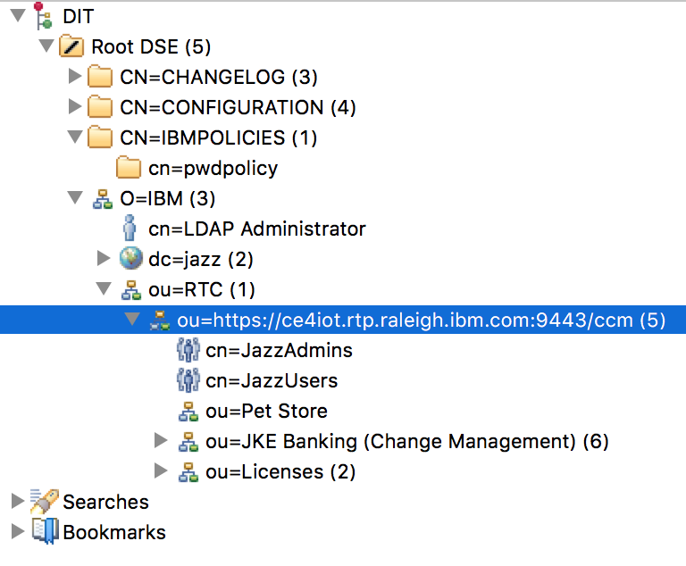
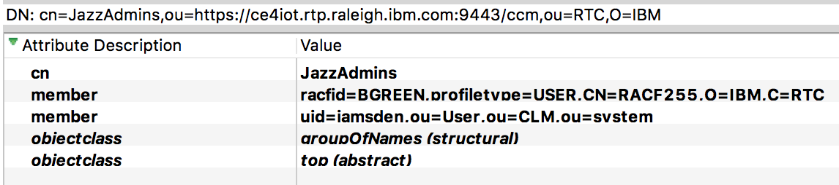
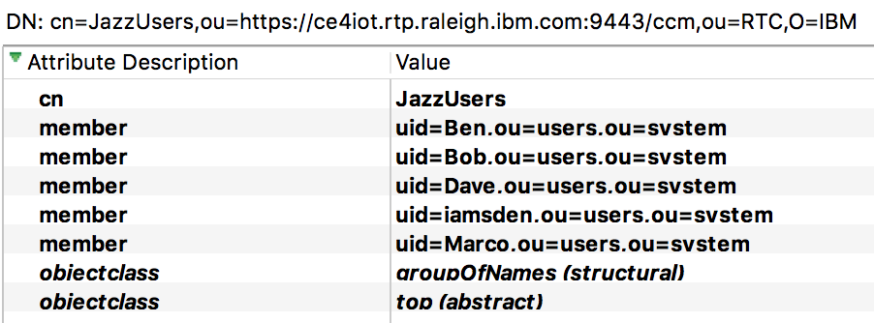
RTC Server, JazzAdmins and JazzUsers
RTC server has administrators, users, licenses and project areas

Slide 14
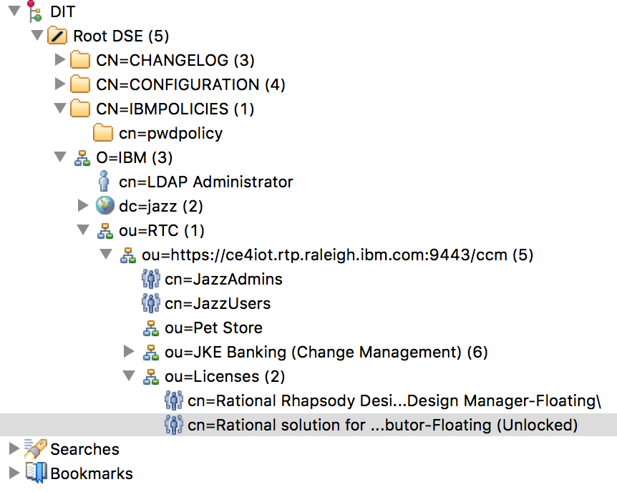
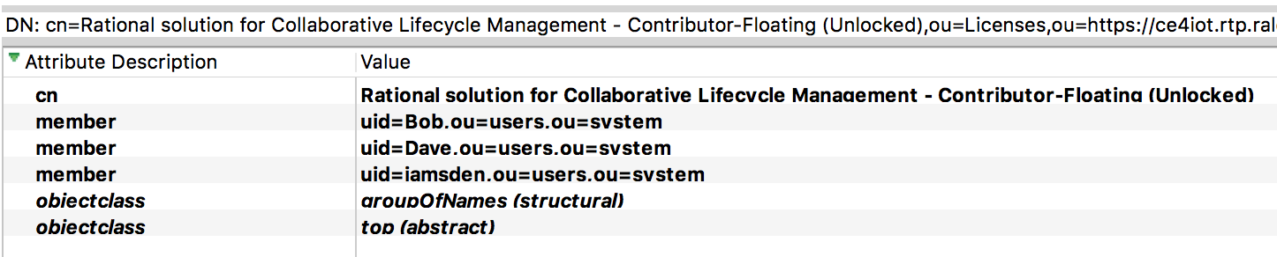
Installed Client Access Licenses and License Allocation

Slide 15
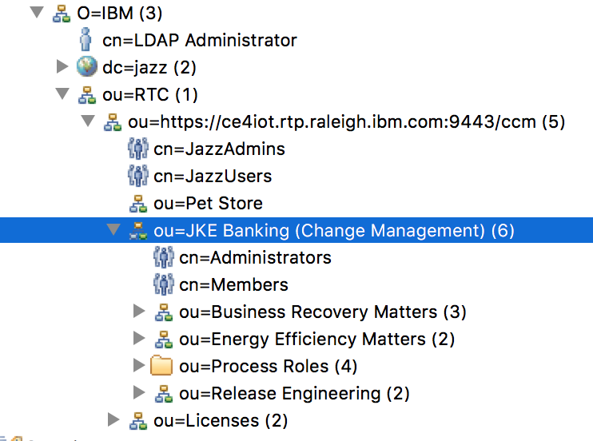
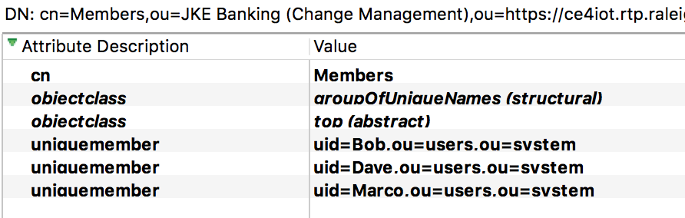
RTC Project and Team Areas

Slide 16
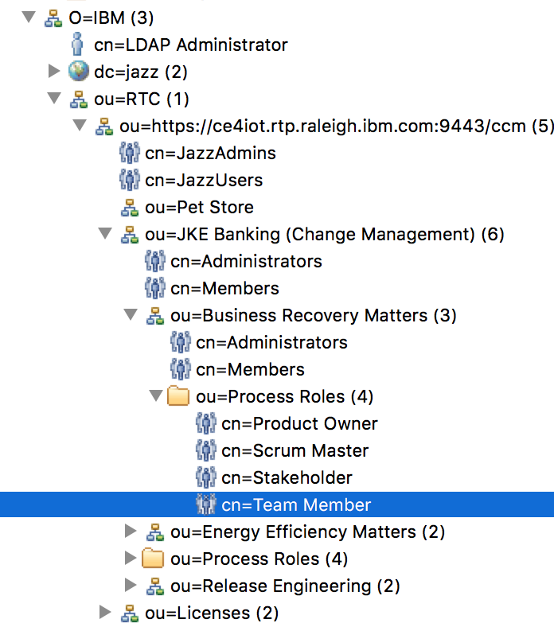
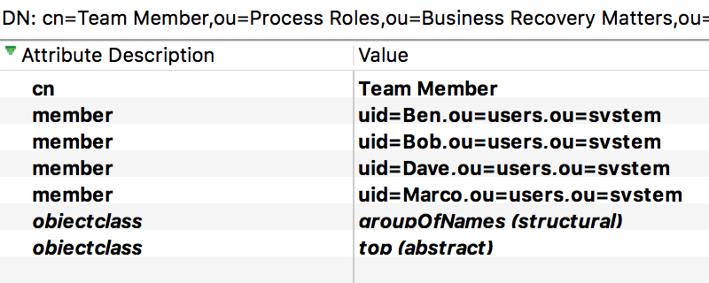
Process Roles

Slide 17
z/OS TDS configuration options
TDS configured for RACF and LDBM backends with appropriate permissions separating access to the RACF users and groups, and RTC configuration information
RACF defines uses and groups and a federated LDAP server with LDBM backend contains the RTC configuration referencing the RACF users and groups
RACF defines users and groups, all RTC configuration is in a separate JSON file mapping RACF groups to RTC project and team areas, process roles and client access licenses.

Slide 18
1. TDS configured for RACF and LDBM backends
The preferred solution if technically and politically possible. Both need to be investigated
All user configuration and management are in one place
One user interface is used for RACF users and RTC configuration of those users
Members of RTC organizationalUnits can reference RACF users: e.g., see example on chart 7 with racfid=BGREEN,profiletype=USER,CN=RACF255,O=IBM,C=RTC
No RTC configuration needed and no configuration files to edit that could introduce errors and security holes

Slide 19
2. Federated LDAP servers
TDS/RACF used to manage corporate users and groups
A separate LDAP server provides the RTC configuration
One user interface is used for RACF users and RTC configuration of those users
Members of RTC organizationalUnits can reference RACF users through federation
No RTC configuration needed and no configuration files to edit that could introduce errors and security holes
LDAP authentication can be used for both servers controlling access to user information
An additional LDAP server is required to be installed, configured and maintained.

Slide 20
Open Questions
Can LDAP and RTC names match? As long as the LDAP directory server supports the permissions and names
Does z/OS LDAP server with RACF support this design? Needs exploration, but even if it does, it may not be allowed at Rabobank – see following charts
What is the configuration of the Rabobank z/OS LDAP server? TDS with RACF backend only
Do all user sync operations need to be logged, or just errors and warnings?
Should a —simulate option be supported to log what will be done without making the changes in RTC? Yes, especially if a configuration mapping file is required to debug the file.
Would it be desirable and/or possible to develop an RTC schema for the configuration information? Probably not necessary.

