Slide 1
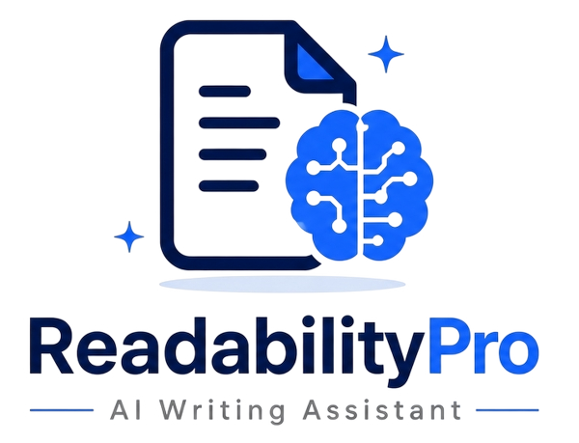
ReadabilityPro – AI Writing Assistant
Write Better, Smarter, Faster with AI
Developed by: Fiza Bashir (8594)
Jamshaid Ghafoor (8186)
Hasham Ikhlaq (7156)
Sana Batool (8554)
Course Department: Computing Department

Slide 2
Introduction
Problem:
Many users struggle with writing clarity
Complex sentences reduce readability
Time-consuming manual editing
Solution:
AI-based text analysis system
Provides instant readability feedback
Suggests improvements automatically
👉 “Our system simplifies writing and improves communication efficiency.”

Slide 3
System Approach
Step 1: Input Text
User enters or pastes content
Step 2: Analyze Readability
System evaluates sentence structure
Checks complexity and readability score
Step 3: Generate Suggestions
AI suggests improvements
Simplifies complex sentences
Step 4: Display Output
Shows results instantly
User can improve content

Slide 4
Target Users
🎓 Students → assignments & reports
✍️ Writers → blogs & content
📝 Bloggers → online writing
💼 Professionals → emails & documents
👉 “Designed for anyone who wants to write clearly and effectively.”

Slide 5
Business & Value
How to Sell:
Freemium model (free + premium features)
Subscription plans
Why Users Will Buy:
Saves time ⏱
Improves writing quality ✍️
Easy to use ⚡
AI-powered insights 🤖
Key Benefits:
Fast results
No technical skills required
Accessible from anywhere
👉 “ReadabilityPro turns complex writing into clear communication.”

