Slide 1
Bloom’s taxonomy
Bloom’s taxonomy is a hierarchical model used for classifying learning objectives by levels of complexity and specificity.
Bloom’s taxonomy is effective in helping instructors identify clear learning objectives as well as create purposeful learning activities and instructional materials.

Slide 2
Cognitive domain
Cognitive: knowledge or thinking
The cognitive domain has been the primary focus in education.
The cognitive domain is made up of six levels of objectives.
These levels are organized by hierarchy, moving from foundational skills to higher-order thinking skills.

Slide 3




















Slide 4
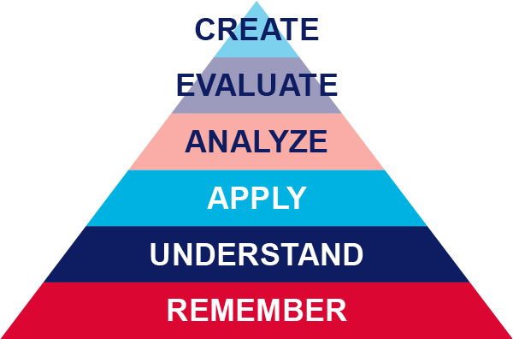

Slide 5
Remember: retrieve relevant knowledge from memory.
Understand: determine the meaning of instructional messages.
Apply: use a procedure in a given situation.
Analyze: break materials into components and determine how they work together.
Evaluate: make judgments based on criteria and standards.
Create: create a new or original work.

Slide 6






Remembering: list, define, recall, identify.
Understanding: explain, summarize, interpret, describe.
Applying: use, solve, demonstrate, apply.
Analyzing: compare, contrast, categorize, examine.
Evaluating: critique, judge, evaluate, assess.
Creating: design, construct, develop, invent.

Slide 7
Effective domain
The affective domain outlines behaviors that correspond to attitudes and values and as the learner progresses through the levels of the affective domain, they become self-reliant and internally motivated.

Slide 8
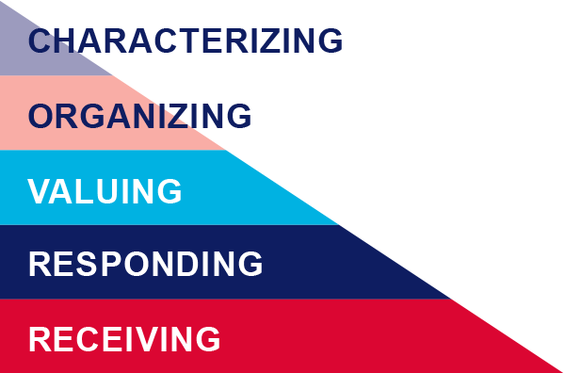

Slide 9

Receiving: Willing to listen and receive knowledge.
Responding: Actively participates and engages in knowledge transfer.
Valuing: Finds value and worth in one’s learning with motivation to continue.
Organizing: Integrates and compares values, resolves conflict between these values, and orders them according to priorities.
Characterizing: Creates a value system that controls behavior. The behavior is pervasive, consistent, predictable, and characteristic of the learner.

Slide 10




Receiving: listen, notice, observe, attend.
Responding: participate, answer, help, comply.
Valuing: appreciate, support, show interest, adopt.
Organizing: prioritize, rank, integrate, contrast.
Characterizing: act, advocate, influence, embody.

Slide 11
Psychomotor domains
The psychomotor domain includes physical movement, coordination, and motor skills. Development of these skills requires practice and is measured in terms of speed, precision, distance, procedures, or technical execution.

Slide 12
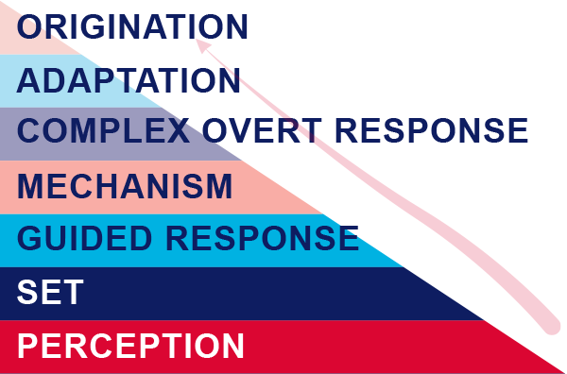

Slide 13




Perception: Use sensory cues to guide actions or movements.
Set: Demonstrates a readiness (physically, mentally, emotionally, and spiritually) to take action to perform the task or objective.
Guided response: Knows steps required to complete the task or objective and learns through trial and error by practicing.
Mechanism: Performs task or objective in a somewhat confident, proficient, and habitual manner.
Complex overt response: Performs task or objective in a confident, proficient, and habitual manner. Expert level, high proficiency and performs with accuracy.
Adaptation: Performs task or objective and can modify actions to account for new or problematic situations.
Origination: Create new procedures and solutions to approach various situations.

Slide 14
Perception: observe, identify, distinguish, detect.
Set: prepare, position, arrange, set up.
Guided Response: imitate, follow, repeat, copy.
Mechanism: perform, demonstrate, execute, apply.
Complex Overt Response: coordinate, perform, master, respond.
Adaptation: modify, adjust, alter, refine.
Origination: invent, create, design, construct.

Slide 15
Example
"Students will apply their understanding of teaching styles to design a lesson plan that incorporates a specific teaching style
"Students will explain the differences between various teaching styles
"Students will observe and identify different teaching styles used by their peers during practice teaching sessions."

