Slide 1

Project Description
Data Warehouse Case Study

Slide 2
Car Industry Data Warehouse
This project is about the Car Industry that sells and services (repairs) the cars. These three business processes are handled by the three systems:
  Car Sales Module.
  Car Service Center.
  Car Parts Suppliers.
The management wants to build a data warehouse based on these three source systems for the purpose of better business understanding and increasing business profit for their industry.

Slide 3
Business Processes
Car Sales.
Car Service Center.
Cars Parts Suppliers.

Slide 4
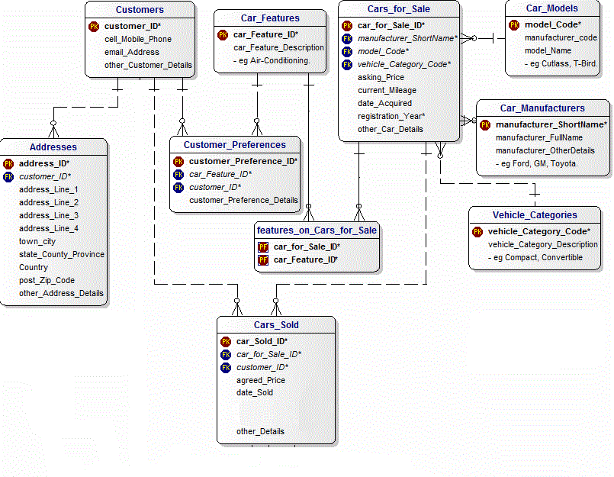
Car Sales

Slide 5
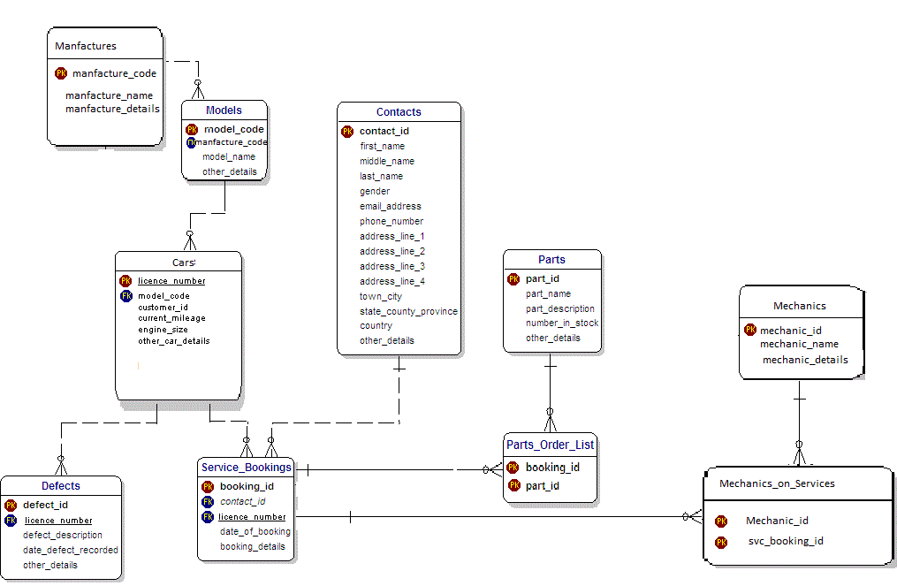
Car Service Center

Slide 6
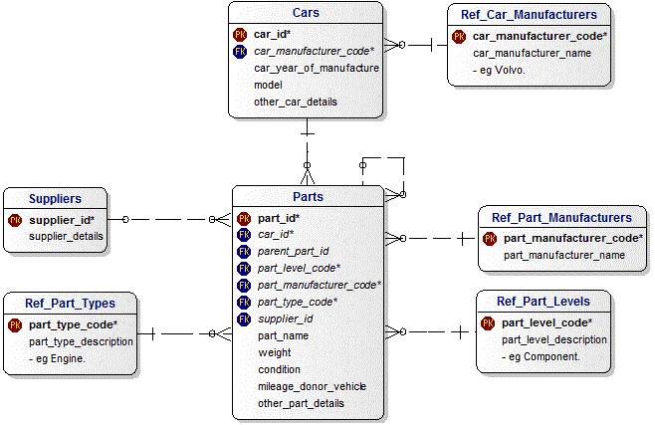
Cars Parts Suppliers

Slide 7
Abstraction of Possible Queries
Which car is on demand the most?
How many customers bought a particular car?
Which car features are most preferred by customers?
Which manufacture cars mostly came for service?
Which mechanic resolved cars issues the most?
Which is the most demanding car part?
Which car model part is most demanding?
Who are most valuable car parts suppliers?

Slide 8
Phase-1
Integrated ER Model of Target DW
Dimensional Models of Data Marts
  Your design shall be complete in all respects including the domain, entity integrity and referential integrity constraints. All models shall be designed using ERWIN or Fat Free Star Tool. You will also have to implement your data model in SQL SERVER.

Slide 9
Phase-2
Design the extraction strategy for your data warehouse
Design the transformation strategy for your data warehouse
Design the loading strategy for your data warehouse
Implementation of ETL using MS Business Intelligence studio.

Slide 10
Phase-3
Design the indexing strategy for your data warehouse. Determine which indexes are to be used on which columns of the table. Determine scenarios in which indexes will be helpful and what will be the costs associated. Some aspects of implementation of indexes and table joining techniques will also be required.

Slide 11
Instructions
Manage your Time Properly
There will be individual Evaluations As well as Group Evaluation
You have to submit proper Job Log
No Extension in Submission

