Slide 1
IP Addressing
CS176A
Ramya Raghavendra
ramya@cs.ucsb.edu

Slide 2
IP Addressing
Primary job of IP – delivering messages
IP Addressing
  Network Interface Identification
  Routing
Become more complicated with subnetting and classless addressing
Rest of the class…
  IP addressing schemes

Slide 3
Dotted decimal notation
32 bit binary
Four 8-bit octets
Ex: 11100011010100101001101110110001
11100011 - 01010010 - 10011101 - 10110001
E3 - 52 - 9D - B1
What’s a subnet ?
  device interfaces with same subnet part of IP address
  can physically reach each other without intervening router

Slide 4
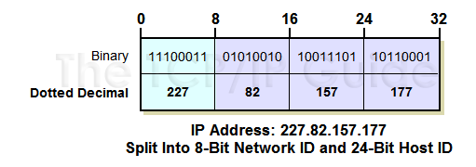
Internet IP Address Structure
32 bits have an internal structure with 2 components
  Network Identifier (Network ID)
  Host Identifier (Host ID)
  Like a telephone number! (401) 555-7777
The fundamental division of the bits of an IP address is into a network ID and host ID. Here, the network ID is 8 bits long, shown in cyan, and the host ID is 24 bits in length.

Slide 5
IP Address Scheme Categories
Conventional (“Classful”) Addressing
  Dividing line occurs only at octet boundaries
  A, B, and C depending on how many octets for network ID and host ID
Subnetted “Classful” Addressing
  3 tier system: network ID, subnet ID, host ID
  Ex: Class C 24 (NID) + 8 (HID)
  24(NID) + 3(SID) + 5 (HID)

Slide 6
Classful Addressing
IP Address Class | Fraction of Total IP Address Space | Number Of Network ID Bits | Number Of Host ID Bits | Intended Use
Class A | 1/2 | 8 | 24 | Unicast addressing for very large organizations with hundreds of thousands or millions of hosts to connect to the Internet.
Class B | 1/4 | 16 | 16 | Unicast addressing for medium-to-large organizations with many hundreds to thousands of hosts to connect to the Internet.
Class C | 1/8 | 24 | 8 | Unicast addressing for smaller organizations with no more than about 250 hosts to connect to the Internet.
Class D | 1/16 | n/a | n/a | IP multicasting.
Class E | 1/16 | n/a | n/a | Reserved for “experimental use”.

Slide 7
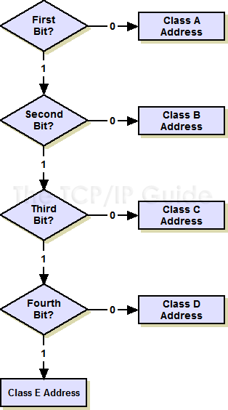
"Classful" Addressing Class Determination Algorithm
If the first bit is a “0”, it's a class A address and we're done. (Half the address space has a “0” for the first bit, so this is why class A takes up half the address space.) If it's a “1”, continue to step two.
If the second bit is a “0”, it's a class B address and we're done. (Half of the remaining non-class-A addresses, or one quarter of the total.) If it's a “1”, continue to step three.
If the third bit is a “0”, it's a class C address and we're done. (Half again of what's left, or one eighth of the total.) If it's a “1”, continue to step four.
If the fourth bit is a “0”, it's a class D address. (Half the remainder, or one sixteenth of the address space.) If it's a “1”, it's a class E address. (The other half, one sixteenth.)

Slide 8
Summary of “Classful” Addressing Issues
Lack of Internal Address Flexibility
  Big organizations are assigned large, “monolithic” blocks of addresses that don't match well the structure of their underlying internal networks.
Inefficient Use of Address Space
  The existence of only three block sizes (classes A, B and C) leads to waste of limited IP address space.
Proliferation of Router Table Entries
  As the Internet grows, more and more entries are required for routers to handle the routing of IP datagrams, which causes performance problems for routers. Attempting to reduce inefficient address space allocation leads to even more router table entries.

Slide 9
Subnetting Concepts
Revise: binary nos., boolean operators AND
Phone number analogy still works!
(401) 555-7777
Host ID: divided into Subnet ID and Host ID
Need to communicate which part is subnet ID
32 bit binary number called “Subnet mask”
The bits of the mask in any given subnetted network are chosen so that the bits used for either the network ID or subnet ID are ones, while the bits used for the host ID are zeroes.

Slide 10
Subnetting Concepts (Cont)
Subnet Bit Is A One: In this case, we are ANDing either a 0 or 1 in the IP address with a 1. If the IP address bit is a 0, the result of the AND will be 0, and if it is a 1, the AND will be 1. In other words, where the subnet bit is a 1, the IP address is preserved unchanged.
Subnet Bit Is A Zero: Here, we are ANDing with a 0, so the result is always 0 regardless of what the IP address is. Thus, when the subnet bit is a 0, the IP address bit is always cleared to 0.
A router that performs this function is left with the address of the subnet. Since it knows from the class of the network what part is the network ID, it also knows what subnet the address is on.
Bit Allocation Example
  We can decide to use 1 bit for the subnet ID and 15 bits for the host ID. If we do this, then the total number of subnets is 2¹ or 2: the first subnet is 0 and the second is 1. The number of hosts available for each subnet is 2¹⁵-2 or 32,766.

Slide 11
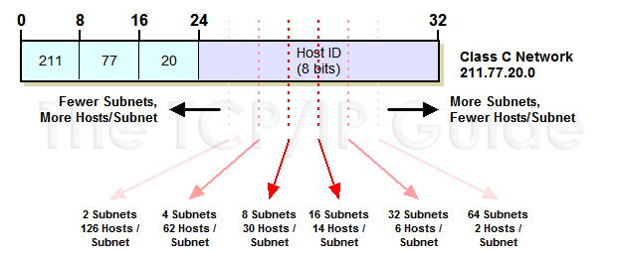
Example: IP Subnetting
Requirements
  Class, how many hosts, scalability, min, max
  Subnetting Design Trade-Off For Class C Networks

Slide 12
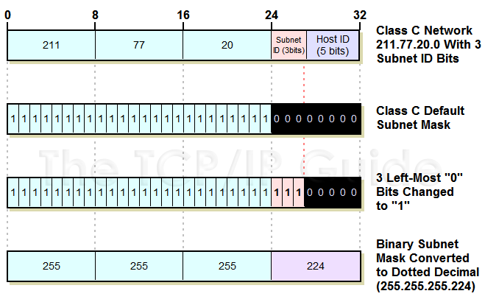
Class C Custom Subnet Mask Calculation Example
  3 for subnet ID and 5 for host ID
  Express Subnet Mask In “Slash Notation”: 255.255.255.224 is equivalent to “/27”.

Slide 13
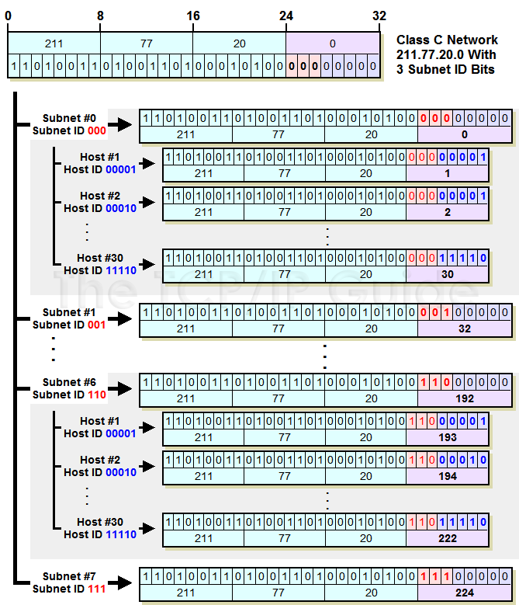
Determining Host Address for each Subnet

Slide 14
References
TCP/IP guide http://tcpipguide.com/free/t_toc.htm

