Slide 1
IP Addressing
Introductory material.
An entire module devoted to IP addresses.

Slide 2
IP Addresses
Structure of an IP address
Subnetting
CIDR
IP Version 6 addresses

Slide 3
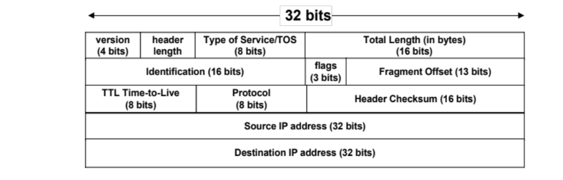
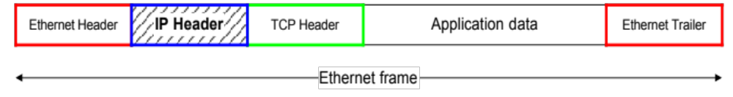
IP Addresses

Slide 4
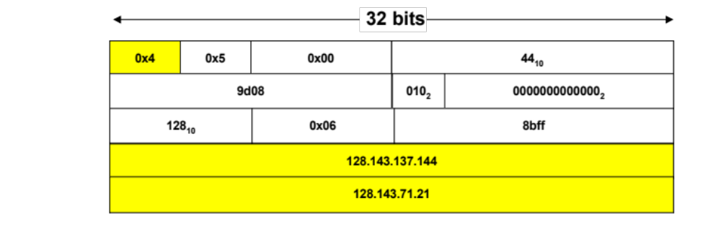
IP Addresses

Slide 5
What is an IP Address?
An IP address is a unique global address for a network interface
An IP address:
- is a 32 bit long identifier
- encodes a network number (network prefix)
and a host number

Slide 6
Dotted Decimal Notation
IP addresses are written in a so-called dotted decimal notation
Each byte is identified by a decimal number in the range [0..255]:
Example:
10000000
10001111
10001001
10010000
1st Byte
= 128
2nd Byte
= 143
3rd Byte
= 137
4th Byte
= 144
128.143.137.144

Slide 7
Network prefix and Host number
The network prefix identifies a network and the host number identifies a specific host (actually, interface on the network).
How do we know how long the network prefix is?
  The network prefix is implicitly defined (see class-based addressing)
  The network prefix is indicated by a netmask.
network prefix
host number

Slide 8
Example
Example: ellington.cs.virginia.edu
Network id is: 128.143.0.0
Host number is: 137.144
Network mask is: 255.255.0.0 or ffff0000
Prefix notation: 128.143.137.144/16
        Network prefix is 16 bits long
128.143
137.144

Slide 9
The old way: Classful IP Adresses
When Internet addresses were standardized (early 1980s), the Internet address space was divided up into classes:
  Class A: Network prefix is 8 bits long
  Class B: Network prefix is 16 bits long
  Class C: Network prefix is 24 bits long
Each IP address contained a key which identifies the class:
  Class A: IP address starts with “0”
  Class B: IP address starts with “10”
  Class C: IP address starts with “110”

Slide 10
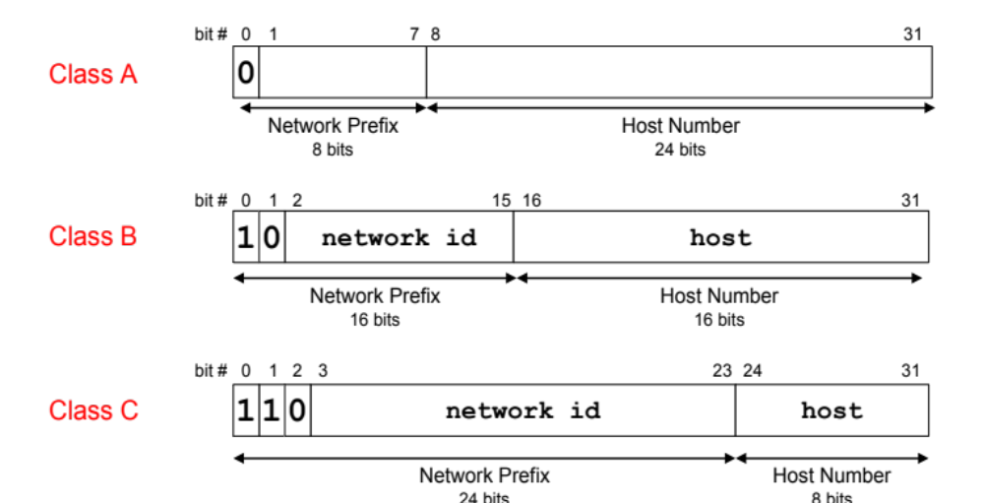
The old way: Internet Address Classes

Slide 11
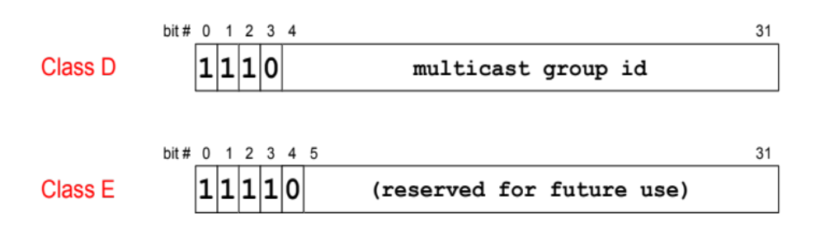
The old way: Internet Address Classes
We will learn about multicast addresses later in this course.

Slide 12
Problems with Classful IP Addresses
The original classful address scheme had a number of problems
Problem 1. Too few network addresses for large networks
  Class A and Class B addresses are gone
Problem 2. Two-layer hierarchy is not appropriate for large networks with Class A and Class B addresses.
  Fix #1: Subnetting

Slide 13
Problems with Classful IP Addresses
Problem 3. Inflexible. Assume a company requires 2,000 addresses
  Class A and B addresses are overkill
  Class C address is insufficient (requires 8 Class C addresses)
  Fix #2: Classless Interdomain Routing (CIDR)

Slide 14
Problems with Classful IP Addresses
Problem 4: Exploding Routing Tables: Routing on the backbone Internet needs to have an entry for each network address. In 1993, the size of the routing tables started to outgrow the capacity of routers.
  Fix #2: Classless Interdomain Routing (CIDR)

Slide 15
Problems with Classful IP Addresses
Problem 5. The Internet is going to outgrow the 32-bit addresses
  Fix #3: IP Version 6

Slide 16
Subnetting
Problem: Organizations have multiple networks which are independently managed
  Solution 1: Allocate one or more addresses for each network
    Difficult to manage
    From the outside of the organization, each network must be addressable.
  Solution 2: Add another level of hierarchy to the IP addressing structure
University Network
Engineering
School
Medical
School
Library
Subnetting

Slide 17
Basic Idea of Subnetting
Split the host number portion of an IP address into a subnet number and a (smaller) host number.
Result is a 3-layer hierarchy
Then:
    Subnets can be freely assigned within the organization
    Internally, subnets are treated as separate networks
    Subnet structure is not visible outside the organization
network prefix
host number
network prefix
subnet number
host number
extended network prefix

Slide 18
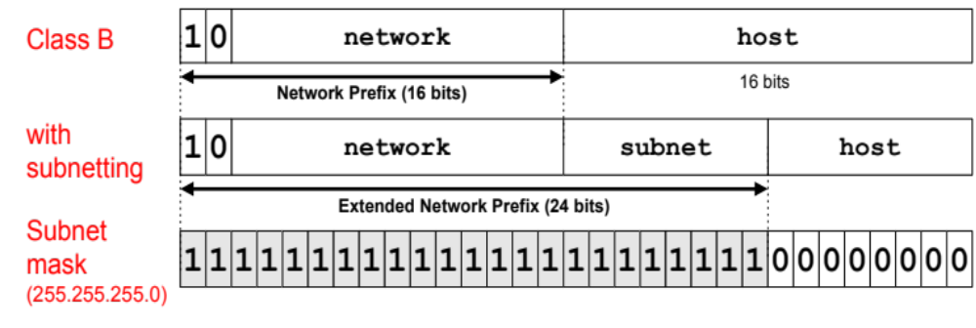
Subnet Masks
Routers and hosts use an extended network prefix (subnet mask) to identify the start of the host numbers
* There are different ways of subnetting. Commonly used netmasks for university networks with /16 prefix (Class B) are 255.255.255.0 and 255.255.0.0

Slide 19
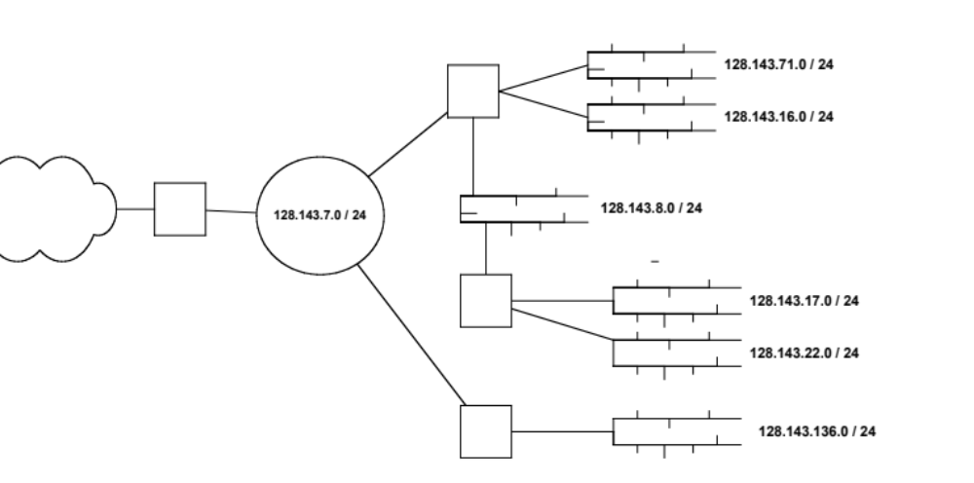
Typical Addressing Plan for an Organization that uses subnetting
Each layer-2 network (Ethernet segment, FDDI segment) is allocated a subnet address.
128.143.0.0/16

Slide 20
Advantages of Subnetting
With subnetting, IP addresses use a 3-layer hierarchy:
        Network
        Subnet
        Host
Improves efficiency of IP addresses by not consuming an entire address space for each physical network.
Reduces router complexity. Since external routers do not know about subnetting, the complexity of routing tables at external routers is reduced.
Note: Length of the subnet mask need not be identical at all subnetworks.

Slide 21
CIDR - Classless Interdomain Routing
IP backbone routers have one routing table entry for each network address:
  With subnetting, a backbone router only needs to know one entry for each network
  This is acceptable for Class A and Class B networks
    2⁷ = 128 Class A networks
    2¹⁴ = 16,384 Class B networks
  But this is not acceptable for Class C networks
    2²¹ = 2,097,152 Class C networks
In 1993, the size of the routing tables started to outgrow the capacity of routers
Consequence: The Class-based assignment of IP addresses had to be abandoned

Slide 22
CIDR - Classless Interdomain Routing
Goals:
  Restructure IP address assignments to increase efficiency
  Hierarchical routing aggregation to minimize route table entries
Key Concept: The length of the network id (prefix) in the IP addresses is kept arbitrary
Consequence: Routers advertise the IP address and the length of the prefix

Slide 23
CIDR Example
CIDR notation of a network address:
192.0.2.0/18
    "18" says that the first 18 bits are the network part of the address (and 14 bits are available for specific host addresses)
The network part is called the prefix
Assume that a site requires a network address with 1000 addresses
With CIDR, the network is assigned a continuous block of 1024 addresses with a 22-bit long prefix

Slide 24
CIDR: Prefix Size vs. Host Space
CIDR Block Prefix # of Host Addresses
/27 32 hosts
/26 64 hosts
/25 128 hosts
/24 256 hosts
/23 512 hosts
/22 1,024 hosts
/21 2,048 hosts
/20 4,096 hosts
/19 8,192 hosts
/18 16,384 hosts
/17 32,768 hosts
/16 65,536 hosts
/15 131,072 hosts
/14 262,144 hosts
/13 524,288 hosts

Slide 25
CIDR and Address assignments
Backbone ISPs obtain large block of IP addresses space and then reallocate portions of their address blocks to their customers.
Example:
Assume that an ISP owns the address block 206.0.64.0/18, which represents 16,384 (2³²⁻¹⁸=2¹⁴) IP addresses
Suppose a client requires 800 host addresses
Assign a /22 block (512=2⁹<800<1024=2¹⁰ -> 32-10=22), e.g., 206.0.68.0/22 gives a block of 1,024 (2¹⁰) IP addresses.

Slide 26
CIDR and Routing Information
Company X :
206.0.68.0/22
ISP X owns:
206.0.64.0/18
204.188.0.0/15
209.88.232.0/21
Internet Backbone
ISP y :
209.88.237.0/24
Organization z1 :
209.88.237.192/26
Organization z2 :
209.88.237.0/26

Slide 27
CIDR and Routing Information
Backbone routers do not know anything about Company X, ISP Y, or Organizations z1, z2.
Company X :
206.0.68.0/22
ISP X owns:
ISP X does not know about Organizations z1, z2.
ISP y sends everything which matches the prefix:
209.88.237.192/26 to Organizations z1
209.88.237.0/26 to Organizations z2
206.0.64.0/18
204.188.0.0/15
209.88.232.0/21
Internet Backbone
ISP X sends everything which matches the prefix: 206.0.68.0/22 to Company X,
209.88.237.0/24 to ISP y
ISP y :
209.88.237.0/24
Backbone sends everything which matches the prefixes 206.0.64.0/18, 204.188.0.0/15, 209.88.232.0/21 to ISP X.
Organization z1 :
209.88.237.192/26
Organization z2 :
209.88.237.0/26

Slide 28
Example
You can find about ownership of IP addresses in North America via http://www.arin.net/whois/
The IP Address: 207.2.88.170
207
2
88
170
11001111
00000010
01011000
10101010
Belongs to:
City of Charlottesville, VA: 207.2.88.0 - 207.2.92.255
11001111
00000010
01011000
00000000
Belongs to:
Cable & Wireless USA 207.0.0.0 - 207.3.255.255
11001111
00000000
00000000
00000000

Slide 29
CIDR and Routing
Aggregation of routing table entries:
  128.143.0.0/16 and 128.142.0.0/16 are represented as 128.142.0.0/15
Longest prefix match: Routing table lookup finds the routing entry that matches the longest prefix
What is the outgoing interface for
128.143.137.0 ?
Prefix | Interface
128.143.128.0/17 | interface #1
128.128.0.0/9 | interface #2
128.0.0.0/4 | interface #5
Routing table

Slide 30
IPv6 - IP Version 6
IP Version 6
  Is the successor to the currently used IPv4
  Specification completed in 1994
  Makes improvements to IPv4 (no revolutionary changes)
One (not the only !) feature of IPv6 is a significant increase in size of the IP address to 128 bits (16 bytes)
    IPv6 will solve – for the foreseeable future – the problems with IP addressing

Slide 31
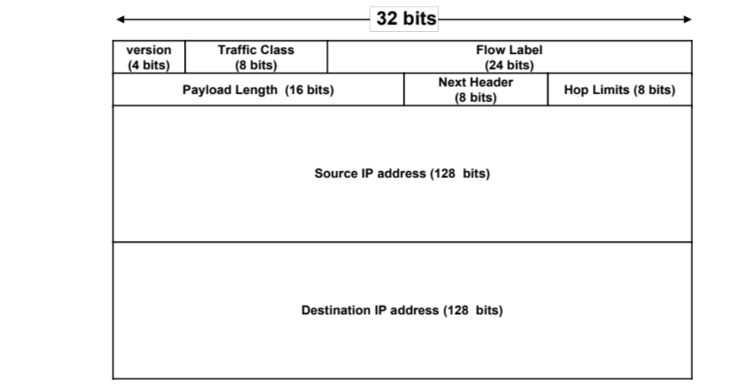
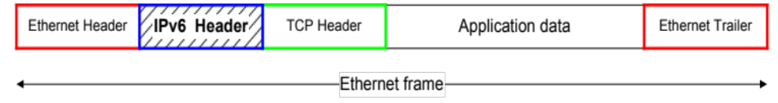
IPv6 Header

Slide 32
IPv6 vs. IPv4: Address Comparison
IPv4 has a maximum of
    2³² ≈ 4 billion addresses
IPv6 has a maximum of
  2¹²⁸ = (2³²)⁴ ≈ 4 billion x 4 billion x 4 billion x 4 billion addresses

Slide 33
Notation of IPv6 addresses
Convention: The 128-bit IPv6 address is written as eight 16-bit integers (using hexadecimal digits for each integer)
CEDF:BP76:3245:4464:FACE:2E50:3025:DF12
Short notation:
Abbreviations of leading zeroes:
CEDF:BP76:0000:0000:009E:0000:3025:DF12
→ CEDF:BP76:0:0:9E :0:3025:DF12
“:0000:0000” can be written as “::”
CEDF:BP76:0:0:FACE:0:3025:DF12 → CEDF:BP76::FACE:0:3025:DF12
IPv6 addresses derived from IPv4 addresses have 96 leading zero bits. Convention allows to use IPv4 notation for the last 32 bits.
  ::80:8F:89:90 → ::128.143.137.144

Slide 34
IPv6 Provider-Based Addresses
The first IPv6 addresses will be allocated to a provider-based plan
Type: Set to “010” for provider-based addresses
Registry: identifies the agency that registered the address
The following fields have a variable length (recommeded length in “()”)
Provider: Id of Internet access provider (16 bits)
Subscriber: Id of the organization at provider (24 bits)
Subnetwork: Id of subnet within organization (32 bits)
Interface: identifies an interface at a node (48 bits)
010
Registry
ID
Provider
ID
Subscriber
ID
Subnetwork
ID
Interface
ID

Slide 35
More on IPv6 Addresses
The provider-based addresses have a similar flavor as CIDR addresses
IPv6 provides address formats for:
  Unicast – identifies a single interface
  Multicast – identifies a group. Datagrams sent to a multicast address are sent to all members of the group
  Anycast – identifies a group. Datagrams sent to an anycast address are sent to one of the members in the group.

