Slide 1
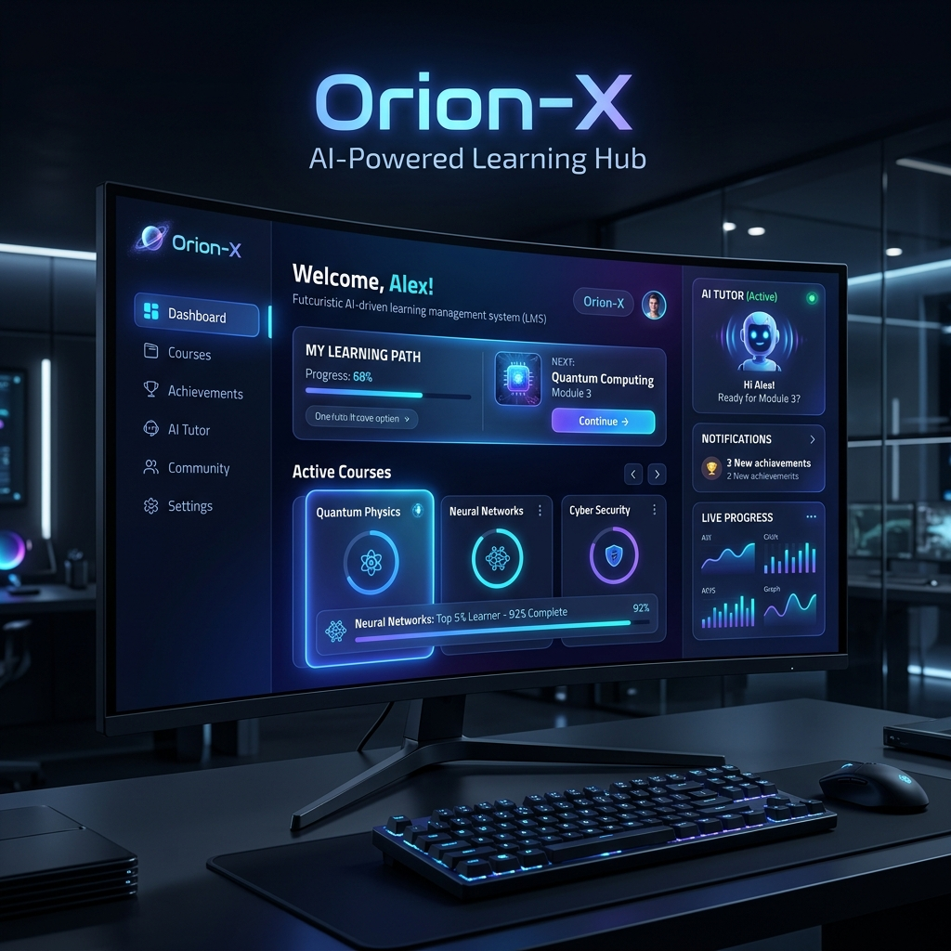
🚀 Orion-X
The AI-Powered Learning Ecosystem
Transforming static PDFs into dynamic, personalized learning experiences using Generative AI.
FastAPI • React 19 • Google Gemini • PostgreSQL • Cloudinary

Slide 2
🛑 The Problem
📄
Static Content
👥
One-Size-Fits-All
PDFs sit passively — students read, forget, repeat.
Every student gets the same experience regardless of pace.
⏰
Teacher Overload
😴
Low Engagement
Manually creating quizzes and study guides is exhausting.
Students disengage from dense, uninteractive material.

Slide 3
✅ The Solution — Orion-X
An AI-native Learning Management System that doesn't just host content — it understands it.
🧠
🎯
💬
⚡
Dynamic Content Ingestion
Personalized Study Paths
Interactive AI Tutor
Instant Assessments
PDFs are parsed, indexed, and turned into searchable knowledge.
AI generates custom roadmaps with summaries & time estimates.
RAG-based chatbot that answers questions from YOUR notes.
Generate quizzes in seconds, not hours.

Slide 4
👨‍🏫 Key Features — For Teachers
📄 Smart Content Ingestion
🤖 AI Quiz Architect
▸ Upload PDFs directly to Cloudinary
▸ Auto-extract text with PyMuPDF
▸ Seamless content pipeline
▸ MCQ generation via Gemini 2.0 Flash
▸ Based on actual uploaded notes
▸ Saves hours of manual work
📹 Virtual Classrooms
📊 Performance Analytics
▸ Instant Jitsi Meet integration
▸ One-click meeting launch
▸ No external tools needed
▸ Automated student scoring
▸ Real-time progress tracking
▸ Actionable insights

Slide 5
🎓 Key Features — For Students
💬 Interactive AI Tutor (RAG)
🗺️ Personalized Study Paths
▸ Chat with AI about YOUR course materials
▸ Retrieval-Augmented Generation
▸ Context-aware, accurate responses
▸ AI-generated learning roadmaps
▸ Summaries, key terms, study estimates
▸ Tailored to each module
⏱️ Real-time Quizzing
✨ Premium UI/UX
▸ Timed quizzes with instant feedback
▸ Track your progress over time
▸ Challenge yourself continuously
▸ Modern dark-mode design
▸ Framer Motion animations
▸ Responsive across devices

Slide 6
🛠️ Technical Stack
Frontend
Backend
AI / ML
React 19, Vite, Framer Motion Axios, Lucide React Icons
FastAPI (Python 3.12) SQLAlchemy ORM, JWT Auth
Google Gemini Pro RAG Implementation
Database
Storage
Video
PostgreSQL / Supabase Relational + Cloud-hosted
Cloudinary PDF & Media Hosting
Jitsi Meet Integration Real-time Conferencing

Slide 7
🧠 System Architecture
Client Layer
API Layer
Data Layer
React 19 SPA Framer Motion, Axios JWT Token Management
FastAPI Server Business Logic & Auth AI Orchestration (Gemini)
PostgreSQL / Supabase SQLAlchemy ORM Cloudinary Storage

Slide 8
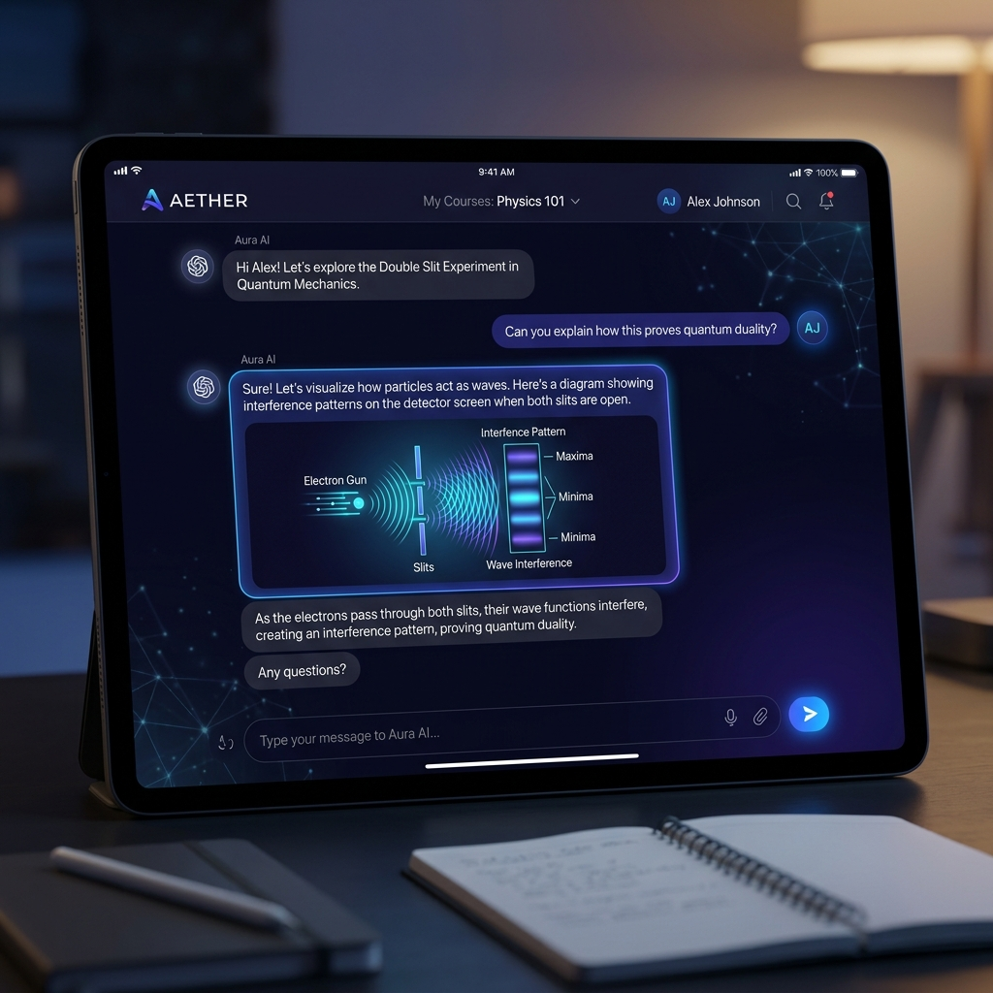
💬 AI Tutor — RAG in Action
The AI Tutor uses Retrieval-Augmented Generation to provide accurate, context-aware answers from your exact course PDFs.
▸ Student uploads question
▸ System retrieves relevant PDF chunks
▸ Gemini generates contextual answer
▸ Response cites source material
▸ Supports follow-up conversations

Slide 9
🚀 Thank You!
Orion-X: The AI-Powered Learning Ecosystem
"The transition from hosting information to providing intelligence."
Questions & Discussion

