Slide 1
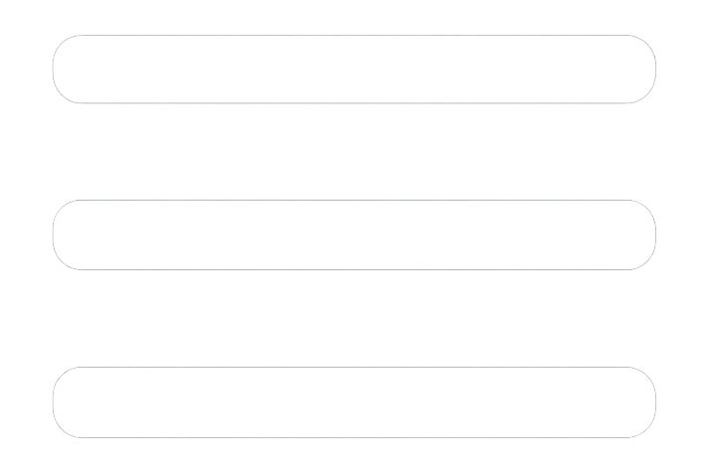
Business Performance Overview

