Slide 1
Big Data Technology Final Project
by Jamsrandorj B. 986168

Slide 2
Tweet Pessimistic/Positive predictions
by Jamsrandorj B. 986168

Slide 3
Twitter API
Kafka
Spark Streaming
Hbase
Jupyter
Python/Local Machine

Slide 4
Twitter API
Well known
Lot of examples
Easy to use
Filter options /hashtag, location, language, follower count…/
Instagram deprecated api’s

Slide 5
Kafka
Big data maker
Simple
Producer, consumer, topic

Slide 6
Kafka-Producer
Listens filtered tweet
Send them to topic, consumer
Without interruption

Slide 7
Kafka-Consumer
Do some calculation
Simple NLP
predict negative or positive
Negative_words.txt, positive_words.txt
Total_words_tweet/positive_words_cnt
Total_words_tweet/negative_words_cnt
Otherwise N/A
Save it into HBase

Slide 8
HBase
create_namespace 'ns_twitter'
create 'ns_twitter:tb_twitter', 'full_text', 'positive_predictions', 'negative_predictions', 'created_date'
scan 'ns_twitter:tb_twitter'

Slide 9
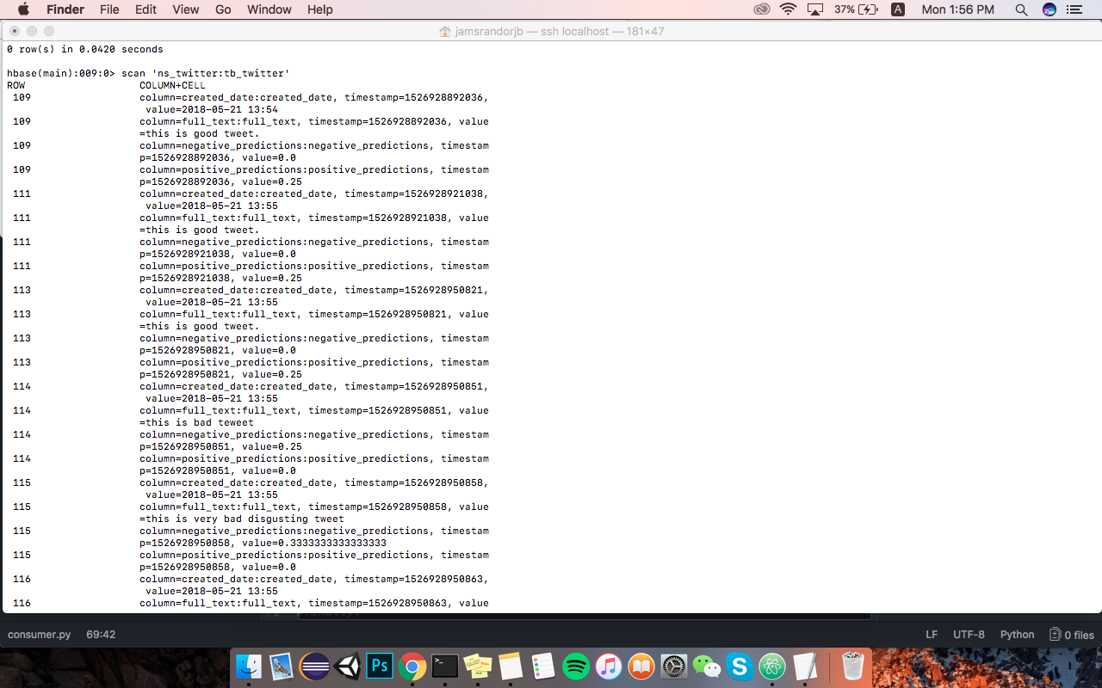
HBase

Slide 10
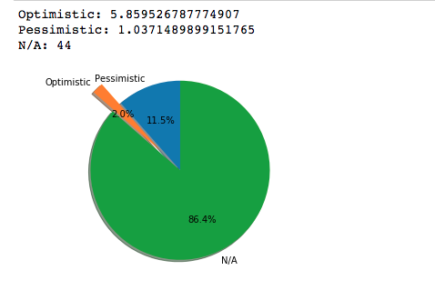
Jupyter
Total = df['positive_predictions'].sum()*100
Total1 = df['negative_predictions'].sum()*100
Total2 = 100-int(Total)-int(Total1)

Slide 11
in terms of setting up environment
Hbase, Hive, Hadoop, Kafka

Slide 12
Demo Time

