Slide 1
Rationale
In today’s competitive business environment, the information should be accessible from anywhere, anytime. This can be done by creating presentable and informative Web applications.
A Web application is an application delivered to users from a Web server over a network such as the World Wide Web or an intranet.
Web applications enable you to share and access information over the Internet and corporate intranets.
Content on the various pages in a Web application can be of two types:
  Static: Consists only of HTML pages and does not respond dynamically to the actions performed by users.
  Dynamic: Changes every time the user visits the page and/or responds dynamically to the actions performed by users.

Slide 2
Rationale (Contd.)
Dynamic Web pages provide several advantages over static Web pages.
To create a dynamic Web page, you must include a script in the page.
The script used to make a Web page dynamic can be of two types:
  Client-side script
  Server-side script
A single page can also contain both client-side and
server-side scripts.
Notes:
Initiate the session by explaining the session objectives.
Tell the students that the success of a software solution depends largely on how well its various components have been designed. An effort should be made to ensure that the components of the existing software solution can be reused. This can be done by using frameworks and patterns.
You need to elaborate the concept of applying patterns and frameworks by using the case study of BlueSeas Inc. This will help students to relate their programming skills with the actual practices followed in the software industry.

Slide 3
Rationale (Contd.)
Client-side script:
  Is downloaded on the browser and runs on the client side
  Offers an easy way to enhance the functionality and user experience of the site
  Examples of client-side scripting technologies: Javascript, Jscript, and VBScript
Server-side script:
  Runs on the server that hosts the Web application
  Offers a mechanism to access server-side resources, such as databases, that are not accessible on the client side
  Examples of server-side scripting technologies: ASP, PHP, and JSP
When server-side scripting is used, the server-side scripting must be supported by the hosting server.
Notes:
Initiate the session by explaining the session objectives.
Tell the students that the success of a software solution depends largely on how well its various components have been designed. An effort should be made to ensure that the components of the existing software solution can be reused. This can be done by using frameworks and patterns.
You need to elaborate the concept of applying patterns and frameworks by using the case study of BlueSeas Inc. This will help students to relate their programming skills with the actual practices followed in the software industry.

Slide 4
Rationale (Contd.)
What is ASP.NET?
  ASP.NET is a Web application framework marketed by Microsoft that can be used to build dynamic Web sites, Web applications, and XML Web services.
  It is part of Microsoft's .NET platform and is the successor to Microsoft's Active Server Pages (ASP) technology.
  Applications developed using ASP.NET must be hosted on an Internet Information Services (IIS) server.
Notes:
Initiate the session by explaining the session objectives.
Tell the students that the success of a software solution depends largely on how well its various components have been designed. An effort should be made to ensure that the components of the existing software solution can be reused. This can be done by using frameworks and patterns.
You need to elaborate the concept of applying patterns and frameworks by using the case study of BlueSeas Inc. This will help students to relate their programming skills with the actual practices followed in the software industry.

Slide 5
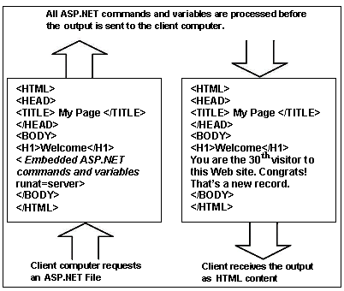
Rationale (Contd.)
The following figure describes how an IIS server processes the request for an ASP.NET file:
Notes:
Initiate the session by explaining the session objectives.
Tell the students that the success of a software solution depends largely on how well its various components have been designed. An effort should be made to ensure that the components of the existing software solution can be reused. This can be done by using frameworks and patterns.
You need to elaborate the concept of applying patterns and frameworks by using the case study of BlueSeas Inc. This will help students to relate their programming skills with the actual practices followed in the software industry.

Slide 6
Rationale (Contd.)
ASP.NET provides the following advantages:
  Enables you to access information from data sources, such as back-end databases and text files that are stored on a Web server.
  Provides enriched tool support in the form of Visual Studio .NET integrated development environment (VS .NET IDE).
  Enables you to develop your application in any .NET language.
  Enables you to build user interfaces that separate application logic from presentation content.
  Enables you to manage Web applications by storing the configuration information in an XML file.
  Helps improve developer productivity and provides facilities for improving the performance, reliability, and scalability of Web applications.
Notes:
Initiate the session by explaining the session objectives.
Tell the students that the success of a software solution depends largely on how well its various components have been designed. An effort should be made to ensure that the components of the existing software solution can be reused. This can be done by using frameworks and patterns.
You need to elaborate the concept of applying patterns and frameworks by using the case study of BlueSeas Inc. This will help students to relate their programming skills with the actual practices followed in the software industry.

Slide 7
Web Site Types
You can use Visual Studio 2005 to create the following Web site types:
  File-system Web sites
  Local Internet Information Services (IIS) Web sites
  Remote IIS Web sites
  FTP sites

Slide 8
Web Site Types (Contd.)
File-System Web sites:
  The ASP.NET Development Server acts as a Web server.
  Files are stored in any folder on the local computer’s file system or in a shared network folder.
  Advantages:
    The site can be accessed only from the local computer, reducing security vulnerabilities.
    You do not require IIS to be able to create and develop
    File-System Web sites.
    You do not need administrative rights to create or debug local Web sites.
    If the computer is configured to allow remote desktop connections, multiple users can create and debug local sites at the same time.

Slide 9
Web Site Types (Contd.)
  Disadvantages:
    Web site cannot be accessed from a remote computer.
    You can not test IIS features, such as HTTP based authentication, application pooling, and ISAPI filters.

Slide 10
Web Site Types (Contd.)
Local IIS Web site:
  An IIS server installed on the local computer acts as a Web server.
  The pages and folders for the site are stored in a folder under the default IIS folder for Web sites (Inetpub\wwwroot).
  Web site can be browsed by using localhost as a server name.
  Advantages:
    The site is accessible from other computers.
    You can test IIS features, such as HTTP-based authentication, application pooling, and ISAPI filters.
  Disadvantages:
    You must have administrative rights to create or debug IIS Web sites.
    Only one user can debug IIS at any one time.
    Local IIS Web sites have remote access enabled by default.

Slide 11
Web Site Types (Contd.)
Remote IIS Web site:
  An IIS server running on a remote computer that is configured with FrontPage Server Extensions acts as a Web server.
  The pages and folders for the site are stored in the default IIS folder on the remote computer.
  Web site can be browsed by using the server name of the remote site.
  Advantages:
    Web site can be tested on the server where it will actually be deployed.
    Multiple developers can work against the same site at the same time.
  Disadvantages:
    Configuration for debugging can be complex.
    Only one developer can debug the application at any one time, all other requests are suspended while the developer is debugging the Web site.

Slide 12
Web Site Types (Contd.)
FTP site:
  The site exists on a remote computer that has been configured as an FTP server.
  You must have read/write privileges on the remote server to create and edit pages on that server.
  The server computer must have a browse location to enable a user to see the Web pages from an FTP site in a browser.
  Advantages:
    You can test the Web site on the server where it will actually be deployed.
  Disadvantages:
    You do not have local copies of the files unless you copy them yourself.

Slide 13
A Tour of Visual Web Developer
The most commonly used windows and tools available in Visual Web Developer are:
  Toolbars
  Solution Explorer
  Document windows
  Properties windows
  View tabs
  Toolbox
  Server Explorer

Slide 14
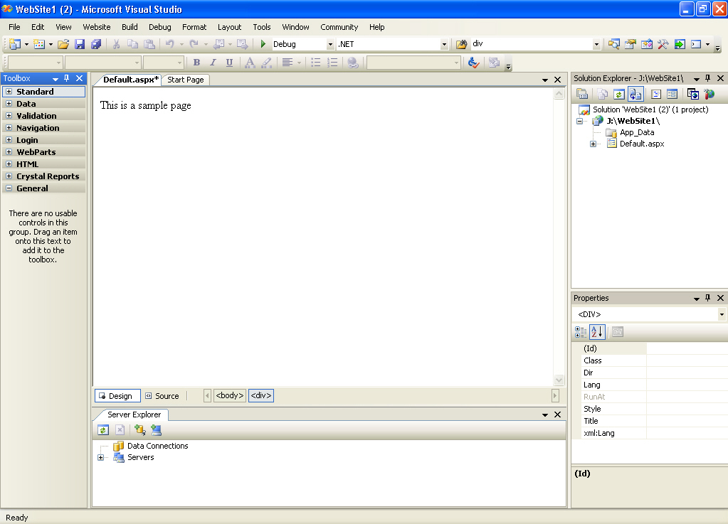
A Tour of Visual Web Developer (Contd.)
Document Window
Solution Explorer
Toolbars
Toolbox
Properties Window
View Tabs
Server Explorer

Slide 15
ASP.NET Web Page Code Model
A Microsoft ASP.NET Web page consists of two parts:
  Visual elements
  Programming logic for the page
ASP.NET provides two models for managing the visual elements and code:
  Single-file page model
  Code-behind page model

Slide 16
ASP.NET Web Page Code Model (Contd.)
The Single-File Page Model:
  The page’s HTML markup and its programming code are in the same physical .aspx (extension) file.
  The programming code is contained in a <script> block that specifies the attribute runat=“server”.
  At run time, the compiler converts a single-file page into a class that derives from the System.Web.UI.Page.

Slide 17
ASP.NET Web Page Code Model (Contd.)
Advantages of the single-file model include the following:
  In pages without a lot of code, keeping the programming code and the HTML markup in a single file proves to be very convenient while studying the file.
  Pages written by using the single-file model are slightly easier to deploy or to send to another programmer because there is only one file.
  A single-file page is easier to rename because there is no dependency between files.
  Managing files in a source code control system is slightly easier because the page is self-contained in a single file.

Slide 18
ASP.NET Web Page Code Model (Contd.)
The Code-Behind Page Model:
  HTML markup are kept in one file and the programming code in another file.
  There are two differences in the .aspx page between the single-file and the code-behind models:
    In the code-behind model, there is no <script> block with the runat="server" attribute.
    In the code-behind model, the @Page directive contains attributes that reference an external file and a class.
  The code file contains a partial class, which indicates that the class contains only some of the total code that makes up the full class for the page.
  The partial class inherits from a base Page class (either System.Web.UI.Page or a class derived from System.Web.UI.Page).

Slide 19
ASP.NET Web Page Code Model (Contd.)
The Code-Behind Page Model: (Contd.)
  The .aspx file contains an Inherits attribute that points to the code-behind partial class.
  When the page is compiled, ASP.NET creates a new partial class for the .aspx file. This class is a peer of the code-behind partial class file and contains the declarations for the page’s controls.
  Finally, ASP.NET generates a class that inherits from the partial class created from the .aspx file and the code-behind partial class.
  The generated class is compiled into an assembly that runs in order to render output to the browser.

Slide 20
ASP.NET Web Page Code Model (Contd.)
Advantages of the code-behind model include the following:
  Code-behind pages offer a clean separation of the HTML markup (user interface) and code.
  Code is not exposed to graphic designers or others who are working only with the page HTML markup.

Slide 21
Default Event Handling in Web Applications
The ASP.NET 2.0 Framework provides many different objects (such as page, buttons).
These objects enable quick and easy development of Web applications.
Many objects expose one or more events.
When an object exposes multiple events, one of the events is designated as the default event.
To create the event handler for the default event, you can simply double-click on the object in the Visual Studio 2005 IDE.
This will create an empty event procedure for the default event.

Slide 22
Web Configuration Files
Web application settings are contained in a hierarchy of XML based configuration files.
These configuration files contain settings for Microsoft .NET Framework applications, including ASP.NET Web applications.
ASP.NET allows you to easily edit the configuration data before, or after applications are deployed on the server.
The files in the configuration hierarchy allow you to make configuration settings at different levels.

Slide 23
Web Configuration Files (Contd.)
The levels, the corresponding configuration files, and their descriptions are listed in the following table:
Level | File Name | Description
Server Settings | Machine.config | Present at the root of the configuration hierarchy; It defines global configuration settings for all .NET Framework applications.
Root Web Settings | Web.config | Present in the same directory as machine.config; It defines configuration settings for all ASP.NET applications.
Web site settings (optional) | Web.config | Present in the root directory of each IIS Web site; contains settings that are specific to the Web site.
Application root settings (optional) | Web.config | Present in the root directory of each application; contains settings that are specific to the application.
Application subfolder (optional) | Web.config | Present in a subfolder of the application root; contains settings for specific section of a Web application.

Slide 24
<customError> Element
The <customErrors> element provides information about how custom error messages are handled for a Microsoft ASP.NET application.
It can be defined in the global web.config file for the host computer and in the web.config file for the application.
The customErrors element has the following syntax:
  <customErrors
  defaultRedirect="url"
  mode="On|Off|RemoteOnly">
  <error
  statusCode="statuscode"
  redirect="url"/>
  </customErrors>

Slide 25
<compilation> Element
The <compilation> element can be defined in the system.web section of a configuration file.
It enables you to specify compilation settings for a Web application.
Example of a simple configuration for the compilation settings of an application:
  <configuration>
  <system.web>
  <compilation defaultLanguage="VB"
  debug="true"
  numRecompilesBeforeAppRestart="15">
  </compilation>
  </system.web>
  </configuration>

