Slide 1
Rationale

Slide 2

Objectives
In this session, you will learn to:
    Identify the basics of Web application development
    Explore ASP.NET

Slide 3
Introduction to Web Application Development
Among all technologies, the Internet is the fastest growing technology, which:
    Has changed the way business is conducted.
    Helps organizations to reach a larger range of people, irrespective of their geographical locations.
    Helps organizations in sharing and accessing information from anywhere, anytime.
    Has changed the focus of application development from desktop applications to Web applications.

Slide 4
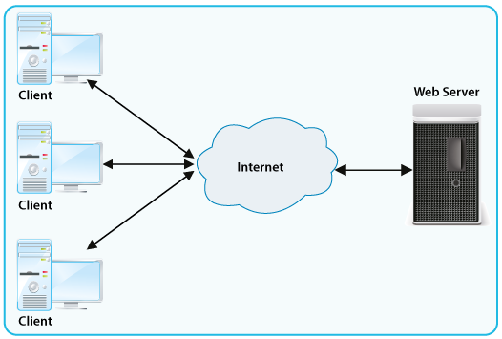
Defining Web Applications
Web applications:
    Are programs that are executed on a Web server and accessed from a Web browser.
    Enable organizations to share and access information on the Internet and corporate intranets.
    Can support online commercial transactions, popularly known as e-commerce.
      The following figure shows the working of a Web application.

Slide 5
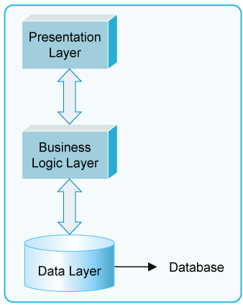
The Three Layers of a Web Application
All Web applications can be broken into three layers.
Each layer has its own components and functionality.
The following figure depicts the various layers that constitute a Web application.

Slide 6
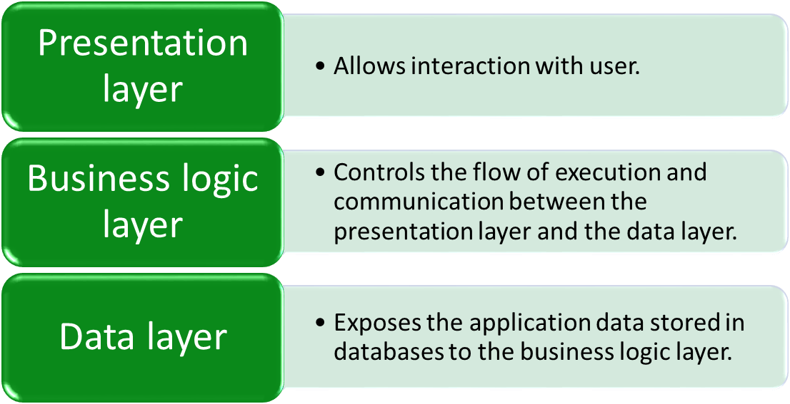
The Three Layers of a Web Application (Contd.)
The layers of a Web application are:

Slide 7
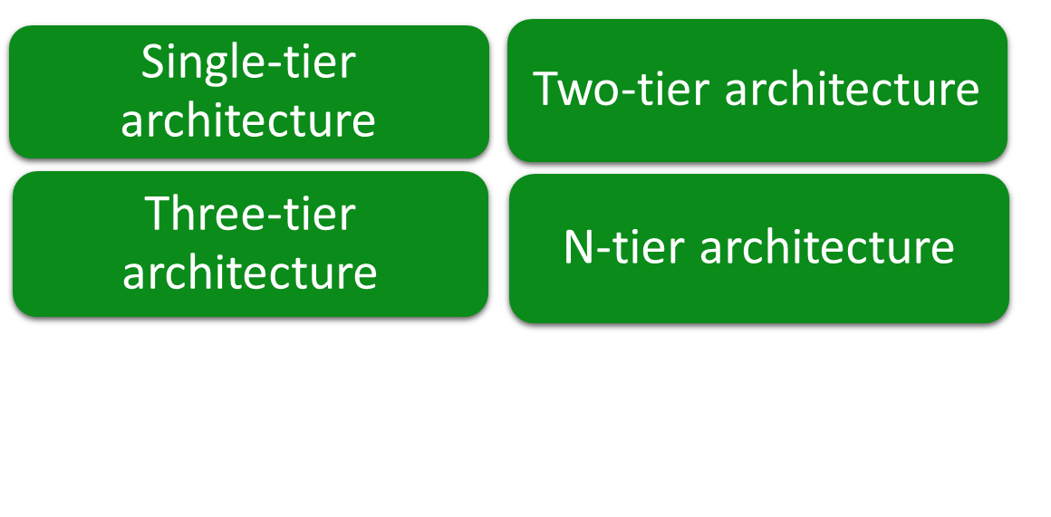
Architecture of a Web Application
An application can have one of the following types of architectures:
Let us view an animation, which explains the architecture of a Web application

Slide 8
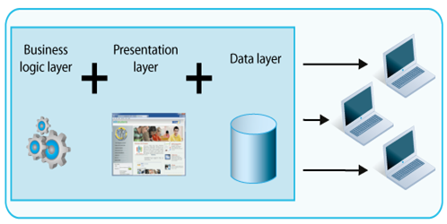
Architecture of a Web Application (Contd.)
In an application based on single-tier architecture:
    All the three layers are integrated together and can be installed on a single computer.
    If the application needs to be accessed on multiple computers, a separate installation is required on each computer.
    The following figure displays the single-tier architecture.

Slide 9
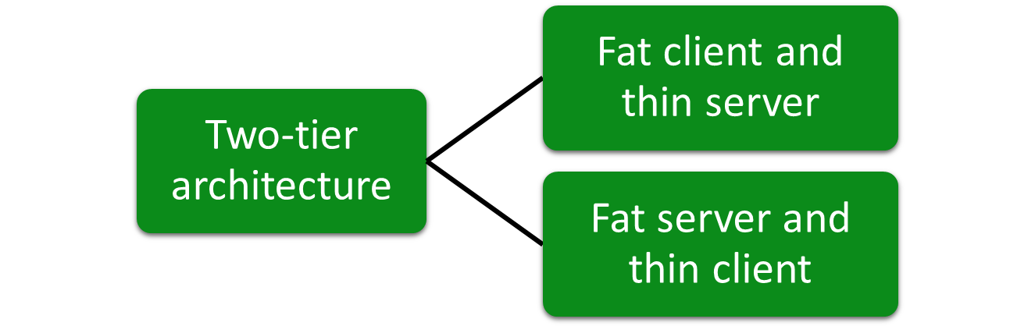
Architecture of a Web Application (Contd.)
In an application based on two-tier architecture:
    The three layers are distributed over two tiers, a client and a server.
    The presentation layer resides on each client computer.
    The business logic layer resides either on the client or on the server.
    The data access layer resides on the server.

Slide 10
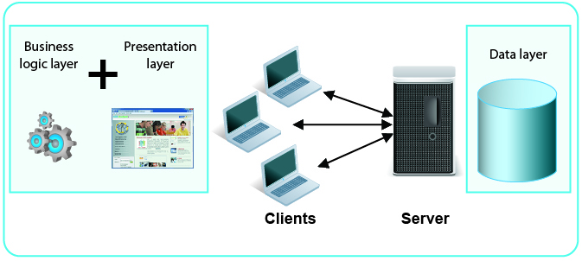
Architecture of a Web Application (Contd.)
    In fat client and thin server architecture, the business logic layer resides on the client.
The following figure displays the fat client and thin server architecture.

Slide 11
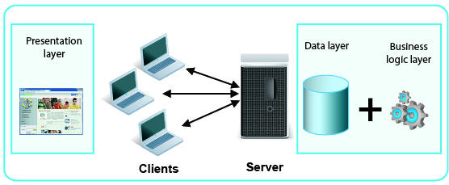
Architecture of a Web Application (Contd.)
In fat server and thin client architecture, the business logic layer resides on the server.
The following figure displays the thin client and fat server architecture.

Slide 12
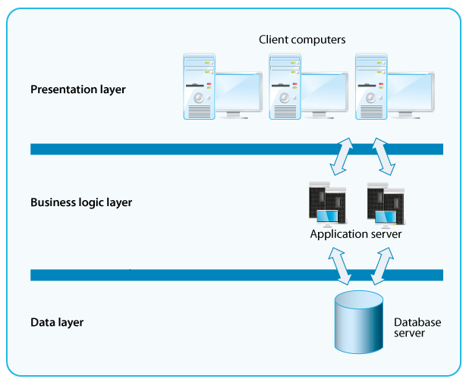
Architecture of a Web Application (Contd.)
In an application based on three-tier architecture:
    The three layers of the application are placed separately as three different entities.
    Communication among the layers occurs with the help of a request-response mechanism.
    The following figure displays the three-tier architecture.

Slide 13
Architecture of a Web Application (Contd.)
N-tier architecture:
    Involves further separation of the presentation layer and the data layer.
    May divide the presentation layer into the GUI layer and the presentation logic layer.
    May divide the data layer into the data access layer and the data layer.
    Separates the various business processes into discrete units of functionality called services.
    Provides improved flexibility and scalability of applications, as compared to the three-tier architecture.

Slide 14
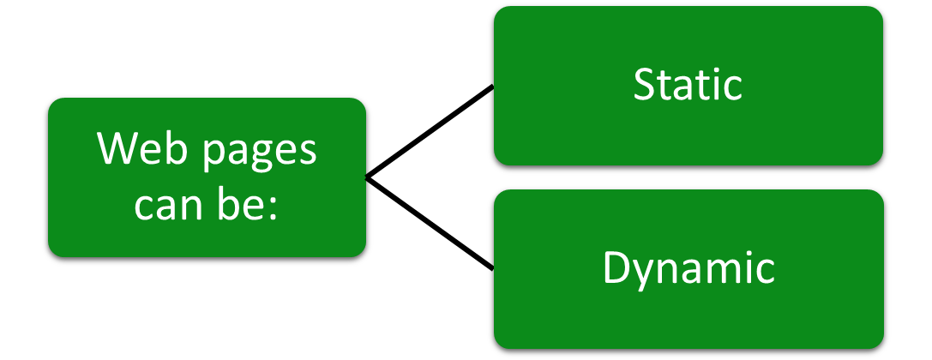
Introduction to Web Pages
A Web application consists of certain Web pages.
A Web page is a Web document that can be accessed through a Web browser.

Slide 15
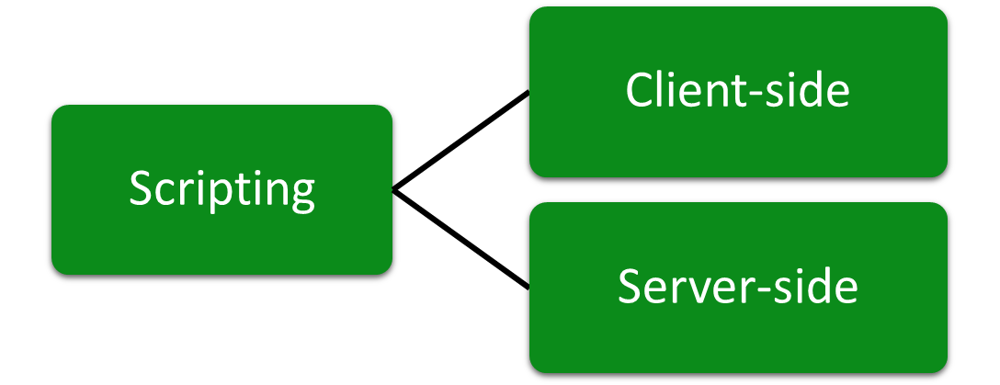
Creating a Dynamic Web Page
To create a dynamic and interactive Web page, you need to use scripting.

Slide 16
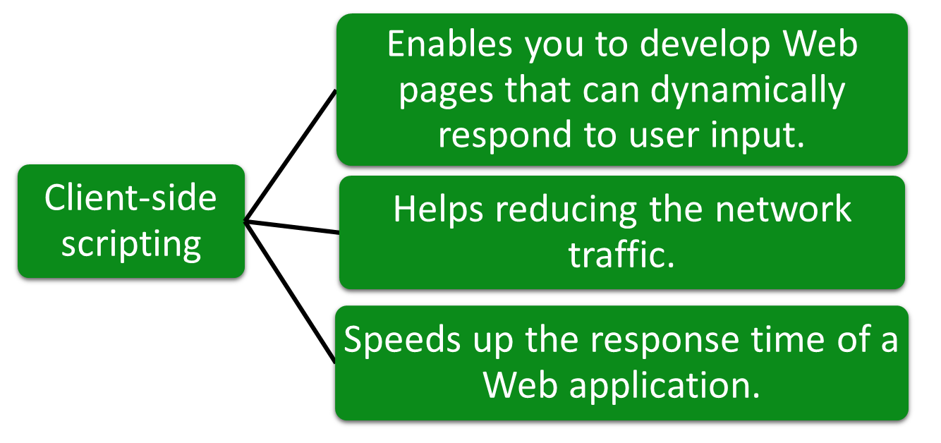
Creating a Dynamic Web Page (Contd.)

Slide 17
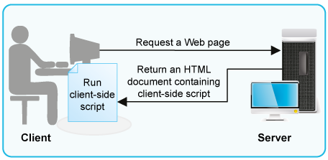
Creating a Dynamic Web Page (Contd.)
    The following figure displays the working of client-side scripts.

Slide 18
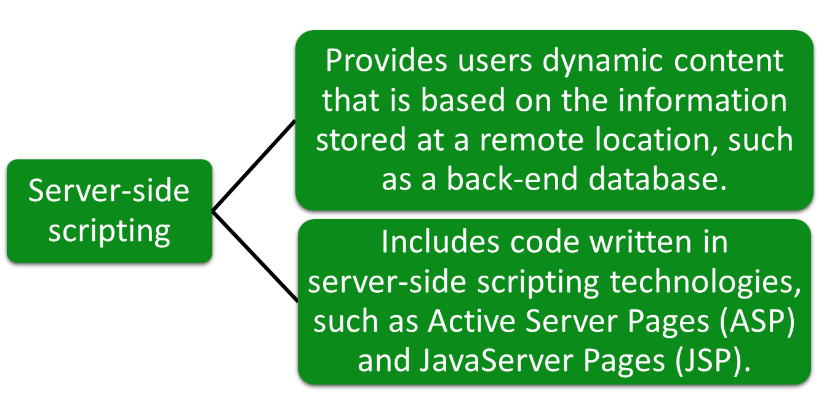
Creating a Dynamic Web Page (Contd.)

Slide 19
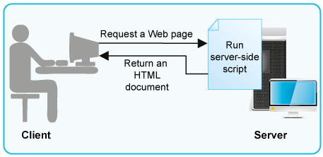
Creating a Dynamic Web Page (Contd.)
    The following figure displays the working of server-side scripts.

Slide 20
Just a Minute
    Identify the architecture in which the presentation layer resides on each client computer, the business logic layer resides either on the client or on the server, and the data layer resides on the server.
    Single-tier architecture
    Two-tier architecture
    Three-tier architecture
    N-tier architecture

Slide 21
Just a Minute (Contd.)
    Solution:
    Two-tier architecture

Slide 22
Exploring ASP.NET
ASP.NET:
    Is a server-side technology that enables programmers to create dynamic Web applications.
    Has a number of advanced features, such as simplicity, security, and scalability.
    Is built on Microsoft .NET Framework.

Slide 23
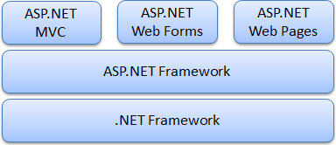
Introducing Microsoft’s Web Development Platforms
  The Microsoft Web development platform consists of various Web application development models, as shown in the following figure.
  These Web development models work on top of the .NET Framework.

Slide 24
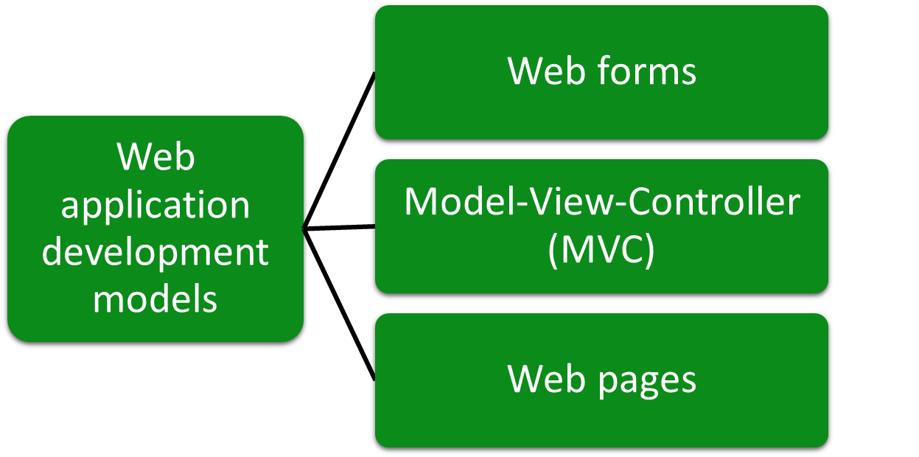
Introducing Microsoft’s Web Development Platforms (Contd.)

Slide 25
Introducing Microsoft’s Web Development Platforms (Contd.)
Web forms:
    Enables you to develop dynamic and powerful websites.
    Provides many controls, such as text boxes and check boxes.
    Enables you to drag and drop server controls to design your Web forms pages.
    Enables you to easily set the properties, methods, and events for a control or a page to specify the page's behavior.
    Are pages that are written by using a combination of HTML, server controls, and server code, and users request them through their browsers.

Slide 26
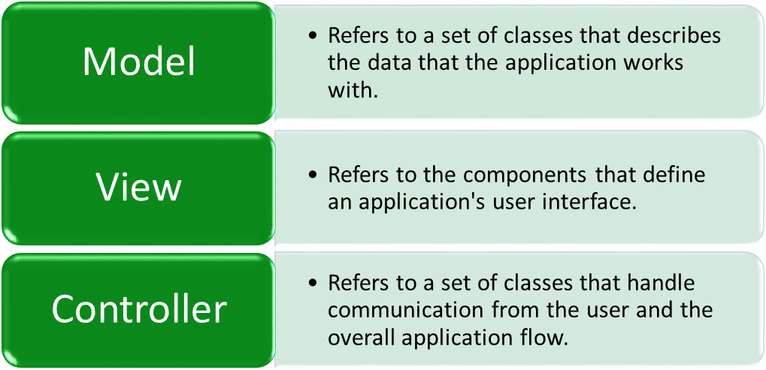
Introducing Microsoft’s Web Development Platforms (Contd.)
MVC:
    Is an alternative to the ASP.NET Web forms model for developing Web applications.
    Is a light-weight model and supports existing ASP.NET features.
    Ensures loose coupling by separating the application modules as:

Slide 27
Introducing Microsoft’s Web Development Platforms (Contd.)
Web pages:
    Are the simplest way to develop dynamic ASP.NET Web applications.
    Combine HTML, CSS, JavaScript, and server code at one place to build dynamic websites.
    Uses inline scripts rather than separate controller classes.

Slide 28
Summary
In this session, you learned that :
    Web applications are programs that are executed on a Web server and accessed from a Web browser.
    An application can have one of the following types of architectures:
      Single-tier architecture
      Two-tier architecture
      Three-tier architecture
      N-tier architecture
    A Web page is a Web document that can be accessed through a Web browser.
    To create a dynamic and interactive Web page, you need to use scripting, which includes:
      Client-side scripting
      Server-side scripting

Slide 29
Summary (Contd.)
    ASP.NET is a server-side technology that enables programmers to create dynamic Web applications.
    ASP.NET offers various Web application development models. These are:
      Web forms
      MVC
      Web pages

