Slide 1

Objectives
In this session, you will learn to:
    Explore ASP.NET
    Work with controllers
    Work with views

Slide 2
Introduction to the MVC Development Platform

Slide 3
Introduction to the MVC Development Platform (Contd.)
The MVC development platform separates the application data, the presentation, and the flow of application, into three separate components:
    The model
    The view
    The controller
  The model:
    Manages the application data.
    Encapsulates data stored in a database as well as code used to manipulate the data.
  The view manages the display of information.
  The controller:
    Manages the flow of application.
    Handles user input.
    Provides data to the relevant view.

Slide 4
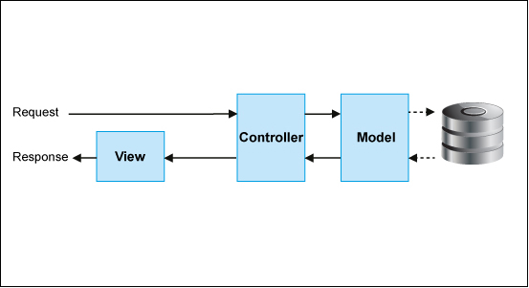
Introduction to the MVC Development Platform (Contd.)
In the ASP.NET implementation of MVC:
    Incoming requests are handled by controllers, which are C# classes that contain methods.
    Each public method in a controller is referred to as an action method or a controller action.
    The action methods can be invoked by using a URL.
    When an HTTP request is sent to the server by using a URL:
      The controller action associated with the URL is executed to perform the required operation on a model.
      A view is rendered and displayed to the client, as shown in the following figure.

Slide 5
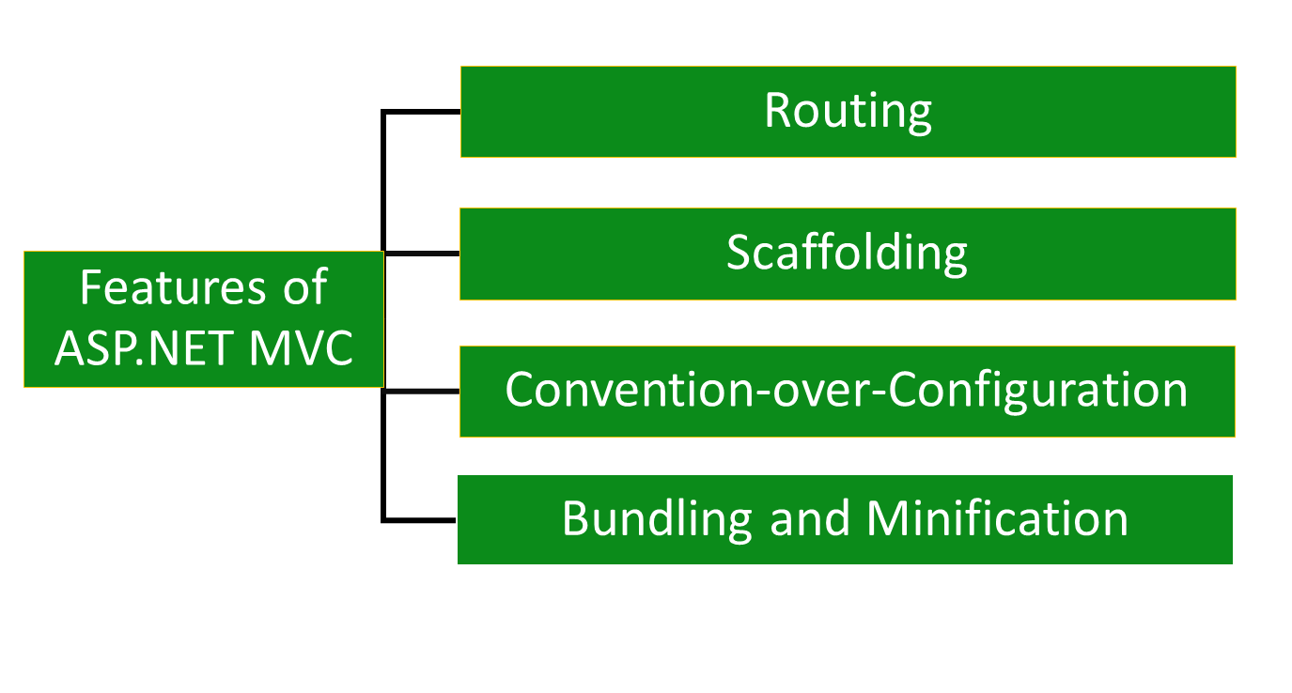
Introduction to the MVC Development Platform (Contd.)

Slide 6
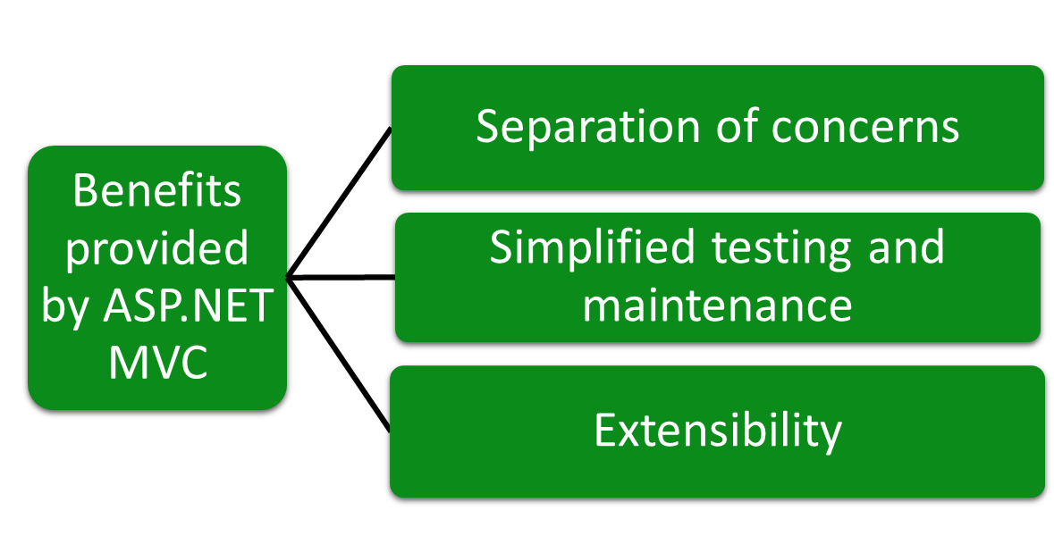
Introduction to the MVC Development Platform (Contd.)

Slide 7
Structure of an ASP.NET MVC Project
ASP.NET MVC project
Files
Properties
favicon.ico
Directories
References
Global.asax
App_Data
packages.config
App_Start
Web.config
Content
Controllers
Filters
Images
Models
Scripts
Views

Slide 8
Structure of an ASP.NET MVC Project(Contd.)
ASP.NET uses a hierarchy of configuration files to keep application configuration settings separate from the application code.
A configuration file provides the following benefits:
    Provides control and flexibility over the way you run applications.
    Eliminates the need to recompile the application every time a setting changes.
    Controls access to the protected resources and the location of remote applications and objects by defining configuration settings.
    The two files included in the hierarchy of configuration files are Machine.config and Web.config.
    The Machine.config file always resides at the root of the configuration hierarchy and contains the global and default settings for all the .NET Framework applications on the server.
    The Web.config file can reside at multiple levels in the hierarchy.

Slide 9
Just a Minute
____________ removes unnecessary white space and comments from the JavaScript or CSS code, and shortens variable names.

Slide 10
Just a Minute (Contd.)
    Solution:
    Minification

Slide 11
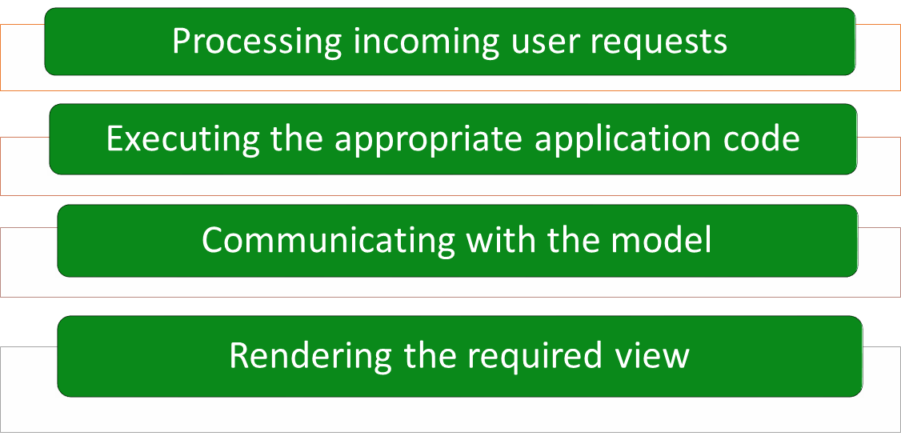
Working with Controllers
Controllers are responsible for:

Slide 12
Working with Controllers (Contd.)
    A controller:
    Is a C# class inherited from .NET Framework’s built-in Controller class.
    Contains an application logic in the form of various public methods called action methods.

Slide 13
Creating a Controller
You can create a controller by:
    Creating a .cs file in the Controllers folder of the project.
    Inheriting the Controller class, as shown in the following code snippet:
        public class HomeController : Controller
        {
        //Some code
        }
According to the ASP.NET MVC convention, the name of a controller is always suffixed by the word, Controller.

Slide 14
Creating Action Methods
Action methods are public methods in the controllers.
They handle user interactions with the application.
Example:
    The following code snippet defines two action methods in a controller class:
      public class HomeController : Controller
      {
      public ActionResult Index()
      {
      //Some code
      }
      public ActionResult About()
      {
      //Some code
      }
      }

Slide 15
Invoking Controller Actions
To invoke an action method, you can specify a URL in the Web browser.
This URL contains the information about a controller and the action method within the controller.
Example:
      http://newbay.com/Home/Registration
Base URL
Controller
Action Method

Slide 16
Passing Parameters in Controller Actions
While requesting for a Web page, you may need to specify information other than the name of the Web page.
This additional information can be sent to the server in the form of a query string included in the URL.
Example:
http://www.demo.com/home/browse?Category=Soap
    The browse action method can access the value for the Category parameter by using its arguments as shown in the following code snippet:
public string browse(string Category)
{
return ("Category is: " + Category);
}
Base URL
Controller
Action Method
Additional Information

Slide 17
Just a Minute
Which one of the following conventions is used while creating a controller?
    The name of a controller is always suffixed by the word, Controller.
    The name of a controller is always prefixed by the word, Controller.

Slide 18
Just a Minute (Contd.)
Solution:
    The name of a controller is always suffixed by the word, Controller.

Slide 19
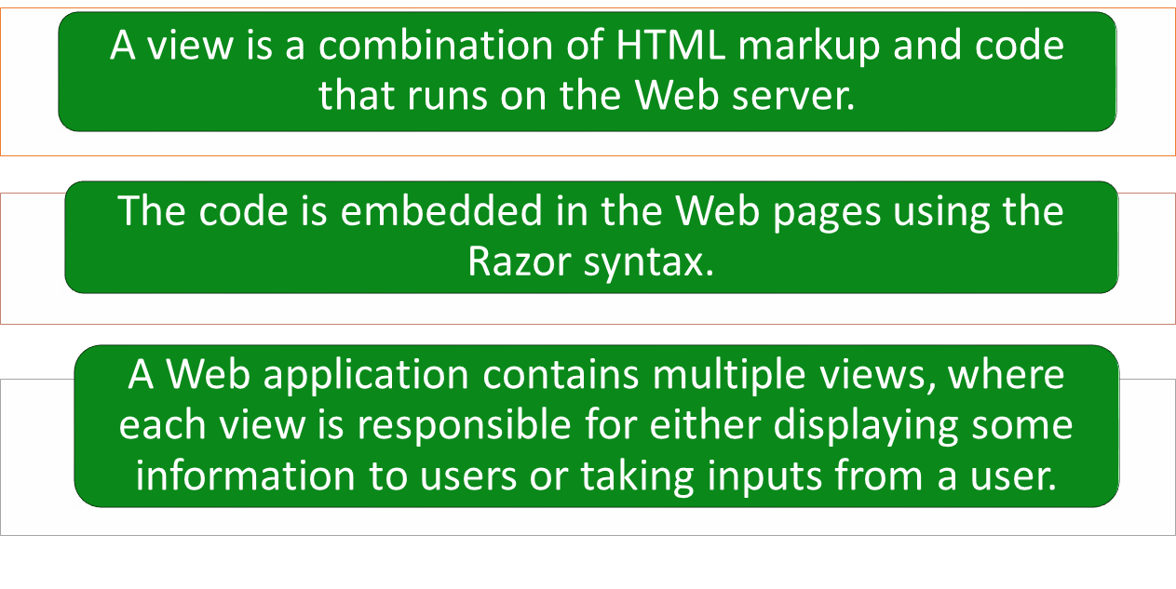
Working with Views

Slide 20
Specifying the View for an Action
Once a request is processed, a controller renders an appropriate view that is shown to the user.
For this, an action method needs to return a view.
Example:
    You can return a view from within the Index() action method of the Home controller as shown in the following code snippet:
public class HomeController : Controller
{
public ActionResult Index()
{
return View();
}
}

Slide 21
Specifying the View for an Action (Contd.)
When a view is returned without specifying any name for the view MVC searches for the view:
    With the same name as the action method
    Within the /Views/<ControllerName> folder
You can also specify the name of the view as a parameter of the View() method, as shown in the following code snippet:
      public class HomeController : Controller
      {
      public ActionResult Index()
      {
      return View("NewIndex");
      }
      }

Slide 22
Specifying the View for an Action (Contd.)
You can also render a view defined in a different folder other than the default folder created by MVC for every controller, as shown in the following code snippet:
        public class HomeController : Controller
        {
        public ActionResult Index()
        {
        return View("~/Views/Special/Index.cshtml");
        }
        }

Slide 23
Summary
In this session, you learned that:
    Controllers are C# classes that contain methods. Each public method in a controller is known as an action method or a controller action.
    Some of the features of ASP.NET MVC are:
      Routing
      Scaffolding
      Convention-over-Configuration
      Bundling and Minification
    ASP.NET uses a hierarchy of configuration files to keep application configuration settings separate from the application code.
    A configuration file is an XML file that contains configuration settings for an application and has a .config extension.
    Controllers are implemented in an MVC application as C# classes
    inherited from .NET Framework’s built-in Controller class.

Slide 24
Summary (Contd.)
    The controllers are placed in a folder named Controllers under the Web application folder.
    To invoke an action method, you can specify a URL in the Web browser that contains the information about a controller and the action method within the controller.
    A view is a combination of HTML markup and code that runs on the Web server.

