Slide 1

Objectives
In this session, you will learn to:
    Work with models

Slide 2
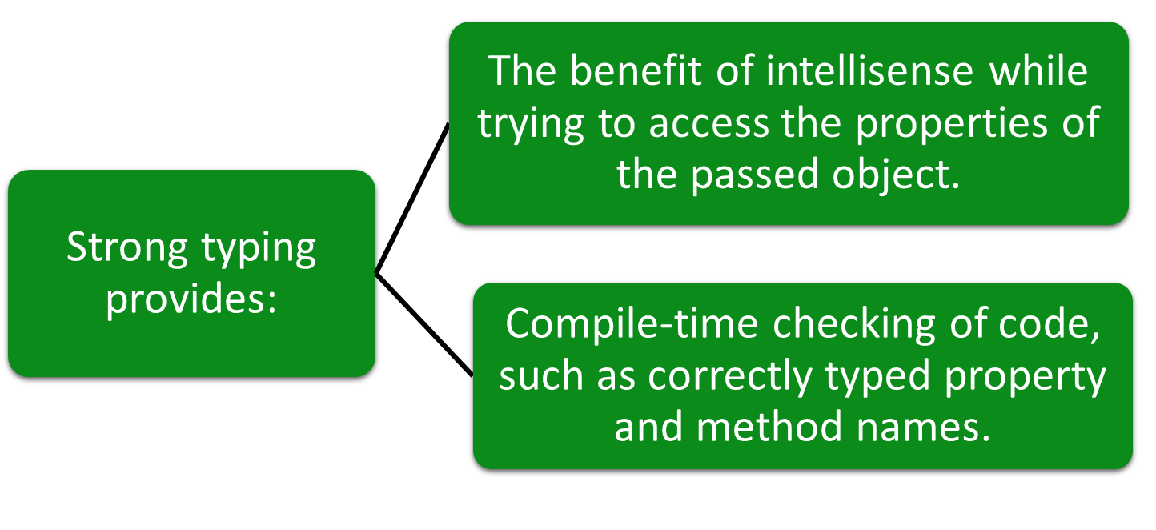
Using Strong Typing

Slide 3
Using Strong Typing (Contd.)
To implement strong typing, you can typecast the model data to a specific type, as shown in the following code snippet:
@{
var product = Model as Newbay.Models.Product;
}
@product.name <br/>
@product.price <br/>
Further, you can avoid explicit type casting of the model object by creating a strongly typed view.
A strongly typed view specifies the type of model it expects by using the @model declaration, as shown in the following code snippet:
@model Newbay.Models.Product
Now, you can access the properties of the model object by using the
following code snippet:
@Model.name <br/>
@Model.price <br/>

Slide 4
Using Strong Typing (Contd.)
To avoid specifying a fully qualified type name for the model, you can use the @using declaration, as shown in the following code snippet:
@using Newbay.Models
@model Product
Alternatively, you can declare the namespace in the Web.config file within the Views directory, as shown in the following code snippet:
<namespaces>
<add namespace="System.Web.Mvc" />
<add namespace="System.Web.Mvc.Ajax" />
<add namespace="System.Web.Mvc.Html" />
<add namespace="System.Web.Routing" />
<add namespace="Newbay.Models" />
</namespaces>
You can implement strong typing while passing a collection of objects by using the IEnumerable interface, as shown in the following code snippet:
@model IEnumerable<Newbay.Models.Product>

Slide 5
Introduction to Scaffolding
Scaffolding
Allows you to create auto-generated controllers and their corresponding views.
Uses a predefined convention for naming controllers and views.
Knows where to place auto-generated codes for the application to work.

Slide 6
Introduction to Scaffolding (Contd.)
Empty MVC controller
MVC controller with empty read/write actions
Scaffolding templates
API controller with empty read/write actions
MVC controller with read/write actions and views using Entity Framework

Slide 7
Introduction to Scaffolding (Contd.)
In addition, scaffolding provides various templates for creating views.
List
Delete
Templates for Creating Views
Create
Details
Edit

Slide 8
Introduction to Scaffolding (Contd.)
Let us see how to create views using scaffolding templates

Slide 9
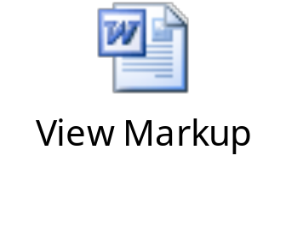
The List Template
The List template is used to create a view that displays a list of model objects.
This list is passed to the view through a controller action, as shown in the following code snippet:
public ActionResult Index()
{
var products = new List<Product>();
//Code to populate the products collection
return View(products);
}
The following embedded Word document contains the markup generated, when you create a view for the Product model using the List template.

Slide 10
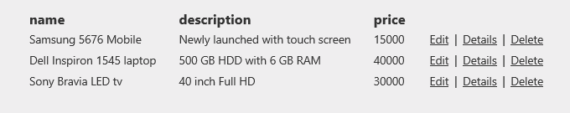
The List Template (Contd.)
The sample output generated by the preceding markup is displayed in the following figure.

Slide 11
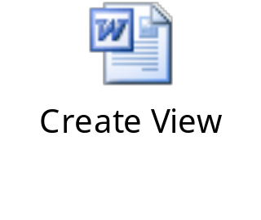
The Create Template
The Create template can be used to generate a view that needs to be used for accepting the details of a new object to be stored in a data store.
To render a view based on the Create template, you need to create an action method, as shown in the following code snippet:
public ActionResult Create()
{
return View();
}
The following embedded Word document contains the markup generated, when you create a view named Create for the Product model using the Create template.

Slide 12
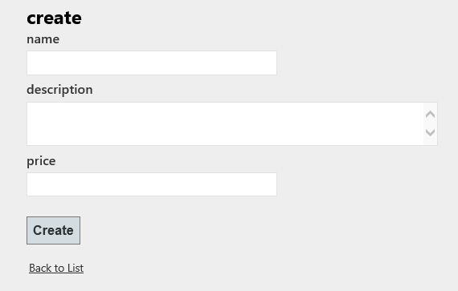
The Create Template (Contd.)
The preceding markup will generate a view, as shown in the following figure.

Slide 13
The Create Template (Contd.)
Further, to handle the HTTP POST request, another action method named Create needs to be created as shown in the following code snippet:
[HttpPost]
public ActionResult Create(Product product)
{
/*Code to save the details of the product object to a data
store and return an appropriate view. */
}
In addition, the originally created Create method can be decorated with the HttpGet attribute, as shown in the following code snippet:
[HttpGet]
public ActionResult Create()
{
return View();
}

Slide 14
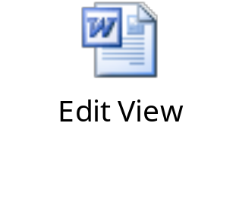
The Edit Template
The Edit template can be used to generate a view that needs to be used for modifying the details of an existing object stored in a data store.
To render a view, you need to create an action method that passes the model object to be edited to the view.
The following embedded Word document contains the markup generated, when you create a view named Edit for the Product model using the Edit template.

Slide 15
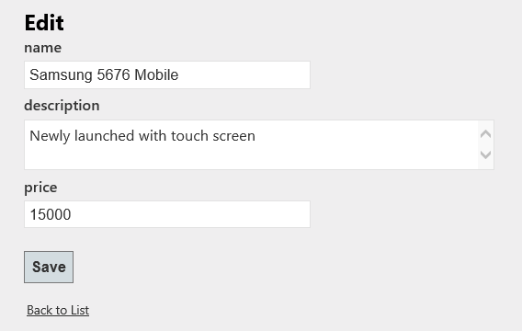
The Edit Template (Contd.)
The preceding markup will generate the view, as shown in the following figure.
To handle the HTTP POST request of the preceding view,
you need to create another action method named Edit()
with an HttpPost attribute.

Slide 16
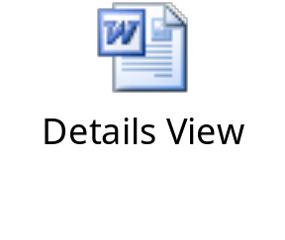
The Details Template
The Details template is used to create a view that displays details of a model object.
The details of the model object are passed to the view through a controller action.
The following embedded Word document contains the markup generated, when you create a view for the Product model using the Details template.

Slide 17
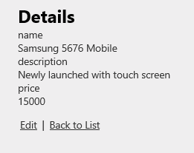
The Details Template (Contd.)
The preceding markup will generate the view, as shown in the following figure.

Slide 18
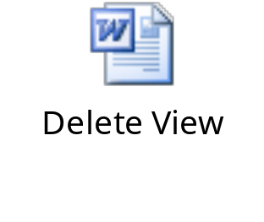
The Delete Template
The Delete template can be used to generate a view that needs to be used for deleting an existing object from a data store.
To render a view, you need to create an action method that passes the model object to be deleted to the view.
The following embedded Word document contains the markup generated, when you create a view for the Product model using the Delete template.

Slide 19
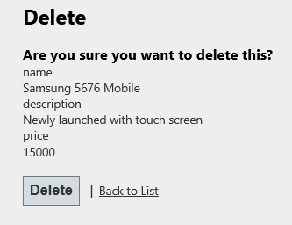
The Delete Template (Contd.)
The preceding markup will generate the following interface.
To handle the HTTP POST requests of the preceding view,
another action method named DeleteConfirmed() needs
to be created with an HttpPost attribute.

Slide 20
Just a Minute
Which one of the following options is used to pass model data from a controller to a view?
    ViewBag
    @model
    @using

Slide 21
Just a Minute (Contd.)
Solution:
    ViewBag

Slide 22
Demo: Working with the Movie Model (Contd.)
Solution:
    To solve the preceding problem, you need to perform the following tasks:
      Create a model.
      Create a controller.
      Define a data source.
      Create a view for the Add Movie page.
      Create a view for the Movies List page.
      Execute the application.

Slide 23
Summary
In this session, you learned that:
    The model data passed could be a single object or a collection of objects.
    Scaffolding provides the following templates for creating controller and associated views:
      Empty Controller
      Controller with Empty Read/Write Actions
      API Controller with Empty Read/Write Actions
      Controller with Read/Write Actions and Views, Using Entity Framework
    Scaffolding provides the following templates for creating views:
      List
      Create
      Edit
      Details
      Delete

