Slide 1
ADO.NET Overview
INTRODUCTION TO ADO.NET
ADO.NET IN THE .NET FRAMEWORK
ADO.NET ARCHITECTURE
ADO VERSUS ADO.NET
ADO.NET DATA PROVIDERS
ADO.NET NAMESPACES
Notes:
Click through to the next slide…

Slide 2

Learning Objectives and Overview
After completing this learning
unit, you should be able to:
In this section, we will discuss the following:
  Understand what ADO.net is and explain its features and advantages.
  What is ADO.NET?
  How ADO.NET works in the .Net framework?
  How ADO.NET compares with ADO?
  The classes and interfaces in the ADO.NET object model.
  What are the data providers in ADO.NET?
  What is ADO.NET namespaces?
Notes:
Course or Module Title
Date or Rev. #
Our objective here is to understand the importance of Polymorphism in Java and the ways we are going to implement it in Java.
After doing the practice exercises included in this section, you should be able to include polymorphism concept wherever it is appropriate to your code.
Excellere Restricted

Slide 3
What is a ADO.NET?
ADO.NET is a set of classes, interfaces, structures and enumerations that are used to access relational data from a .NET application.
Is a successor of ADO?
It allows programmers using ADO to leverage their current knowledge to write applications using ADO.NET.
It can be easily learnt and used by programmers who have been using ADO to access data from their applications.
Supports management of data access from a variety of data stores. Data sources supported by ADO.NET include relational data bases such as
SQL Server
Oracle
Data sources which are accessible through OLEDB and XML.
Notes:
Course or Module Title
Date or Rev. #
Excellere Restricted

Slide 4
More About ADO.NET
In a data driven application, there are data consumers and data providers.
Consumers : The application and services that use the data retrieved form a source are known as data consumers.
Data providers: Data providers are a light weight layer between the data source and the code for accessing the data source.
Different types of data sources have different data providers which make communication and data transfer possible between the data consumer and the data source.
The .NET framework comes with various in built data providers meant for connecting to different types of data sources.
Third-party vendors can create their own data providers to enable .NET applications to access data stored in their data source.

Slide 5


Connected & Disconnected Data Access
ADO.NET supports
Connection oriented data access
Disconnected data access
An object known as the DataAdapter object manages data access.
Once the connection is established, this object executes the command and loads the data into a object known as the dataset.
A dataset is an in-memory data store that can hold multiple tables in memory at a single point of time.
A dataset only holds the data that is loaded by the DataAdapter and does not interact with the database.
The application opens a connection with the data source and carries out further data operations using this connection.
The application maintains a constant connection to the data source.
The connection is kept busy even when the application is not using the connection to perform data related operations which makes this architecture less efficient and scalable.

Slide 6
Features of ADO.NET
    Provides a uniform way of accessing data from a variety of data sources.
The way data is accessed from an Access database is not very different from the way data is accessed from a SQL Server or an Oracle database.
This uniformity in data access makes the learning curve of the developers less steep and enables them to work with different types of data sources without much complexity.
    Provides support for both connected and disconnected data access.
    The disconnected data access feature of ADO.NET makes it extremely scalable and efficient as it conserves system resources and has a lower impact on its performance.
    It also makes database access much more secure, thus making it the chosen technology for data access in web services and distributed business objects.

Slide 7
Features of ADO.NET (Contd…)
    Provides integrated support for XML.
ADO.NET incorporates XML support at a very fundamental level.
The XML classes and the ADO.NET classes in the .NET framework are part of the same architecture. XML is becoming the standard for data encoding on the web.
    Designed for highly efficient data access:
    Since ADO.NET supports the disconnected data access architecture, it makes the whole process of data access and manipulation extremely efficient and fast.

Slide 8
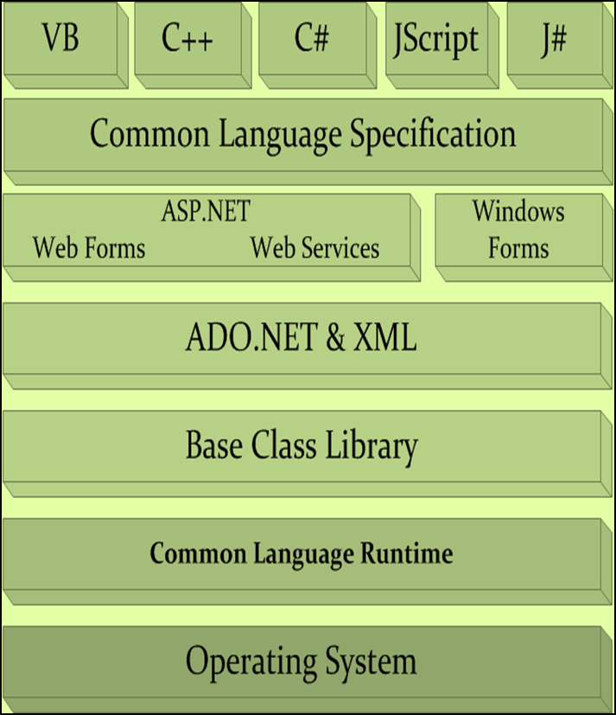
ADO.NET and the .NET Framework
    ADO.NET is based on the .NET Base Class Library and is very closely coupled with the XML classes of the .NET framework.
    Since ADO.NET is based on the Base Class Library, its classes can be used by applications created in any of the .NET supported languages such as C# and VB.NET.
    ADO.NET is based on the Base Class Library and thus it uses the services of the .Net’s Common Language Runtime for execution.

Slide 9
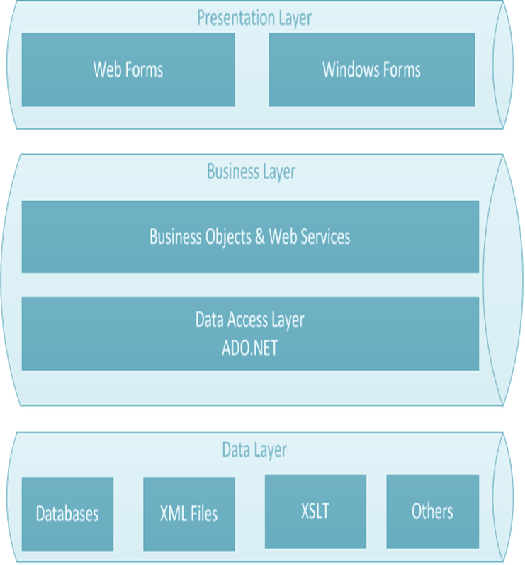
ADO.NET and the .NET Applications
    ADO.NET resides at the Data Access Layer of an N-Tier application.
    It supports multiple technologies at both the presentation layer as well as the data layer
    ADO.NET can provides data access services to both windows based applications as well as web based applications such as ASP.NET web forms or web services.
    Similarly at the data layer ADO.NET is capable of supporting multiple types of data sources ranging from relational databases to XML files

Slide 10
Objects in ADO.NET
Connection : Represents the connection established by the .NET application with the database.
It contains the properties and the methods that are required to connect to a data source and open the connection using which data can be transferred between the application and the data source.
      The ConnectionString property of the connection class specifies the details required to establish a connection with the data source.
      For example the connection string specifies details such as the name of the server to connect, username, password, the data base and the authentication mode to be used.
Command: Used to execute commands and get the results returned by the data source.
DataReader: The DataReader object is used to perform connection based data access in a .Net application.
Used to read forward-only stream of rows from a database.

Slide 11
Objects In ADO.NET
DataAdapter: The interface which enables exchange of data between a dataset and data source.
This object has the onus of populating the DataSet from the underlying data source and facilitating further insertion, modification, retrieval and deletion of data in the dataset.
This object also has methods which transmit the changes made to the data in the dataset to the underlying data source.
DataSets: A container in memory which can hold data from different kinds of data sources.
It can hold data from multiple tables as separate DataTable objects.
This is the object which makes the whole paradigm of disconnected data access in .NET possible.

Slide 12
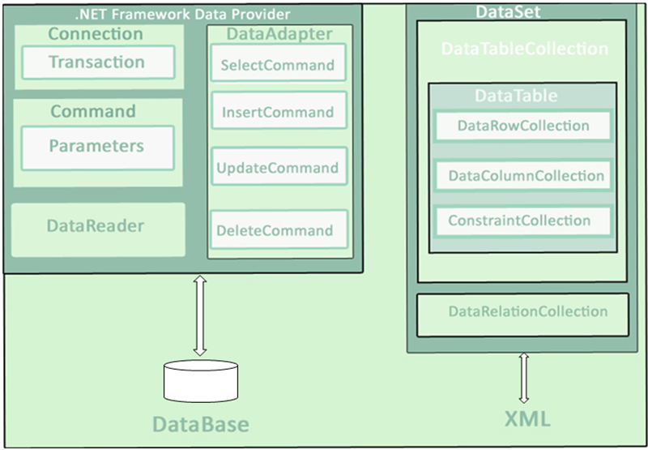
The ADO.NET Architecture

Slide 13
ADO and ADO.NET – a comparison
ADO | ADO.NET
RecordSet objects stored data from multiple tables and made them appear like a single table. | Dataset objects can contain a collection of multiple DataTable object each representing a separate data table.
Data is read into the RecordSet object sequentially. | Data can be read both sequentially and non sequentially as it depends on the relationships between the data tables.
Limited support for disconnected data access | Extensive support for disconnected data access with update.
Data records passed through network using COM marshaling. | Uses XML to transfer data records.
Limited scalability due to tight coupling with the data source. | Disconnected data access offers high scalability.

Slide 14
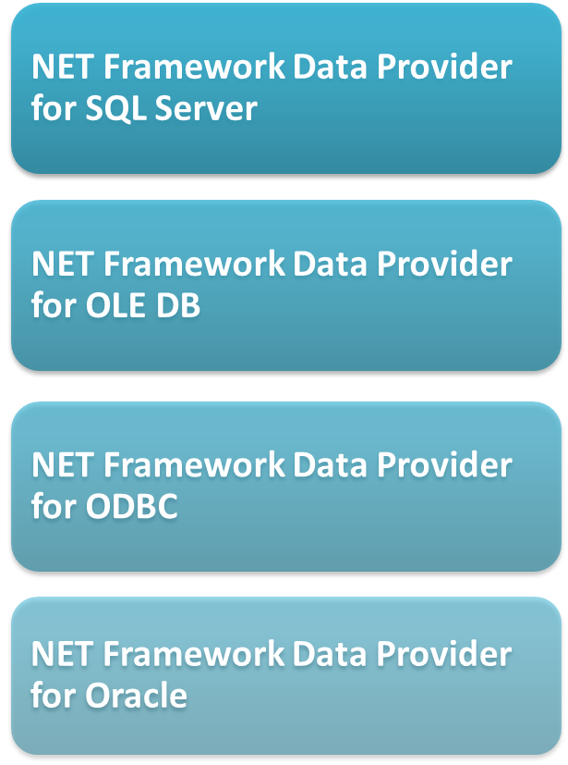
ADO.NET Data Providers
    The .NET Framework data provider for SQL Server is used to access data from SQL Server version 7.0 or later.
    The .NET Framework data provider for OleDb is used to access data exposed by the OleDb data sources such as MS Excel.
    The .NET Framework provider for ODBC is used to access data from data sources that support an ODBC driver.
    The .NET Framework data provider for Oracle is used to connect to Oracle databases.

Slide 15
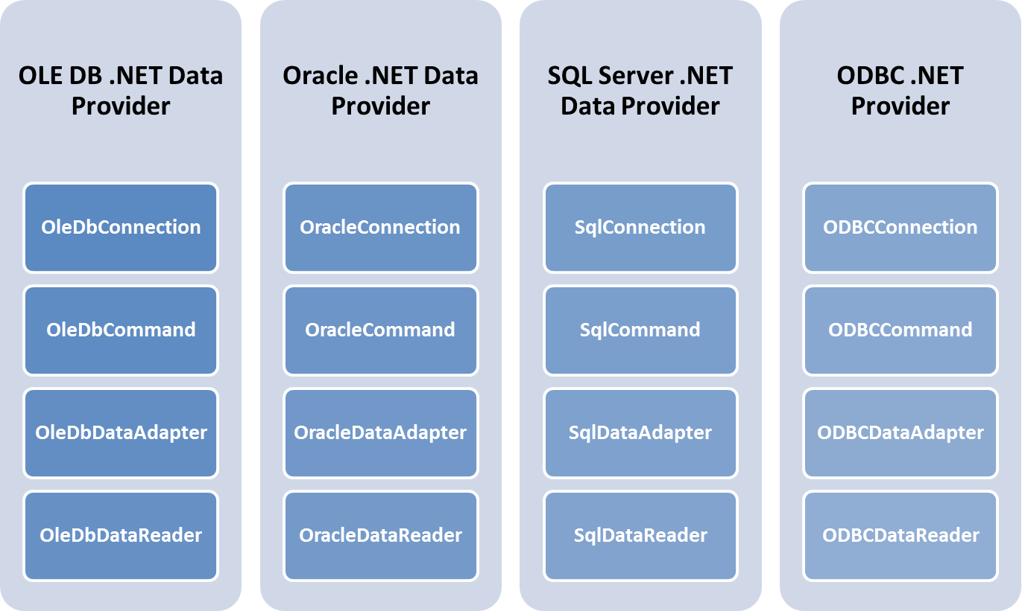
Data Providers and their Classes

Slide 16
Important Namespaces in ADO.NET
System.Data: This namespace contains classes that represent the ADO.NET architecture. It contains classes such as DataTable, Constraints, DataRelation and DataException.
System.Data.Common: This namespace contains classes that are commonly used by all the data providers in .NET. It contains classes such as DbConnection, DbCommand, DbAdapter and DbException.
System.Data.SqlClient: This namespace is the data provider for SQL Server in the .NET framework. It contains classes such as SqlConnection, SqlCommand, SqlDataAdapter and SqlDataReader.
System.Data.OleDB: This namespace is the data provider for OleDB data sources. It contains classes such as OleDbConnection, OledbCommand, OleDbDataAdapter and OleDbDataReade.

Slide 17
Important Namespaces in ADO.NET (Continued)
System.Data.SqlTypes: It provides classes which correspond to the native data types used in SQL. Using these classes instead of the classes in the .NET CLR (Common Language Runtime) prevents type conversion errors that might occur due to loss of precision.
For example: The SqlBinary type in this namespace can be used to retrieve and store SQL Server data of type binary, varbinary and timestamp.
Similarly, the SqlString type in this package can be used to handle SQL Server
data of type Char, NChar, Text, Ntext, NVarChar and VarChar.
System.Xml & System.Xml.Schema:
The System.Xml namespace provides classes to process XML data according to the standards laid down by W3C (World Wide Web Consortium).
The System.Xml.Schema namespace provides classes that allow working with XML Schema Definition Language (XSD). These classes too support all the standards laid down by W3C.

Slide 18
Reference Reading
http://msdn.microsoft.com/en-us/library/ee817654.aspx#daag_introducingadonet
http://msdn.microsoft.com/en-us/library/h43ks021(v=vs.71).aspx
Note: The links provided here are valid at the time of production of this content. However, web URLs may change from time to time , so users are encouraged to exercise their own judgment in using the information given in the pages referred to by these links

Slide 19
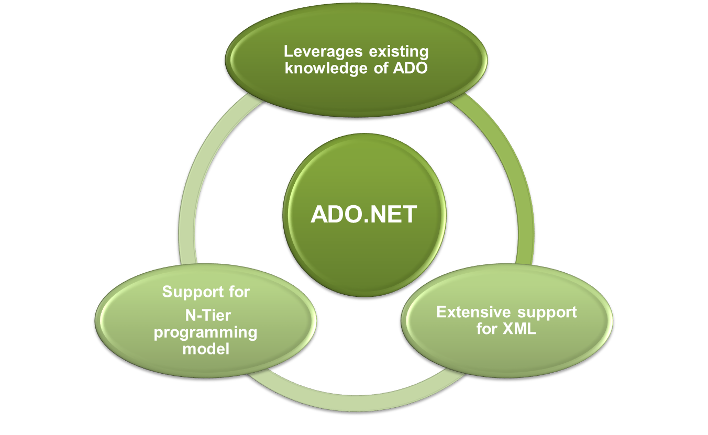
Summary

