Slide 1
Introduction to .Net Framework

Slide 2
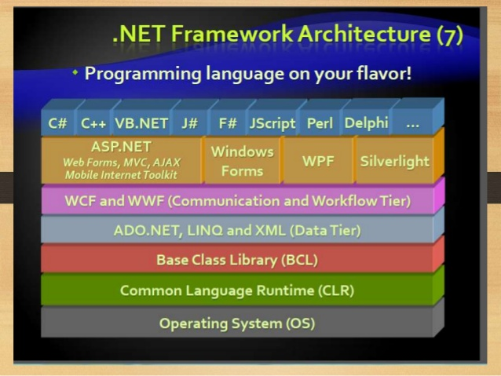
Architecture

Slide 3
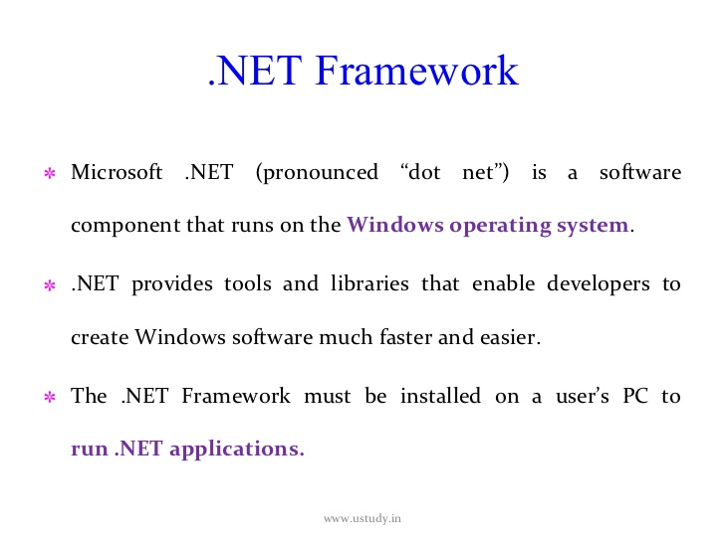

Slide 4
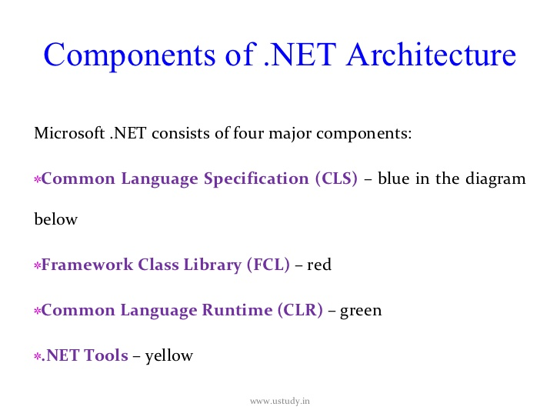

Slide 5
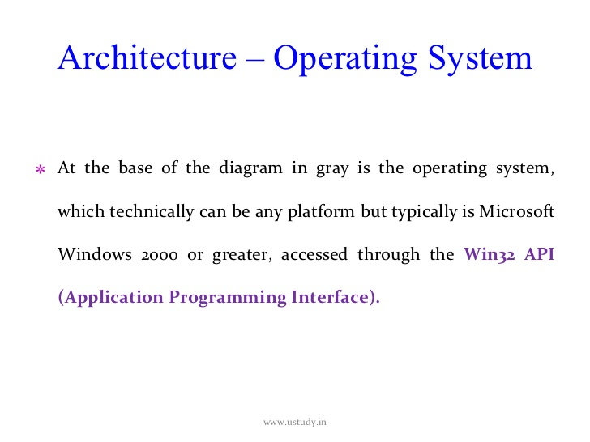

Slide 6
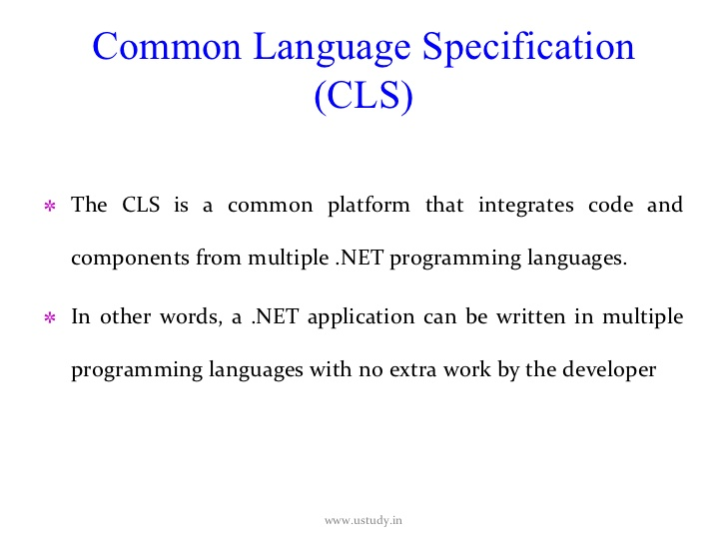

Slide 7
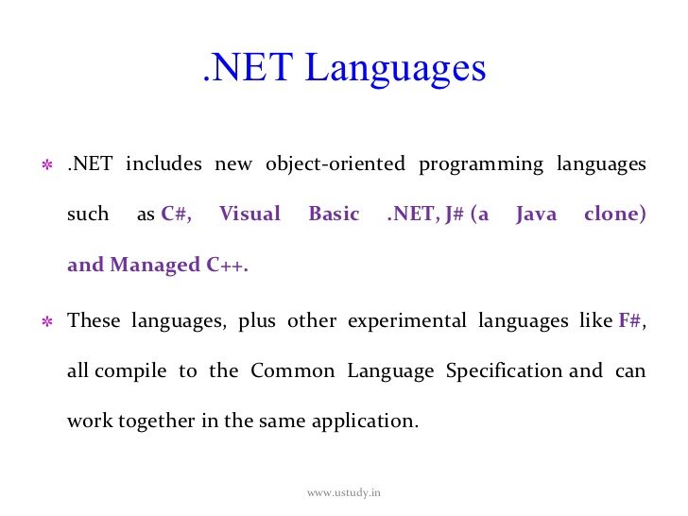

Slide 8
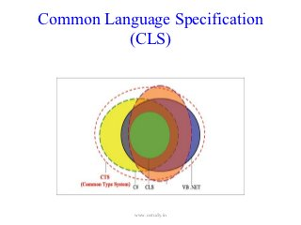

Slide 9
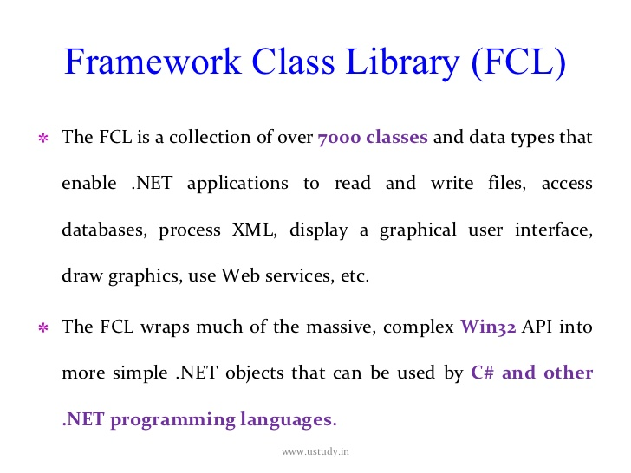

Slide 10
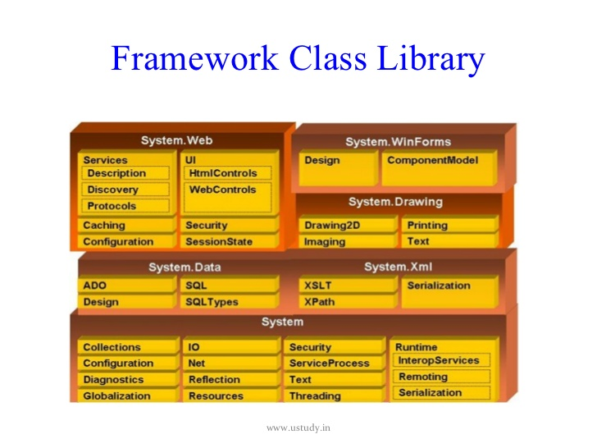

Slide 11
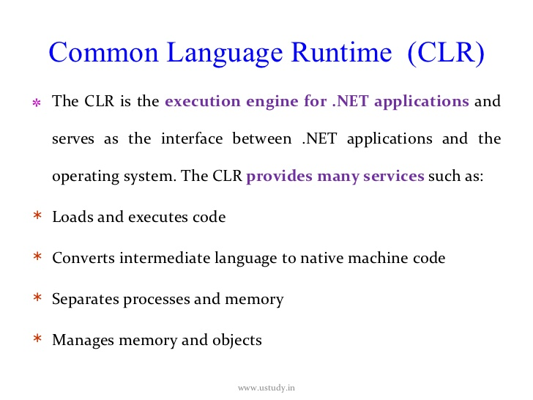

Slide 12
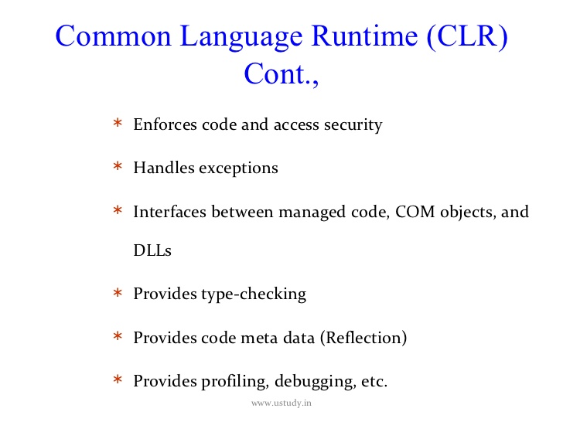

Slide 13
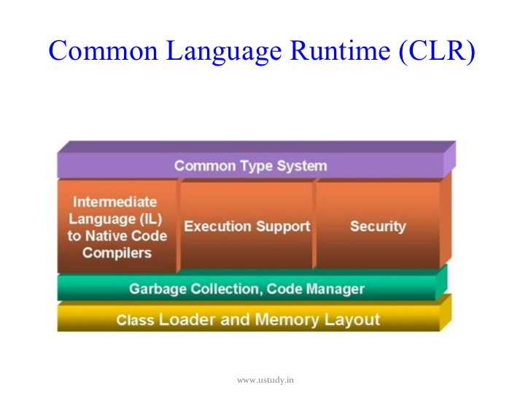

Slide 14
Points to remember
IL is also called as MSIL,CIL, Managed Code
Assemblies have an extension of either .dll, or.exe depending on the type of application.
.Net assemblies contain IL, whereas pre .Net assemblies contain native code.
.Net Application on execution contains 2 steps
Compilation – source code to IL
Execution on JIT compilation – IL to platform specific native code
The native code is not stored permanently anywhere. Once the program execution is over, it is thrown away. When we execute the program again, the native code is generated.

Slide 15
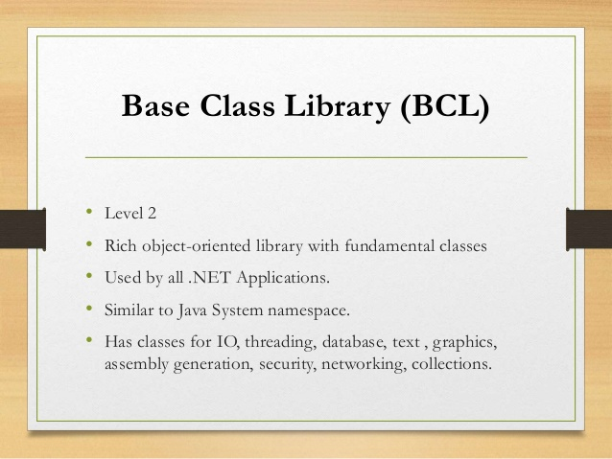

Slide 16
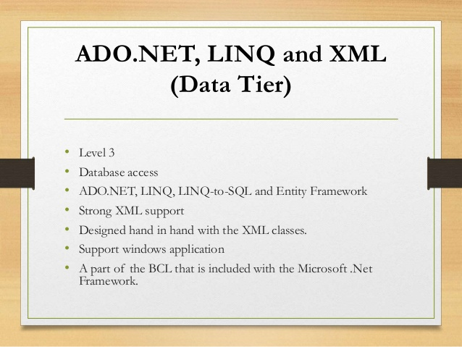

Slide 17
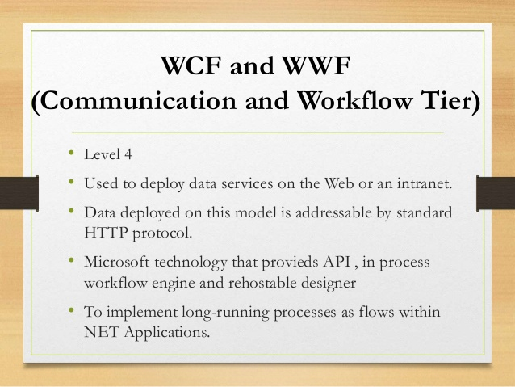

Slide 18
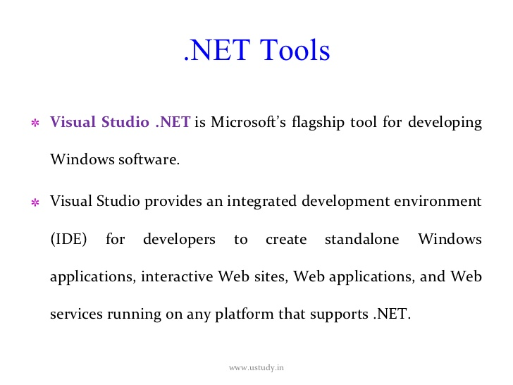

Slide 19
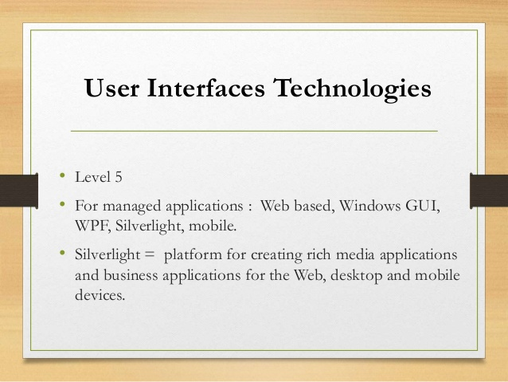

Slide 20
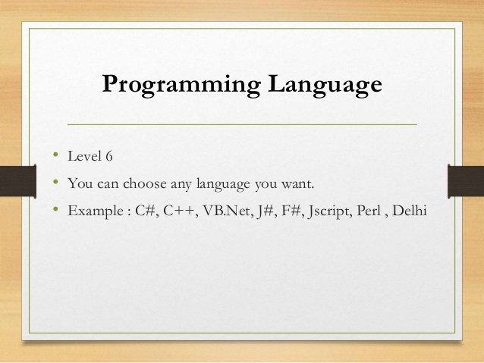

Slide 21
In Conclusion..
.Net is the Microsoft Web Services Strategy to connect information, people, systems and device through software.
.Net is a platform that provides a standardized set of services
Data Access and connectivity (ADO.Net)
Use Interfaces (Winforms, WPF)
Web Applications (ASP.net , Silverlight)
Network Communication (WCF), Workflow(WF)

Slide 22
Kinds of Application
Desktop - deployed in each machine
Console , Windows Application
Web – Internet based Application, accessed through browser
ASP.Net, MVC Core
Mobile - Xamarin

Slide 23
Assemblies
Any .Net Application on compilation gives assembly files(.dll or .exe)
Assemblies are fundamental unit of deployment, version control, reuse and security for a .net application.
Assembly contains – PE Header, CLR Header, Manifest and IL
Manifest files contain metadata
Assemblies can be private or shared
Shared Assemblies are placed in GAC

Slide 24
Assemblies contd….
Some information in the assembly manifest can be modified using attributes
We use ILDASM to peek into the assembly Manifest and IL file. We can use this tool to export the same to a text file.
We use ILASM to reconstruct an assembly from the text file into assembly Manifest and the IL.

Slide 25
Global Assembly Cache
Machine wide central repository of assemblies
Assemblies in GAC must be strongly named
Strong name consists of simple text name, version number, and culture information(if provided), a public key and a digital signature
gacutil / i for installing and / u for uninstalling

Slide 26
Assembler Tools
ILDASM – IL Disassembler
ILASM – IL Assembler

Slide 27
C Sharp

Slide 28
Major Objectives
C# Basics
Namespaces
Data Types
Data Conversions and Typecasts
Nullables
Operators
Decision Making
Loops
Classes
Encapsulation
Method Parameters
Polymorphism
Inheritance

Slide 29
C Sharp Basics
C# is a modern, general-purpose, object-oriented programming language developed by Microsoft
C# was developed by Anders Hejlsberg and his team during the development of .Net Framework.
C# is designed for Common Language Infrastructure (CLI), which consists of the executable code and runtime environment that allows use of various high-level languages on different computer platforms and architectures.

Slide 30
Namespace
It is a logical way to organize your program
It is a collection of Classes, Interfaces, Events, Delegates, Structures, Enums and also other Namespaces.
Provides assistance in avoiding name clashes.

Slide 31
Data Types
Are basically either
Value Types - All integral data types
Reference Types – All objects of Classes, Interfaces, Delegates, Arrays etc.
Boolean
Integral
Floating
Decimal

Slide 32
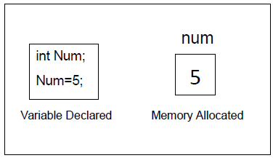
Value types
Value types are derived from System.ValueType
Value type variables stores the data
Value types are stored in Stack Memory

Slide 33
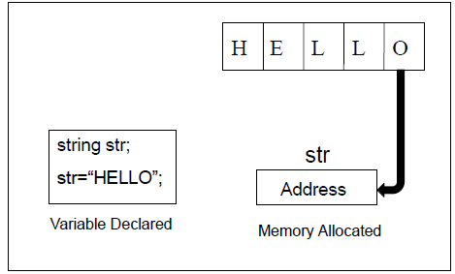
Reference types
A type that is defined as a class,delegate,array or interface is a reference type
String and object are also reference types
Contains the address of the memory where data is stored
Reference types are stored in heap memory
Notes:
The reference types do not contain the actual data stored in a variable, but they contain a reference to the variables.
In other words, they refer to a memory location. Using more than one variable, the reference types can refer to a memory location. If the data in the memory location is changed by one of the variables, the other variable automatically reflects this change in value.
Example of built in reference types are:object, dynamic and string.

Slide 34
Data Types in C#(contd …)
Structures
User Defined
Enumerations
Value Type
Pre Defined
All Primitive Types
Data Type
string
Pre Defined
object
Reference Type
User Defiled
Classes
Arrays
Interface

Slide 35
Literals in C#
Real Literals
String Literals
Integer Literals
Literals
Character Literals
Null Literals
Boolean Literals
Notes:
A literal is a source code representation of a value.
literal:boolean-literal integer-literal real-literal character-literal string-literal null-literal

Slide 36
Data Types In C# contd…
Integer Literals
Ex: 1234
Real Literals
Ex: 10.5
Character Literals
Ex: ‘a’ or ’1’
Notes:
The number that are represented without decimal point. Whole numbers having positive or negative values.
Real Literals are floating point constants or numbers with decimal points .ex 80.5,0.001,-3.2,1.0E-03.
Character Literals are Constants which are alphanumeric in character, Alphabets(Upper and Lower), Digits, Special Characters.
String is a Set of alphanumeric characters. Group of characters enclosed within double quotes. Ex:”String in Java”.
Boolean represent true or false and is applied in logical situation, there will be no quotes.
Null Literal It is represented as ‘/0’ ,String terminator Marks the end of the String.

Slide 37
Data Types In C# contd…
String Literals
Ex: “Hello World”
Boolean Literal
Ex: true/false
Null Literal
Ex: ‘/0’

Slide 38
Boxing and Unboxing
Boxing
When a Value Type is converted to Object Type / Reference Type
Eg. Object obj; obj=100;
Unboxing
When an Object type / Reference type is converted to Value Type
Eg : Obj obj;
Int n =(int)obj;

Slide 39
Type Conversions
Implicit type conversion − These conversions are performed by C# in a type-safe manner. For example, conversions from smaller to larger integral types and conversions from derived classes to base classes.
Eg :
Explicit type conversion − These conversions are done explicitly by users using the pre-defined functions. Explicit conversions require a cast operator.
Eg:
C # provides various conversion methods
ToInt16, ToInt32, ToBoolean, ToChar, ToString etc.
Parse()

Slide 40
Nullables
C# provides a special data type, the nullable types, to which you can assign normal range of values as well as null values.
nullable types bridge the difference between C# types and the Database types
Transformation of nulls and non nulls.

Slide 41
Operators
Arithmetic Operators
Relational Operators
Logical Operators
Assignment Operators
Misc. Operators :
Sizeof(), Typeof(), ?: etc
Null Coalescing Operator : ??

Slide 42
Visual Studio
IDE for creating .NET application
Console Applications
Web Applications
Windows Applications
Web Services
Features
Page Design
Automatic error detection
Debugging tools
IntelliSense
Short cut keys
Notes:
Visual Studio Is a software development environment (also know as an Integrated Development Environment or IDE), It's used primarily by Software Developers to build Software products, websites and Utilities.
Visual Studio was introduced by Microsoft in 1998 and has seen many evolutions, product versions are:
Visual Studio 6.0 (1998)
5.2 Visual Studio .NET (2002)
5.3 Visual Studio .NET 2003
5.4 Visual Studio 2005
5.5 Visual Studio 2008
5.6 Visual Studio 2010
The current Version of Visual Studio is 2012 and is available in a number of different versions, each designed to suite a different type of user:
Visual Studio 2010 - Express (Free Version)
Visual Studio 2010 - Professional
Visual Studio 2010 - Premium
Visual Studio 2010 - Ultimate
Visual Studio 2010 - Test Professional
Visual Studio 2012

Slide 43
Control Statements
Control statements control the execution path of the program
Selection Statements
If
Switch
Notes:
Control statements give you additional means to control the processing within the applications you develop. This section explores the syntax and function of the if, switch, do-while, for, for each, goto, break, continue, and return statements.

Slide 44
Control Statements
Iteration Statement
While
Do while
For
For each
Jump Statements
break
continue
goto
return
Throw

Slide 45
Control Statements contd…
If-else Statement
if (<conditional expression>) < statement action> else < statement action>
Notes:
The if/else statement is an extension of the if statement. If the statements in the if statement fails, the statements in the else block are executed.
When executing a switch statement, the program falls through to the next case. Therefore, if you want to exit in the middle of the switch
statement code block, you must insert a break statement, which causes the program to continue executing after the current code block.

Slide 46
Control Statements contd…
Switch Case Statement
switch (<non-long integral expression>)
{ case label : <statement>
break; case label: <statement>
break; case label: <statement>
break; default: <statement>
}

Slide 47
Methods and Parameters
Methods in c# can have parameters of the following type
Value
Reference
Out
Parameter Arrays
(Params keyword helps in giving a variable number of arguments, arraylist separated by a comma, or no arguments )
Params keyword should be the last in the method declaration
Only one Params keyword is allowed

Slide 48
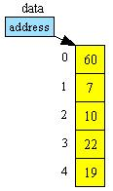
Arrays in C#
Array is a collection of values of same data type
The following figure shows the array structure in system memory
Notes:
In C#, an array index starts at zero. That means the first item of an array starts at the 0thposition. The position of the last item on an array will total number of items - 1. So if an array has 10 items, the last 10th item is at 9th position. In C#, arrays can be declared as fixed length or dynamic.
A fixed length array can store a predefined number of items.
A dynamic array does not have a predefined size. The size of a dynamic array increases as you add new items to the array. You can declare an array of fixed length or dynamic. You can even change a dynamic array to static after it is defined.
Arrays can be divided into the following four categories.
Single-dimensional arrays
Multidimensional arrays or rectangular arrays
Jagged arrays

Slide 49
Arrays in C# contd…
There are 3 types of arrays
Single-Dimensional
Two-Dimensional/Multi-Dimensional
Jagged Array

Slide 50
Array Instantiation
Datatype [] Array_name=new Data type[size];
Data type: specifies what type of data is stored
Array_name: Indicates name of the array
new: It allocates memory to the array at runtime
Size: Indicates number of elements
Notes:
In C#, arrays are objects. That means that declaring an array doesn't create an array. After declaring an array, you need to instantiate an array by using the "new" operator.
The following code snippet defines arrays of double, char, bool, and string data types.
double[] doubleArray = new double[5];
char[] charArray = new char[5];
bool[] boolArray = new bool[2];
string[] stringArray = new string[10];

Slide 51
Array Instantiation
ex: int []a=new int[5];
string []names=new string[3];
int []data=new int[5]{10,20,30,40,50} ;

Slide 52
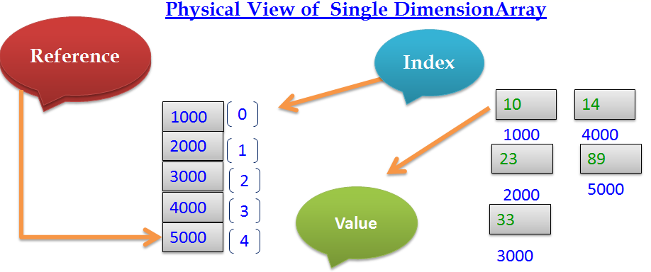
Arrays in C# contd…

Slide 53
Arrays in C# contd…
Assigning values to array
int []a= new int[4]
a[0]=10
a[1]=20
a[2]=30
a[3]=40
int []a=new int[4]{10,20,30,40}
int []a={10,20,30,40} //Dynamic allocation
a[index]- returns the array value at particular index
Notes:
Once an array is declared, the next step is to initialize an array. The initialization process of an array includes adding actual data to the array.
The following code snippet creates an array of 3 items and values of these items are added when the array is initialized.
// Initialize a fixed array
int[] staticIntArray = new int[3] {1, 3, 5};
Alternative, we can also add array items one at a time as listed in the following code snippet.
// Initialize a fixed array one item at a time
int[] staticIntArray = new int[3];
staticIntArray[0] = 1;
staticIntArray[1] = 3;
staticIntArray[2] = 5;
The following code snippet declares a dynamic array with string values.
// Initialize a dynamic array items during declaration
string[] strArray = new string[] { "Mahesh Chand", "Mike Gold", "Raj Beniwal", "Praveen Kumar", "Dinesh Beniwal" };

Slide 54
System.Array Class
sort() : It sorts array elements in ascending order.
System.Array.Sort(array name)
reverse(): It arrange array elements in reverse order
System.Array.Reverse(array name)
copy() : It copies one Array elements into to another array
System.Array.Copy(source array name, destination array name, count)
Length: It returns size of the array
Rank: It returns dimension of the array
Notes:
Array class is the mother of all arrays and provides functionality for creating, manipulating, searching, and sorting arrays in .NET Framework.
Array class, defined in the System namespace, is the base class for arrays in C#. Array class is an abstract base class that means we cannot create an instance of the Array class.

Slide 55
Two-Dimensional Array
It stores values in one or more columns
Has rows and columns
Ex: int [,] table=new table[4,3];
Notes:
A multi-dimensional array, also known as a rectangular array is an array with more than one dimension. The form of a multi-dimensional array is a matrix.
Declaring a multi-dimensional array
A multi dimension array is declared as following:
string[,] mutliDimStringArray;
A multi-dimensional array can be fixed-sized or dynamic sized.
int[,] numbers = new int[3, 2] { { 1, 2 }, { 3, 4 }, { 5, 6 } };
string[,] names = new string[2, 2] { { "Rosy", "Amy" }, { "Peter", "Albert" } };

Slide 56
Two-Dimensional Array contd…
Assigning Values to 2-Dimensional Arrays
int [,] a=new int[2,2]{{12,32},{34,54}};
int[,]table =new table[4,3] {
{400, 450, 510},
{500, 560, 630},
{625, 676, 740},
{1000, 1250, 1600}
};

Slide 57
Jagged Arrays
Jagged arrays are often called array of arrays
An element of a jagged array itself is an array
Datytype [][] Array_name = new Datatype[size][] ;
Size indicates no of arrays stored in jagged array
Ex: int [][]j _array =new int[3][];
j_array[0]=new int[] {1,2,3,4};
j_array[1]=new int[] {5,6,7};
j_array[2] =new int[] { 8,9};
Notes:
Jagged arrays are arrays of arrays. The elements of a jagged array are other arrays.
Declaring Jagged Arrays
Declaration of a jagged array involves two brackets. For example, the following code snippet declares a jagged array that has three items of an array.
int[][] intJaggedArray = new int[3][];
The following code snippet declares a jagged array that has two items of an array.
string[][] stringJaggedArray = new string[2][];
Initializing Jagged Arrays
Before a jagged array can be used, its items must be initialized. The following code snippet initializes a jagged array; the first item with an array of integers that has two integers, second item with an array of integers that has 4 integers, and a third item with an array of integers that has 6 integers.
// Initializing jagged arrays
intJaggedArray[0] = new int[2];
intJaggedArray[1] = new int[4];
intJaggedArray[2] = new int[6];
We can also initialize a jagged array's items by providing the values of the array's items. The following code snippet initializes item an array's items directly during the declaration.
// Initializing jagged arrays
intJaggedArray[0] = new int[2]{2, 12};
intJaggedArray[1] = new int[4]{4, 14, 24, 34};
intJaggedArray[2] = new int[6] {6, 16, 26, 36, 46, 56 };

Slide 58
Strings in c#
String is a collection of characters
Memory is allocated on the heap
string s=“abc”;
string s1 = @"D:/Sample/ConsoelAPp“;
String is a predefined reference type
Strings are Immutable
Strings have fixed size
String memory cannot be changed dynamically
Notes:
The System.String data type is used to represent a string. A string in C# is an object of type System.String. The string class in C# represents a string. The following code creates three strings with a name, number and double values. // String of characters System.String authorName = "Mahesh Chand";
// String made of an Integer System.String age = "33"; // String made of a double System.String numberString = "33.23";

Slide 59
Methods of String Class
copy()- copies one string into another
String. Copy(value)
concat()-concats two strings
String.Concat(s1,s2)
compare()-compares two strings
compare(string s1,string s2,bool ignorecase)
Equal(String s)- Compares two strings and return boolean value
split()-splits string into substrings
string []s=s1.split('separator',' separator',....)
Notes:
join() -I t will join the array of strings into one string with separator
string s= string.join ( ‘separator', array name)

Slide 60
Methods of String Class
indexof("char")-finds the index of given char
indexof(“string”)-finds the index of given string
contains("substring")-checks if substring exists in the string
tolower()-returns string in lowercase
toupper()-returns string in uppercase
TocharArray()-converts string to char array
replace("old string", "new string")- replaces old string with new string
replace('old char', 'new char')-replaces old char with new char
Notes:
Substring( int index)-it return the substring stating from index to total string.
Substring(int index,int count)-it return the substring starting from index to given counted chars
String. Format(format, "string”)-it format the string
ex:string.format(“{0:C}”,”1234”)-$1234

Slide 61
Formatting strings
Formatting strings are used to format the output
{0:Fn}-To display fixed decimal points n=1,2,….
{0:E}-To display output in exponential format
{0:C}-To display in currency format-$123
{0:P}-To display in percentage format-123%
{0:D}-To display date in long format-March 5 2011
{0:d}-To display date in small format-02/5/2011
{0:T}-To display time in long format-12:23:12
{0:t}-To display time in small format-12:23
Notes:
Format controls appear inside the braces ({}) of the place holders. The format of a place holder with a format control is as follows:
{n:controlx}
Where n is the place holder number and control is the special format control sequence to be applied to the argument. The x is an optional number which further formats the output for certain controls.

Slide 62
Enumerations
Enumeration is the set of named constants
It is a user defined value type
enum keyword is used to declare enumeration
enumeration type is any integral type like int ,long ,byte short
The default type of the enumeration list elements is int
Notes:
The enum keyword is used to declare an enumeration, a distinct type consisting of a set of named constants called the enumerator list.
Every enumeration type has an underlying type, which can be any integral type except char. The default underlying type of the enumeration elements is int.
By default, the first enumerator has the value 0, and the value of each successive enumerator is increased by 1.

Slide 63
Enumerations contd…
enum enumname:datatype {enumeration list};
default data type is int
Ex:enum Days {Sat, Sun, Mon, Tue, Wed, Thu, Fri};
In Enumeration list the items are called enumerators
The value of the first enumerator is 0 .
The value of the each successive enumerator is increased by 1

Slide 64
Enumerations contd…
Enumerator can be initialized to override the default value
Ex: enum Days{sat=1,sun,mon,tue,wed,thu}
Assigning enumerator value to variables
int i= (int) Days.sat [returns value]
Accessing the enumerator name to variables
string name= Days.sat [returns name]
Notes:
Enums type can be integer (float, int, byte, double etc.).
enum is used to create numeric constants in .NET framework. All member of enum are of enum type. There must be a numeric value for each enum type.
The default underlying type of the enumeration elements is int. By default, the first enumerator has the value 0, and the value of each successive enumerator is increased by 1.
enum Dow {Sat, Sun, Mon, Tue, Wed, Thu, Fri};

Slide 65
Implicitly Typed Variables
Var
Dynamic

Slide 66
Day 2

Slide 67
Assemblies
ILDASM
ILASM
Strong Name creation
GAC deployment using gacutil
Creating a DLL and referencing the same

Slide 68
OO Programming
Classes
Definition of Class
Constructors
Overloaded Constructors
This Keyword
Destructors

Slide 69
Abstraction - Encapsulation
Encapsulation is defined 'as the process of enclosing one or more items within a physical or logical package'. Encapsulation, in object oriented programming methodology, prevents access to implementation details.
Encapsulation is implemented by using access specifiers.
An access specifier defines the scope and visibility of a class member. C# supports the following access specifiers −
Public
Private
Protected
Internal
Protected internal

Slide 70
Protected :
-Protected Members of a class are accessible to the class and all its derived classes
-The derived classes can be in the same assembly or different assembly
Public :
- All classes within the assembly or outside the assembly with or without derivation can access the public members of the class
-they just need to create an object of the class where the public members are declared.
Internal :
- It acts exactly the same as public access specifiers, but allows access to other derived or non derived classes of the same assembly

Slide 71
Internal Protected :
-Internal to all the derived and non derived classes of the assembly and
- Protected to all the derived classes irrespective of the assembly.
Private : Accessible only in the class where it is declared.
- No access anywhere else
All Classes and Interface are internal by default (You can change the access specifiers to public)
-All Class members are private by default (you can change them to public or internal or Protected)
-All interface members are public by default(you cannot change it with any other modifier)

Slide 72
Polymorphism
Definition
Overloading
Function
Operator

Slide 73
Properties
Properties are named members of classes, structures, and interfaces.
Member variables or methods in a class or structures are called Fields.
Properties are an extension of fields and are accessed using the same syntax. They use accessors through which the values of the private fields can be read, written or manipulated.
Properties do not name the storage locations. Instead, they have accessors that read, write, or compute their values.

Slide 74
Indexers
An indexer allows an object to be indexed such as an array. When you define an indexer for a class, this class behaves similar to a virtual array. You can then access the instance of this class using the array access operator ([ ]).
Use of Indexers
Declaration and behavior of an indexer is to some extent similar to a property. similar to the properties, you use get and set accessors for defining an indexer. However, properties return or set a specific data member, whereas indexers returns or sets a particular value from the object instance. In other words, it breaks the instance data into smaller parts and indexes each part, gets or sets each part.
Defining a property involves providing a property name. Indexers are not defined with names, but with the this keyword, which refers to the object instance.

Slide 75
Interfaces
Interfaces are like classes, which contains properties, methods, delegates or events – but only declarations and no implementations.
Interface members are public by default
They do not allow explicit access modifiers
The class that inherits from an interface will have to provide implementation to all members
A class can inherit from multiple Interfaces
Interfaces can inherit from other Interfaces.
We cannot create an instance of an interface, but a reference variable can point to derived class object

Slide 76
Advantages of Interface:
It is used to achieve loose coupling.
It is used to achieve total abstraction.
To achieve component-based programming
To achieve multiple inheritance and abstraction.
Interfaces add a plug and play like architecture into applications.

Slide 77
Explicit Interface Implementation
When A class inherits from 2 interfaces, and both the interfaces have the same method name.
When a class explicitly implements an interface member, the interface member can no longer be accessed thru class reference variable, but only thru interface reference variable
Access modifiers are not allowed on explicitly implemented members
To make one of the interface method, the default, then implement that method normally, and the other explicitly. This makes the default method to be accessed thru class instance.

Slide 78
Feature | Interface | Abstract class
Multiple inheritance | A class may inherit several interfaces. | A class may inherit only one abstract class.
Default implementation | An interface cannot provide any code, just the signature. | An abstract class can provide complete, default code and/or just the details that have to be overridden.
Access Modfiers | An interface cannot have access modifiers for the subs, functions, properties etc everything is assumed as public | An abstract class can contain access modifiers for the subs, functions, properties
Core VS Peripheral | Interfaces are used to define the peripheral abilities of a class. In other words both Human and Vehicle can inherit from a IMovable interface. | An abstract class defines the core identity of a class and there it is used for objects of the same type.

Slide 79
Homogeneity | If various implementations only share method signatures then it is better to use Interfaces. | If various implementations are of the same kind and use common behaviour or status then abstract class is better to use.
Speed | Requires more time to find the actual method in the corresponding classes. | Fast
Adding functionality (Versioning) | If we add a new method to an Interface then we have to track down all the implementations of the interface and define implementation for the new method. | If we add a new method to an abstract class then we have the option of providing default implementation and therefore all the existing code might work properly.
Fields and Constants | No fields can be defined in interfaces | An abstract class can have fields and constrants defined

Slide 80
Types of Classes
Abstract - Cannot be instantiated, but can be inherited. The subclasses can either implement or override its method
Eg : Abstract class Mycalss
Sealed – Can be instantiated but cannot be inherited. To avoid overriding or extending a class.
Eg: sealed class sclass
Partial - Can be defined in Multiple Files. Multiple developers can work simultaneously.
Eg public partial class MyPartialClass
Static – Cannot be inherited and cannot be instantiated
can have only all static members

Slide 81
Exceptions
An exception is an unwanted or unexpected event, which occurs during the execution of a program i.e at runtime, that disrupts the normal flow of the program’s instructions.
Sometimes during the execution of program, the user may face the possibility that the program may crash or show an unexpected event during its runtime execution.
This unwanted event is known as Exception and it generally gives the indication regarding something wrong within the code.

Slide 82
Exception Handling
try − A try block identifies a block of code for which particular exceptions is activated. It is followed by one or more catch blocks.
catch − A program catches an exception with an exception handler at the place in a program where you want to handle the problem. The catch keyword indicates the catching of an exception.
finally − The finally block is used to execute a given set of statements, whether an exception is thrown or not thrown. For example, if you open a file, it must be closed whether an exception is raised or not.
throw − A program throws an exception when a problem shows up. This is done using a throw keyword.

Slide 83
Exception Classes in C#
C# exceptions are represented by classes. The exception classes in C# are mainly directly or indirectly derived from the System.Exception class. Some of the exception classes derived from the System.Exception class are the System.ApplicationException and System.SystemExceptionclasses.
The System.ApplicationException class supports exceptions generated by application programs. Hence the exceptions defined by the programmers should derive from this class.
The System.SystemException class is the base class for all predefined system exception.

Slide 84
Errors:
Errors are unexpected issues that may arise during computer program execution.
Errors cannot be handled.
All Errors are exceptions.
Exceptions:
Exceptions are unexpected events that may arise during run-time.
Exceptions can be handled using try-catch mechanisms.
All exceptions are not errors.

Slide 85
Collections
Collection classes are specialized classes for data storage and retrieval. These classes provide support for stacks, queues, lists, and hash tables. Most collection classes implement the same interfaces.
Collection classes serve various purposes, such as allocating memory dynamically to elements and accessing a list of items on the basis of an index etc. These classes create collections of objects of the Object class, which is the base class for all data types in C#.
Common Collection classes are
ArrayList
SortedList
Stacks
Queue
HashTable etc.

Slide 86
ArrayList
Arraylist is a class that is similar to an array, but it can be used to store values of various types.
An Arraylist doesn't have a specific size.
Any number of elements can be stored.
SortedList
Is a class that has the combination of arraylist and hashtable.
Represents the data as a key and value pair.
Arranges all the items in sorted order.

Slide 87
Generics
Generics allows to create Classes and Methods decoupled with datatypes
Generics is a way to let you define type-safe classes without compromising
type safety
Performance
Productivity

Slide 88
Non-generic Generic
ArrayList -------------> List
HashTable -------------> Dictionary
SortedList -------------> SortedList
Stack -------------> Stack
Queue -------------> Queue

Slide 89
Difference between Collections and Generics
Non-Generic
Each element can represent a value of a different type.
Array Size is not fixed.
Elements can be added / removed at runtime.

Slide 90
Delegates
C# delegates are similar to pointers to functions, in C or C++. A delegate is a reference type variable that holds the reference to a method. The reference can be changed at runtime.
Delegates are especially used for implementing events and the call-back methods. All delegates are implicitly derived from the System.Delegateclass.
Declaring Delegates
Delegate declaration determines the methods that can be referenced by the delegate. A delegate can refer to a method, which has the same signature as that of the delegate.

