Slide 1
JavaScript

Slide 2
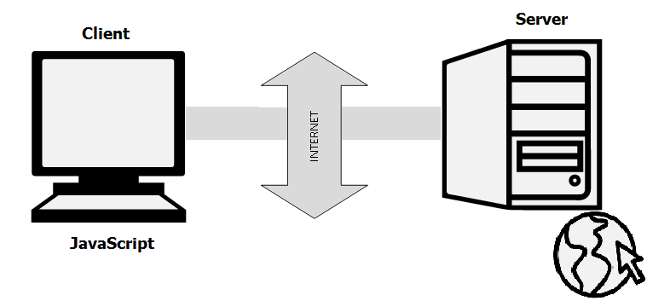
Introduction
JavaScript is a very powerful client-side scripting language.
JavaScript is used mainly for enhancing the interaction of a user with the webpage
JavaScript is Object Based

Slide 3
Where to place script?
JavaScript code must be inserted between <script> and </script> tags.
Scripts can be placed in the <body>, or in the <head> section of an HTML page, or in both.
Snippet:
<script>
alert("Hello world");
</script>

Slide 4
Data Types
Primitive datatype
Number,string,Boolean,undefined
Complex datatype
Objects,function
Snippet
<script>
var length = 16; //number
var lastName = "Johnson"; //string
var x = { firstName: "John", lastName: "Doe" }; //object
document.getElementById(“num").innerHTML = length;
document.getElementById("str").innerHTML = lastName;
document.getElementById("obj").innerHTML = x.firstName + "" + x.lastName;
</script>

Slide 5
Function
A JavaScript function is a block of code designed to perform a particular task.
Syntax:
function name(parameter1, parameter2, parameter3)
{ code to be executed }
Snippet
function Addition(a, b) {
return a + b;
}

Slide 6
Function Invocation
Function Invocation takes place in one of the following way
The code inside the function will execute when "something" invokes (calls) the function:
When an event occurs (when a user clicks a button)
When it is invoked (called) from JavaScript code
Automatically (self invoked)
Snippet
document.getElementById("demo").innerHTML = Addition(4, 5);

Slide 7
Array
An array is a special variable, which can hold more than one value at a time.
Syntax:
var array_name = [item1, item2, ...];
var array_name = new Array [item1, item2, ...];
Eg:
var color=[“red”,”blue”,”green”];
var color=new color[“red”,”blue”,”green”];

Slide 8
Array Properties and Methods
Property
length property --> If you want to know the number of elements in an array, you can use the length property.
prototype property --> If you want to add new properties and methods, you can use the prototype property.
reverse method --> You can reverse the order of items in an array using a reverse method.
Method
sort method --> You can sort the items in an array using sort method.
pop method --> You can remove the last item of an array using a pop method.
shift method --> You can remove the first item of an array using shift method.
push method --> You can add a value as the last item of the array.

Slide 9
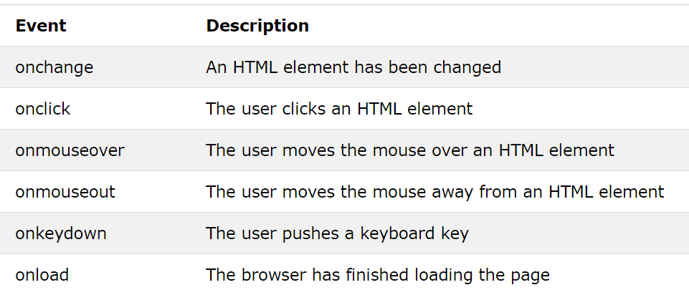
JavaScript Events
HTML allows event handler attributes, with JavaScript code, to be added to HTML elements.
Syntax:
<element event="some JavaScript">
Eg:
<button onclick="document.getElementById('demo').innerHTML = Date()">The time is?</button>
Below are the HTML Events

Slide 10
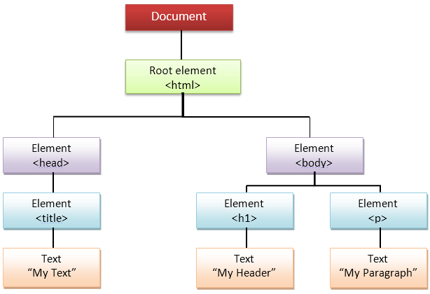
DOM in JavaScript
Document Object Model (DOM) is a platform and language-neutral interface that allows programs and scripts to dynamically access and update the content, structure, and style of a document.
The HTML DOM is a standard for how to get, change, add, or delete HTML elements.

Slide 11
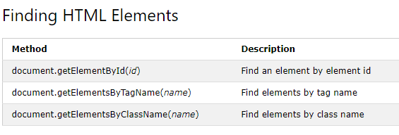
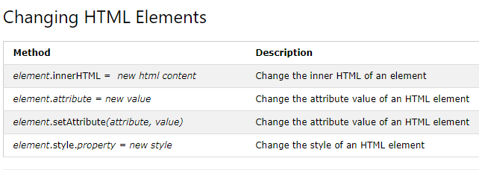

Slide 12
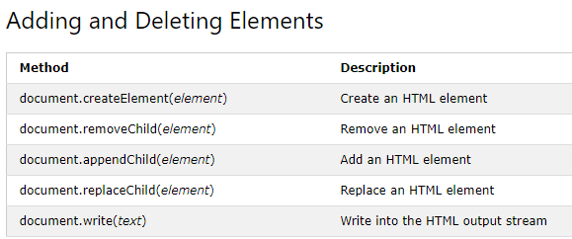

Slide 13
Snippet:
<script type="text/javascript">
function change(){
var paragraphs = document.getElementsByTagName("p");
document.getElementById("second").innerHTML = "The orginal message is changed.";
}
</script>
Html Code:
<p id="second">This is the technology section.</p>
<button onclick=" change()">Click to change value</button>

Slide 14
Exceptions Handling
JavaScript implements the try,catch,finally and throw operator to handle exceptions.
script type="text/javascript">
<!--
try {
// Code to run
[break;]
}
catch ( e ) {
// Code to run if an exception occurs
[break;]
}
[ finally {
// Code that is always executed regardless of
// an exception occurring
}]
//-->
</script>

Slide 15
Regular Expressions
A regular expression is a sequence of characters that forms a search pattern.
Regular expressions can be used to perform all types of text search and text replace operations.
Syntax
/pattern/modifiers;
Eg:
var patt = /Google/i; //Note:i is a modifier (modifies the search to be case-insensitive).

Slide 16
Regular Expressions cont
Modifiers
Modifier | Description
i | Perform case-insensitive matching
g | Perform a global match (find all matches rather than stopping after the first match)
m | Perform multiline matching
Patterns
Expression | Description
[abc] | Find any of the characters between the brackets
[0-9] | Find any of the digits between the brackets
(x|y) | Find any of the alternatives separated with |

Slide 17
Regular Expressions cont
Metacharacters
Metacharacter | Description
\d | Find a digit
\s | Find a whitespace character
\b | Find a match at the beginning or at the end of a word
\uxxxx | Find the Unicode character specified by the hexadecimal number xxxx
Quantifiers
Quantifier | Description
n+ | Matches any string that contains at least one n
n* | Matches any string that contains zero or more occurrences of n
n? | Matches any string that contains zero or one occurrences of n

Slide 18
Eg:
var patt = /e/; patt.test("The best things in life are free!"); //true

