Slide 1
Introduction to Qiskit and Primitives
Janani A
IBM Quantum
https://github.com/jan-an/ICIIS-2024

Slide 2
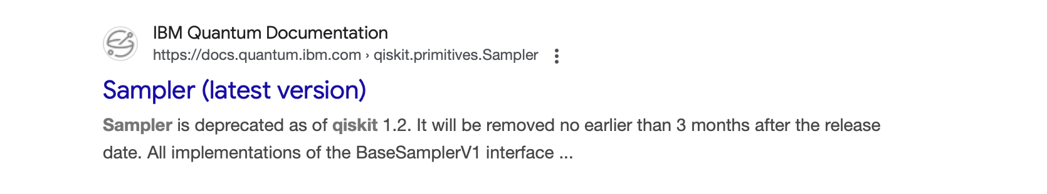
Looking up documentation
https://docs.quantum.ibm.com (IBM Quantum Documentation)
Latest version of the code and available features
Usually has the (latest version) tag
Regularly update to latest version of Qiskit and Qiskit Runtime
Best source is the github repository: https://github.com/qiskit

Slide 3
Observables & Expectation Values
Observables are operators (matrices) and expectation values are scalars
Observables encode information about a physical/measurable trait of a system.
Example: Hamiltonian -> Total energy of a system
Expectation values are the ‘measurements’ of these observables
Expectation values of a Hamiltonian will yield the measurement outcome: energy

