Slide 1
Variational Quantum Algorithms
Kalyan Dasgupta
IBM

Slide 2
Landscape of Quantum Algorithms
Quantum Algorithms
Full Quantum
Hybrid Quantum/Classical
Quantum Fourier Transformation
Hamiltonian
Simulation
Variational Eigen-solvers (VQE)/QAOA
Variational Quantum
classifier (VQC)
SQD
Search Algorithms
QSVM
Ground state energy estimation
Classification problems
Diagonalization
Grover’s algorithm
Quantum phase estimation
Quantum signal processing
Amplitude
amplification
Optimization problems
Shor’s algorithm
Quantum walk
Eigenvalue
decomposition
IBM Quantum | © 2024 IBM Corporation
Notes:
There are primarily two category of algorithms currently in use. The first category is of the type, we can refer to as “Full Quantum” algorithms. In this category the algorithm is executed end-to-end in a Quantum computer. The second category of algorithms fall in hybrid segment. Given the limitations of contemporary Quantum hardware, hybrid algorithms have become very popular for solving a large category of problems.

Slide 3
What are VQAs?
VQAs are a class of algorithms where a hybrid of Quantum and Classical subroutines are used to solve certain problems.
Time independent Schrödinger’s equation (VQE)
$$\hat{H}\left|ψ\right\rangle =E|ψ⟩$$
Energy function
$$E_{min}=\min{ \left\langle ψ\left|\hat{H}\right|ψ\right\rangle }$$
Energy eigenvalue
wave function
Optimization problems
$$\min_{x ∈ \{0,1\}}{f(x)}$$
$f(x)$has to be expressed in the form of an energy function having some properties.
Classification problems (VQC)
$$+1$$
$$\hat{H}=Z⊗Z⊗…⊗Z$$
$$\left\langle ψ\left|\hat{H}\right|ψ\right\rangle$$
Encoded training data passed through a circuit
$$−1$$

Slide 4










VQA layout
Quantum
Classical
$${\left|0\right\rangle }^{⊗n}$$
$${|φ}_{ref}⟩$$
$$θ±Δθ$$
$$|ψ⟩$$
$$|0⟩$$
Encoding
Strategy
Ansatz Prep
Classical optimizer
$$\left\langle \hat{H}\right\rangle$$
$$\left\langle \hat{H}\right\rangle$$
$$|0⟩$$
$$|ψ⟩=U(θ){|φ}_{ref}⟩$$
Optimizer
Gradient based
Non-gradient based
Encoding strategy
Occupation number basis
One hot encoding
Amplitude Encoding
Phase encoding
Ansatz
Domain inspired
Hardware Efficient
QAOA
IBM Quantum © 2024 IBM Corporation

Slide 5
Fundamental Principles
Energy functions $\hat{H}$ are represented by linear operators. The result of a measurement can only take values that are the eigenvalues of the operator. These energy functions are also known as an observable.
The state for which the eigenvalue is $λ_{i}$ is expressed as $|\left.λ_{i}\right\rangle$, the eigenvector.. If the system collapses to the state $|\left.\text{λ}\text{i}\right\rangle ,$ the result of the measurement will be $λ_{i}$.
The operators are Hermitian. $\hat{H}$ = ($\hat{H}$*)^{T} = $\hat{H}$†
Result of a measurement is a real number → Eigenvalues of Hermitian matrices are real numbers.
Eigenvectors of Hermitian matrices are orthogonal.
Distinguishable states are represented by orthogonal vectors (e.g.,: ‘spin up’ and ‘spin down’ states, $\left|0\right\rangle and |1⟩$ states ).
If the state vector is $|\left.Ψ\right\rangle$, and the observable $\hat{H}$ is measured, the probability to observe the value $λ_{i}$ is
$P\left(λ_{i}\right)=\left\langle λ_{i} | Ψ\right\rangle ⟨Ψ|λ_{i}⟩$ where $|\left.λ_{i}\right\rangle$ is an eigenvector of $\hat{H}$.
The result in our case will always be ±1, i.e., the eigenvalues must be ±1. These are the eigenvalues corresponding to the eigenstates of the Pauli Z operator ($\left|0\right\rangle /|1⟩$).

Slide 6
Expectation value of a measurement outcome
Let $\hat{H}$ be an observable. P($λ_{i}$) is the probability of having outcome $λ_{i}$.
$$\left\langle \hat{H}\right\rangle$$
- Expectation of the observable.
$\left\langle \hat{H}\right\rangle$ = $\sum_{i}{λ_{i}}\text{P}\text{(}λ_{i}\text{)}$
Let $|\left.Ψ\right\rangle$ be a quantum state and it is expanded in terms of the eigenvectors of $\hat{H}$.
Observable
$|\left.Ψ\right\rangle$ = $\sum_{i}{\text{c}\text{i}}|\left.λ_{i}\right\rangle$ → $\text{P}\text{(}λ_{i}\text{)}$ = $\text{c}\text{i}$* $\text{c}\text{i}$
$\hat{H}|\left.Ψ\right\rangle$ = $\sum_{i}{\text{c}\text{i}}\hat{H}|\left.λ_{i}\right\rangle$ = $\sum_{i}{\text{c}\text{i}}λ_{i}|\left.λ_{i}\right\rangle$
$\left\langle Ψ\right.|\hat{H}|\left.Ψ\right\rangle$ = $\sum_{i}{\left\langle λ_{i}\right.|\text{c}\text{i}\text{∗}\text{c}\text{i}}λ_{i}|\left.λ_{i}\right\rangle$ = $\sum_{i}{\text{c}\text{i}\text{∗}\text{c}\text{i}}λ_{i}\left\langle λ_{i}\right.|\left.λ_{i}\right\rangle$
= $\sum_{i}{λ_{i}}\text{P}\text{(}λ_{i}\text{)}$ = $\left\langle \hat{H}\right\rangle$
$\left\langle Ψ\right.|\hat{H}|\left.Ψ\right\rangle$ = $\left\langle \hat{H}\right\rangle$
Given state
$|ϕ$⟩ = $e^{−iθ}$ $|\left.Ψ\right\rangle$ → $\left\langle Ψ\right.|\hat{H}|\left.Ψ\right\rangle$ = $\left\langle ϕ\right.|\hat{H}|\left.ϕ\right\rangle$
Global phase change in a state does not alter the expectation.

Slide 7
Variational principle
We have seen
$$\left\langle ψ\left|\hat{H}\right|ψ\right\rangle = \sum_{i}{λ_{i} P(λ_{i})}$$
for any eigenvalue $λ_{i}$
$${λmin≤λ}_{i }≤λmax$$
Now,
$$\sum_{i}{λ_{min} P(λ_{i})}≤\sum_{i}{λ_{i} P\left(λ_{i}\right)}≤\sum_{i}{λ_{max} P(λ_{i})}$$
$$λ_{min}\sum_{i}{ P(λ_{i})}≤\sum_{i}{λ_{i} P\left(λ_{i}\right)}≤λ_{max}\sum_{i}{ P(λ_{i})}$$
$$λ_{min}≤\sum_{i}{λ_{i} P\left(λ_{i}\right)}≤λ_{max}$$
For any given parameterized ansatz
$λ_{min}≤$ $\left\langle ψ(θ)\left|\hat{H}\right|ψ(θ)\right\rangle ≤λmax$

Slide 8
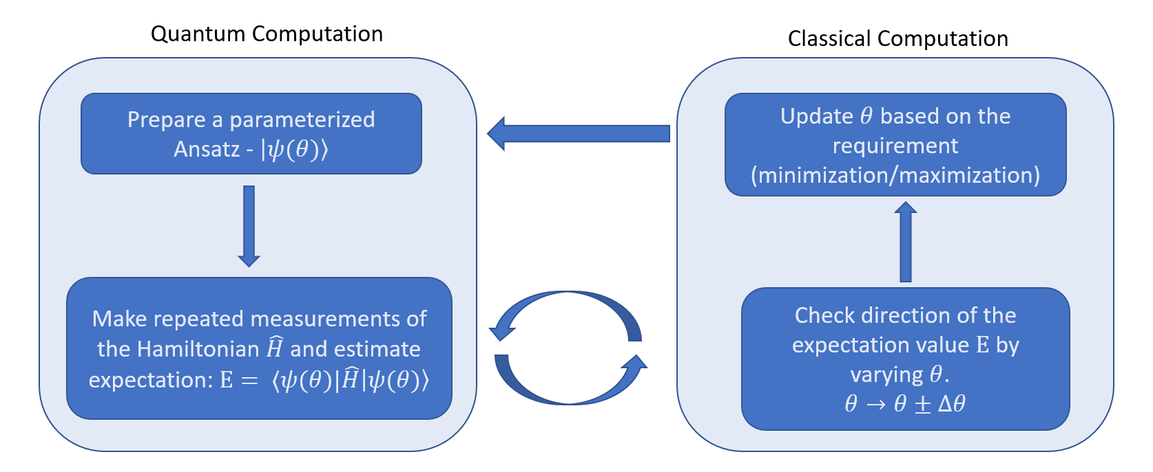
Variational Quantum Eigen-solver

Slide 9
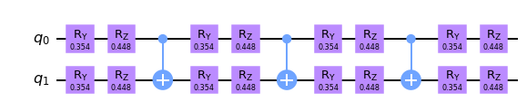
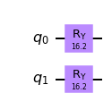
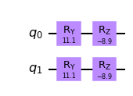
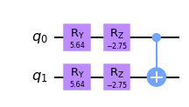
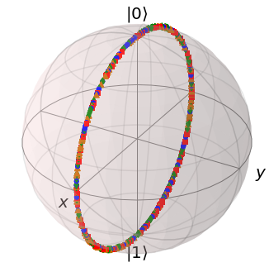
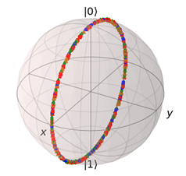
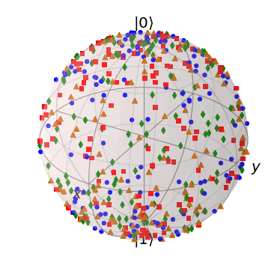
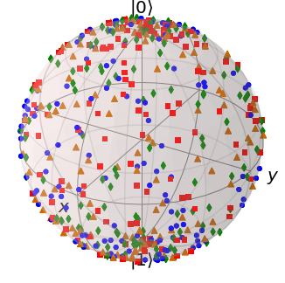
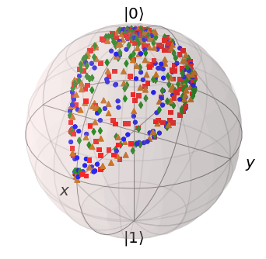
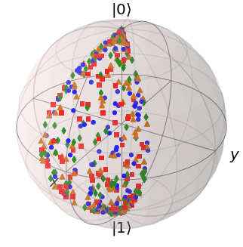
Ansatz Preparation
1 layer
Single qubit rotations
Entanglers

Slide 10

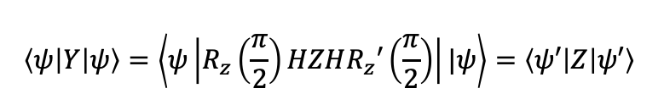

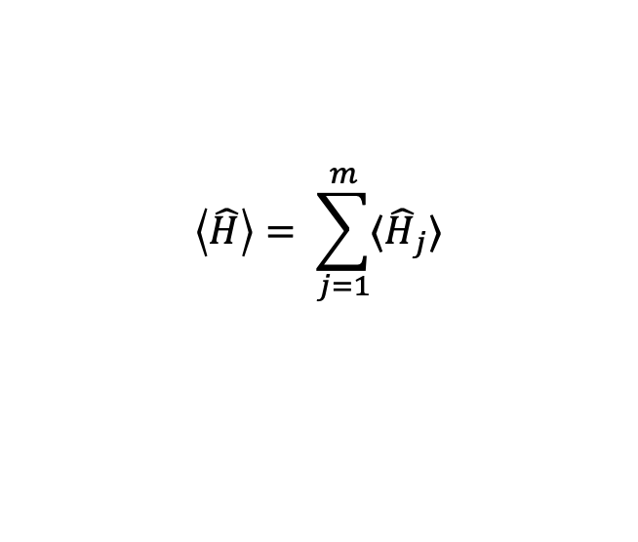



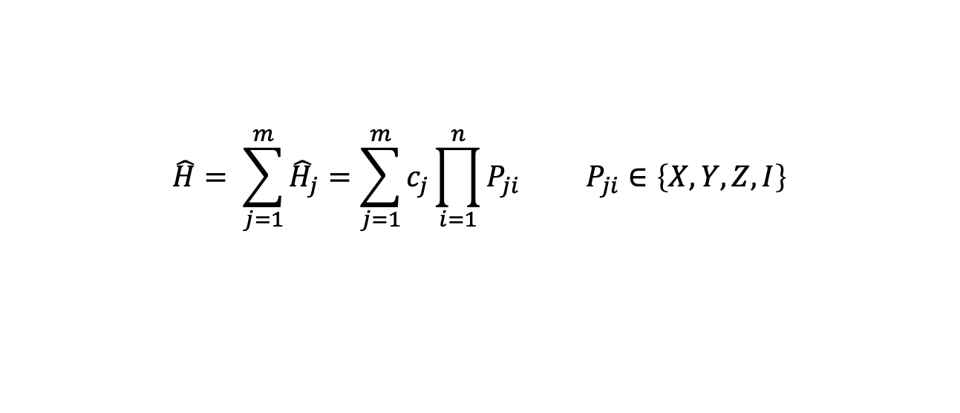

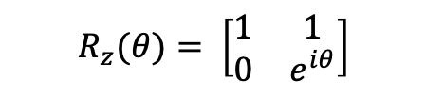





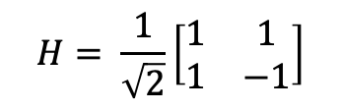

Hamiltonian (Observable/Operator)
$$\hat{H}= \sum_{j=1}^{m}{{\hat{H}}_{j}}=\sum_{j=1}^{m}{c_{j}}\prod_{i=1}^{n}{P_{ji}} P_{ji}∈\left\{X, Y, Z, I\right\}$$
$$\left\langle \hat{H}\right\rangle = \sum_{j=1}^{m}{{⟨\hat{H}}_{j}}⟩$$
For the purpose of measurement all the Pauli terms are transformed to $±Z$ computational basis.
$$|ψ⟩=U{|φ}_{ref}⟩$$
$$\hat{H}=XY$$
$$|ψ⟩=U{|φ}_{ref}⟩$$
$$\hat{H}=ZZ$$
Ansatz Prep
Ansatz Prep
$${|φ}_{ref}⟩$$
$$|ψ⟩$$
$${|φ}_{ref}⟩$$
$$R_{z}′\left(\frac{π}{2}\right)$$
$$H= \frac{1}{\sqrt{2}}\left[\begin{matrix}1 & 1 \\ 1 & −1\end{matrix}\right]$$
$$\left\langle ψ\left|X\right|ψ\right\rangle =\left\langle ψ\left|HZH\right|ψ\right\rangle =\left\langle ψ′\left|Z\right|ψ′\right\rangle$$
$$\left|ψ^{′}\right\rangle =H\left|ψ\right\rangle$$
$$R_{z}(θ)= \left[\begin{matrix}1 & 1 \\ 0 & e^{iθ}\end{matrix}\right]$$
$$\left\langle ψ\left|Y\right|ψ\right\rangle =\left\langle ψ\left|R_{z}\left(\frac{π}{2}\right)HZHR_{z}′\left(\frac{π}{2}\right)\right||ψ\right\rangle =\left\langle ψ′\left|Z\right|ψ′\right\rangle$$
$$|ψ′⟩\text{ = }HR_{z}′\left(\frac{π}{2}\right)|ψ⟩$$

Slide 11
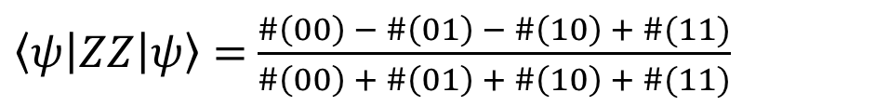
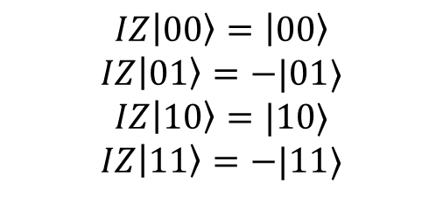




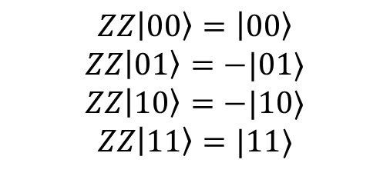
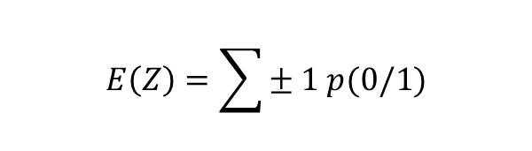



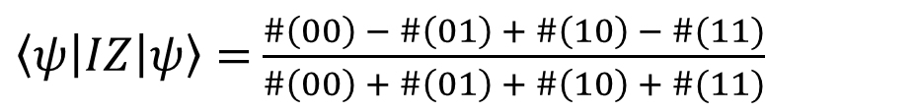
Count statistics and Expectation
$$E\left(Z\right)=\sum{± 1 p(0/1)}$$
$⟨Z⟩$
$$E\left[𝒳\right]=\sum{x p(x)}$$
$\left|ψ\right\rangle =c_{1}\left|0\right\rangle +c_{2}|1⟩$
$p\left(0\right)= \frac{\#0}{\#0 + \#1}$ $p\left(1\right)= \frac{\#1}{\#0 + \#1}$
$$E\left(Z\right)=\left\langle ψ\left|Z\right|ψ\right\rangle =c_{1}^{2}.1+c_{2}^{2}. \left(−1\right)=c_{1}^{2} −c_{2}^{2}$$
$$\left\langle ψ\left|Z\right|ψ\right\rangle =p\left(0\right)−p(1)$$
$⟨ZZ⟩$
$⟨IZ⟩$
$$ZZ\left|00\right\rangle =\left|00\right\rangle$$
$$ZZ\left|01\right\rangle =−|01⟩$$
$$ZZ\left|10\right\rangle =−|10⟩$$
$$ZZ\left|11\right\rangle =|11⟩$$
$$IZ\left|00\right\rangle =\left|00\right\rangle$$
$$IZ\left|01\right\rangle =−|01⟩$$
$$IZ\left|10\right\rangle =|10⟩$$
$$IZ\left|11\right\rangle =−|11⟩$$
$\left\langle ψ\left|ZZ\right|ψ\right\rangle =$ $\frac{\#\left(00\right) − \#\left(01\right) − \#\left(10\right) + \#(11)}{\#\left(00\right) + \#\left(01\right) + \#\left(10\right) + \#(11)}$
$\left\langle ψ\left|IZ\right|ψ\right\rangle =$ $\frac{\#\left(00\right) − \#\left(01\right) + \#\left(10\right) − \#(11)}{\#\left(00\right) + \#\left(01\right) + \#\left(10\right) + \#(11)}$

Slide 12
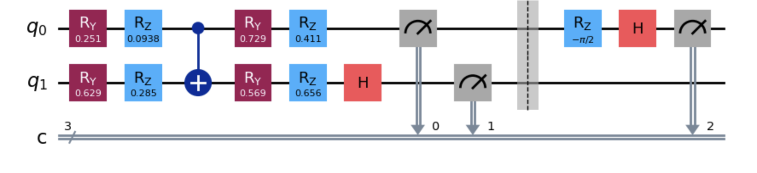
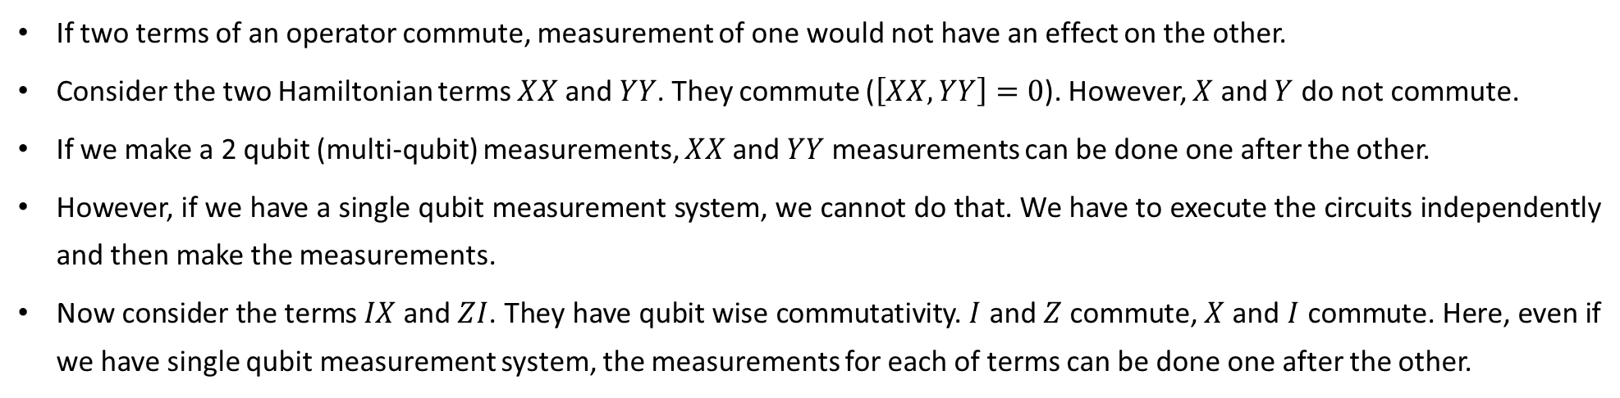



When to measure?
If two terms of an operator commute, measurement of one would not have an effect on the other.
Consider the two Hamiltonian terms $XX$ and $YY$. They commute ($\left[XX, YY\right]=0$). However, $X$ and $Y$ do not commute.
If we make a 2 qubit (multi-qubit) measurements, $XX$ and $YY$ measurements can be done one after the other.
However, if we have a single qubit measurement system, we cannot do that. We have to execute the circuits independently and then make the measurements.
Now consider the terms $IX$ and $ZI$. They have qubit wise commutativity. $I$ and $Z$ commute, $X$ and $I$ commute. Here, even if we have single qubit measurement system, the measurements for each of terms can be done one after the other.
$$H=α_{1} XI+α_{2} IY$$
$$XI$$
$$IY$$
Ansatz

