Slide 1
Inferential Statistics
Virtual COMSATS
Ossam Chohan
Assistant Professor
CIIT Abbottabad
M.Sc Statistics (QAU), MIT (CIIT), MS Operations Research (DU Sweden)

Slide 2
What are Our General Learning Objectives?
1 Describe the important elements of Statistics-population, sample, parameter, statistic and variable
2 Differentiate between population and sample data.
3 Why this is important to study statistics?
4 Differentiate between Descriptive Statistics and Inferential Statistics.

Slide 3
What is Statistics?
What does Statistics mean to you. Does it bring to your mind, the averages that you have learned in secondary school?
Or is it just a university requirement that you have to complete?

Slide 4
Definition of Statistics
Statistics is the science of collecting, summarizing, organizing, analyzing, and interpreting data in order to make decisions (is that so????)
Statistics presents a rigorous scientific method for gaining insight into data. For example, suppose we measure the weight of 100 patients in a study. With so many measurements, simply looking at the data fails to provide an informative account. However statistics can give an instant overall picture of data based on graphical presentation or numerical summarization irrespective to the number of data points. Besides data summarization, another important task of statistics is to make inference and predict relations of variables.

Slide 5
We have learned the definition of Statistics. We should study one simple Example
Do female undergraduates perform better in Examination than their male counterparts?

Slide 6
A Simple Application
Do female undergraduates perform better than male undergraduates in examination?
Identify the target group of undergraduates.
Collect their examination marks.
Presenting Data in the form of charts, graphs or tables
Make a data analysis so as to find the answer to the question. Give suggestions as to why it happens
Send the final results to policy makers for decision-making.
Data
Analysis
Why?
Decision-
Making
© 1984-1994 T/Maker Co.
Notes:
:1, 1, 3

Slide 7
We start off by Studying the Elements of Statistics
There are 5 important elements of
Statistics we need to define and
Study.
Population
Sample
Parameter
Statistic
Variable

Slide 8
Population
"The term "population" is used in statistics to represent all possible measurements or outcomes that are of interest to us in a particular study.".
Sample
"The term "sample" refers to a portion of the population that is representative of the population from which it was selected."
.
Notes:
A statistical population is a set of entities concerning which statistical inferences are to be drawn, often based on a random sampletaken from the population. For example, if we are interested in making generalizations about all crows, then the statistical population is the set of all crows that exist now, ever existed, or will exist in the future. Since in this case and many others it is impossible to observe the entire statistical population, due to time constraints, constraints of geographical accessibility, and constraints on the researcher's resources, a researcher would instead observe a statistical sample from the population in order to attempt to learn something about the population as a whole.

Slide 9
Parameter
A number that describes a population characteristic.
Example:
Average CGPA of all Students in the COMSATS in 2002.
Population mean, population median, population correlation and etc…

Slide 10
Statistic
A number that describes a sample characteristic
Example:
Average CGPA of students in three campuses of COMSATS for year 2009.
Sample mean, sample median, sample correlation coefficient and etc…

Slide 11
Variable
A Variable is a characteristic or property of the population.
Example:
All men in Pakistan is a statistical population.
The height of all these men is a variable.

Slide 12
Statistical Methods
To use Statistics for analysis, there are generally two methods to do so. Whichever method to be used should depend on the need, condition and what data is available.

Slide 13
Statistical Methods
Statistical
Methods
Descriptive
Inferential
Statistics
Statistics

Slide 14
Descriptive Statistics
Utilizes numerical and graphical methods to look for patterns in the data set.
Summarize the information revealed in a data set.
Present the information in a convenient form.

Slide 15
Descriptive Statistics
1. Involves
  Collecting Data
  Presenting Data
  Characterizing Data
2. Purpose
  Describe Data
$
50
25
0
Q1
Q2
Q3
Q4
‾X = 30.5 S² = 113

Slide 16
Inferential Statistics
Utilizes sample data to make estimates, conclusions, predictions or other generalization about a larger set of data, referred to as population.
It involves hypothesis testing and estimation of unknown quantities known as parameters like population mean, population standard deviation, population proportion and etc.

Slide 17
Inferential Statistics
1. Involves
  Estimation
  Hypothesis
  Testing
2. Purpose
  Draw conclusions About Population Characteristics
Population?

Slide 18
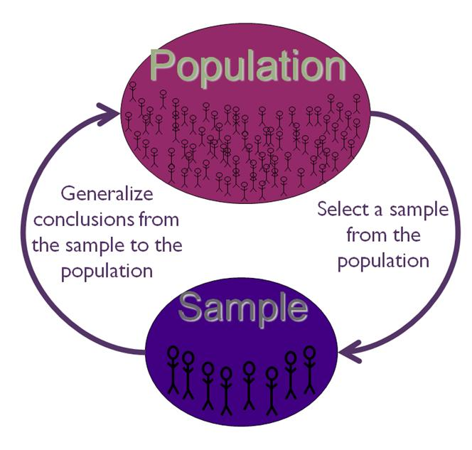
SI- An Overview

Slide 19
Key Terms Revisit
1. Population (Universe)
  All Items of Interest
2. Sample
  Portion of Population
3. Parameter
  Summary Measure about Population
4. Statistic
  Summary Measure about Sample
P in Population
& Parameter
S in Sample
& Statistic
Notes:
Data
facts or information that is relevant or appropriate to a decision maker
Population
the totality of objects under consideration
Sample
a portion of the population that is selected for analysis
Parameter
a summary measure (e.g., mean) that is computed to describe a characteristic of the population
Statistic
a summary measure (e.g., mean) that is computed to describe a characteristic of the sample

Slide 20
Statistics can be applied in the following Areas
Economics
  Forecasting
  Demographics
Sports
  Individual & Team Performance
Engineering
  Construction
  Materials
Business
  Consumer Preferences
  Financial Trends

Slide 21
Basic Terminology
Summarizing versus Analyzing
Descriptive Statistics
Inferential Statistics
  Inference from sample to population
  Inference from statistics to parameter
  Factors influencing the accuracy of a sample’s ability to represent a population:
    Size
    Randomness

Slide 22
Assessment Questions
1 Survey Agency ABC regularly conduct opinion polls to determine the popularity rating of the current president. Suppose a poll is to be conducted tomorrow in which 2000 individuals will be asked whether the president is doing a good or bad job. The 2000 individuals will be selected by random digit telephone dialing and asked the question over the phone.
a. What is the relevant population?
b What is the variable of interest? Is it quantitative or qualitative?
c What is the sample?
d What is the inference of interest to the Agency?
e What method of data collection is employed?
f How likely is the sample to be representative?

Slide 23
Assessment Questions
2. A large paint retailer has had numerous complaints from customers about under filled paint cans. As a result, the retailer has begun inspecting incoming shipments of paints from suppliers. Shipments with under fill problems will be returned to the supplier. A recent shipment contained 2440 gallon size cans. The retailer sampled 50 cans and weighed each on a scale capable of measuring weight to four decimal places. Properly filled cans weigh 10 pounds.
a Describe the population
b Describe the variable of interest
c Describe the sample
d Describe the inference (not on this stage!)

Slide 24
Sampling and Sampling Distributions
Aims of Sampling
Probability Distributions
Sampling Distributions
The Central Limit Theorem
Types of Samples

Slide 25
Aims of sampling
Reduces cost of research (e.g. political polls)
Generalize about a larger population (e.g., benefits of sampling city r/t neighborhood)
In some cases (e.g. industrial production) analysis may be destructive, so sampling is needed

Slide 26
Sampling distribution
Sampling distribution of the mean – A theoretical probability distribution of sample means that would be obtained by drawing from the population all possible samples of the same size.

Slide 27
Central Limit Theorem
No matter what we are measuring, the distribution of any measure across all possible samples we could take approximates a normal distribution, as long as the number of cases in each sample is about 30 or larger.

Slide 28
Central Limit Theorem
If we repeatedly drew samples from a population and calculated the mean of a variable or a percentage or, those sample means or percentages would be normally distributed.

Slide 29
The standard deviation of the sampling distribution is called the standard error

Slide 30

The Central Limit Theorem
Standard error can be estimated from a single sample:
Where
s is the sample standard deviation (i.e., the sample based estimate of the standard deviation of the population), and
n is the size (number of observations) of the sample.

Slide 31
Sampling
Population – A group that includes all the cases (individuals, objects, or groups) in which the researcher is interested.
Sample – A relatively small subset from a population.

Slide 32
Why sampling?
Get information about large populations
Less costs
Less field time
More accuracy i.e. Can Do A Better Job of Data Collection
When it’s impossible to study the whole population

Slide 33
Target Population:
The population to be studied/ to which the investigator wants to generalize his results
Sampling Unit:
smallest unit from which sample can be selected
Sampling frame
List of all the sampling units from which sample is drawn
Sampling scheme
Method of selecting sampling units from sampling frame

Slide 34
Types of sampling
Non-probability samples
Probability samples

Slide 35
Non probability samples
Convenience samples (ease of access)
sample is selected from elements of a population that are easily accessible
Snowball sampling (friend of friend….etc.)
Purposive sampling (judgemental)
    You chose who you think should be in the study
  Quota sample

Slide 36
Non probability samples
Probability of being chosen is unknown
Cheaper- but unable to generalise
potential for bias

Slide 37
Probability samples
Random sampling
  Each subject has a known probability of being selected
Allows application of statistical sampling theory to results to:
  Generalise
  Test hypotheses

Slide 38
Conclusions
Probability samples are the best
Ensure
  Representativeness
  Precision

Slide 39
Methods used in probability samples
Simple random sampling
Systematic sampling
Stratified sampling
Multi-stage sampling
Cluster sampling

Slide 40
Random Sampling
Simple Random Sample – A sample designed in such a way as to ensure that (1) every member of the population has an equal chance of being chosen and (2) every combination of N members has an equal chance of being chosen.
This can be done using a computer, calculator, or a table of random numbers

Slide 41
Simple random sampling

Slide 42
Table of random numbers
6 8 4 2 5 7 9 5 4 1 2 5 6 3 2 1 4 0
5 8 2 0 3 2 1 5 4 7 8 5 9 6 2 0 2 4
3 6 2 3 3 3 2 5 4 7 8 9 1 2 0 3 2 5
9 8 5 2 6 3 0 1 7 4 2 4 5 0 3 6 8 6

Slide 43
Systematic sampling
Sampling fraction
Ratio between sample size and population size

Slide 44
Random Sampling
Systematic random sampling – A method of sampling in which every Kth member (K is a ration obtained by dividing the population size by the desired sample size) in the total population is chosen for inclusion in the sample after the first member of the sample is selected at random from among the first K members of the population.

Slide 45
Systematic sampling

Slide 46
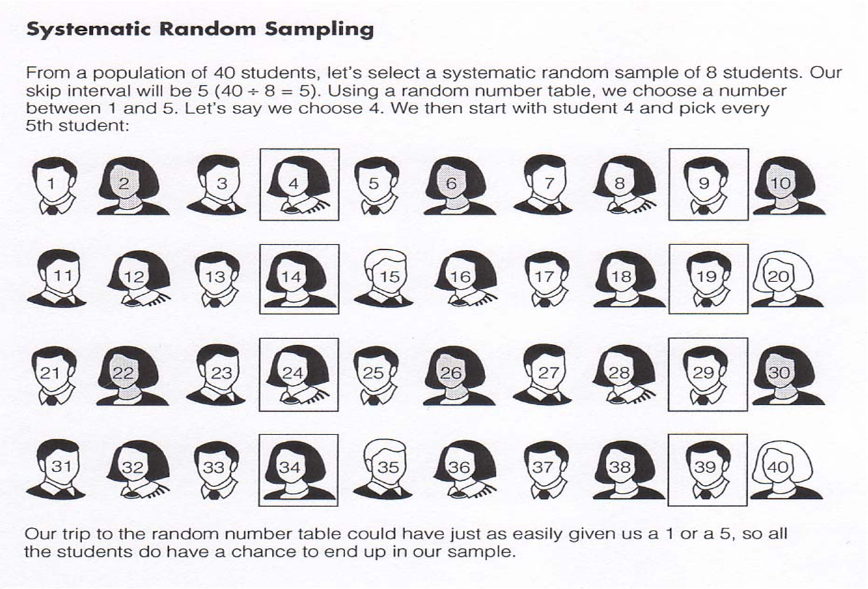
Systematic Random Sampling-Example

Slide 47
Cluster sampling
Cluster: a group of sampling units close to each other i.e. crowding together in the same area or neighborhood

Slide 48
Cluster sampling
Section 1
Section 2
Section 3
Section 5
Section 4

Slide 49

Population inferences can be made...

Slide 50
...by selecting a representative sample from the population

Slide 51
Stratified Random Sampling
Proportionate stratified sample – The size of the sample selected from each subgroup is proportional to the size of that subgroup in the entire population. (Self weighting)
Disproportionate stratified sample – The size of the sample selected from each subgroup is disproportional to the size of that subgroup in the population. (needs weights)

Slide 52
Stratified Random Sampling
Stratified random sample – A method of sampling obtained by (1) dividing the population into subgroups based on one or more variables central to our analysis and (2) then drawing a simple random sample from each of the subgroups

