Slide 1
Virtual COMSATS
Inferential Statistics
Lecture-5
Ossam Chohan
Assistant Professor
CIIT Abbottabad

Slide 2
Recap of last lecture
Sampling distribution
Sampling with or without replacement
Sampling distribution of mean, proportions
Sampling distribution of difference between means.
Biased and unbiased estimators.

Slide 3
Objective of this lecture
After completing this lecture, students will be to understand the concept of central limit theorem and its application in sampling distributions.
Sampling error and standard error.
Understanding normal table
Reading normal table.

Slide 4
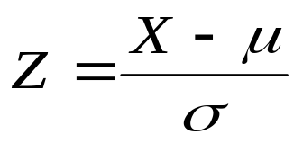
More problems in sampling distributions
Normal variable:
  By using normal distribution we can deduce random variable, and it can be designed by subtracting its mean and dividing it by its standard deviation, that is:

Slide 5



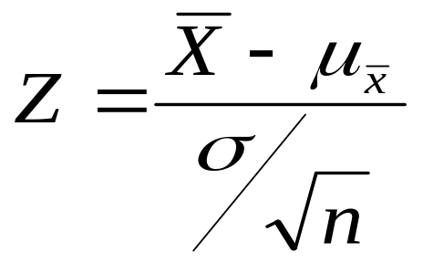
Using CLT
Now using Central limit theorem, for large samples size, sampling distribution of is therefore approximately normal with mean µx and δ = δ/√n.
Then is approximately normal(0,1)

Slide 6
Sampling Error and Standard Error

Slide 7
Problem-1
Given the population 1,1,1,3,4,5,6,6,6 and 7.
Find the probability that a random sample of size 36 selected with replacement will yield a sample mean between 3.26 and 4.74.

Slide 8
Problem-1 Solution

Slide 9
Problem-1 Solution

Slide 10
Problem-2
A random sample of size 25 is selected from a Poisson distribution with µ=3. Find, using CLT, the probability that the sample mean will be greater than 4.

Slide 12
Problem-3
Car batteries produced by company A have a mean life of 4.3 years with a standard deviation of 0.6 years. A similar battery produced by company B has a mean life of 4.0 years and standard deviation of 0.4 years. What is the probability that a random sample 49 batteries from company A will have a mean life of at least 0.5 years more than the mean life of a sample of 36 batteries from company B

Slide 13
Problem-3 Solution

Slide 14
Problem-3 Solution

Slide 15
Problem-4
Ten percent of the 1 kg boxes of sugar in a large warehouse are underweight. Suppose a retailer buys a random sample of 144 of these boxes. What is the probability that at least 5% of the sample boxes will be underweight?

Slide 16
Problem-4 Solution

Slide 17
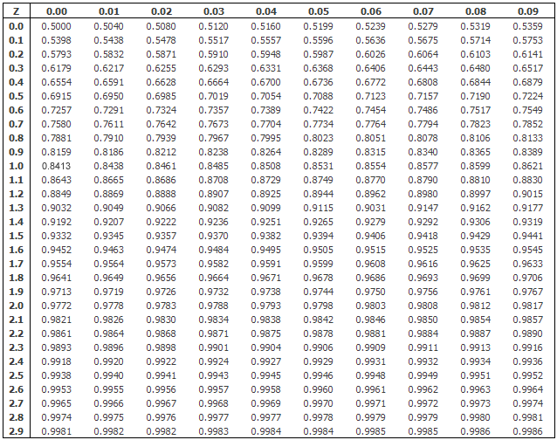
Normal distribution table

Slide 18
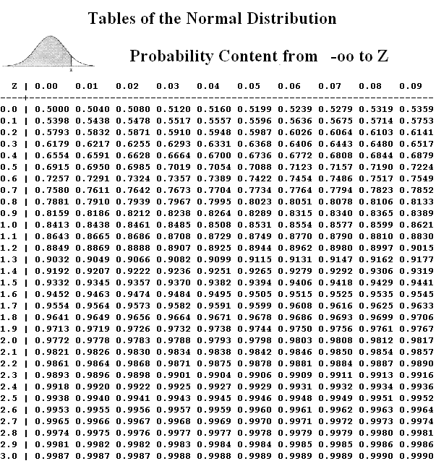

Slide 19
How to read the table??
For following z values, find the tabulated values:
P(z≥2.83)=0.0023
P(z≤1.87)=0.9693
P(z≥-2.10)=0.9821
P(z≤-0.97)=0.166

Slide 22
Home work (Normal table)
Find the following probabilities using normal table.
Pr(-1.28 ≤ z ≤ 1.28)
Pr(z ≤ 2.39 )
Pr(z ≥ -2.07)
Pr(z ≥ 3.23) ????

