Slide 1
Virtual COMSATS Inferential Statistics Lecture-6
Ossam Chohan
Assistant Professor
CIIT Abbottabad

Slide 2
Remaining portion of lecture-5

Slide 3
Problem-5
A recent study by the EPA has determined that the amount of contaminant in some lakes (in parts per million) is normally distributed with mean 64 ppm and variance 17.6. Suppose 35 lakes are randomly selected and sampled. What is the probability that the sample average amount of contaminants is:
Above 72 ppm
Between 64 and 72 ppm
Exactly 64 ppm
Above 94 ppm

Slide 4
Problem-5 Solution

Slide 5
Problem-5 Solution

Slide 6
Problem-5 Solution

Slide 7
Assessment Problem1
From a population of 75 items with a mean of 364 and variance of 18.32 items were randomly selected without replacement.
What is the standard error of the mean.
What is the P(363≤ ≤366)?

Slide 8
Choosing sample size
Sample contains important information and depends upon two factors.
Sampling plan or experimental design which comprises all the procedures used to collect information.
The sample size n, which shows the amount of data you need to address your problem.

Slide 9
Accuracy of estimation
Accuracy of estimation which depends upon two factors discussed above can be measured by:
Margin of Error
Width of confidence interval
Approximately 95%of the time in repeated sampling, the distance between the sample mean and the population mean will be less than 1.96SE. Why 1.96??

Slide 10
Margin or error
Margin of error mean that how much away the value is from true population mean. (will discuss in next lecture)
For 95%, value of z is 1.96. How?

Slide 11
Now, if you want this quantity to be less than 4, then
1.96 SE <4
1.96 [δ/√n] <4
n>[1.96/4] ² or n>0.24 δ²
* if δ is known, value of n can be calculated.
* If not known then estimated value can be used (most often)

Slide 12
Sampling distribution-revisited
Until now we have learned following concepts:
Introduction to Statistical Inference.
Population and Sample
Parameter and Statistic
Probability and non probability sampling
Central Limit Theorem
Sampling with and without replacement
Sampling error and Standard error

Slide 13
Sampling distribution Revisited
Sampling distribution of different statistics
Proving population results using sampling distribution
Application of central limit theorem
Problems solving using z.
Understanding normal table and reading different values using normal curve.

Slide 14
Assessment Problem-2
It has been found that 2% of the tools produced by a certain machine are defective. What is the probability that in a shipment of 400 such tools
3% or more and
2% of less will prove defective

Slide 15
Assessment Problem-3
Five hundred ball bearings have a mean weight of 5.02 grams (g) and a standard deviation of 0.30g. Find the probability that a random sample of 100 ball bearings chosen from this group will have combined wieght of
Between 496 and 500g
More that 510g
Don’t forget fpc

Slide 16
Recap of previous work
So far we have covered the following concepts:
Descriptive Statistics
Inferential Statistics (Introduction only)
Population and Sample
Sampling techniques
Probability and non-probability sampling
With or without replacement sampling
Sampling distribution of different statistics
Relation between statistics and parameter using sampling distribution
Central Limit Theorem
Understanding normal table
Calculating Z values
Number of problems for all of above where necessary.

Slide 17
Lecture-6

Slide 18
Objectives of this unit
In this series of lectures, students will understand the following concepts
Introduction to Statistical Inferences.
Estimation
Point Estimation
Interval Estimation
Confidence internal Estimation
Hypothesis Testing (might be)

Slide 19
The Problem
µ?
δ^{2=?}
^{P=?}
.
.
.
How to estimate these population parameters.?
Should we make simple guess, intelligent guess?
Is there any scientific way to estimate above parameters or any unknown characteristics of population?

Slide 20
Denotations
Population parameters are denoted using Greek letters μ (mean), σ (standard deviation), π (proportion)
Sample values are denoted x (mean), s (standard deviation), p (proportion)
Population
Sample
μ, σ, π
x, s, p
Estimates for parameters
Parameters

Slide 21
Statistical Inferences
Statistical Inferences can be defined as set of procedures based upon properly drawn samples to estimate population parameters using respective sample statistics.
Methods for making statistical inferences can be categorized in one of two categories.
Estimation
Hypothesis Testing

Slide 22
Definition
Estimation: Estimating (rough or intelligent?) the value of unknown population parameter.
Hypothesis Testing: Drawing conclusion about the pre-assumed value of population parameter by following well defined set of steps.
An estimator is rule to estimate the population parameter.

Slide 23
Some estimators
We use to estimate µ,
s² to estimate δ²,
to estimate P and so on…
In above cases sample statistics , s² and are estimators, whereas µ, δ² and P are population parameters.
This concept is not limited to only above parameters but there is always an estimator for respective population parameters.

Slide 24
Degree of confidence
Statistical inference tools allows or helps to estimate population parameters with known (self selected, if you like) degree of confidence.
This is state of the art approach and benefit of statistics to help decision makers so that they can have precise information about population with known degree of confidence.

Slide 25
Degree of confidence
For example an investor would be interested to know about the rate of returns with 95%confidence.
Researcher in pharmacy would be interested to know reaction time of certain medicine with 99% confidence.
A food chain would like to know their sales with confidence of 85%.

Slide 26
Why confidence?
As results are based upon small set of population or in other words we are based upon random samples, so uncertainty is inevitable but measureable.
For non-random samples, there is no known relationship between sample statistics and population parameters.
Therefore confidence value can be achieved for random samples

Slide 27
Good or bad estimator
There could be many estimators for single population parameter. For example there are many average techniques (sample mean, sample median, and etc) to estimate population mean µ.
Good estimators are closer to the true population parameters, closer, the better.

Slide 28
Bull’s eye shooting
Judging the accuracy of estimate without knowing the true value of population parameter(s) is same as Bull’s eye shooting.
That is, if you can’t see bull’s eye then how do you know the preciseness of your hit?

Slide 29
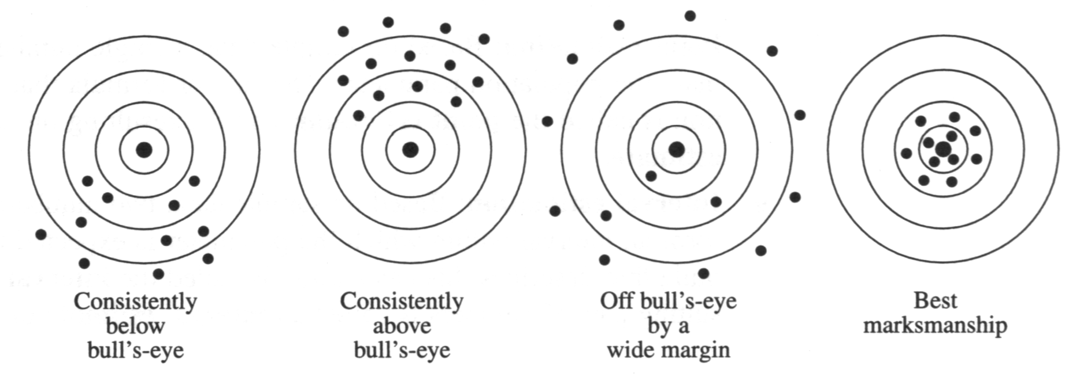
©1998 Brooks/Cole Publishing/ITP

Slide 30
Types of Estimators
Subjective Estimates:
Many estimates are subjective-based upon the experience (experts of certain field can suggest). For example a chemical engineer can suggest the average quantity of certain chemical in composition.
But in such situations, no degree of confidence can be achieved. Why?
Statistics provides estimates with precise reliability but experts can’t. No generalization?

Slide 31
Types of Estimates
Point Estimate: Based upon sample data, a single number is suggested (recommended) for population parameter.
For example, it can be inferred that population mean µ=20, if sample mean = 20.
Here 20 is point estimate whereas sample mean is an estimator.
Is this approach good enough?

Slide 32
Example-1
A random sample of n=6 has the elements 6, 10, 13.14, 18, 20. compute a point estimate of (i) the population mean, (ii) the population standard deviation, and (iii) the standard error of estimate mean.
= Σx_{i}/n
S = √[Σx_{i}²/n] – [Σx_{i}/n]2 Σx_{i}²=1225
Σx_{i} = 81
When sample size is less than 5%of the population size, the standard error of the mean is
δ = δ/√n we will use S instead of δ??

Slide 33
Example-1 cont…

Slide 34
Example-2
A Veterinarian doctor wants to estimate the average weight gain per month of 4 months old breeder chicken that have been placed on special diet. The population consists of the weight gain per month of all 4-month-old breeder chicken that are given this particular diet. Hence, it is hypothetical population where µ is the average monthly weight gain for all 4-month-old chicken on this diet. This is the unknown parameter that the doctor wants to estimate. Possible estimator based on sample data is the sample mean

Slide 35
Example-2 continued
= Σx_{i}/n
It is possible to measure in single number like 2.9 pounds.
Still our question is there, is it good estimate for whole population of such chickens??
For instance, what if we have values are in the form of interval?

