Slide 1
Data Persistence in SwiftUI
Data persistence is storing data so it remains available after the app is closed.
Different approaches depend on the data type and complexity.
Types of Storage:
UserDefaults: Small key-value storage, often for settings.
File Storage: Stores custom files like JSON or images.
Core Data: Ideal for larger, structured data.
CloudKit: For syncing data across devices (iCloud).

Slide 2
Saving Simple Data with UserDefaults
UserDefaults is best for small pieces of information, like user preferences.
Stored in a key-value format.
UserDefaults.standard.set("John", forKey: "username")
let username = UserDefaults.standard.string(forKey: "username") ?? "Unknown"
Note: Avoid using UserDefaults for large data or sensitive information.

Slide 3
File Storage for Custom Data (e.g., JSON)
For saving data to files (e.g., JSON), SwiftUI uses FileManager.
Works well for larger data or custom data structures.
struct Person: Codable {
let name: String
let age: Int
}
func saveToFile(person: Person) {
let fileManager = FileManager.default
let url = fileManager.urls(for: .documentDirectory, in: .userDomainMask)[0].appendingPathComponent("person.json")
do {
let data = try JSONEncoder().encode(person)
try data.write(to: url)
} catch {
print("Error saving to file: \(error)")
}
}
func loadFromFile() -> Person? {
let fileManager = FileManager.default
let url = fileManager.urls(for: .documentDirectory, in: .userDomainMask)[0].appendingPathComponent("person.json")
if let data = try? Data(contentsOf: url) {
return try? JSONDecoder().decode(Person.self, from: data)
}
return nil
}

Slide 4
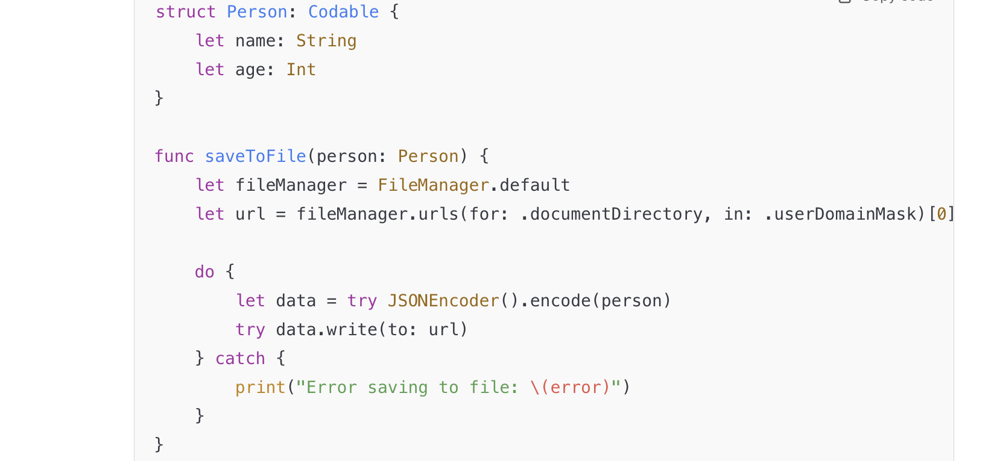
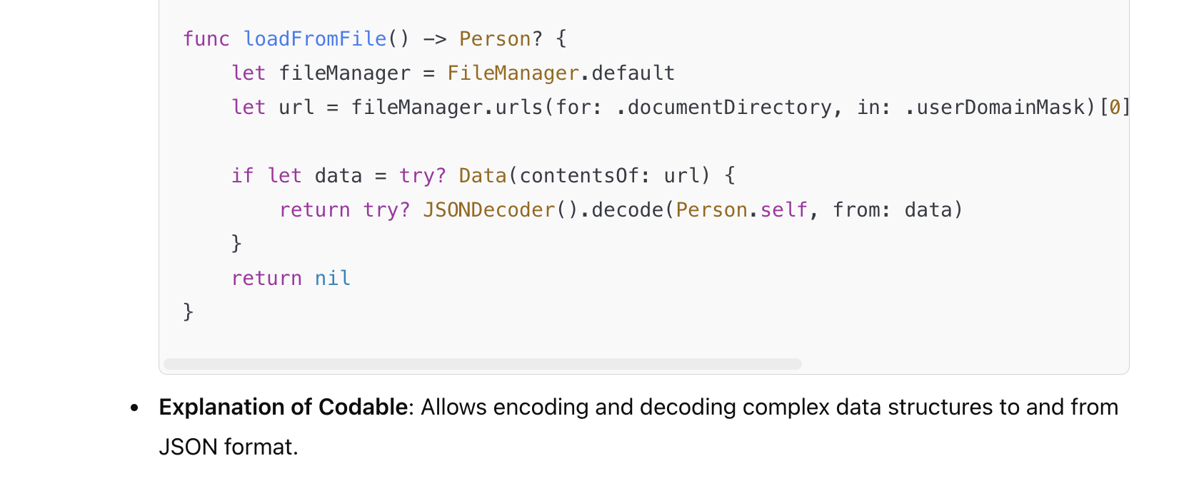

Slide 5
Core Data for Persistent, Structured Data
Core Data is suitable for apps needing complex data models or large datasets.
Integrates directly with SwiftUI via @Environment.
Setting Up Core Data:
In Xcode, enable Core Data in the app template.
Core Data uses NSManagedObjectContext, NSManagedObject, and NSPersistentContainer.
Basic Core Data Model:
Example entity: Task with attributes title (String) and completed (Bool).

Slide 6
CRUD Operations with Core Data
Basic CRUD operations:
Creating new records in Core Data.
Reading records using Fetch Requests.
Updating existing data in Core Data.
Deleting records.
Code examples for each operation: (next slide)

Slide 7
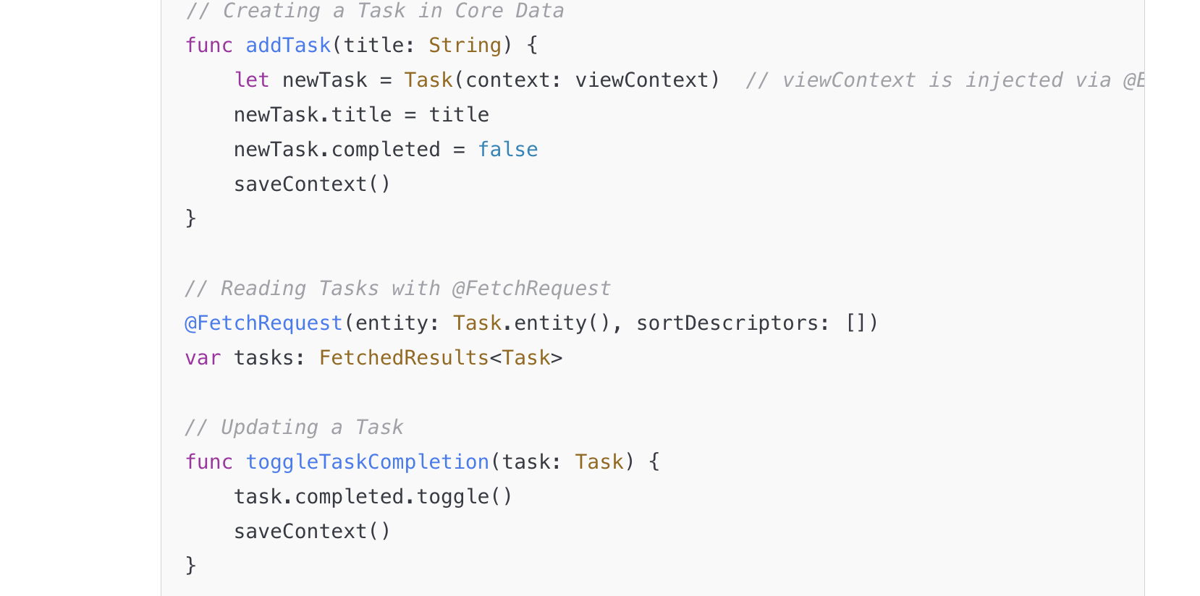
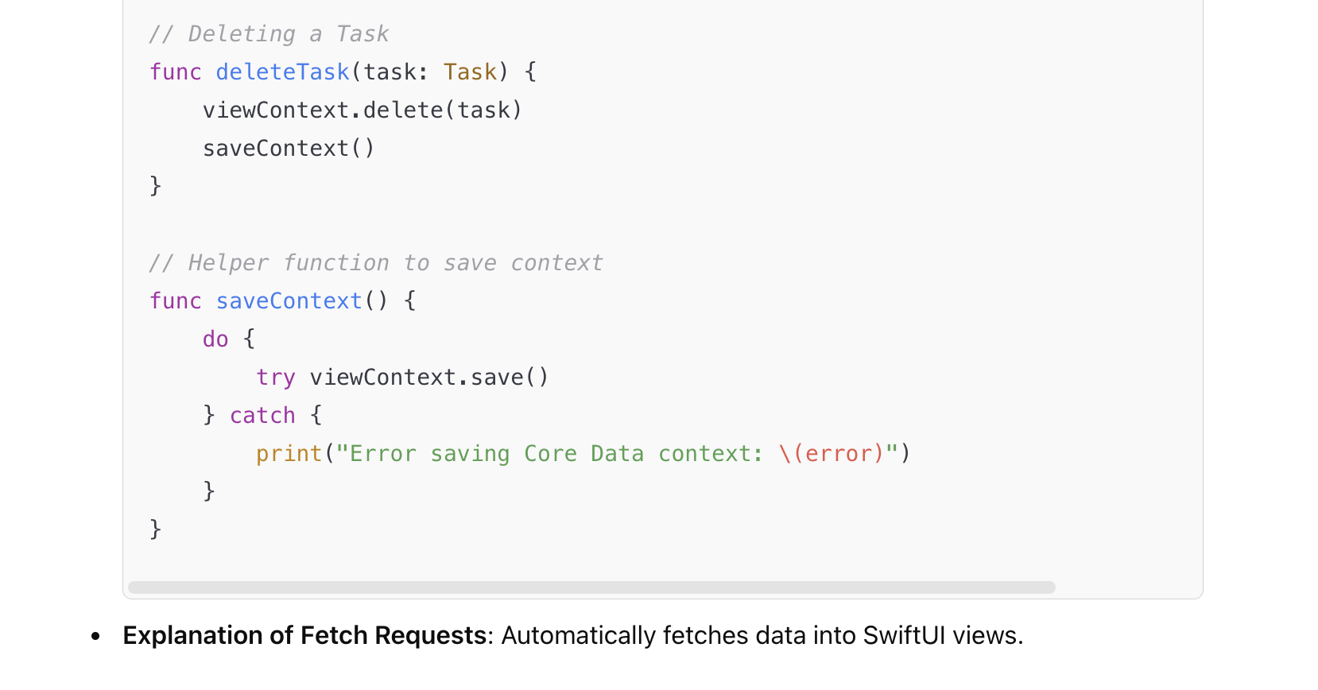

Slide 8
@AppStorage and @SceneStorage
@AppStorage provides persistent storage for lightweight data tied to a key.
@SceneStorage stores transient state specific to a scene or window.
- Code Example for @AppStorage:
struct ContentView: View {
@AppStorage("username") var username: String = "Guest"
var body: some View {
VStack {
Text("Hello, \(username)")
TextField("Enter your name", text: $username)
.textFieldStyle(RoundedBorderTextFieldStyle())
.padding()
}
}
}
- Code Example for @SceneStorage:
struct ContentView: View {
@SceneStorage("currentPage") var currentPage: Int = 0
var body: some View {
TabView(selection: $currentPage) {
Text("Page 1").tabItem { Text("Page 1") }.tag(0)
Text("Page 2").tabItem { Text("Page 2") }.tag(1)
}
}
}

Slide 9
Choosing the Right Storage Option
Comparison Table:
UserDefaults: Quick settings, user preferences.
File Storage: Custom data in files, larger storage needs.
Core Data: Complex relationships, structured data, persistence.
CloudKit: Syncing data across devices (requires iCloud setup).
Summary:
Select storage based on app needs.

Slide 10
Setting Up Core Data in SwiftUI
1. Create a Core Data-Enabled Project
When creating a new SwiftUI project in Xcode:
Check the "Use Core Data" box.
Xcode automatically sets up the Core Data stack with:
A PersistentContainer.
A pre-configured data model file (YourApp.xcdatamodeld).
2. Core Data Components
Managed Object Model
Defines entities, attributes, and relationships.
Persistent Container
Manages the Core Data stack.
NSManagedObject
Represents an entity in the data model.
FetchRequest
Retrieves data from the database.

Slide 11
Injected Core Data Environment in SwiftUI
In YourApp.swift, the Core Data persistentContainer is injected into the SwiftUI environment:
import SwiftUI
@main
struct YourApp: App {
let persistenceController = PersistenceController.shared
var body: some Scene {
WindowGroup {
ContentView()
.environment(\.managedObjectContext,persistenceController.container.viewContext)
}
}
}

Slide 12
Persistence Controller
This is a helper class to manage Core Data setup:
import CoreData
struct PersistenceController {
static let shared = PersistenceController()
let container: NSPersistentContainer
init(inMemory: Bool = false) {
container = NSPersistentContainer(name: "YourAppModel")
if inMemory {
container.persistentStoreDescriptions.first?.url = URL(fileURLWithPath: "/dev/null")
}
container.loadPersistentStores { _, error in
if let error = error as NSError? {
fatalError("Unresolved error \(error), \(error.userInfo)")
}
}
}
}

Slide 13
Fetching Data with @FetchRequest
Use @FetchRequest to retrieve data from Core Data.
import SwiftUI
struct ContentView: View {
@Environment(\.managedObjectContext) private var viewContext
@FetchRequest(
sortDescriptors: [NSSortDescriptor(keyPath: \Item.timestamp, ascending: true)],
animation: .default
) private var items: FetchedResults<Item>
var body: some View {
List {
ForEach(items) { item in
Text("Name: \(item.name ?? "Unknown")")
}
}
.toolbar {
ToolbarItem(placement: .navigationBarTrailing) {
Button(action: addItem) {
Label("Add Item", systemImage: "plus")
}
}
}
}

Slide 14
Continued from previous slide
private func addItem() {
withAnimation {
let newItem = Item(context: viewContext)
newItem.name = "New Item"
newItem.timestamp = Date()
do {
try viewContext.save()
} catch {
// Handle error
let nsError = error as NSError
fatalError("Unresolved error \(nsError), \(nsError.userInfo)")
}
}
}
}

Slide 15
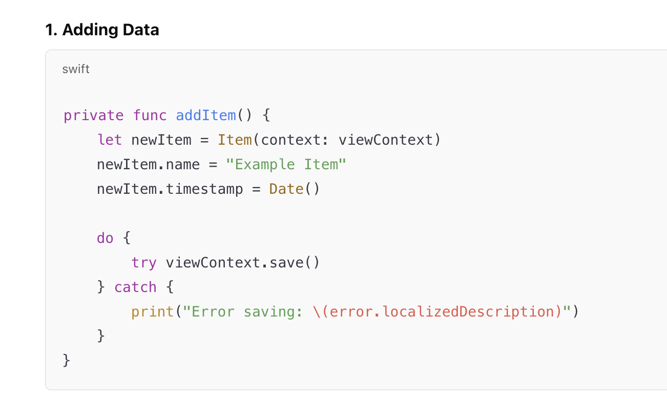

Slide 16
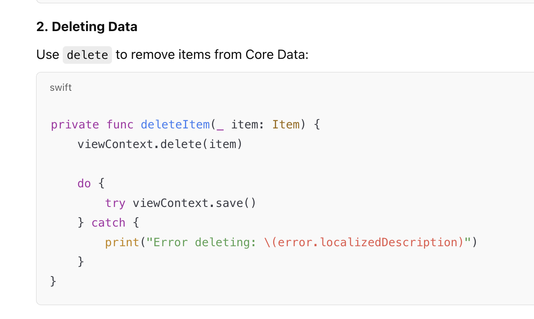

Slide 17
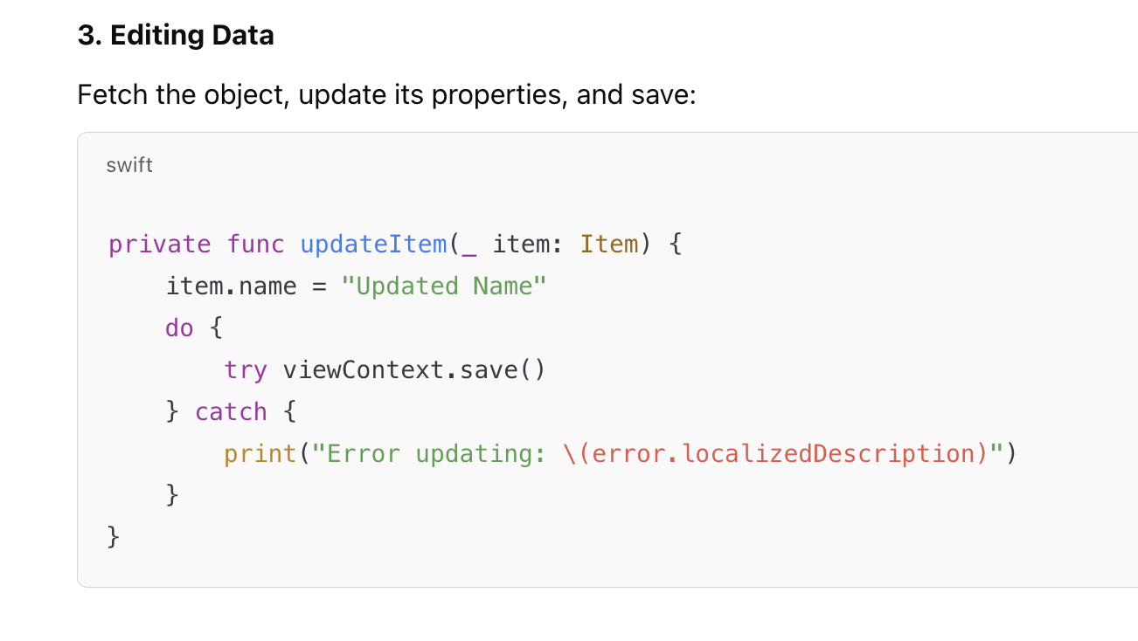

Slide 18
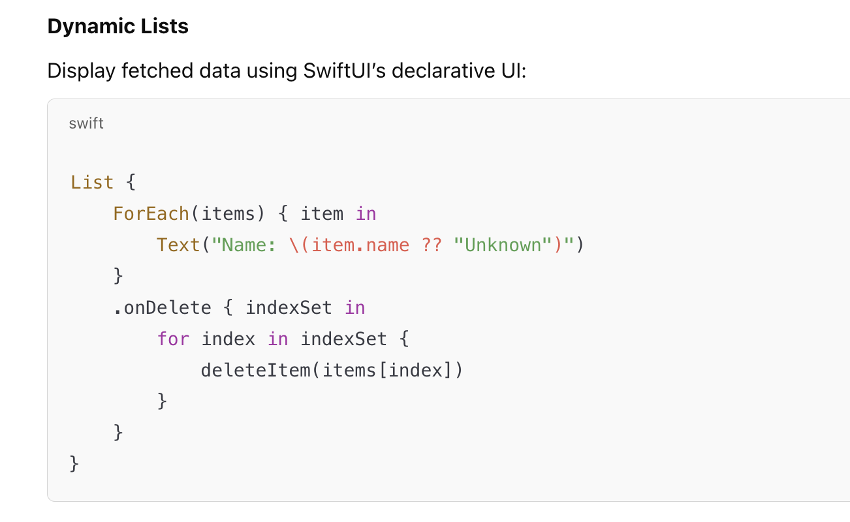
Displaying Core Data in SwiftUI

Slide 19
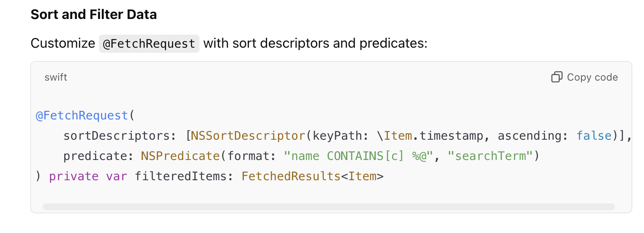
Sort and Filter Data

Slide 20
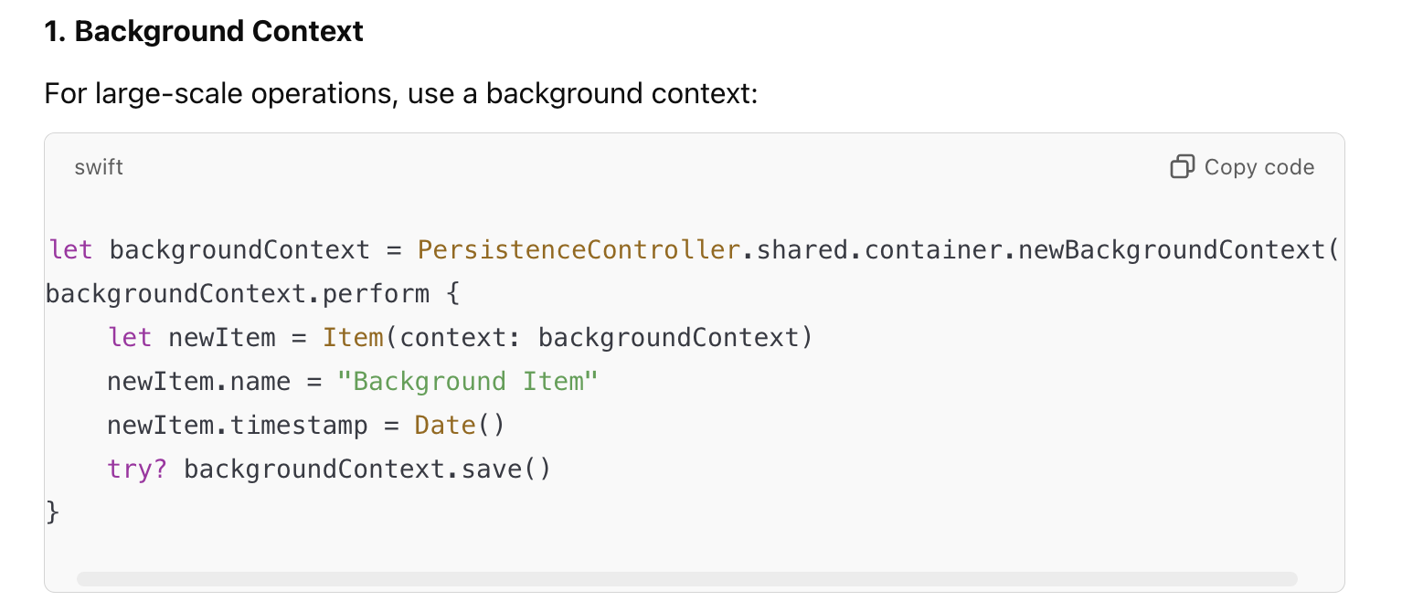
Advanced Core Data Usage

Slide 21
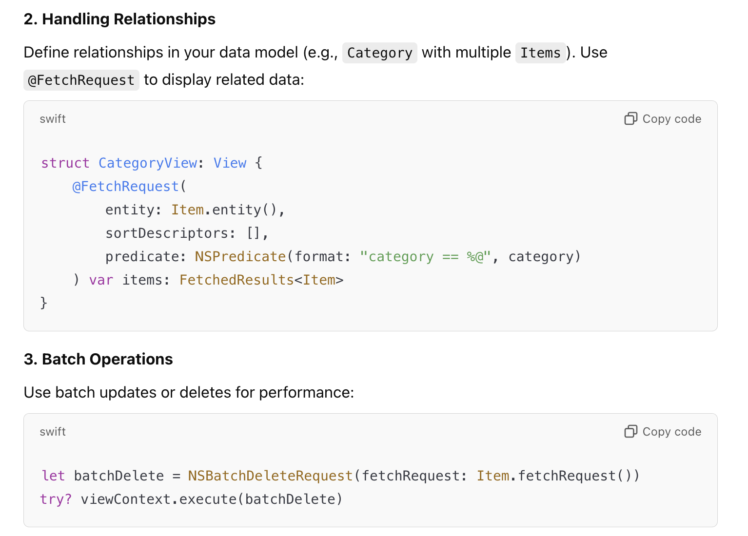

Slide 22
Best Practices
Environment-Driven Context:
Use .environment(\.managedObjectContext) to propagate Core Data’s viewContext.
Save Data Efficiently:
Avoid frequent saves to improve performance; batch updates when possible.
Error Handling:
Always handle errors gracefully to ensure data integrity.
Testing:
Use an in-memory Core Data store for testing:
PersistenceController(inMemory: true)

