Slide 1
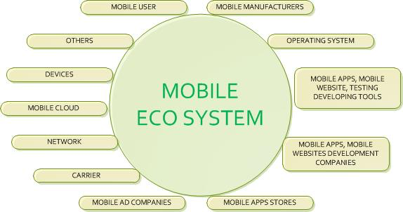

Slide 2
Mobile Application design and development
Developing applications Mobile devices is similar to developing applications for the desktop
Use of the same tools and development environments
But the task can often be daunting given the many technology choices and implementation approaches.
  Can be built in many different ways
  Can be used on many different devices,
  Can operate over many different networks,
  Can integrate with many different back-end systems.
different security models
    determines if an application can run on a device and what access to system resources it has.
    has an impact on how you can distribute and install your applications, especially if you want to target a broad range of different devices from different manufacturers of mobile operators.
Mobile Constraints
  have a smaller screen size that can display a limited number of characters
  have slower processor speeds
  use wireless networks that have a longer latency period than standard LANs
  have less available memory
  have shorter battery life
  display one screen at a time

Slide 3
Mobile Architecture Overview
Most mobile systems extend an existing business system or
Interface with an existing system.
There are typically three major components to a mobile architecture
  An existing system
    Database centric
    File based
  A middleware application
    a central point of communication for the devices
    provide data transformation
    apply business logic
    May be eliminated for new/rewritten systems and move these functionalities into the system itself
  A handheld application

Slide 4
Mobile Architecture Overview (continued)
  Data Transfer
    A significant part of mobile application architecture
    There are tradeoffs:
      Security
      Ease of Implementation
      Reliability
      Cost
    There are several choices for network communication:
      Web Services
      Queuing Services
      TCP Sockets
      HTTP
      FTP

Slide 5
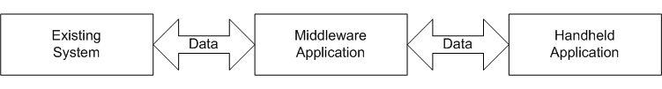
Mobile Application Architecture

Slide 6
Mobile Challenges
Without addressing specific challenges a mobile engagement will not be successful.
Challenges faced on most projects will include:
  Interfacing different Technologies
    applications developed in these different technologies must communicate seamlessly with each other.
    Web services, HTTP, and TCP sockets are used to bridge these gaps.
    Must have the skill and experience to determine the best data transfer design.
  Device Configuration
    Different manufacturers use proprietary methods for loading applications and configuration settings.
    Many Configuration options

Slide 7
Mobile Challenges ( Cont.)
  Software Deployment and Upgrades
    Proprietary packages must typically be written for the management applications that specify the software and configuration files to load
    Or the application should be self-updating.
    Having the users send in their devices to have software reloaded is usually unrealistic
  User Interface Design
    small screen and difficult data entry
    Complex screens will need to be divided into separate screens or tabbed interfaces
    A wizard-like interface may be more appropriate
  Performance
    Many mobile devices are very slow compared to Desktops
    Complex user interfaces, CPU intensive algorithms, and data processing can easily make an application user-hostile.
    Care must be taken during design to avoid performance pitfalls

Slide 8
Mobile Challenges ( Cont.)
  Memory Management
    Most mobile devices come with a set amount of memory and cannot be upgraded
    Efficient data storage is necessary, and low-level interfaces may be required to make the most of the memory available.
    Design must ensure that critical data is stored in non-volatile memory.
  Security
    What if the mobile device is lost?
    Access to sensitive business data must not be allowed.
    A user login should be implemented so that users must present a set of credentials before application use.

Slide 9
Common architectures that have been successfully used to implement a mobile solution
Fat ( Smart) client and mobile architectures
  Application and data reside locally on the mobile device.
  Data is periodically exchanged with the enterprise through a synchronization process.
Thin client mobile architectures
  Application and data reside on a Web server.
  The application is accessed over a wireless network using a Web browser running on the mobile device.

Slide 10
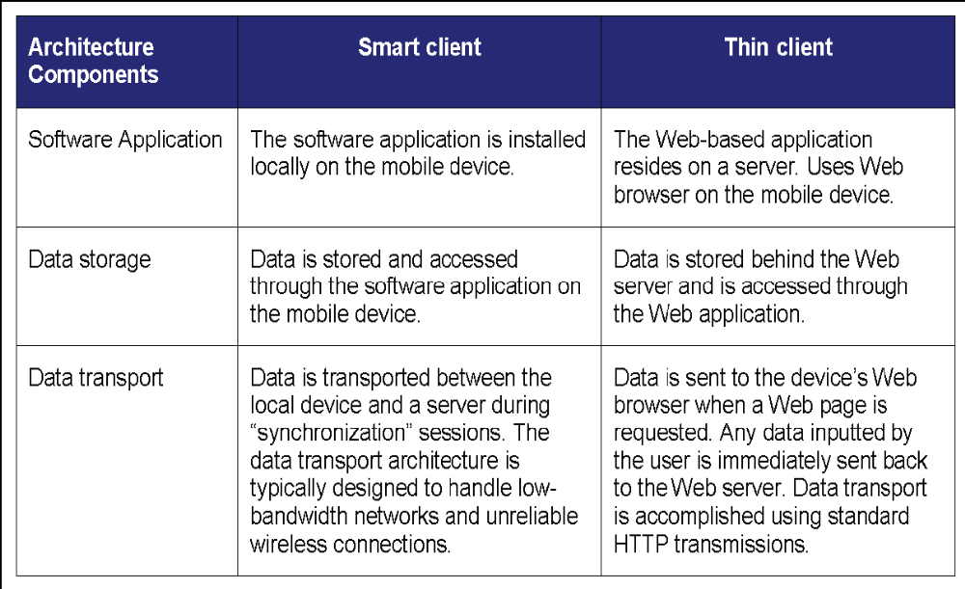
Copyright- iAnywhere Solutions, Inc.

Slide 11
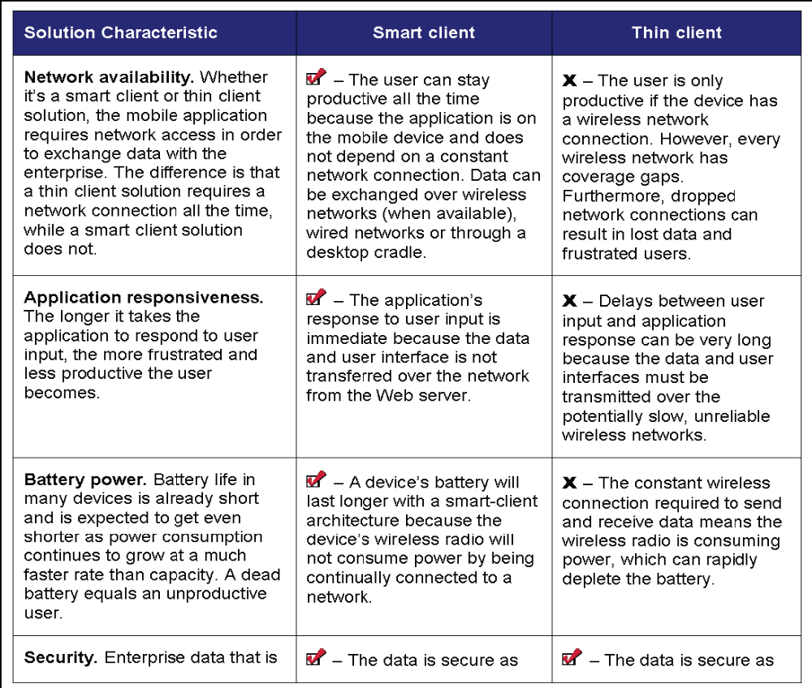
Copyright- iAnywhere Solutions, Inc.

Slide 12
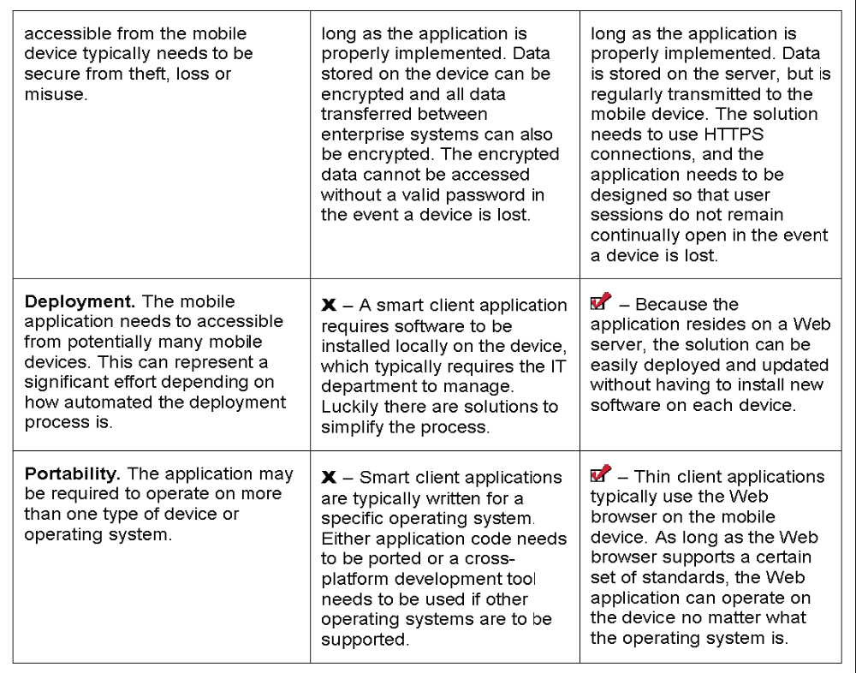
Copyright- iAnywhere Solutions, Inc.

Slide 13
Some common smart client architectures used to build mobile solutions:
  Database & synchronization
    Enterprise databases is extended out to remote databases
    Data that is created, modified or deleted in a remote database is synchronized back to the consolidated database.
    Any changes in the consolidated database is synchronized to some or all of the remote databases.
  Store-and-forward messaging
    Based on Enterprise Messaging
    Asynchronous in nature, using queues to transfer data
    Much more distributed model compared to a database-centric architecture
  Database & synchronization with store-and-forward messaging
  File-based replication for data exchange
    Use files to manage and exchange some or all of the data within a mobile solution
  Offline Web
    Offline Web applications combine the benefits of a thin client model and a smart client model, where the application runs locally on the device.
    With an offline Web solution the application is a set of Web-based content written using standard Web technologies, and additional components to access device peripherals and other on device utilities.
    The cross-platform nature of the Web technologies ensures that the application can be written once and deployed to a variety of mobile devices
  Offline Web with database & synchronization

Slide 14
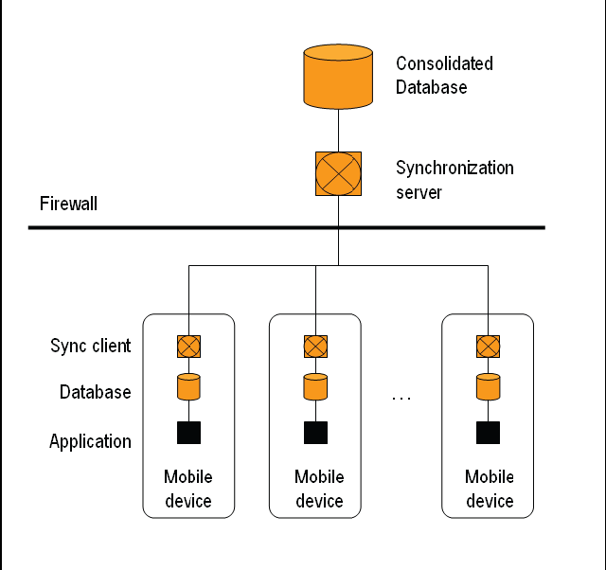

Slide 15
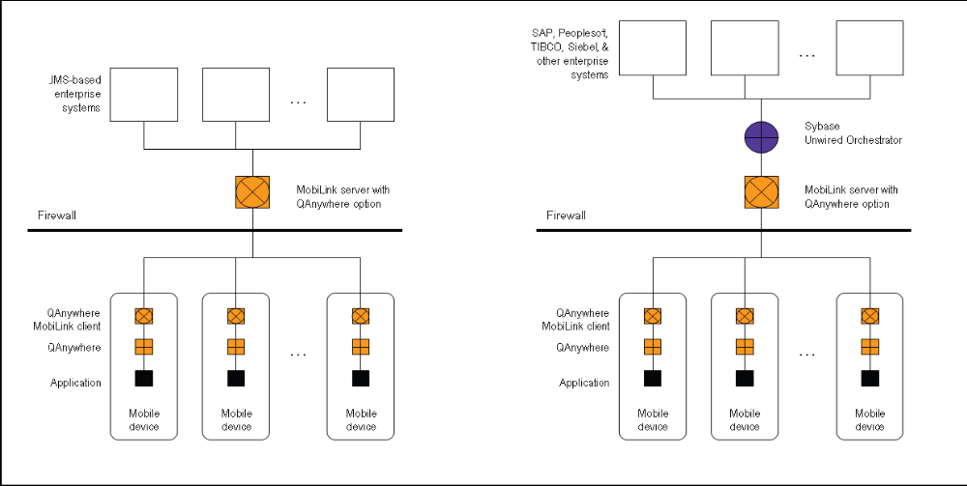

Slide 16
Creating an Architecture
Architecture is the system backbone;
It defines the system's strengths and limitations.
Should be created with future modification or development in mind.
Modifications can be very expensive and difficult, for systems that are built at ad hoc, with no design
The architecture should be created at the beginning of the project after defining the functional and non-functional (or quality) requirements of the system.
Good architecture results in applications capable of running in more than one device or configuration
Creating the architecture is typically an iterative process in which you first do a functional analysis, then a quality assessment, and finally modify the architecture iteratively until you meet all the quality requirements.
  Next slide illustrates the iterative process of creating a software architecture.

Slide 17
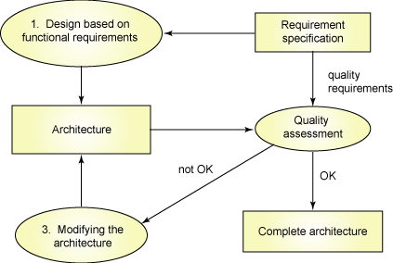
The process of creating a software architecture

Slide 18
Features of a pervasive architecture
Business logic and environments can change rapidly. For maximum flexibility, the business logic (or domain) must be kept separate from the UI logic and persistence management.
Maintenance is 70 percent of the total system cost. Design your architecture with future maintenance in mind; proper documentation is essential to proper maintenance, as well as the success of future development efforts.
It might not be pervasive now, but that can change. Be sure that new interfaces, devices, units, and so on, can be easily added over time. Using design patterns like Proxy, Facade, or Bridge can make your system more adaptable.
Secure the whole system, inside and out. When establishing your system's security requirements, consider both threats from the outside (how easy would it be for a hacker to gain control of your factory or CRM* system) and the inside. Some security threats aren't necessarily hostile; they could be the result of employees using the system incorrectly or without a permission. All components in the system, as well as all devices or units connected to the system, should be secured.
Design for scalability. While your application might start out on one physical server, it should not be tied to that server. Decentralization is a key component of scalability, so design your system with that in mind.
Focus on what's important. It's no secret that badly built or designed systems can be slow (even so slow that they're ultimately useless!), but speed comes at a cost of its own. Carefully consider the functions or use cases in which efficiency is vital to the success of your system.

Slide 19
Project scope and limitations
Before you begin to consider technology platforms and target devices, you must have a crystal-clear picture of the software you're developing. To begin, ask yourself these questions:
Who is your target audience? Is your application intended for consumer use, or will it be used more in business or corporate environments? Consumer devices are generally different from business devices, so knowing your target audience will help you narrow down your target device -- quickly. You won't get far developing a children’s game for the Pocket PC.
Are you developing a game or an application? If it's a game, consider the demographics of the people who will play it (age, gender, economic bracket, and so on). That will give you an idea of which consumer devices to target.
Are there any pre-existing requirements? If your distributor only handles iPhone applications, for example, then your choice is easy. Likewise if you're developing a business app for a company that already has Blackberry phones in place.
What's your skill-set? Assuming you're doing the coding, if you're a Java™ developer then you probably want to stick with the Java platform (unless you have a good reason for switching to some other technology).
How quickly do you need the application or prototype? Some technology solutions add complexity, and thus development time, to a project, whereas others limit both.
How much money do you have? Money is almost always the most important factor to consider.

Slide 20
The Eight Fallacies of Distributed Computing
Peter Deutsch
Essentially everyone, when they first build a distributed application, makes the following eight assumptions. All prove to be false in the long run and all cause big trouble and painful learning experiences.
1. The network is reliable
2. Latency is zero
3. Bandwidth is infinite
4. The network is secure
5. Topology doesn't change
6. There is one administrator
7. Transport cost is zero
8. The network is homogeneous
For more details, read the article by Arnon Rotem-Gal-Oz:
http://www.rgoarchitects.com/Files/fallacies.pdf

Slide 21
Mobile System Example
This system was developed for a large logistics company.
Truck drivers carry cellular phones running the mobile application.
The application informs the drivers of new jobs, allows entry of pickups and deliveries, and general messaging.
This architecture addresses these high-level requirements-
  The system must guarantee message delivery.
  The system must store messages if a mobile device is out of the cellular data network.
  The mobile application must still allow data entry when out of network.
  The system must accommodate over 3,000 users.
  The middleware was developed using Microsoft's .Net technology using a web service, and Windows service. The mobile application was developed in Java using J2ME (Java 2 Mobile Edition). IBM's MQ-Series technology is used for queuing between the middleware and business system.

Slide 22
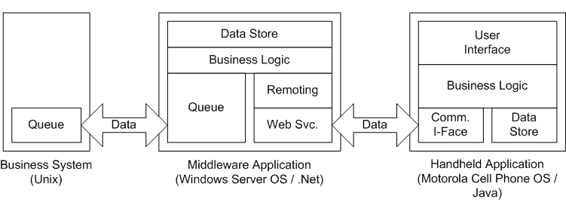
Copyright © 2007 Rus Shuler, Enterprise Architect

Slide 23
Mobile Application Servers (MAS)
Is a software program that runs in a server and provides the following functionality:
Logic to handle:
  business functions (e.g. how to handle information requests from sales personnel in the field)
  and its integration with backend database or business application systems ( such as mainframe financial accounting systems, manufacturing systems, inventory, ERP (Enterprise Resource Planning) and emerging CRM (Customer Resource Management) systems
Presentation services for the Mobile client device (handheld computers, notebook, PDA, etc)
  Takes raw data from database applications/queries and transforms the data on a specific thin client (or a thick client like a PC) considering its presentation space characteristics and limitations.
  This is also called GUI (Graphical User Interface) in some cases though some handheld are more like older text terminals than PC.
  It includes breaking the messages into smaller chunks, filtering redundant information, and even logically compressing the data , etc.
Transaction services, in some cases - including multi-threading for heavy volumes and persistency i.e. recovery across session failures
Application programming level interfaces (APIs) with specialized communications protocols

Slide 24
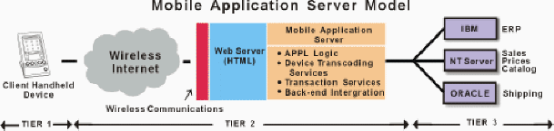

Slide 25
Mobile Application Server Categories
Generic application servers with a web-based SDK - e.g. Netscape, Microsoft, Sun, SilverStream, BEA - may have support for handheld devices and wireless networks strapped on (or bolted on) to the basic application server
Database vendors' Application Servers - e.g. Oracle 9i and Sybase's iAnywhere Application server
Data synchronization vendors - e.g. Puma, Synchrologic, Extended Systems
Specialized Mobile or Web Computing Application Servers - IBM's WebSphere

Slide 26
Mobile Application Server Categories (continued)
Mobile Specific Application Servers - e.g. Aligo, Air2Web, Contec Mobile Application Server (aimed at carriers), Aether System (aimed at enterprises)
  Aligo - A Java-based Mobile Application Server - utilities, healthcare, pharmaceutical, mobile workforce automation
WAP-centric Application servers - Nokia's WAP Server - not a true Application server, in IT sense
E-mail centric Application Servers - Microsoft's Mobile Information server, EdgeMail Application Server

Slide 27
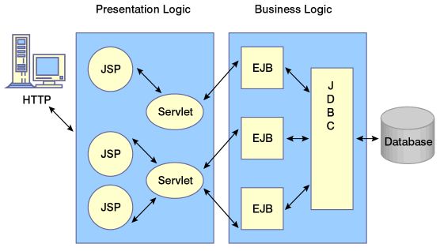
J2EE application structure

Slide 28
The JavaServer Pages (JSPs) and servlets layer is responsible for the generation of dynamic HTML pages.
In WAP applications (Wireless Application Protocol), this layer would generate dynamic Wireless Markup Language (WML) pages instead.
Thus, in order to alter a standard J2EE app for use with mobile devices:
  Write new JSPs and,
  In some cases, new servlets, or modify them to redirect to new JSPs
The Enterprise JavaBeans (EJBs) will be left untouched, since they are not concerned with presentation of data.

Slide 29
Wireless Markup Language (WML)
Web browsers display data encoded in HTML,
WAP-enabled devices display data encoded in Wireless Markup Language (WML);
Web developers can use JavaScript to embed scripting functionality into Web pages,
Device developers can use WMLScript to embed the same kind of functionality into WML pages.
WML is a subset of XML and will look familiar to anyone versed in HTML or other markup languages.
One unique feature of WML is the concept of a deck of cards;
A single HTML document displays as a single Web document,
A single WML document can contain multiple cards.
The WAP device screen will only display a single card at a time.

Slide 30
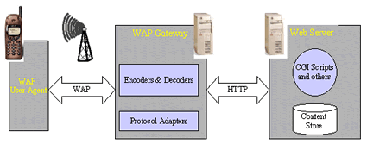
WAP/J2EE application structure

Slide 31
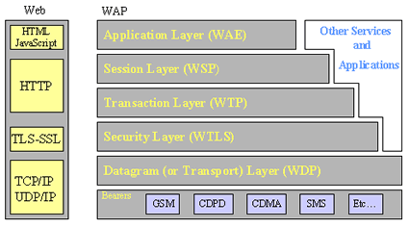
WAP Protocol Stack

Slide 32
WAP/J2EE application structure(continued)
WAP gateway. This component is responsible for conversions from the WAP stack to the Internet stack and vice versa.

Slide 33
APIs for mobile devices

Slide 34
  J2ME/JME
    Java Platform, Micro Edition
    Introduced by Sun in 2000
    Contains a highly optimized Java Runtime Environment
    Addresses the vast consumer space. It covers a wide range of extremely tiny commodities, and enable security, connectivity, and useful utility programs and applications running on mobile and other embedded devices— mobile phones, personal digital assistants (PDAs), smart cards, pagers , TV set-top boxes, printers, and other small appliances.
  JAVA/FX
    By Sun Microsystems, first announced at JavaOne Worldwide Java Developer conference on May 2007.
    Software platform for creating and delivering rich Internet applications (RIA) that can run across a wide variety of connected devices
    Fully integrated with the Java Runtime Environment (JRE) – JavaFX applications will run on any desktop and browser that runs the JRE and on top of mobile phones running Java ME.
    To build JavaFX apps developers use a statically typed, declarative language called JavaFX Script.

Slide 35
  .NET CF (.NET Compact Framework )
    Is a version of the .NET Framework that is designed to run on Windows CE based mobile/embedded devices such as PDAs, mobile phones, factory controllers, set-top boxes, etc
    The .NET Compact Framework uses some of the same class libraries as the full .NET Framework and also a few libraries designed specifically for mobile devices
    First release: Late 2002
  Objective-C
    object-oriented programming language, which adds Smalltalk-style messaging to the C programming language
    Used primarily on Apple's Mac OS X and iPhone OS
    Used by Xcode which is a suite of tools for developing software on Mac OS X and iPhone.

Slide 36
  Symbian/C++ (S60platform)
    Symbian is an operating system (OS) designed for mobile devices and smartphones, with associated libraries, user interface, frameworks and reference implementations of common tools,
    developed by Symbian Ltd.
    It was a descendant of Psion's EPOC and runs exclusively on ARM processors, although an unreleased x86 port existed.
    In 2008 a new, independent non-profit organization called the Symbian Foundation was established and the former Symbian Software Limited was acquired by Nokia.
    Symbian OS and its associated user interfaces S60, UIQ and MOAP(S) were contributed by their owners to the foundation with the objective of creating the Symbian platform as royalty-free, open source software.
    The process of publishing the source code under the Eclipse Public License (EPL) is to be completed in 2010.
    The journey started in 1980 when Psion was founded to develop the EPOC OS.
    Symbian is the leading OS in the "smart mobile device" market.

Slide 37
Bada
  It is an operating system for mobile devices such as smartphones and tablet computers developed by Samsung Electronics
  As Samsung defines it, is not an operating system itself, but a platform with a kernel configurable architecture, which allows using either a proprietary real-time operating system hybrid (RTOS) kernel and Linux kernel.
  The first Bada-based phone was the Samsung Wave S8500, released in April 2010.
  The alpha-version of Bada 2.0 was introduced on February 15, 2011, with the Samsung S8530 Wave II handset.
  The current flagship Bada handset is the Samsung Wave 3 s8600, running Bada
  According to Canalys, Samsung shipped 3.5 million phones running Bada in Q1 of 2011.^{[24]} This rose to 4.5 million phones in Q2 of 2011.^{[25]}
  According to Gartner in Q1 2012 bada gain a grow index of +43% and rose from 1.9% share of the market in the same period last year to 2.7%

Slide 38
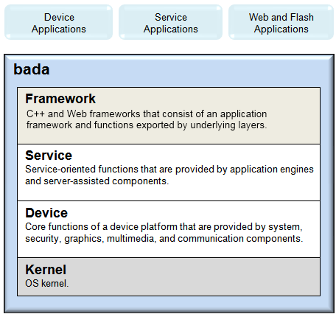
Bada Architecture

Slide 39
Android
  Java is the official language of the system,
  it’s the second most active language on GitHub, and it’s been around for more than 20 years.
  All of this means that tutorials are abundant and you won’t have to worry about the language dying out anytime soon.
  Kotlin is a language that was designed to run on JVM.
  Kotlin apps are compiled to Java bytecode, allowing Kotlin apps to run on any machine that supports JVM — and since most machines can, Kotlin is a relatively easy way to create cross-platform software
  Android Software Development Kit (SDK) and Android Studio/Eclipse
  Android Runtime (ART) is an application runtime environment used by the Android OS
  ART replaces Dalvik, the process virtual machine originally used by Android,
  ART performs the translation of application's bytecode into native instructions that are later executed by the device's runtime environment.^{[1]}
  The most significant change from Dalvik to ART is that Dalvik is based on Just-in-Time (JIT) compilation, while ART is based on Ahead-of-Time (AOT) compilation.

Slide 41
  BREW
    Binary Runtime Environment for Wireless
    Introduced in January of 2001 as an application development platform and was originally used for wireless phones.
    Qualcomm was the company to set up this standard
    It was used for CDMA cellular phones, today it can be used for GSM, GPRS and UMTS.
    BREW allows consumers to download and use applications on their mobile phones. These applications can include chat programs, email, location positioning, games, etc...
  PalmOS
    A mobile operating system initially developed by Palm, Inc. for personal digital assistants (PDAs) in 1996.
    Palm OS is designed for ease of use with a touchscreen-based graphical user interface.
    It is provided with a suite of basic applications for personal information management.
    Later versions of the OS have been extended to support smartphones.
    Several other licensees have manufactured devices powered by Palm OS.

Slide 42
  WebOS
    Following Palm's purchase of the Palm trademark, the currently licensed version from ACCESS was renamed Garnet OS.
    In 2007, ACCESS introduced the successor to Garnet OS, called Access Linux Platform (ALP)
    in 2009, the main licensee of Palm OS, Palm, Inc., switched to from Palm OS to webOS for their forthcoming devices.
    webOS's graphical user interface is designed for use on devices with touchscreens.
    It includes a suite of applications for personal information management and makes use of a number of web technologies such as HTML 5, JavaScript, and CSS.
    Palm claims that the design around these existing technologies was intended to spare developers from learning a new programming language.
    The Palm Pre, released on June 6, 2009, is the first device to run this platform.

Slide 43
Flash Lite
  a lightweight version of Adobe Flash Player, a software application published by Adobe Systems.
  This version is intended for mobile phones and other portable electronic devices
  Allows users of these devices to view multimedia content and applications developed using Adobe's Flash tools, which had previously been available only on personal computers.
  “Recent changes to ActionScript allow Flash Lite to better integrate with and even compete with device-layer technologies like Java ME and BREW “
  It is not an OS. it is a technology for developing applications that run on a mobile operating system.

Slide 44
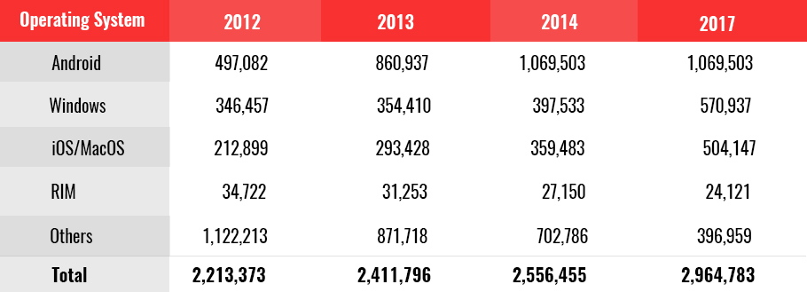
Market Share

Slide 45
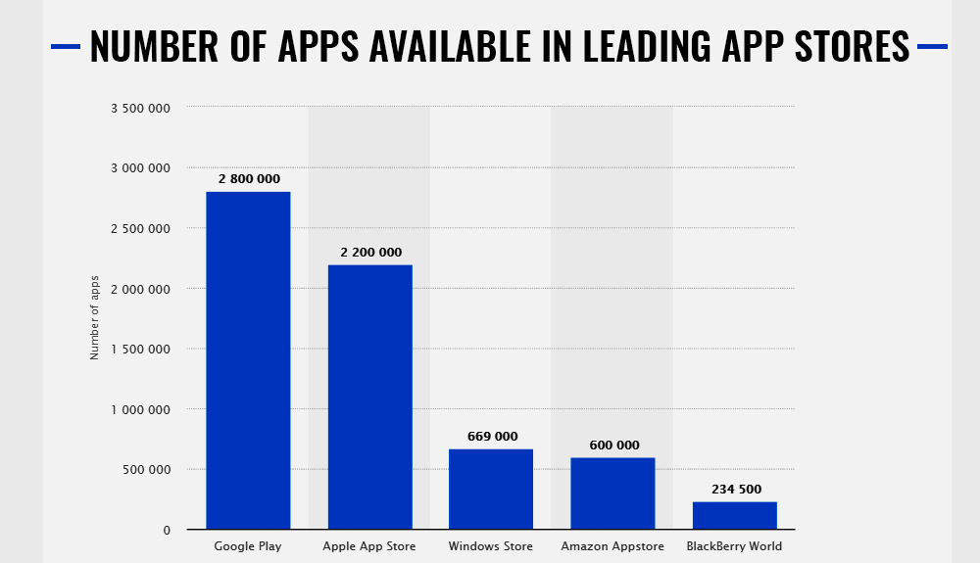

Slide 46
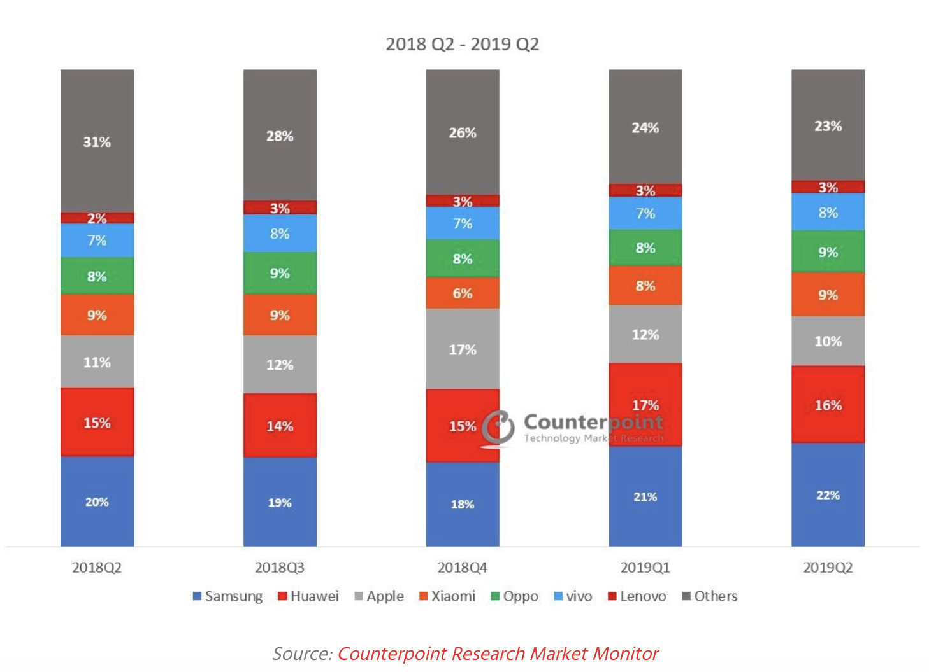

Slide 47
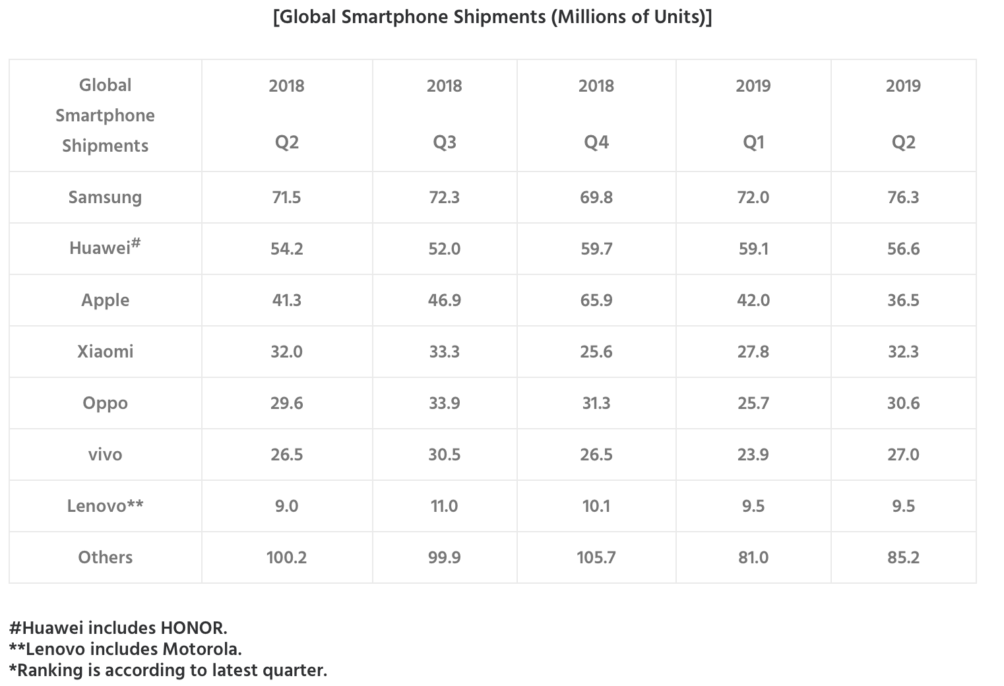

Slide 48
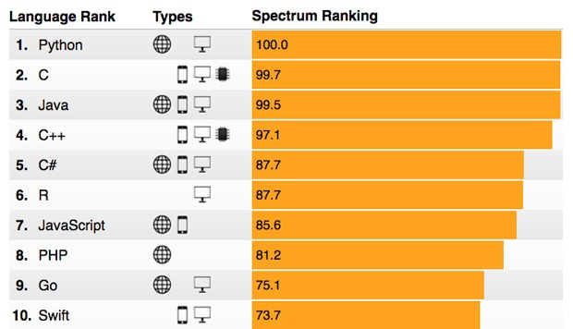
Programming Languages Popularity for 2019-
(IEEE spectrum )

Slide 49
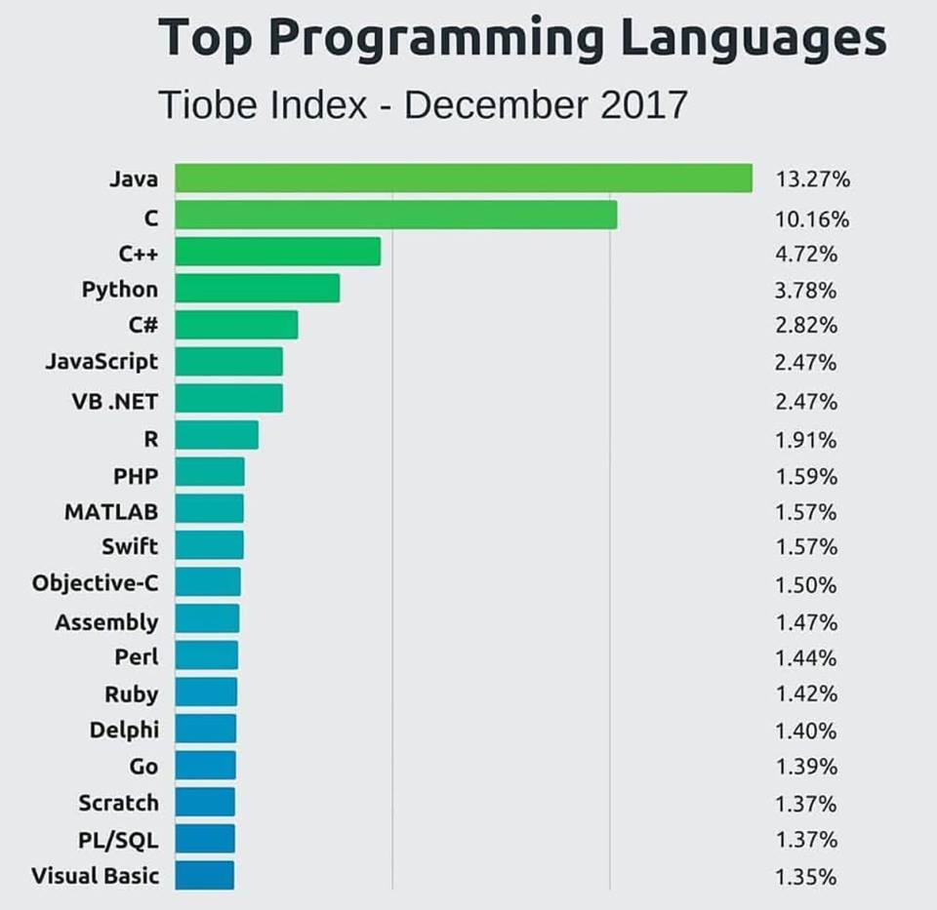
10 Most Demanding Programming Language In Future

