Slide 1
Interaction of material poles and optical poles in different systems

Slide 2
Theory

Slide 3
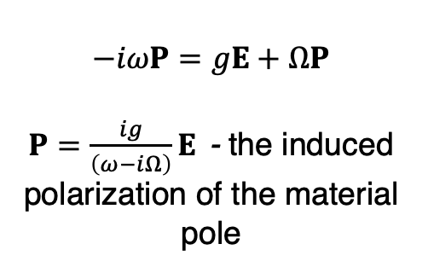
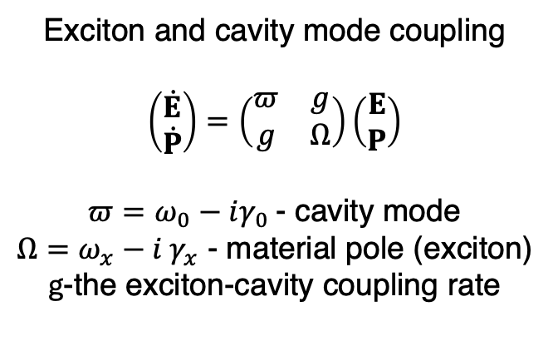
Coupled Damped Oscillator Model
Exciton and cavity mode coupling
$$\left(\begin{aligned}\dot{E} \\ \dot{P}\end{aligned}\right)=\left(\begin{matrix}π & g \\ g & Ω\end{matrix}\right)\left(\begin{aligned}E \\ P\end{aligned}\right)$$
$π=ω_{0}−iγ_{0}$ - cavity mode
$Ω=ω_{x}−i γ_{x}$ - material pole (exciton)
g-the exciton-cavity coupling rate
$$−iωP=gE+ΩP$$
$P=\frac{ig}{\left(ω−iΩ\right)}E$ - the induced polarization of the material pole
C. Carlson et al.,
Phys. Rev. B 104, 125424 (2021)

Slide 4
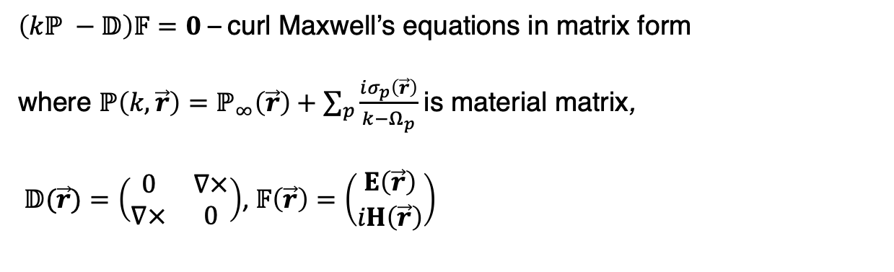
RSE vs material poles
Fabry-perot cavity
$\left(kℙ −𝔻\right)𝔽=0$ – curl Maxwell’s equations in matrix form
where $ℙ\left(k,\vec{r}\right)=ℙ_{∞}\left(\vec{r}\right)+\sum_{p}{\frac{iσ_{p}\left(\vec{r}\right)}{k−Ω_{p}}}$ is material matrix,
$𝔻(\vec{r})=\left(\begin{matrix}0 & ∇× \\ ∇× & 0\end{matrix}\right)$, $𝔽\left(\vec{r}\right)=\left(\begin{aligned}E\left(\vec{r}\right) \\ iH\left(\vec{r}\right)\end{aligned}\right)$
Core-shell particle
E. A. Muljarov and T. Weiss, Optics Letters, 43, 9, 1978-1981 (2018)
E. A. Muljarov and W. Langbein, Phys. Rev. B 93, 075417 (2016)
Notes:
We specialize in exploring various optical systems such as core-shell particles and Fabry-Pérot cavities. To understand their optical properties, we begin by calculating parameters like reflection or absorption coefficients (for Fabry-Pérot cavities) or scattering and absorption coefficients as a function of parameters such as frequency. As a second step, we perform Eigenmode Analysis to interpret the results more comprehensively and gain deeper insights into the system's behavior

Slide 5
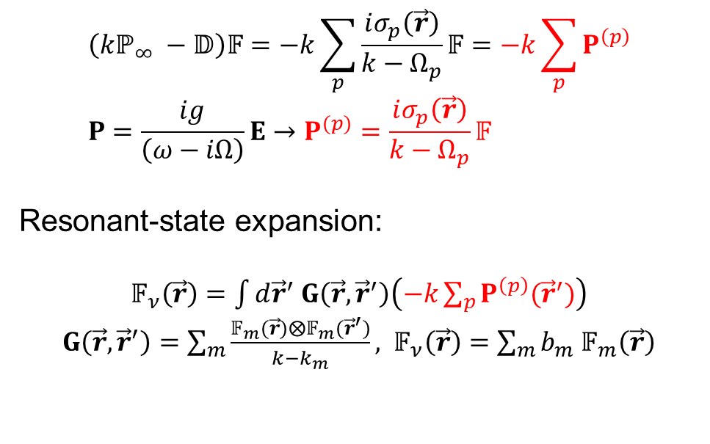
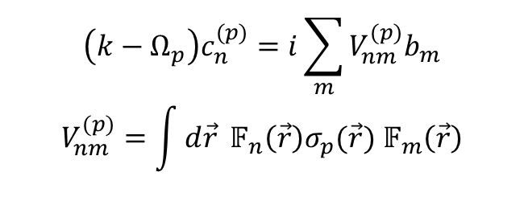
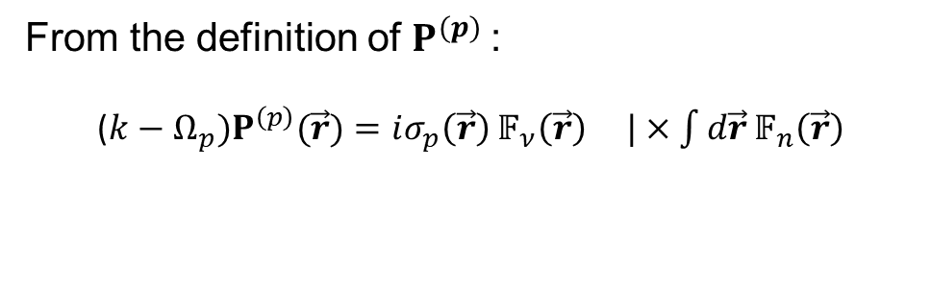
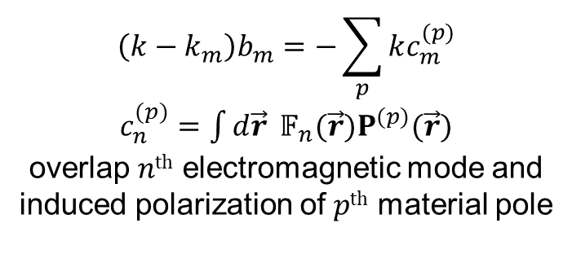
RSE vs material poles – system of equations
1st equation:
$$\left(kℙ_{∞} −𝔻\right)𝔽=−k\sum_{p}{\frac{iσ_{p}\left(\vec{r}\right)}{k−Ω_{p}}}𝔽=−k\sum_{p}{P^{\left(p\right)}} \\ P=\frac{ig}{\left(ω−iΩ\right)}E→P^{(p)}=\frac{iσ_{p}\left(\vec{r}\right)}{k−Ω_{p}}𝔽$$
Resonant-state expansion:
$𝔽_{ν}\left(\vec{r}\right)=\int{d{\vec{r}}^{′}}$ $G\left(\vec{r},{\vec{r}}^{′}\right)\left(−k\sum_{p}{P^{\left(p\right)}({\vec{r}}^{′})}\right)$
$G\left(\vec{r},{\vec{r}}^{′}\right)=\sum_{m}{\frac{𝔽_{m}(\vec{r})⨂𝔽_{m}({\vec{r}}^{′})}{k−k_{m}}},$ $𝔽_{ν}\left(\vec{r}\right)=\sum_{m}{b_{m}}$ $𝔽_{m}\left(\vec{r}\right)$
$$\left(k−k_{m}\right)b_{m}=−\sum_{p}{kc_{m}^{(p)}}$$
$c_{n}^{(p)}=\int{d\vec{r}} 𝔽_{n}(\vec{r})P^{(p)}(\vec{r})$ overlap $nth$ electromagnetic mode and induced polarization of $pth$ material pole
2nd equation:
From the definition of $P^{(p)}$:
($k−Ω_{p})P^{\left(p\right)}(\vec{r})=iσ_{p}\left(\vec{r}\right)$ $𝔽_{ν}\left(\vec{r}\right) |×\int{d\vec{r}}𝔽_{n}\left(\vec{r}\right)$
$$\left(k−Ω_{p}\right)c_{n}^{(p)}=i\sum_{m}{V_{nm}^{(p)}b_{m}}$$
$$V_{nm}^{(p)}=\int{d\vec{r}} 𝔽_{n}\left(\vec{r}\right)σ_{p}(\vec{r}) 𝔽_{m}\left(\vec{r}\right)$$
Notes:
We specialize in exploring various optical systems such as core-shell particles and Fabry-Pérot cavities. To understand their optical properties, we begin by calculating parameters like reflection or absorption coefficients (for Fabry-Pérot cavities) or scattering and absorption coefficients as a function of parameters such as frequency. As a second step, we perform Eigenmode Analysis to interpret the results more comprehensively and gain deeper insights into the system's behavior

Slide 6
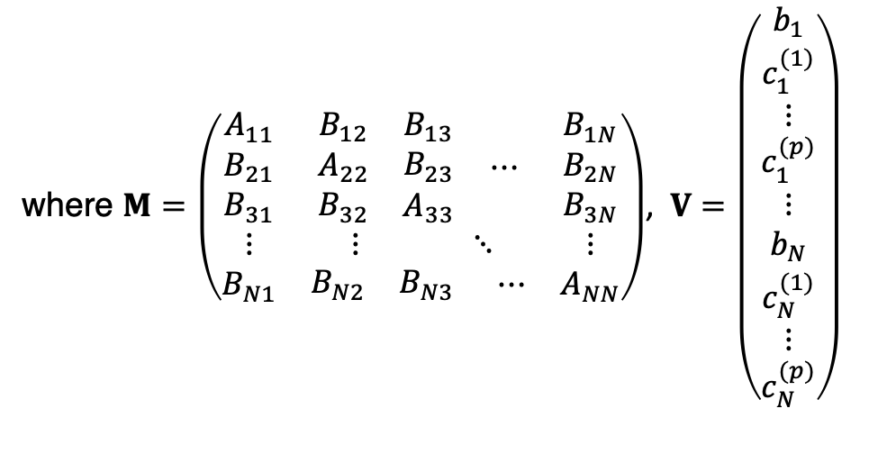

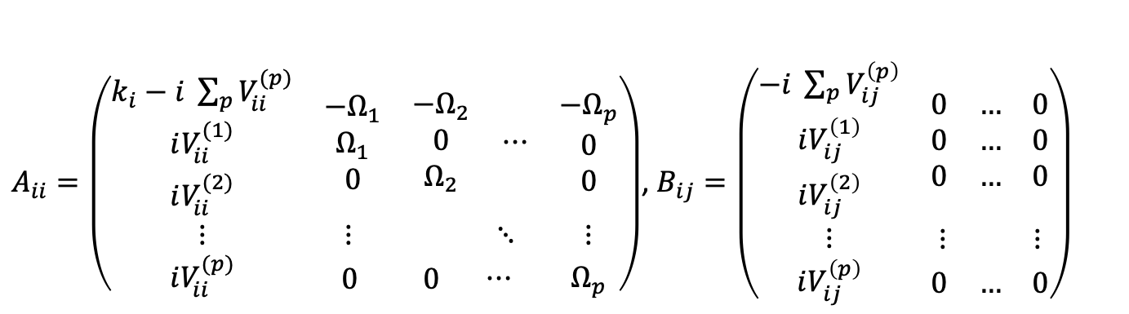

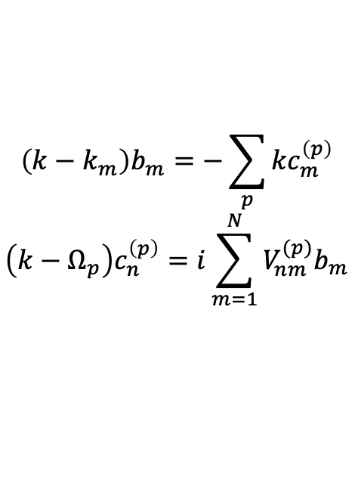
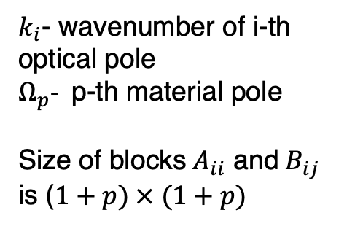
System of equations $→$ Matrix equation
where $M=\left(\begin{matrix}\begin{aligned}A_{11} \\ B_{21} \\ B_{31}\end{aligned} & \begin{matrix}\begin{aligned}B_{12} \\ A_{22} \\ B_{32}\end{aligned} & \begin{aligned}B_{13} \\ B_{23} \\ A_{33}\end{aligned}\end{matrix} ⋯ & \begin{aligned}B_{1N} \\ B_{2N} \\ B_{3N}\end{aligned} \\ ⋮ & ⋮ ⋱ & ⋮ \\ B_{N1} & \begin{matrix}B_{N2} & B_{N3}\end{matrix} ⋯ & A_{NN}\end{matrix}\right)$, $V=\left(\begin{aligned}b_{1} \\ c_{1}^{(1)} \\ ⋮ \\ c_{1}^{(p)} \\ ⋮ \\ b_{N} \\ c_{N}^{(1)} \\ ⋮ \\ c_{N}^{(p)}\end{aligned}\right)$
$$\left(k−k_{m}\right)b_{m}=−\sum_{p}{kc_{m}^{\left(p\right)}}$$
$$\left(k−Ω_{p}\right)c_{n}^{\left(p\right)}=i\sum_{m=1}^{N}{V_{nm}^{(p)}b_{m}}$$
Linear eigenvalue problem
$$kV=M V$$
$V_{nm}^{(p)}=\int{d\vec{r}} 𝔽_{n}\left(\vec{r}\right)σ_{p}(\vec{r})$ $𝔽_{m}\left(\vec{r}\right)$
$A_{ii}=\left(\begin{matrix}\begin{aligned}k_{i}−i \sum_{p}{V_{ii}^{(p)}} \\ iV_{ii}^{(1)} \\ iV_{ii}^{(2)}\end{aligned} & \begin{matrix}\begin{aligned}−Ω_{1} \\ Ω_{1} \\ 0\end{aligned} & \begin{aligned}−Ω_{2} \\ 0 \\ Ω_{2}\end{aligned}\end{matrix} ⋯ & \begin{aligned}−Ω_{p} \\ 0 \\ 0\end{aligned} \\ ⋮ & ⋮ ⋱ & ⋮ \\ iV_{ii}^{(p)} & \begin{matrix}0 & 0\end{matrix} ⋯ & Ω_{p}\end{matrix}\right)$, $B_{ij}=\left(\begin{matrix}\begin{aligned}−i \sum_{p}{V_{ij}^{\left(p\right)}} \\ iV_{ij}^{\left(1\right)} \\ iV_{ij}^{\left(2\right)}\end{aligned} & \begin{aligned}\begin{matrix}0 & … & 0\end{matrix} \\ \begin{matrix}0 & … & 0\end{matrix} \\ \begin{matrix}0 & … & 0\end{matrix}\end{aligned} \\ ⋮ & \begin{matrix}⋮ & ⋮\end{matrix} \\ iV_{ij}^{\left(p\right)} & \begin{matrix}0 & … & 0\end{matrix}\end{matrix}\right)$
$k_{i}$- wavenumber of i-th optical pole
$Ω_{p}$- p-th material pole
Size of blocks${ A}_{ii}$ and $B_{ij}$ is ($1+p) × (1+p)$

Slide 7
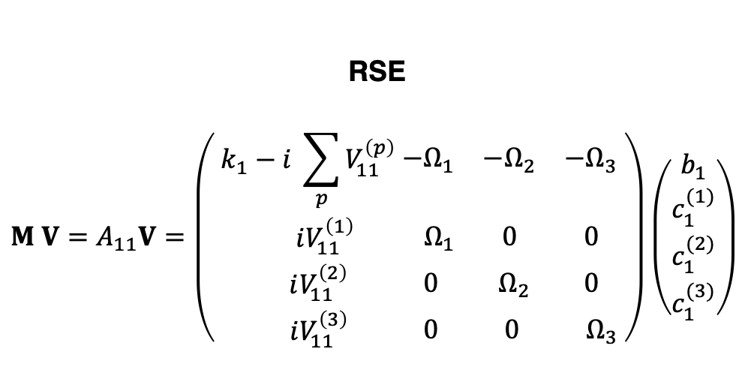
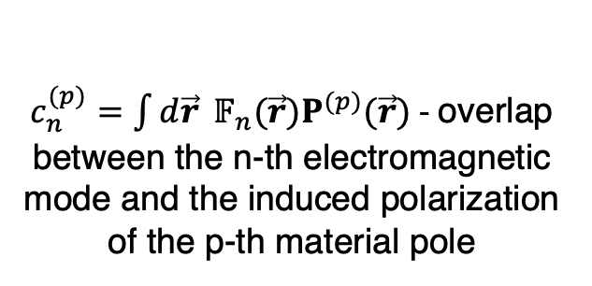
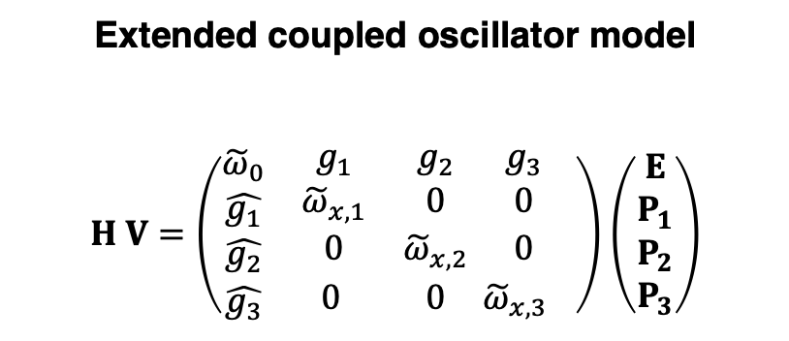
Single mode approximation and 3 material poles
RSE
$$M V=A_{11}V=\left(\begin{matrix}\begin{matrix}k_{1}−i \sum_{p}{V_{11}^{\left(p\right)} \begin{matrix}−Ω_{1} & −Ω_{2} & −Ω_{3}\end{matrix}} \\ iV_{11}^{\left(1\right)} \begin{matrix}Ω_{1} & 0 & 0\end{matrix} \\ \begin{aligned} iV_{11}^{\left(2\right)}\begin{matrix} 0 & { Ω}_{2} & 0\end{matrix} \\ iV_{11}^{\left(3\right) }\begin{matrix} 0 & 0 & Ω_{3}\end{matrix}\end{aligned} \end{matrix}\end{matrix}\right)\left(\begin{aligned}b_{1} \\ c_{1}^{(1)} \\ c_{1}^{(2)} \\ c_{1}^{(3)}\end{aligned}\right)$$
Extended coupled oscillator model
$H V=\left(\begin{matrix}\begin{aligned}{\tilde{ω}}_{0} \\ \hat{g_{1}} \\ \hat{g_{2}}\end{aligned} & \begin{matrix}g_{1} & g_{2} & g_{3} \\ {\tilde{ω}}_{x,1} & 0 & 0 \\ 0 & {\tilde{ω}}_{x,2} & 0\end{matrix} \\ \hat{g_{3}} & \begin{matrix}0 & 0 & {\tilde{ω}}_{x,3}\end{matrix} \end{matrix}\right)$ $\left(\begin{aligned}E \\ P_{1} \\ P_{2} \\ P_{3}\end{aligned}\right)$
M. Balasubrahmaniyam et al.,
Phys. Rev. B 103, L241407 (2021)
There is an additional shift in the first diagonal element.
$c_{n}^{(p)}=\int{d\vec{r}} 𝔽_{n}(\vec{r})P^{(p)}(\vec{r})$ - overlap between the n-th electromagnetic mode and the induced polarization of the p-th material pole

Slide 8
Results

Slide 9
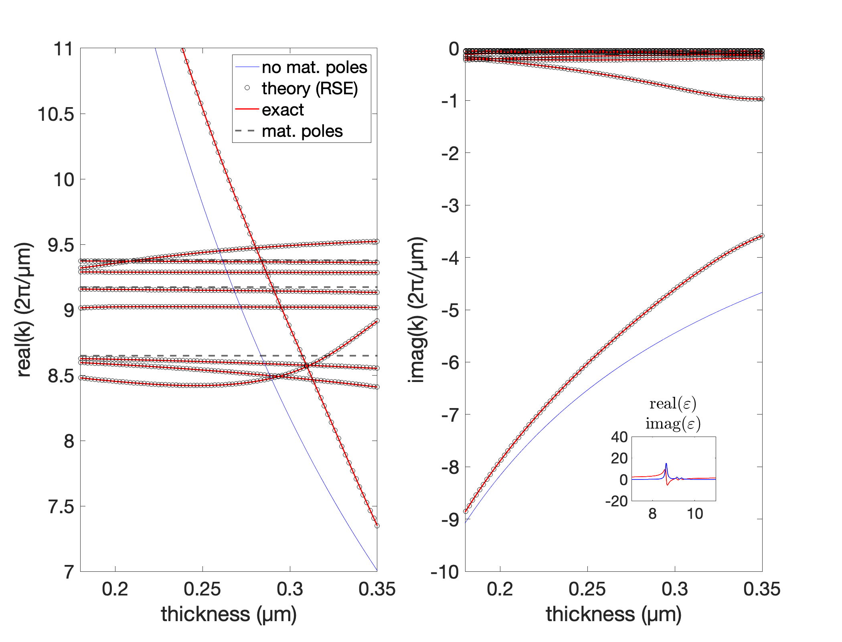


Result – 3 material poles
Air
SURMOF (no mat. poles) $ε_{∞}$
Air
SURMOF $ε(ω)$
N=11 optical poles In the basis there are 2N-1 terms (including –conj(k_{i}))

Slide 10
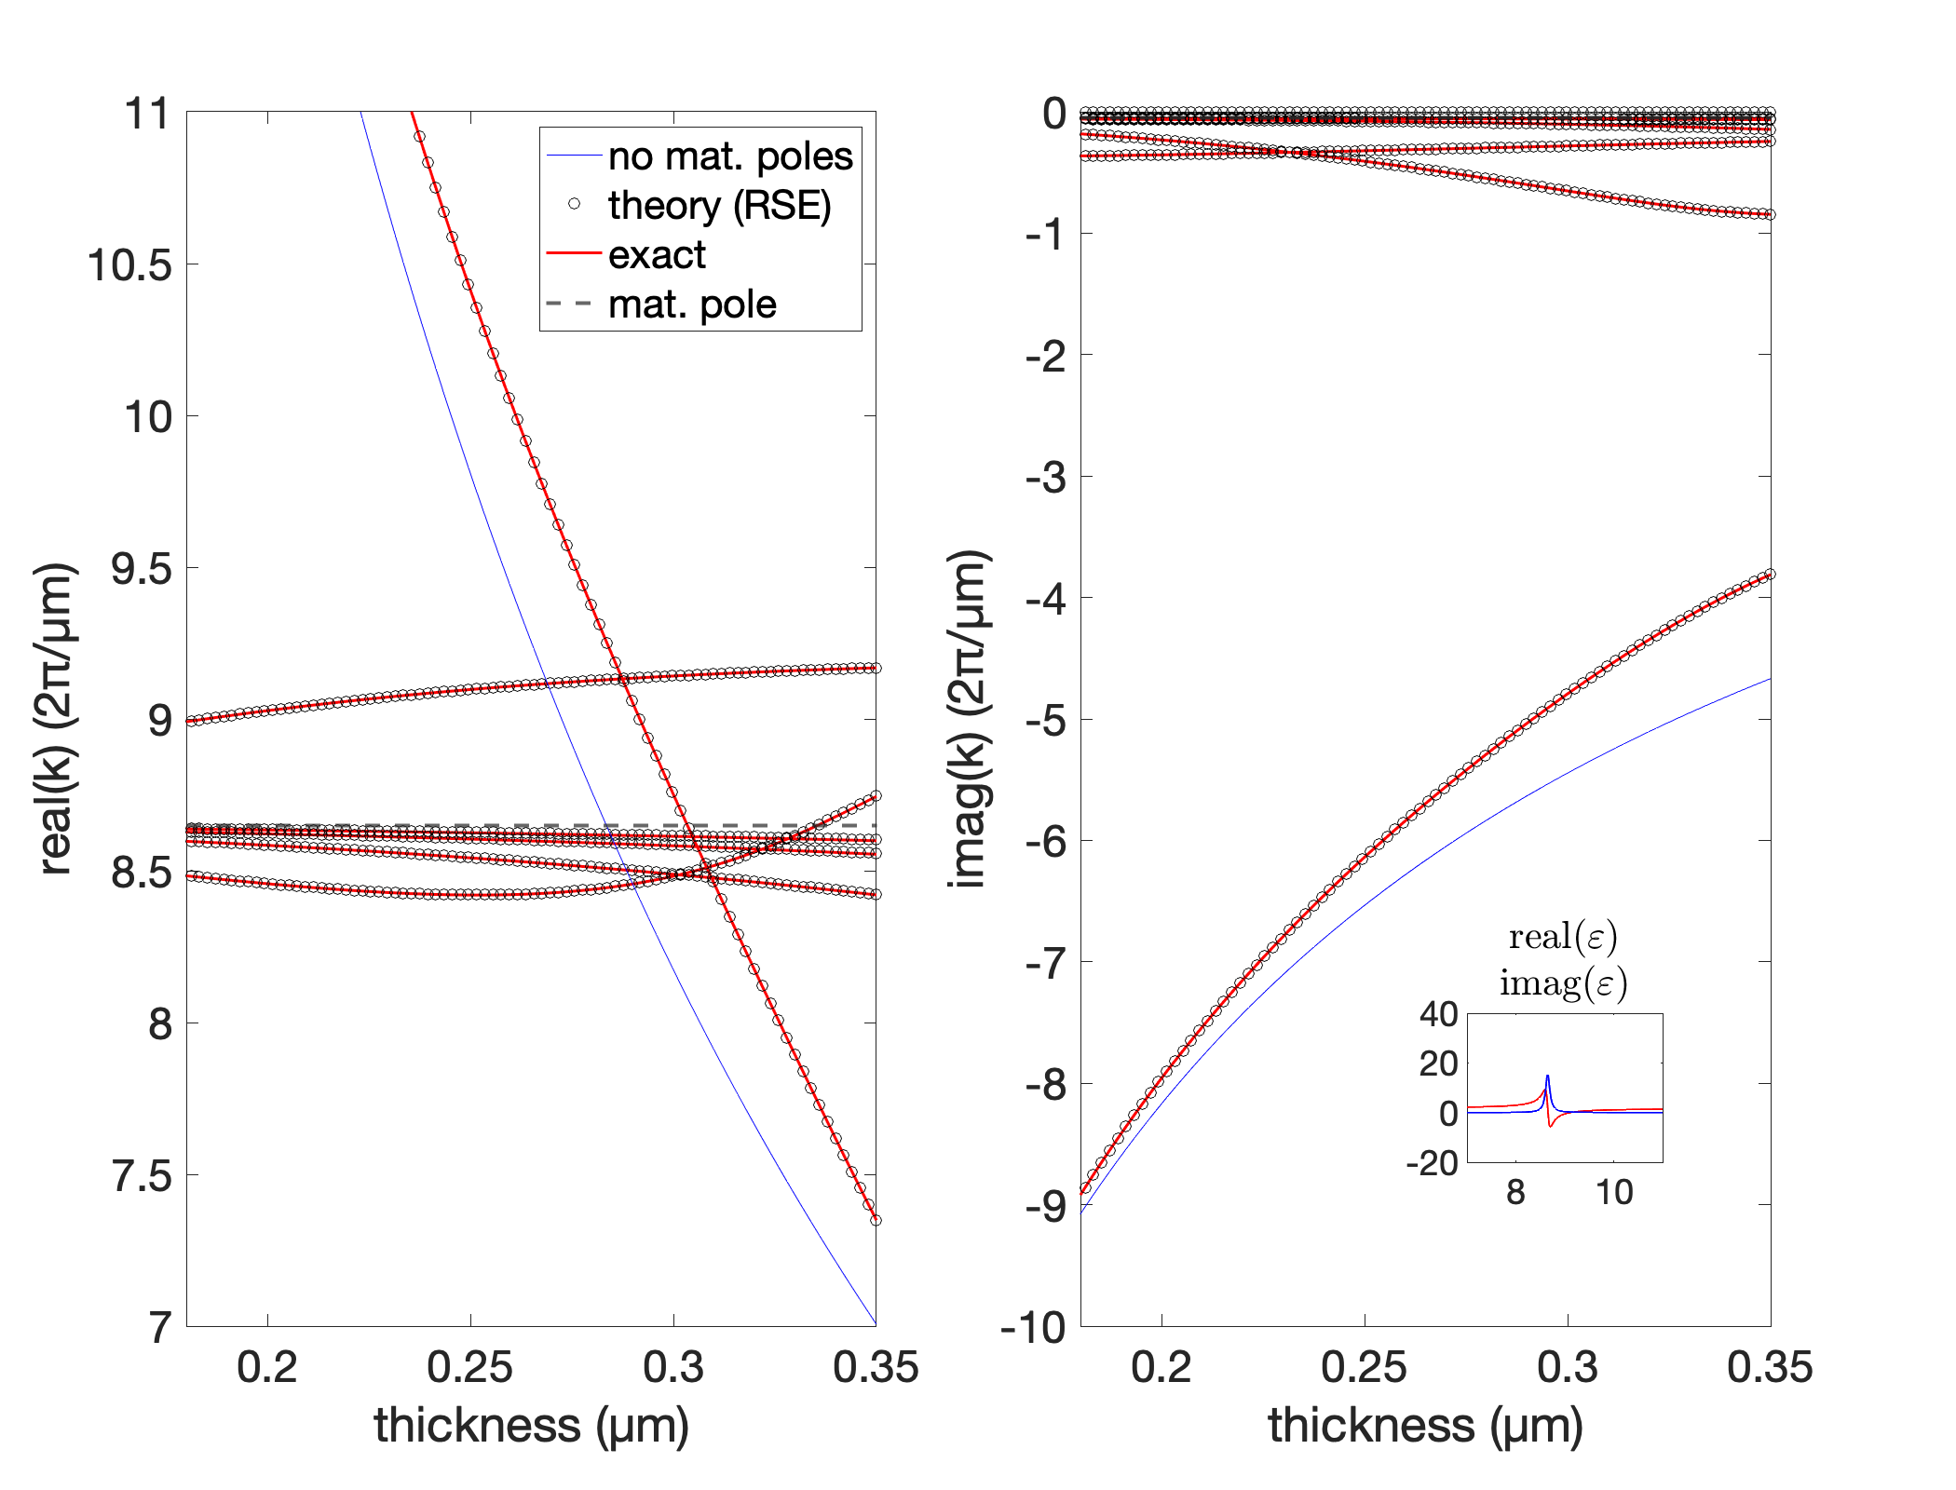
Result – 1st material pole
Air
SURMOF (no mat. poles) $ε_{∞}$
Air
SURMOF $ε(ω)$
N=11 optical poles In the basis there are 2N-1 terms (including –conj(k_{i}))

Slide 11
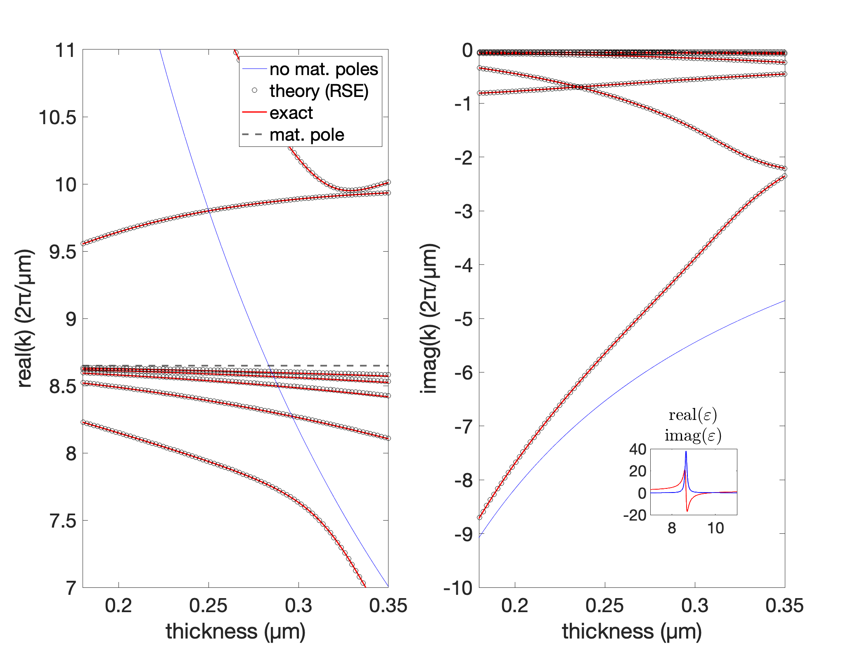
Artificially increasing the oscillator strength
Air
SURMOF (no mat. poles) $ε_{∞}$
Air
SURMOF $ε(ω)$
N=11 optical poles In the basis there are 2N-1 terms (including –conj(k_{i}))

Slide 12
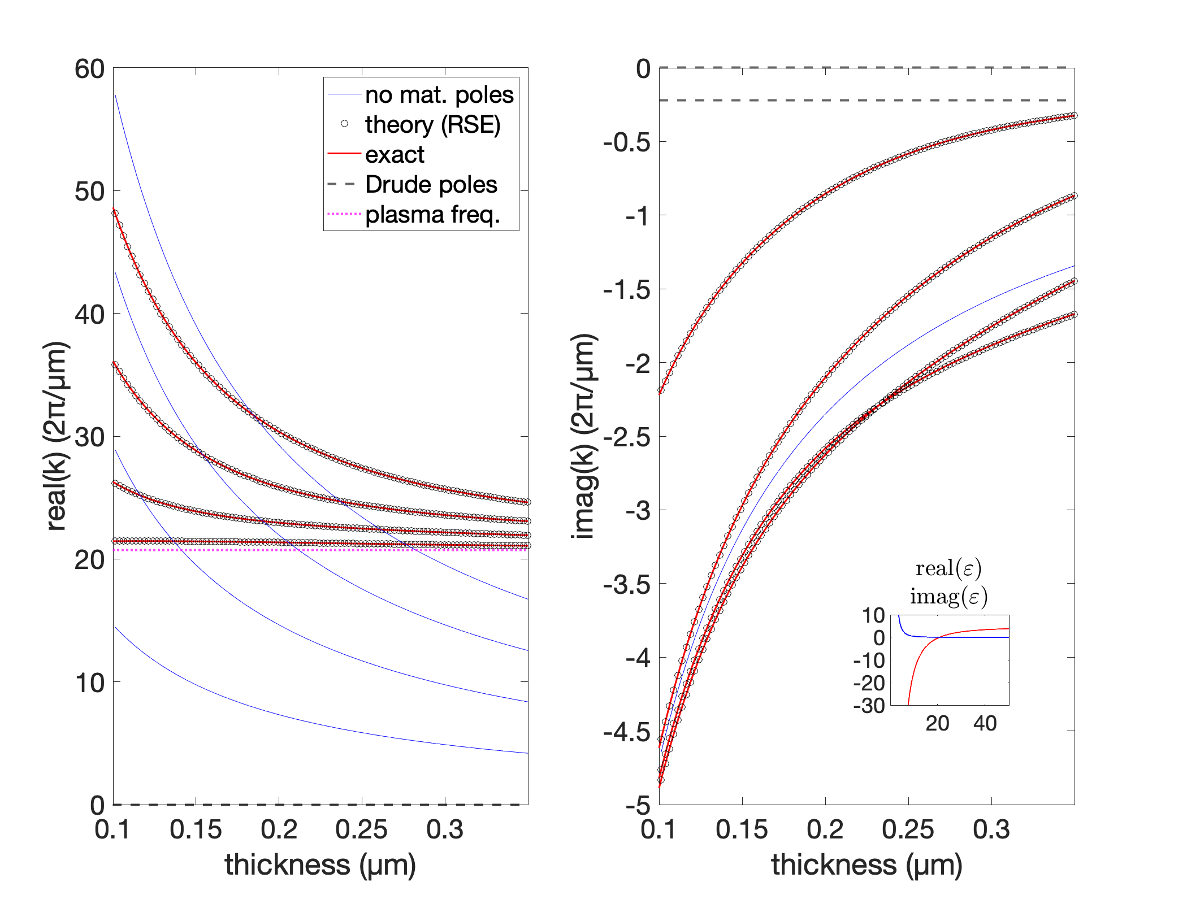


Result – Silver slab
Air
SILVER (no Drude poles) $ε_{∞}$
Air
SILVER $ε(ω)$
N=11 optical poles In the basis there are 2N-1 terms (including –conj(k_{i}))

Slide 13
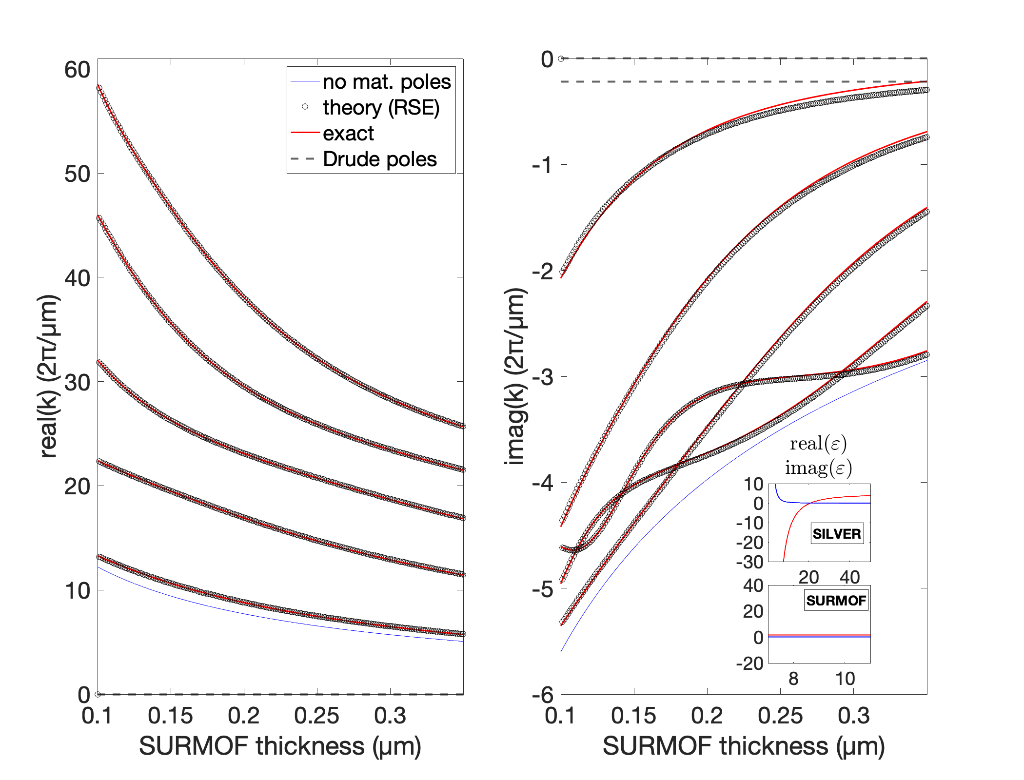
Plasmon-exciton-polariton and RSE - Intermediate step
Fabry-perot cavity
SILVER (no Drude poles)
SURMOF (no mat. poles)
SILVER (no Drude poles)
SILVER
SURMOF (no mat. poles)
SILVER
N=11 optical poles
Thickness of 1st Silver layer = 0.01 um
Thickness of 2nd Silver layer = 0.03 um

Slide 14
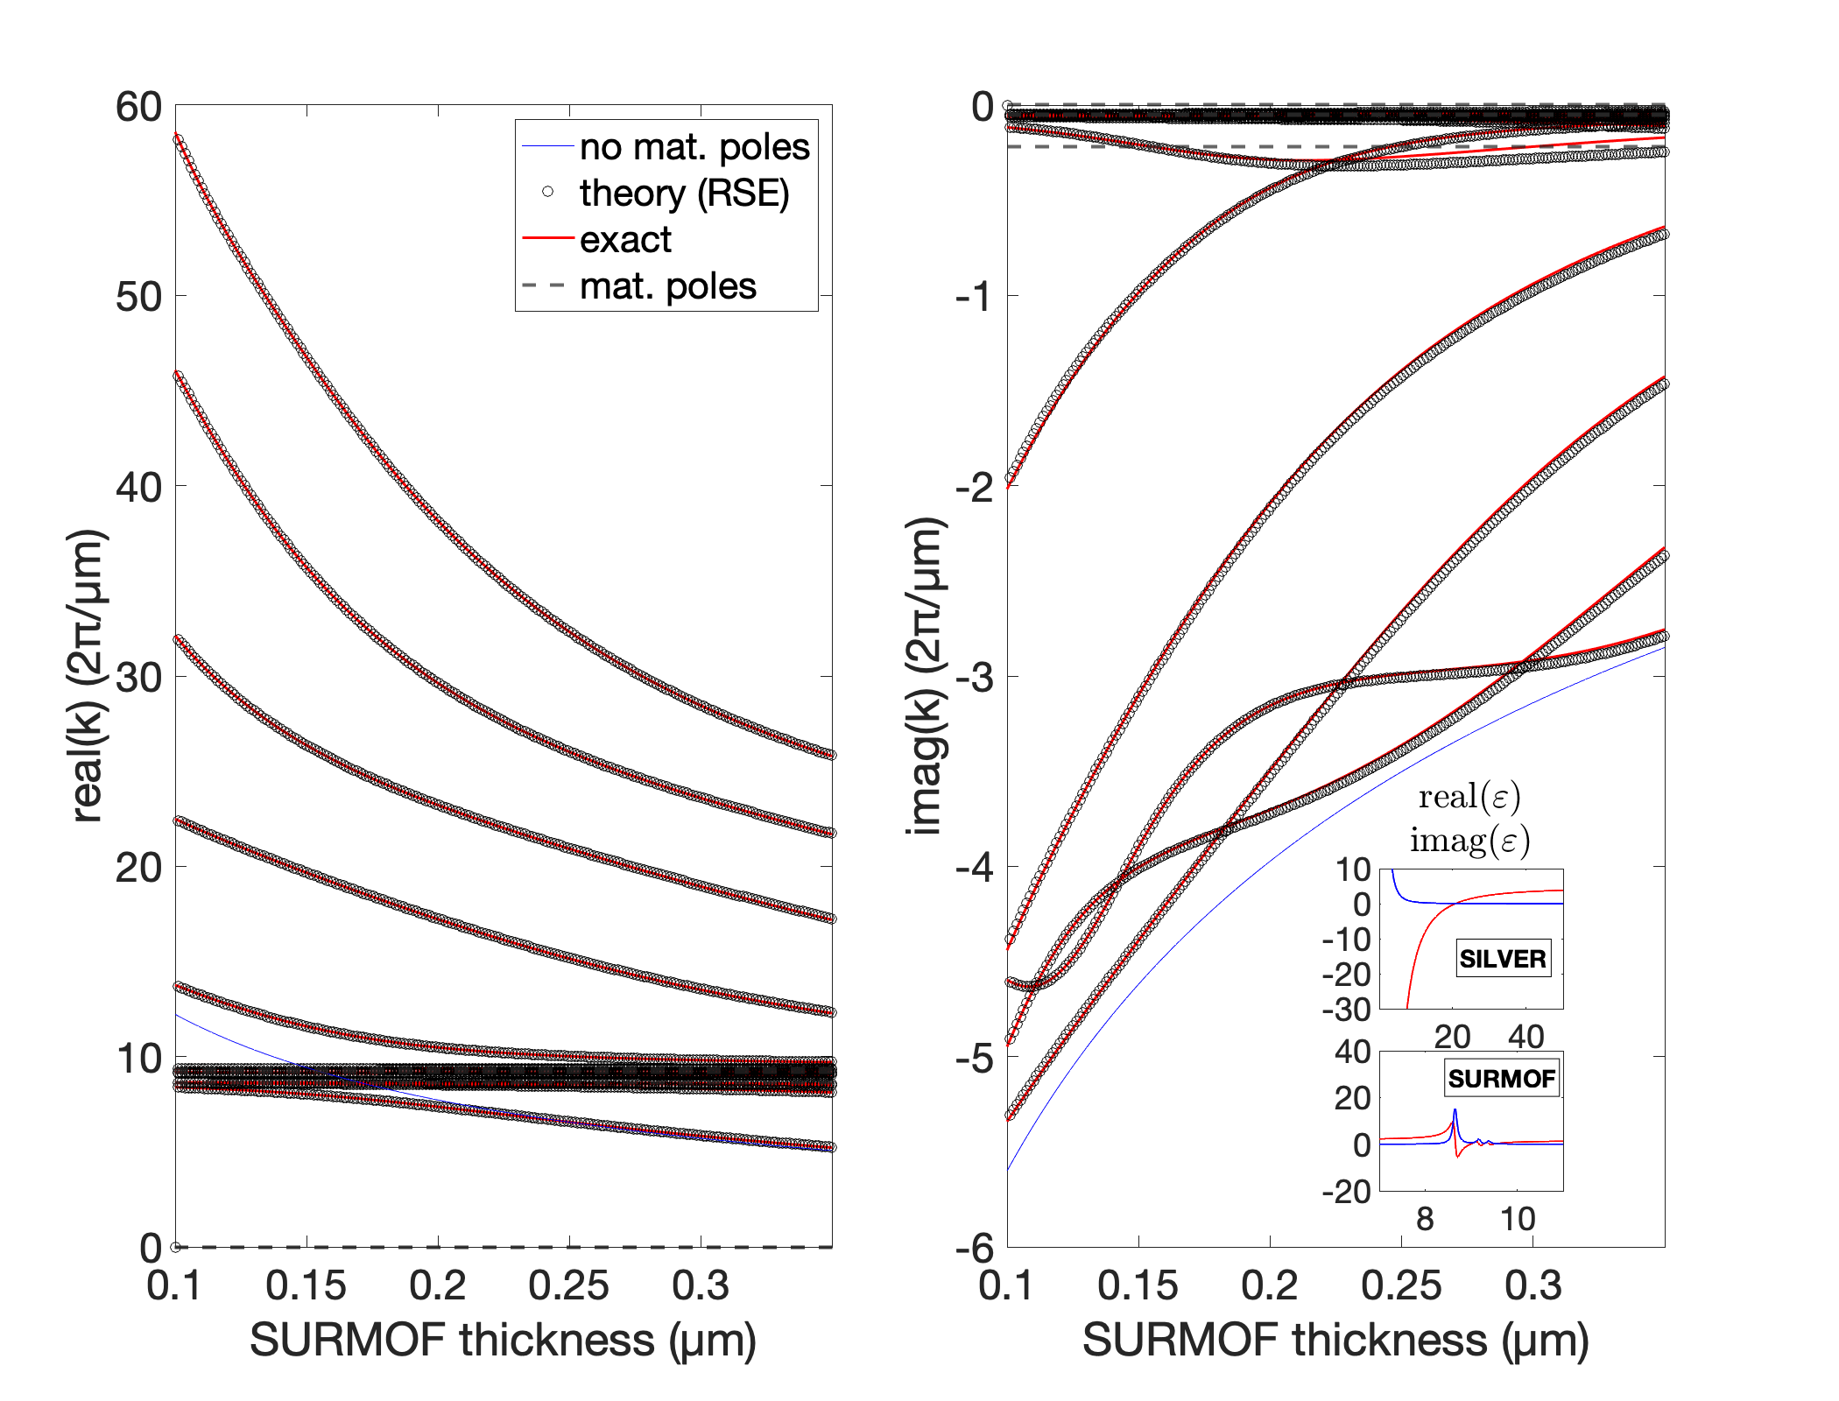
Plasmon-exciton-polariton and RSE
Fabry-perot cavity
SILVER (no Drude poles)
SURMOF (no mat. poles)
SILVER (no Drude poles)
SILVER
SURMOF
SILVER
N=11 optical poles
Thickness of 1st Silver layer = 0.01 um
Thickness of 2nd Silver layer = 0.03 um

Slide 15
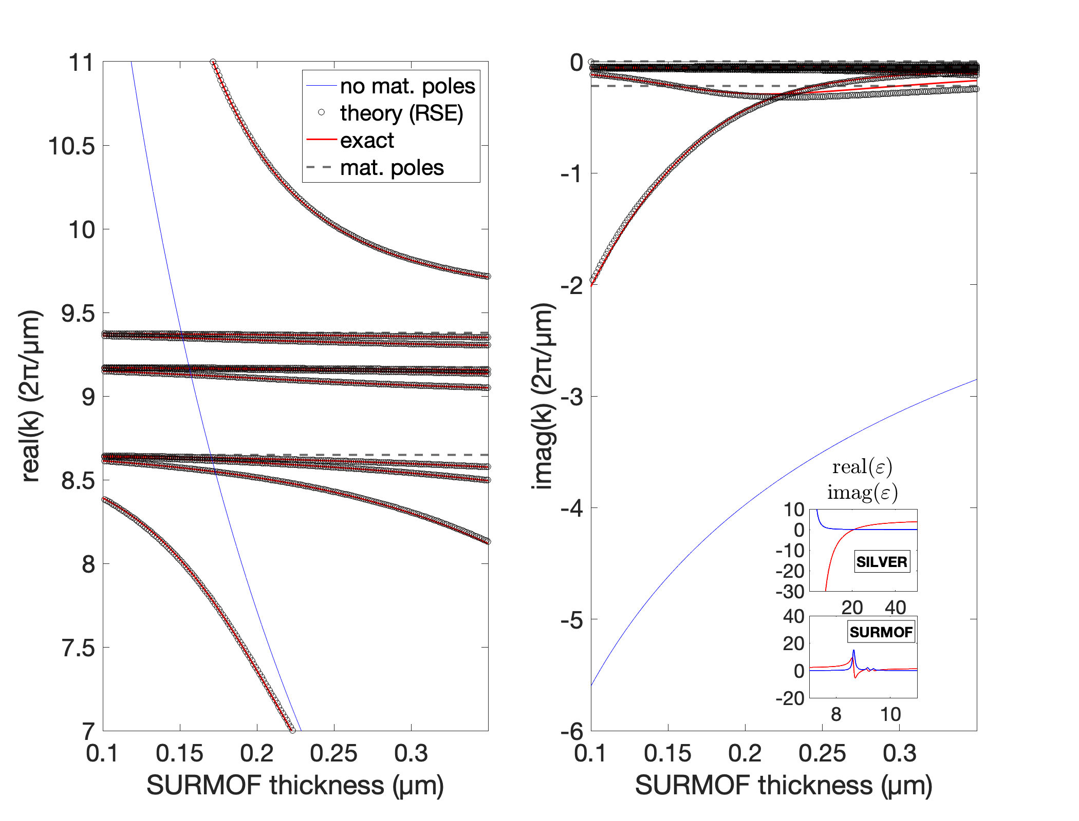
Plasmon-exciton-polariton and RSE
Fabry-perot cavity
SILVER (no Drude poles)
SURMOF (no mat. poles)
SILVER (no Drude poles)
SILVER
SURMOF
SILVER
N=11 optical poles
Thickness of 1st Silver layer = 0.01 um
Thickness of 2nd Silver layer = 0.03 um

Slide 16
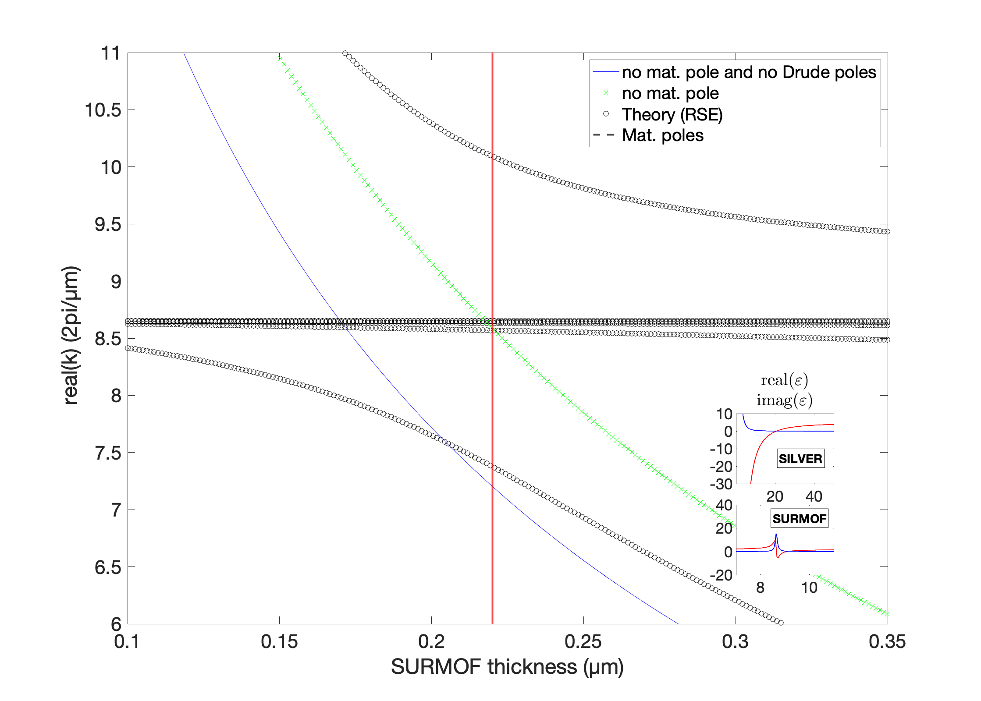
Сoupling of SURMOF poles and optical modes of the silver cavity
Fabry-perot cavity
SILVER (no Drude poles)
SURMOF (no mat. poles)
SILVER (no Drude poles)
SILVER
SURMOF (no mat. poles)
SILVER
SILVER
SURMOF (1 mat. pole)
SILVER
N=3 optical poles

Slide 17
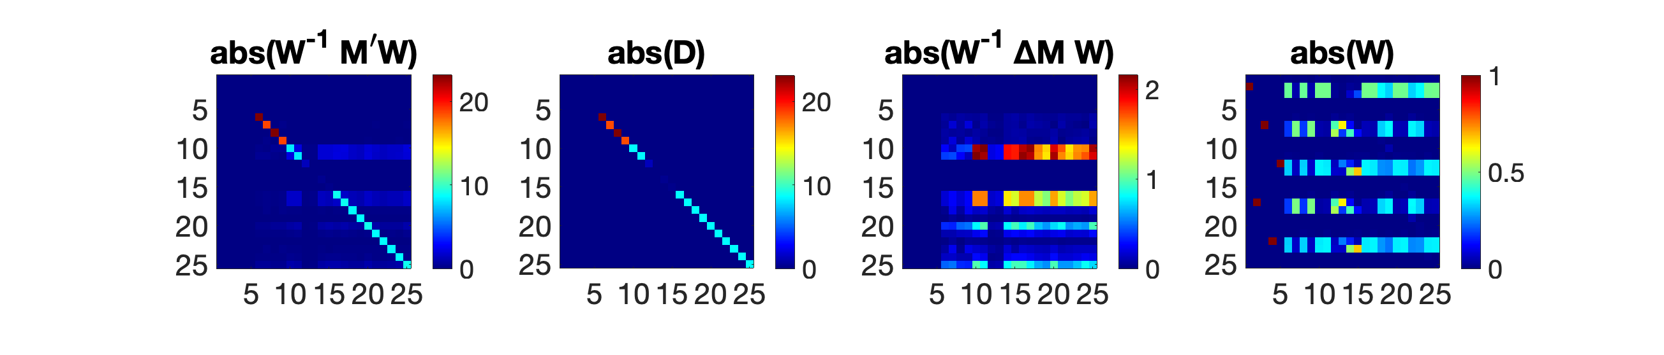

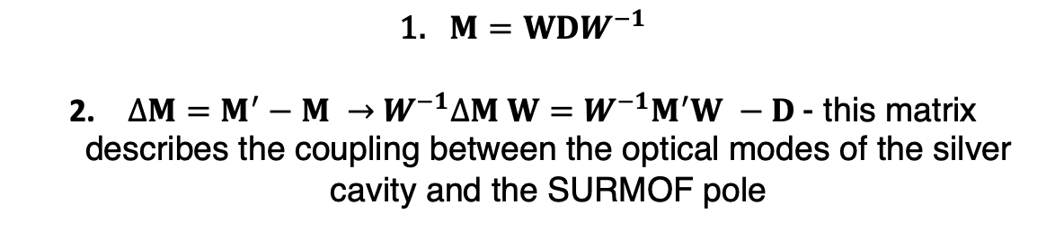

Сoupling of SURMOF poles and optical modes of the silver cavity
SILVER
SILVER
SURMOF (no mat. poles)
SURMOF (1 mat. pole)
SILVER
SILVER
Matrix $M(σ_{p}=0 for mat.pole)$
Matrix $M′(σ_{p}≠0 for mat.pole)$
$M=WDW^{−1}$
$∆M=M^{′}−M →$ $W^{−1}∆M W=W^{−1}M^{′}W −D$- this matrix describes the coupling between the optical modes of the silver cavity and the SURMOF pole

Slide 18
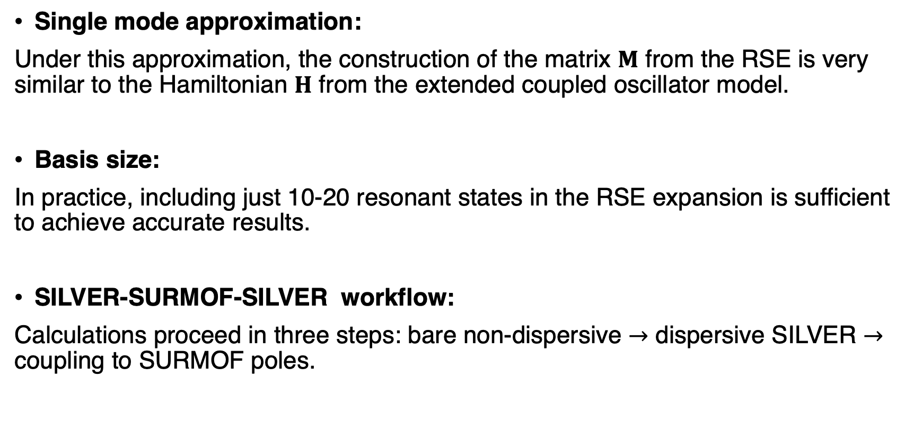
Summary
Single mode approximation:
Under this approximation, the construction of the matrix $M$ from the RSE is very similar to the Hamiltonian $H$ from the extended coupled oscillator model.
Basis size:
In practice, including just 10-20 resonant states in the RSE expansion is sufficient to achieve accurate results.
SILVER-SURMOF-SILVER workflow:
Calculations proceed in three steps: bare non-dispersive $→$ dispersive SILVER $→$ coupling to SURMOF poles.

Slide 19
Сoupling of SURMOF poles and optical modes of the silver cavity

