Slide 1
Epidemics on Networks
Faculty of Business, Economics and Informatics
Network Science Final Project
Bauer Jan, Iten Adrian and Jehoul Astrid
Notes:
Hello, we are Jan, Adrian and Astrid. For the Network Science Final Project, we decided to work on Epidemics on Networks.

Slide 2
Table of Contents
Faculty of Business, Economics and Informatics
Introduction
Theory
Methods
Results
Discussion & Conclusion
Notes:
Our presentation is structured as follows: we’ll start off with a short introduction and theoretical part, before discussing the methods and results. Finally, we’ll close off with a discussion and conclusion.

Slide 3
1 Introduction
Faculty of Business, Economics and Informatics

Slide 4

Introduction
Faculty of Business, Economics and Informatics
Vulnerability of networks
Recently: Computervirusses and SARS-CoV-2
How do viruses spread on networks?
Epidemic models
Synthetic and real-world networks
More effective intervention
Notes:
Networks are vulnerable to the spread of viruses. Not only computer viruses and ransomware, such as WannaCry and NotPetya, but also the recent coronavirus pandemic painfully illustrated this. In our final project, we aim to assess how viruses spread on networks. Hereby, nodes represent agents and the edges between them represent potentially infectious interactions. We’ll be discussing multiple different epidemic models, such as compartmental models, agent-based models and the gillespie algorithm. During our experiments we used 3 types of synthetic networks: the Erdos-Renyi, Watts-Strogatz and Barabasi-Albert graphs. Moreover, we also included 3 real-world networks, being the Facebook Friendship graph and the Sex Escorts graph we saw in class and a Contact Tracing graph from the city of Haslemere. By better understanding the spread of diseases in these networks, more effective intervention strategies can be developed.

Slide 5
2 Theory
Faculty of Business, Economics and Informatics
Notes:
I’ll now shortly discuss the most important theoretical concepts needed for this project.

Slide 6
Theory
Faculty of Business, Economics and Informatics
Simple contagion
Homogeneous mixing assumption
Basic reproduction number R₀
Notes:
Our project focuses on simple contagions, where an individual can get infected after a single exposure to the virus. At any moment in time, the virus might be transmitted between individuals who get in contact. The transmission probability is proportional to the strength of the connection. The agent based simulation helps us to cope with the simplifying homogeneous mixing assumption which does often not hold in reality. This assumption is that all potentially infectious, encounters are equally likely to happen, but usually people interact in heterogeneous ways. The basic reproduction number R_0 is a key parameter in epidemiology, it’s the expected number of secondary cases, caused by a single infected individual that is placed in a fully susceptible population. An R_0 greater than 1 indicated an epidemic, while the disease spread will die out if R0 is below 1.

Slide 7
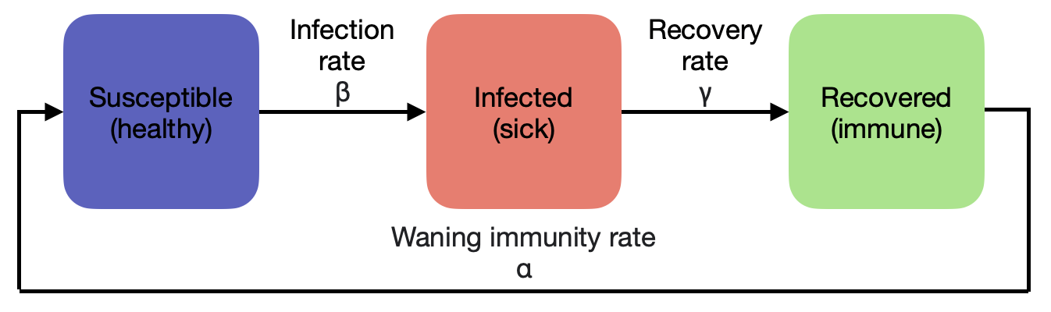
Theory
Faculty of Business, Economics and Informatics
Compartmental models
SI
SIR
SIRS
Agent-based models
Gillespie algorithm
Notes:
For modelling an epidemic on networks, many different types of models exist. The most common technique for modelling infectious diseases are compartmental models. They describe the transition of agents between discrete compartments, depending on their infection status. This can either be Susceptible, Infected or Recovered. The most elaborate compartmental model we’ll discuss is the SIRS model. A susceptible agent has a risk of getting infected of \beta. When infected, the agent will recover at rate \gamma. Unfortunately, an agent can become susceptible again after recovery, as the protective antibodies will progressively decline with rate \alpha. The model is schematically illustrated on the figure here on the slide. The SIR model does not consider the waning immunity rate \alpha and assumes an agent is immune to the disease after recovery and can not get infected again. Furthermore, the SI model drops the Recovered category completely, and divides the population into 2 separate parts: Susceptible and Infected
A drawback from these compartmental models is that they are limited in the complexity they can represent. Agent-based models are able to track individuals throughout time and can thus produce extra results. Agent-based models can encode extra behaviour by characterizing each agent with a set of variables identifying their state.
Finally, the Gillespie algorithm is an important stochastic simulation algorithm. For the system in a given state, it calculates the time to the next event and what that event will be.

Slide 8
3 Methods
Faculty of Business, Economics and Informatics

Slide 9
Methods - Networks
Faculty of Business, Economics and Informatics
Synthetic graphs
1. Barabasi-Albert
2. Erdos-Renyi
3. Watts-Strogatz
Real-world networks
4. Facebook Friendships
5. Sex Escorts
6. Contact Tracing Graph (from Haslemere, England)
Notes:
We identified the most interesting graphs for our analysis from the ones that we got to know in the lecture and in scientific literature.
We focusted on the most important synthetic networks (Barabasi Albert, Erdös Renyi and Watts Strogatz graph) and we selected three real world graphs (Facebook Friendship graph, Sex Escort Graph and Contact tracing graph)
Our experiments observe the effect that changing input parameters (for example the specific network) or model parameters (infection rate) on the disease spread.
The infection rate β for example can be reduced by social distancing and wearing masks, while the recovery rate and waning immunity rate are
more difficult to change since they depend on the specific disease. However, they could be improved by the availability of medication for example.

Slide 10
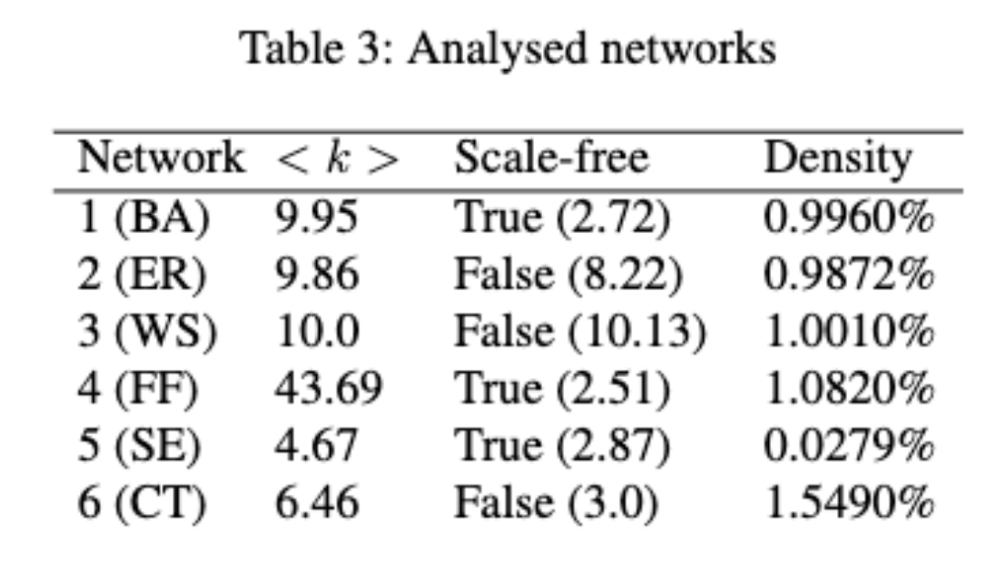
Methods - Metrics
Faculty of Business, Economics and Informatics
Average Degree
Degree distribution
Scale-free property
Graph Density
Notes:
During the lectures, a lot of interesting network measures were discussed. To keep our project compact, we discussed all available metrics from the lecture and selected the most important ones for our purpose. In a social network, the degree of a node can be interpreted as the number of contacts and the average degree as the average number of contacts. The degree distribution provides insight into how the networks topology. Real world networks often show a heavy-tailed distribution, where most nodes only have few connections, apart from some strongly connected hubs. This is called a scale-free network.
The graph density provides an estimation on how connected the network is with each other.

Slide 11
4 Results
Faculty of Business, Economics and Informatics

Slide 12
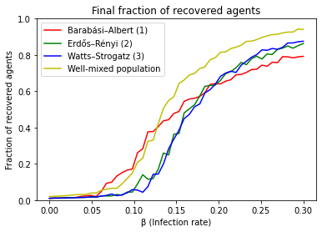
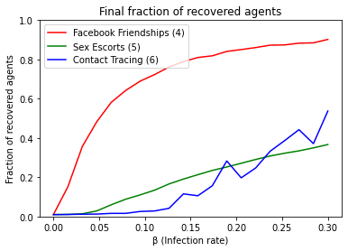
Experiment 1
Faculty of Business, Economics and Informatics
Measuring the influence of infection rate of the disease on its spreading in the SIR model
Agent-based modelling: average of n = 10 runs for each infection rate
x-axis: Infection rate (0- 30%), y-axis: Final fraction of recovered agents
Scale-free networks (facebook) show no epidemic threshold
Notes:
This brings us to our first experiment where we performed a sweep over the infection rate while keeping the other input parameters constant.
Hereby the infection rate is given on a per contact basis. This means that every contact between an susceptible and infected agent infected the susceptible with this probability.

Slide 13
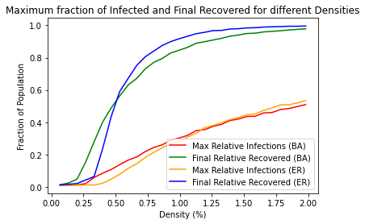
Experiment 2
Faculty of Business, Economics and Informatics
Idea: Measure the influence of two important network properties in the SIR model: density and whether it is scale-free
How: Using synthetic graphs as they can be created for any given size, fix infection rate (10%) and recovery rate (100%)
Goal: get a feeling of what measures relating to the network structure need to achieve
Disease already spreads for low densities, hence very low density has to be achieved by measure
For those low densities, getting rid of the scale-free property may additionally be beneficial (large degree = potential superspreader)

Slide 14
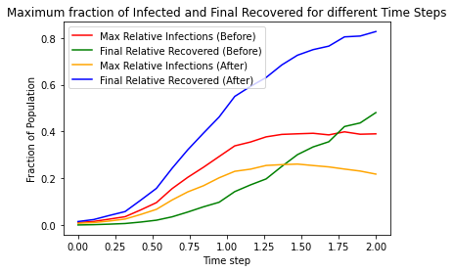
Experiment 3
Faculty of Business, Economics and Informatics
Goal: assess the efficiency of a method that introduces contact restrictions (cuts edges) and tries to eliminate high-degree nodes
Implementation: add a ceiling to the degree
maximum n=5 edges per node (out of 3’000 with original density of 1.33%)
density afterwards < 0.33%
from scale-free to scale-rich
Compare Rates after the introduction of the measure with a timely delay
recovered naturally higher
maximum infected lower, early introduction important

Slide 15
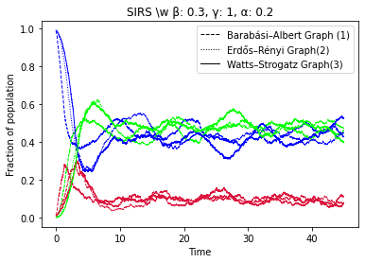
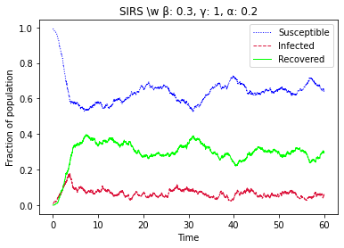
Experiment 4
Faculty of Business, Economics and Informatics
SIRS model: Extension of SIR with possibility of reinfection (α), further extension possible to include death cases, hospitalizations etc.
Less importance of network topology and whether it is scale-free
Wave-form spreading on lower value for real-world Contact Tracing Graph
Notes:
So far we always used the SIR model for all of our simulations where an agent can never get infected twice.
However, depending on the specifics of the disease more fine grained models can be used.
Therefore, the so called SIRS model was used, which is an extension of the SIR model.
In this case the immune response of agents who have previously been infected diminishes with time and at some point they become susceptible to the disease again.
We simulated such an Epidemic different networks and observed two tings.
First of all, the dynamics have changed and the epidemic happens in waves now, and the number of infected against spikes at certain points in time.
Depending on the ratio between infection rate and waning immunity rate, the number of cases might show a downwards facing trend, but much slower compared to SIR epidemics.
Another finding, as you can see in the figure on the right, is that the underlying structure of the network, becomes less relevant when observing long term trends.
We would conclude that the SIR model is much more suitable for observing the short term dynamics of a disease spread.
More advanced models like SIRS can be used to gain more long term insights.

Slide 16
5 Discussion and Conclusion
Faculty of Business, Economics and Informatics

Slide 17
Discussion and Conclusion
Faculty of Business, Economics and Informatics
Showed inexistence of epidemic threshold in scale-free networks, also for real-world networks
Experimented with different network properties in order to see influence on spread in SIR model: in addition to the SIR infection rate, both the degree distribution as well as the density are influential
Simulated a simplified measure to show that acting quick is of big importance due to the exponential spread of diseases
Extending the model (SIRS) leads to different results, but can explain more phenomena

