Slide 1

Federated Reinforcement Learning for private and collaborative Selection of Moving Target Defense Mechanisms
Notes:
Welcome to the initial presentation of my master thesis.
The work is focusing on how moving target defense mechanisms can be used in order to defend against malware attacks on IoT devices.
This is my third week working on the topic now.
My thesis is build on top of Timo Schenks work, who used reinforcement learning to train an agent that is able to select which MTD to deploy depending on the observed device state.

Slide 2

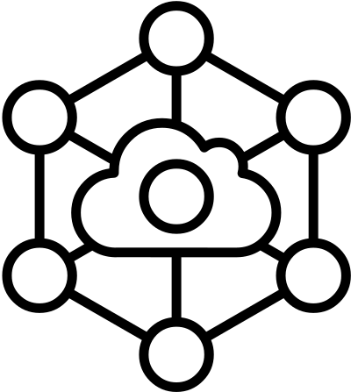



Motivation
Focus on IoT devices
Explosive growth
Insecure design
Recent Attacks
Notes:
But first of all. Why is the security of IoT devices such a big and important issue.
The Internet of Things has seen an explosion in the number of devices over the recent years.
The majority of these devices are consumer grade and rather cheap.
According to Statista in 2022, there is 13 billion IoT devices, (already more than humans on the planet)
By 2030 this number is expected to increase to 30 billion
Although individual device models from only one vendor (for example more than 100 million amazon alexa speakers have been sold) can be sold hundred thousands of times.
Not every vendor sees the necessaty to spend a ot of money on security,
since the individual device should be affordable for end customers.
Many target end consumers which have low IT sec knowledge.
Due to the high number of devices, devices types, models, manufacturers and technologies in use, Iot security is very difficult. The mirai botnet from 2016, was created by simply targeting IoT devices (like IP cameras) and trying out if the standard admin name and password have been changed or not. It is estimated that around 500.000 devices were captured by this simple approach and the botnet was then used to launch DDoS attacks on multiple targets. One attack was powerful enough to take down a DNS service, making websites like Twitter and Github unavailable via DNS for some hours.

Slide 3

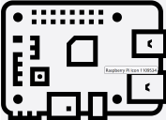
How Moving Target Defense (MTD) Mechanisms can help?
MTD-Pradigm
Attack Surface
What to adapt?
Malware
When to change?
Observe
device state
How to transition?
Notes:
As Jan already said even if more effort is spend on making these devices more secure, perfect security will never be reached.
Not every attack (for example the ones using zero day exploits) can be stopped right at the system boundary.
Therefore, IT security needs to think about how to do defense-in-depth.
Moving Target Defense (MTD). MTD aims to thwart off adversaries who rely on the static nature of the attack target by proactively or reactively altering the attack surface by moving certain system parameters
there are three main questions that need to be clarified to design a technique following the MTD paradigm
what MTD techniques to deploy, when, and how
WHAT
How to alter the attack surface - which features should we change for example the port mappings or ip adress could be such features. Multiple feature can be changed at once. You could dynamically change the data representation (e.g encoding), software, runtime environment (e.g webserver), platform (e.g OS), network structure.
WHEN
When the features should be altered
For some types of malware, like crypto ransomware for example, the MTD needs to be deployed immediately or shortly before the encryption starts happening.
For other types of malware like CnC the timing does not matter that much. Only the right MTD needs to be deployed
HOW
Diversification-based MTD change the system components to different specific implementations (e.g running multiple webservers and switching between them)
Shuffling-based MTD techniques rearrange system or network configurations in a typically randomized fashion.

Slide 4
Matching Malware and MTDs
 | 4 Mitigating MTD
Command and Control & Botnets | - Private IP Address Shuffling
Rootkits | - Rootkit Purging
Ransomware | - Encryptor Trapping with Dummy Files - File Ending Randomization
Notes:
We looked at the most common types of malware for IoT devices
And paired them with their repsecitve MTDs
Command and Control/ Botnets
The CnC malware usually runs a script on the victim machine waiting for commands from the CnC server.
Private IP Adress reshuffling disturbes the communication by periodically reshuffling the network adresses
—-------
User-Level Rootkits
dynamic linker to preload shared libraries specified by an attacker before legitimate libraries can be loaded
In order to sanitize a system from user-level preloading rootkits, all the malicious libraries or the links pointing to them need to be removed
—-------
Ransomware
Ransomware is encrypting files in a systematic manner.
You can either try to trap it in a directory encrypting dummy files
Since ransomware often targets files with specific extensions, you can try to randomize the file endings, such that the ransomware does not consider them.

Slide 5


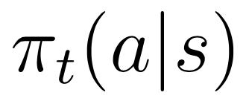
Reinforcement Learning (RL) for MTD-Selection
Goal: Learning a Policy π representing probability of selecting action a when being in state s.
Notes:
The idea behind reinforcement learning is to have an agent that is capable of learning from interaction with an environment.
The agent is trying to learn how to maximize his long-term received reward.
If the agent choses the right action to take according to the state of the environment he is observing then he receives a positive reward and otherwise a negative one.
If our case, if the correct MTD has been selected keeping the device state normal a reward of +1 is received otherwise negative feedback of -1 is received.
Hereby the agent is supposed to learn which mtd to select depending on the state of the IoT device (environment) that he is observing.
—--------
A reinforcement learning policy is a mapping from the current environment observation to a probability distribution of the actions to be taken. A value function is a mapping from the current environment observation to the expected value (the cumulative long-term reward) of the current policy.

Slide 6
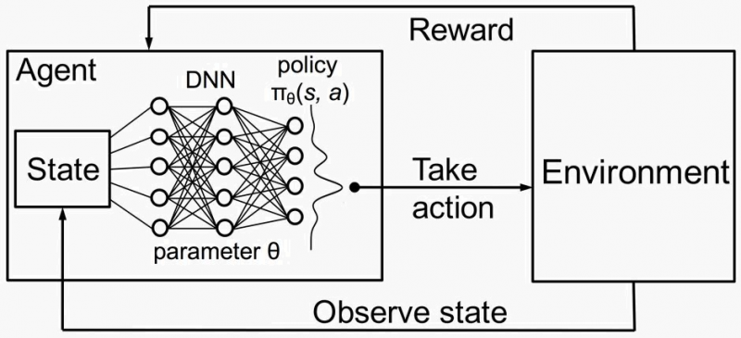
Deep RL for MTD selection
Notes:
Traditional tabular reinforcement learning algorithms like traditional Q-learning or traditional SARSA do not work in this scenario since the device state (monitored via the perf and top command) has to many dimensions and thus to many different combinations exist.
Therefore, we are using Deep Q learning in order to approximate the action-value function or the policy via a deep neural network.
The neural network receives the high dimensional state vector as input and predicts a probability distribution over actions to take.

Slide 7

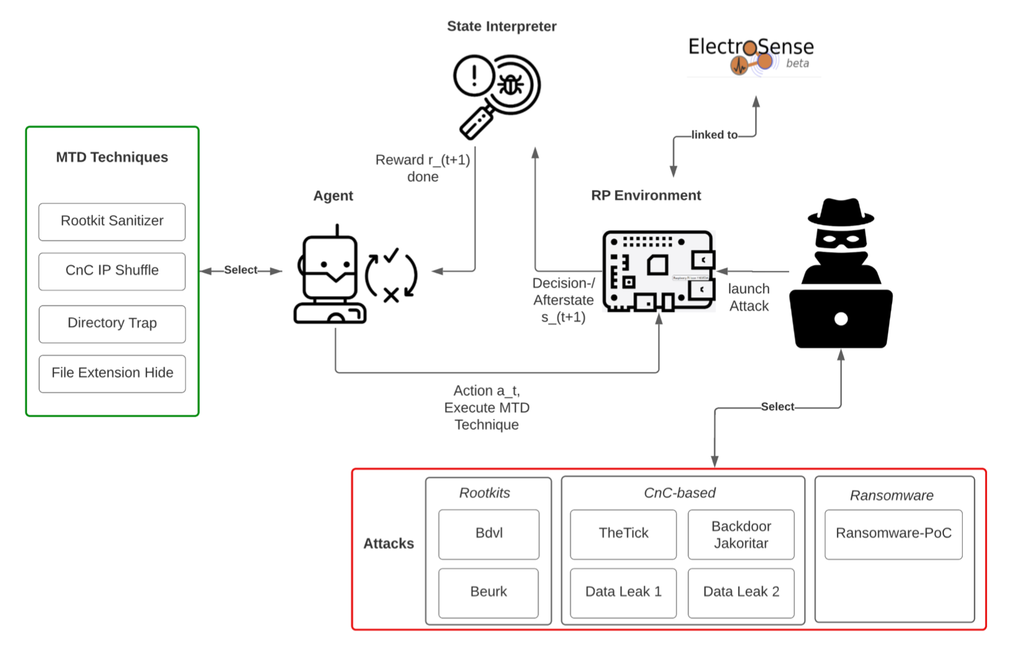
System Architecture
Notes:
Here you can see the current system architecture.
In the center you can see the raspberry pi that is part of the electro sense crowd sensin platform.
The attacker selects and launches one specific attack from the 3 attack categories (CnC, rootkits, ransomware) onto the device.
The agent observes the device behaviour and hopefully selects the right MTD (corresponding to the specific attack)
The state interpreter classifies if the behaviour was brought back to normal or if the malware is still considered to be active.
Depending on this outcome the agent receives a reward of either + or -1.
One crucial element of the system is the anomaly detection that decides for the observed state (before or after the execution of an MTD) can be considered normal or unnormal.

Slide 8

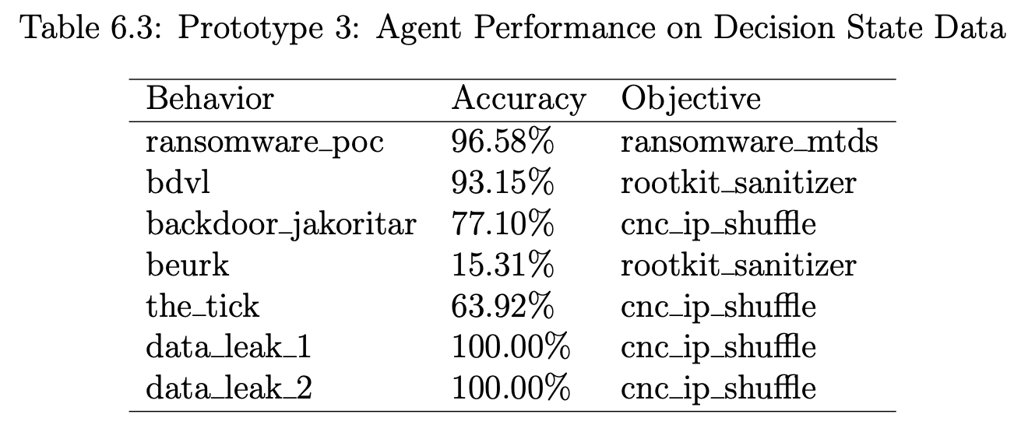
Performance & Limitations
“the time required to learn new attacks may impair viability.”
Notes:
As we can see according to the achieved performance of the RL agent, it is able to select the right MTD with high success rate.
Some malware (e.g ransomware or data leaking malware) alters the behaviour of the device a lot and
Thus it is easier to be recognized by the anomaly detection as malicious behaviour.
The rootkit is harder to detect since it does not really alter the normal device behaviour that much
and thus is not often recognized as unnormal behavour.
And then no MTD is deployed.
=> Anomaly detection on device state is critical to success
Another issue that Timo Mentions in the end of his work is that “the time required to learn how to defend against new unseen attacks migh impair viability”
Therefore, we would like to see if we could decrease this learning time or transfer the knowledge between devices.

Slide 9
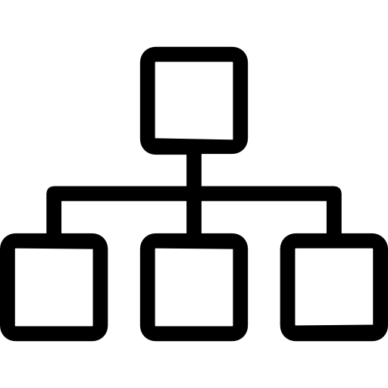

System Architecture with FL
Coordinating Server
Worker A
Worker B
Worker C
Training on full set S of attacks
Training on full set S of attacks
Training only on subset S’ ⊂ S
of attacks!
Question: Will device C be able to defend against one of the unseen attacks?
Notes:
So with the federated learning we would like to decrease the training time it takes to defend against unseen attacks.
In traditional FL fashion the training happens on multiple workers and then the parameters are aggregated and averaged by the coordinating server.
Imagine if only one worker sees a and learns how to defend against a specific attack. Will it be possible that he passes on the knowledge onto all other workers and enable them to defend against the attack when encountering it for the first time?

Slide 10
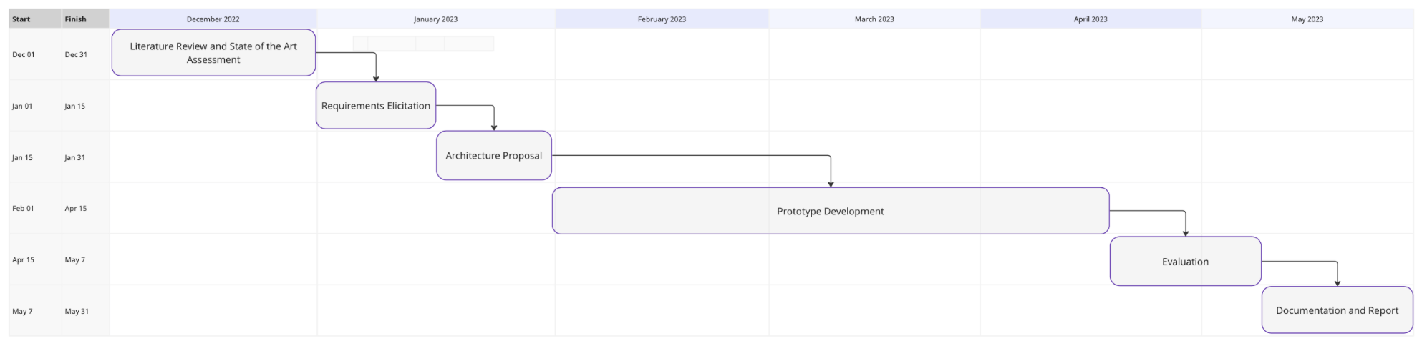
Project Plan
Notes:
I started on Dec 1 and I am going to use December for Literature Review on RL and FL with respect to MTDs.
And understanding Timo Schenks work.
From this we are going to derive a requirements and an architecture for the FL solution to be build
I hope to spend most of my time on the implementation March April and half of may.
The evaluation in form of different experiments will then be documented in the end.
Thats to overall structure.

Slide 11

Future Work
So far we are only learning which MTD to select but not when and how to move.
How to create MTDs that are able to deal with adaptive malware?
Notes:
Some things which are critical but we are not planning to address as part of my thesis.
Maybe someone else will focus on this later
So far we are only selecting which MTD to deploy but this does not really take into consideration when the optimal point in time would be to cha
In case the malware is getting more adaptive then the “how” to move the system parameters is getting much more important.
So as you can see, there is still a lot to be done.

