Slide 1
FedRL for IT Sec /
Meeting 02
31.01.2023
Jan Kreischer
Notes:
Welcome to our second meeting

Slide 2
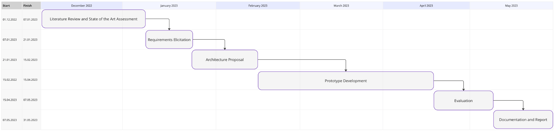
(31.01.2023)
Now
Notes:
First of all i want to show you the ghant chart
After literature review and requirements elicitation i am now in the design phase of the software system.
I am a little bit behind since i should have started with the architecture proposal already, but i will try to catch up.

Slide 3
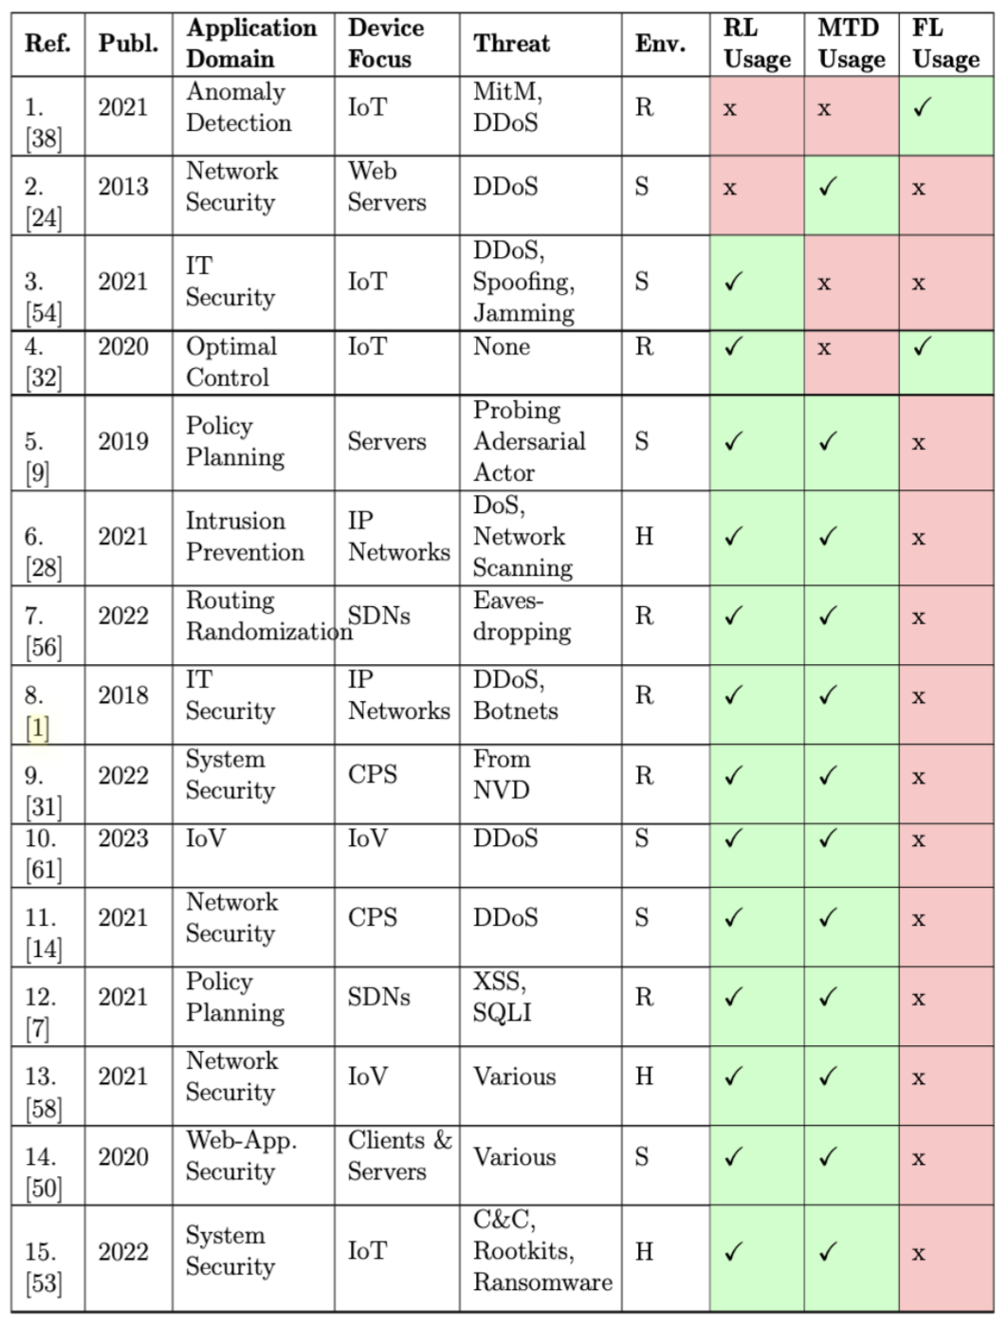
Classification of related work in 7 dimensions
Notes:
As Alberto mentioned i created a table where i classified all the related works along 7 dimensions
The application domain says what is tried to be achieved.
The second column tells which devices the work focuses on.
Some works focus on specific threats or vulnerabilities (but not all) and they are listed in the third column.
Furthermore, we also classify if the experiments done are conducted in a Real, Hybrid or Simulated Environment
The last three columns classify if RL, MTDs or FL was used in the paper.
I want to present you the 3 most notable works

Slide 4
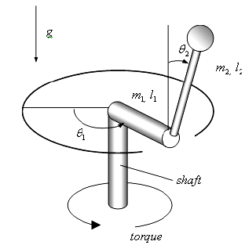
Federated Reinforcement Learning for Training Control Policies on Multiple IoT Devices
by Hyun-Kyo Lim et al. in 2020
Application Domain:
Optimal Control
Device Focus:
Rotary Inverted Pendulum Devices
Techniques:
Deep Federated Reinforcement Learning
Actor–Critic Proximal Policy Optimization
Results:
Accelerated Learning Process (~38%)
Higher Training Stability
Increased Generalization Capability
Notes:
The goal of their work was to train an optimal control policy for multiple inverted rotary pendulums that were connected via a network and a switch.
For such tasks where you need to find a non linear and non trivial control strategy it is very beneficial to refine the strategy through trial and error experimentation.
The emphasize that usually in a domain (e.g a factory) many IoT devices of the same type are usually installed (for example robotic arms that are assembling cars).
However the physical dynamics are usually slightly different, making it unfeasible to simply copy a mature control policy model to multiple devices.
The collaboration between the devices can help to learn the optimal control policy faster.

Slide 5
Deep reinforcement learning based
adaptive moving target defense
by Taha Eghtesad et al. in 2019
Application Domain:
Policy Planning
Device Focus:
Servers
Threats
Adverserial actor trying to gain control
Techniques:
Deep Q-Learning
Results:
Outperformed heuristic and random strategies
Finding good policies is computationally feasible even in analytically complex environments
Notes:
In this work a game theoretic model exists, with a set of n servers and a defender and an attacker.
The goal of the defender is to retain control over the servers and protect them from being taken over by the attacker.
In this work the attacks are modeled as followed.
The adversary can launch a probe against the server at any time, which either compromises the server or increases the success probability of subsequent probes
To keep the servers safe, the defender can “reimage” a server at any time, which takes the server offline for some time, but cancels the adversary’s progress and control.
The use Deep-Q-Learning to find optimal strategies for defenders in this moving target defense model
. The policies found using Deep-Q-Learning outperform heuristic and random strategies.
It was proven that finding such policies is computationally feasible even in analytically complex environments.
However, the experiments only consider a single defending agent in a synthetic environment.

Slide 6
Conclusion
3. Types of Related Work
1. Basic work regarding RL, FL or MTDs
2. Work regarding federated reinforcement learning (FRL)
3. Work regarding reinforcement learning policy based MTD deployment
=> To the best of my knowledge, no prior work regarding MTD Policy Optimization using Federated Reinforcement Learning exists.
Notes:
The goal of their work was to train an optimal control policy for multiple inverted rotary pendulums that were connected via a network and a switch.
For such tasks where you need to find a non linear and non trivial control strategy it is very beneficial to refine the strategy through trial and error experimentation.
The emphasize that usually in a domain (e.g a factory) many IoT devices of the same type are usually installed (for example robotic arms that are assembling cars).
However the physical dynamics are usually slightly different, making it unfeasible to simply copy a mature control policy model to multiple devices.
The collaboration between the devices can help to learn the optimal control policy faster.

Slide 7
Next Steps
Architecture Proposal
Reproduce Timo`s Results

Slide 8
Kernfarben
Blau
Grau
Ockerrot
100%
0R 40G 165B
163R 173G 183B
220R 96G 39B
80%
51R 83G 183B
181R 189G 197B
227R 128G 82B
60%
102R 126G 201B
200R 206G 212B
234R 160G 125B
40%
153R 169G 219B
218R 222G 226B
241R 191G 169B
20%
204R 212G 237B
237R 239G 241B
248R 223G 212B

Slide 9
Ergänzungsfarben
Türkis
Flaschengrün
Lindengrün
Warmgelb
100%
11R 130G 160B
42R 127G 98B
145R 195G 74B
254R 222G 0B
80%
60R 159G 182B
86R 157G 133B
170R 212G 112B
251R 230G 81B
60%
107R 183G 199B
128R 182G 164B
191R 223G 148B
252R 236G 124B
40%
158R 208G 217B
171R 206G 194B
213R 233G 183B
253R 243G 168B
20%
207R 232G 236B
213R 231G 225B
234R 244G 219B
254R 249B 211B

