Slide 1
FedRL for IT Sec /
Meeting 03
14.02.2023
Jan Kreischer
Notes:
Welcome to our second meeting

Slide 2
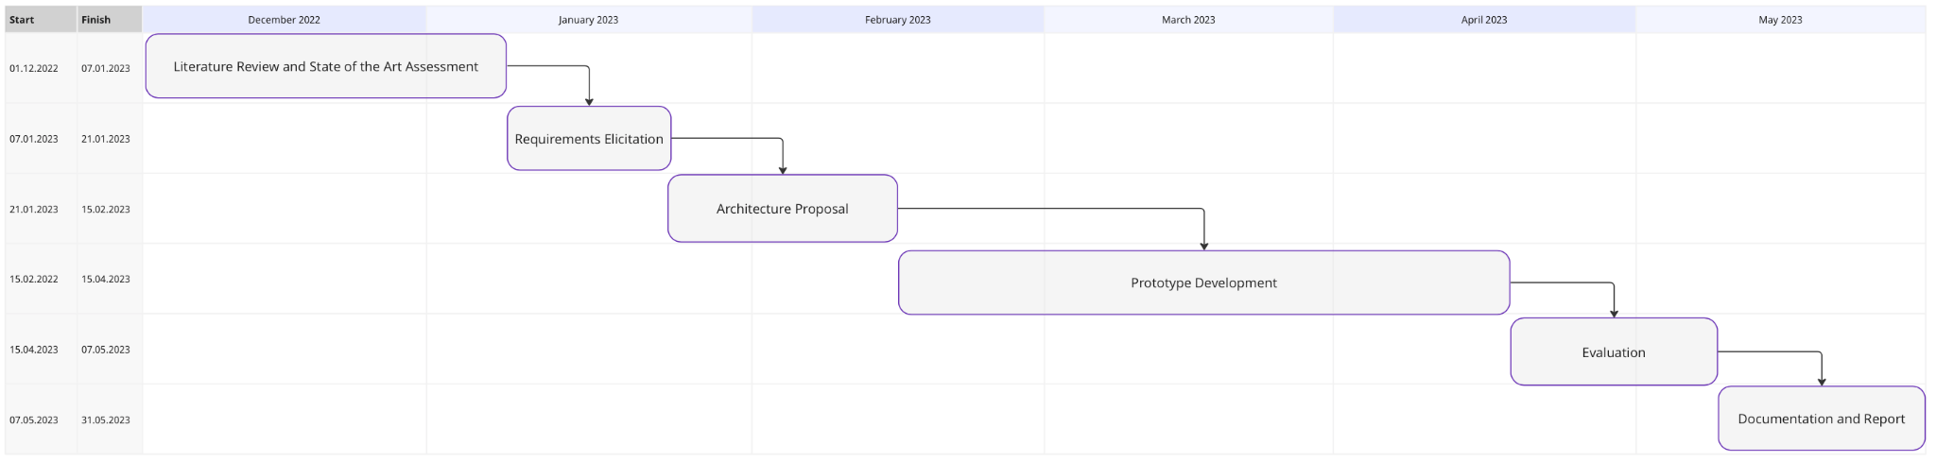
(14.02.2023)
Now

Slide 3






FL Frameworks
with explicit support for RL/ DQN?
✓…Yes, x … No, u … Unkown
Flower
(u)
OpenFL
(✓)
TensorFlow Federated
(✓)
IBM Federated Learning
(✓)
PySyft
(u)
Substra
(x)
Notes:
I did some research on open source FL frameworks that we could use.
I read some whitepapers and checked if the explicitly offer support for RL (or even DQL)
This is indicated by the checkmarks or x after the name
I stopped researching after i found 2 frameworks claiming to support DRL.
The most promising candidate truely seems to be IBM federated learning since they even provide examples for Federated DRL on their github account.
However, I realized that these frameworks usually target a system of clients where they can be deployed.
For my initial prototype this would be an overkill.

Slide 4
Prototype 1 / Experiment 1
Federated Equivalent to Timos Prototype 01
Uses gathered device behaviour for different states
A sampler is used to generate episodes
Behaviour transitions for each State-MTD combination are known with perfect certainty.
The training data is split equally between n devices
Acts as a baseline under ideal conditions
Hopefully reduce the needed training time

Slide 5
Prototype 1 / Experiment 2
Similar to my prototype 01
Same training data
Different data split
Hopefully the two devices together will learn a globally effective defense policy
Notes:
The training data is split equally between n devices

Slide 6
Prototype 2
Extend Prototype Nr. 1 by including the anomaly detector
Notes:
The training data is split equally between n devices

Slide 7
Prototype 3
Extend Prototype Nr. 2 by using a real FL framework
Notes:
The training data is split equally between n devices

Slide 8
Prototype 4
Extend Prototype Nr. 3 by with online sampled behavioural data
Notes:
The training data is split equally between n devices

Slide 9
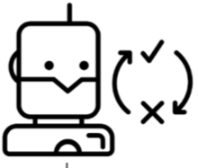

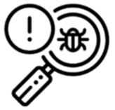
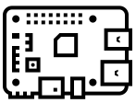
Federated Design Proposal
Global Agent
Request for Model Updates
Request for Model Updates
Collaborated
Model Updates
Collaborated
Model Updates
Client 01
Client 02
State Interpreter
State Interpreter
Local Agent
Local Environment
Local Agent
Environment
Notes:
The training data is split equally between n devices

Slide 10
Global Agent
5.
Next training round
4.
Update global model
1.
Distribute global model
Coordinator
Worker 01
Worker 02
2.
train local models
Local
Agent
Local Environment
Local
Agent
Local Environment
3.
Aggregate
local
models
Notes:
The training data is split equally between n devices

Slide 11

Global Agent
5.
Next training round
4.
Update global model
1.
Distribute global model
Coordinator
Worker 01
Worker 02
2.
train local models
Local
Agent
Local Environment
Local
Agent
Local Environment
3.
Aggregate
local
models
Notes:
The training data is split equally between n devices

Slide 12
Prototype 01
Uses gathered device behaviour for different states
A sampler is used to generate episodes
Acts as a baseline under ideal conditions
Behaviour transitions for each State-MTD combination are kown with perfect certainty.

Slide 13
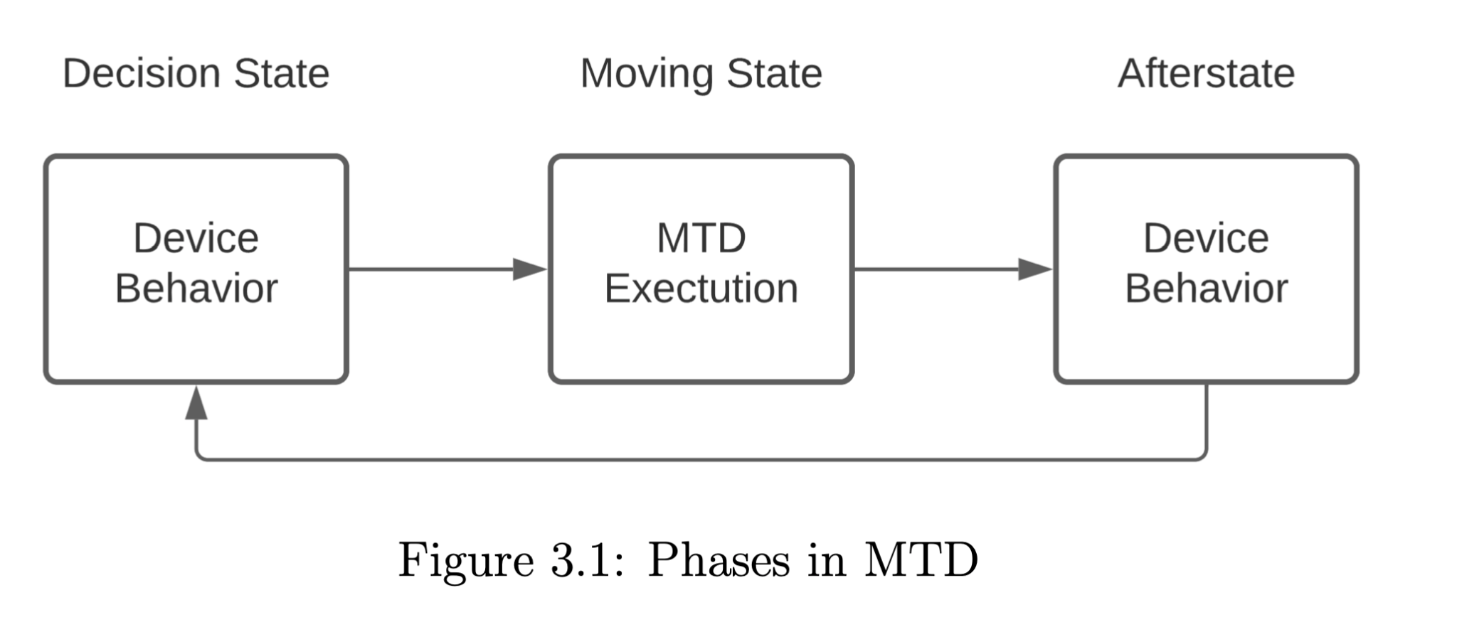
Reward Calculation
The afterstate of the device (after MTD execution) is used to calculate the reward
A trained autoencoder checks the state for normality
Two Cases
1. The chosen MTD was correct for the decision state leading to a normal afterstate behaviour.
2. An incorrcect MTD was chosen in the decision state leading to an non-normal afterstate.
Notes:
Only the normality of the afterstate matters for the reward calculation.

Slide 14
Kernfarben
Blau
Grau
Ockerrot
100%
0R 40G 165B
163R 173G 183B
220R 96G 39B
80%
51R 83G 183B
181R 189G 197B
227R 128G 82B
60%
102R 126G 201B
200R 206G 212B
234R 160G 125B
40%
153R 169G 219B
218R 222G 226B
241R 191G 169B
20%
204R 212G 237B
237R 239G 241B
248R 223G 212B

Slide 15
Ergänzungsfarben
Türkis
Flaschengrün
Lindengrün
Warmgelb
100%
11R 130G 160B
42R 127G 98B
145R 195G 74B
254R 222G 0B
80%
60R 159G 182B
86R 157G 133B
170R 212G 112B
251R 230G 81B
60%
107R 183G 199B
128R 182G 164B
191R 223G 148B
252R 236G 124B
40%
158R 208G 217B
171R 206G 194B
213R 233G 183B
253R 243G 168B
20%
207R 232G 236B
213R 231G 225B
234R 244G 219B
254R 249B 211B

