Slide 1
FedRL for IT Sec /
Meeting 04
28.02.2023
Jan Kreischer
Notes:
Welcome to our fourth meeting (half time meeting)

Slide 2
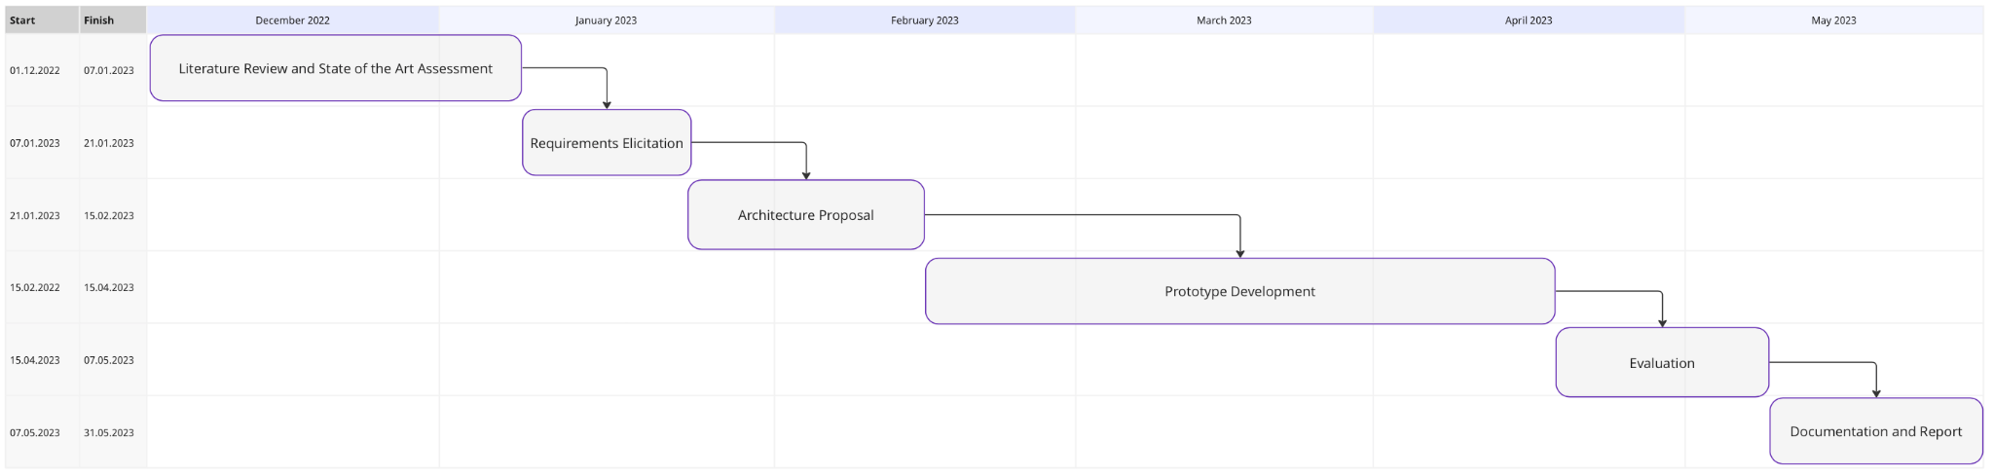
(28.02.2023)
Now
Notes:
Halftime
I worked a lot on implementing the federation and rewriting some of timos code to make it more compatible with a federated learning scenario.

Slide 3
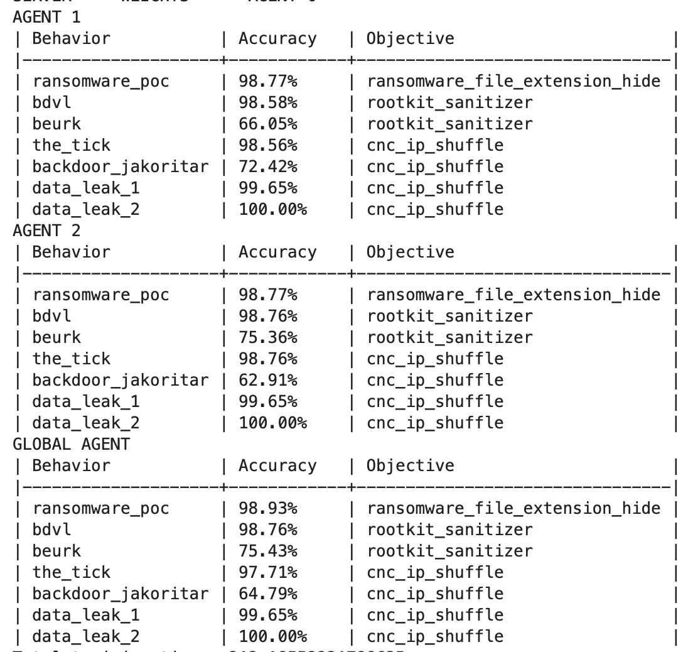
Prototype 1 (Experiment 1)
2 Clients with equally split training data
Both clients see all different types of attacks
Notes:
As we said this is simply the

Slide 4
Prototype 1 (Experiment 2) with some overlap
Notes:
As we said this is simply the

Slide 5
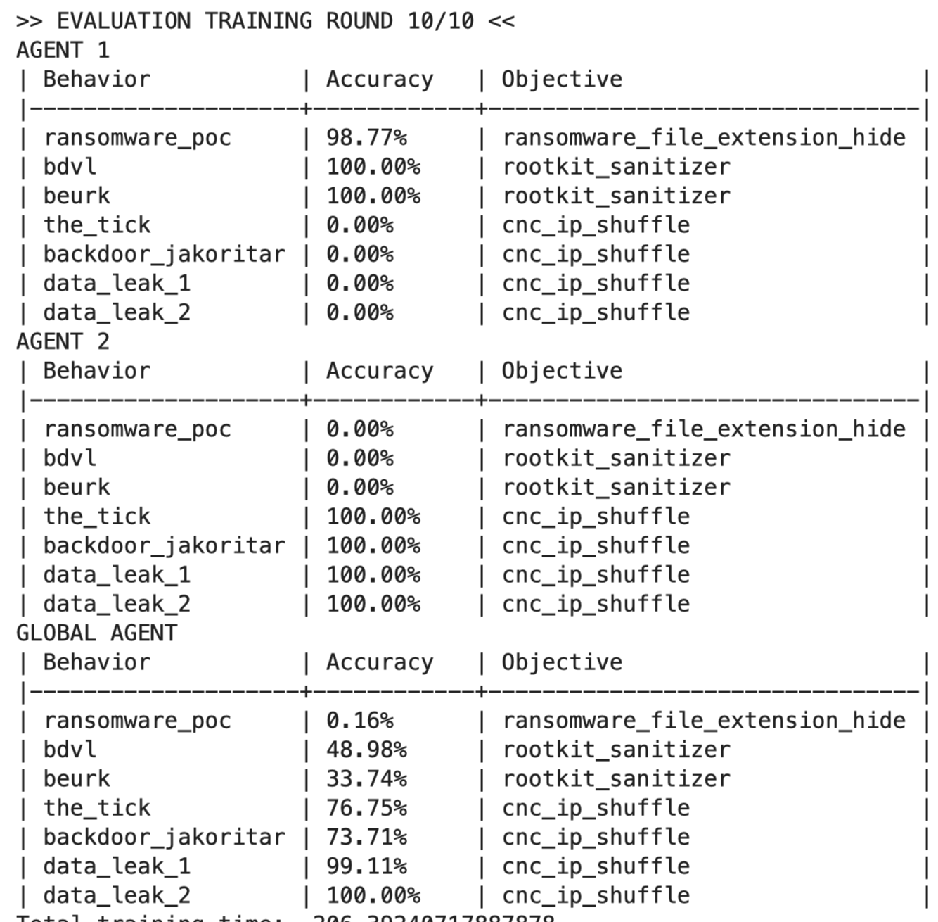
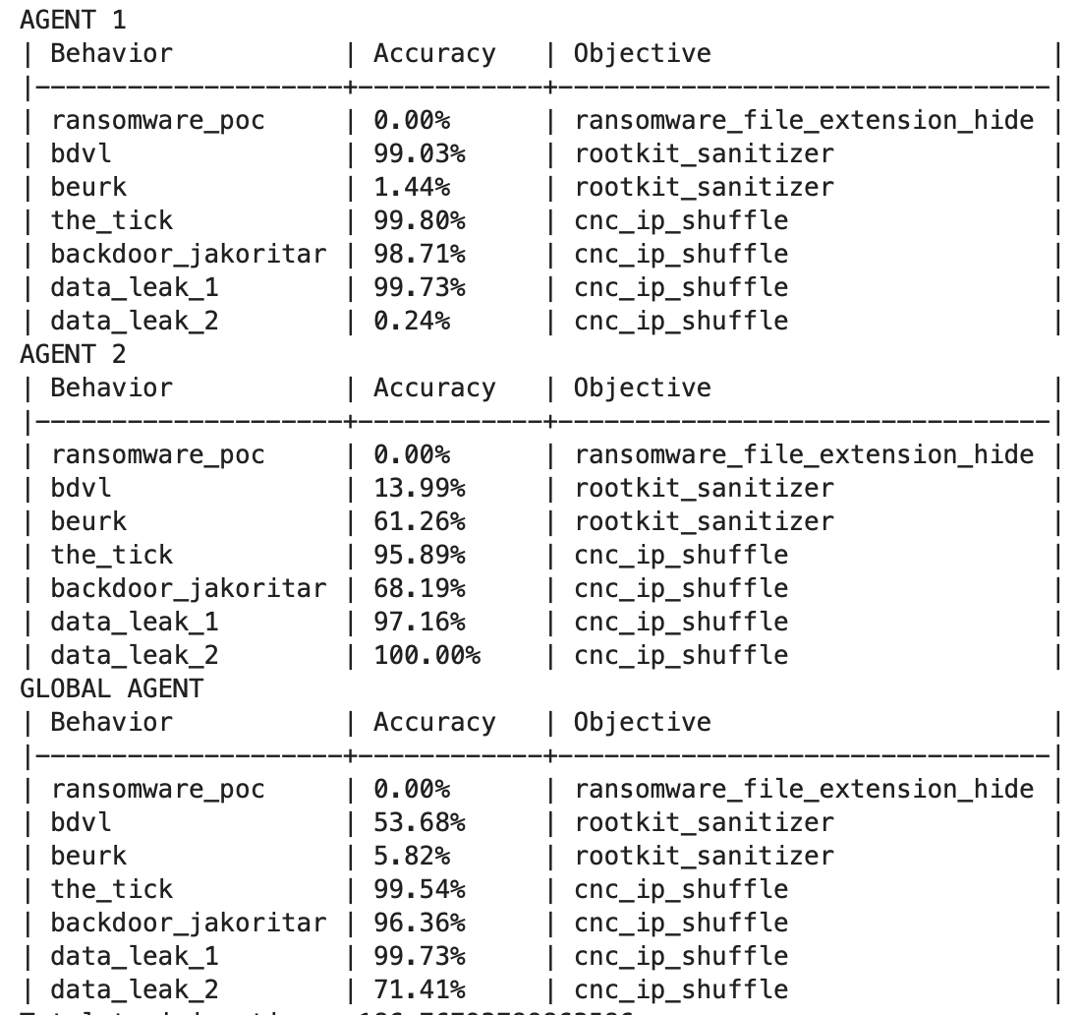
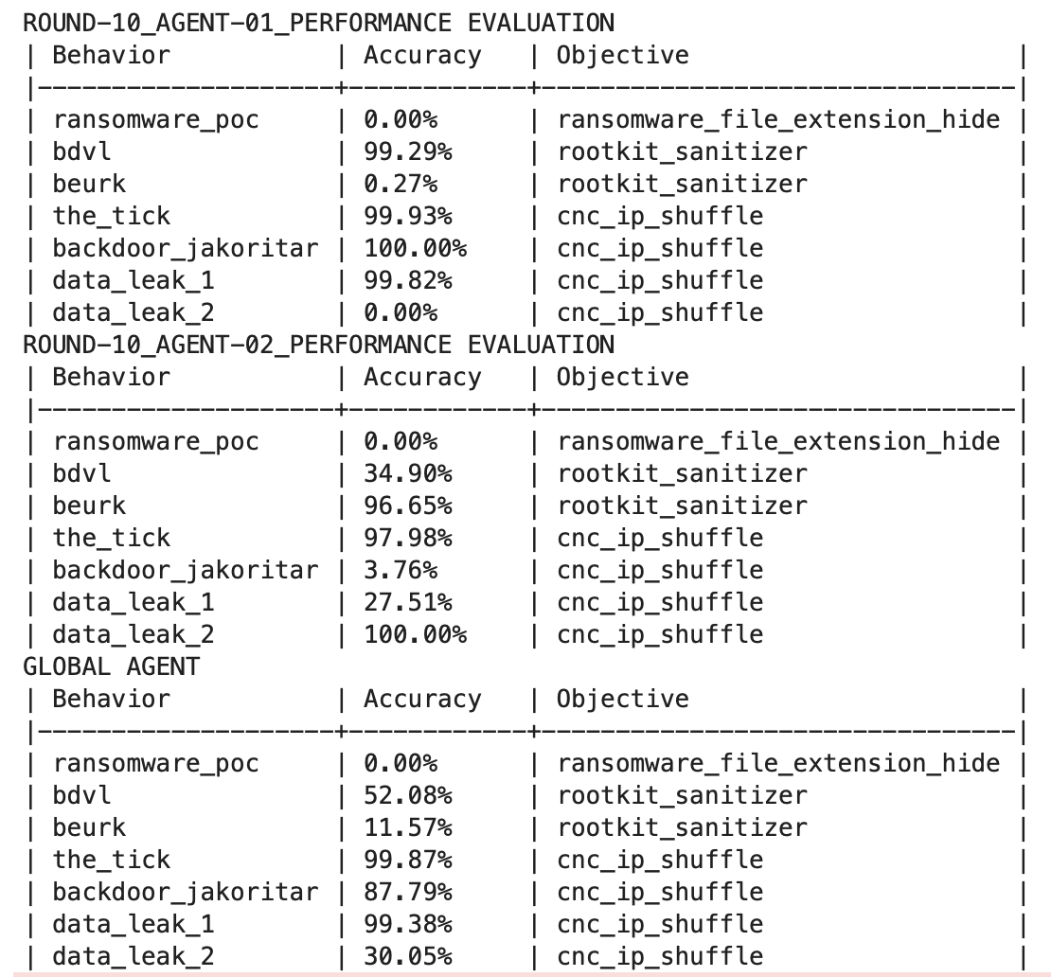
Prototype 1 (Experiment 3)
Data Split 1
Data Split 2
Data Split 3
Notes:
Experiment 02 is about class imbalance / client exclusive classes
I tried this with 2 clients.
The training data is split equally between n devices
The non iid data / client exclusive classes pose a real problem to federated averaging.
At first i was not sure if the federated pretraining of the agent even makes senst, but then i reliazed that in order to get it to work for a more realistic experiment the weight aggregation and model training needs to work here.
Otherwise, it wont be possible.
I actually see multiple problems here
cnc_ip_shuffle covers 4/7 more than half of the attacks, which means it is a very default choice for the network.

Slide 6
FL Weight Aggregation Strategies
How to deal with class imbalance or client exclusive classes?
FedAvg (not enough)
FedProx
Federated Learning with Restricted Softmax (FedRS)
Notes:
There is many papers dealing with the fact that FedAvg performs badly when dealing with non iid data.
An extreme case of non iid data would be client exclusive classes.
For example when agent a and b only see a different subset of attacks (as we intend to do in experiment 01)

Slide 7
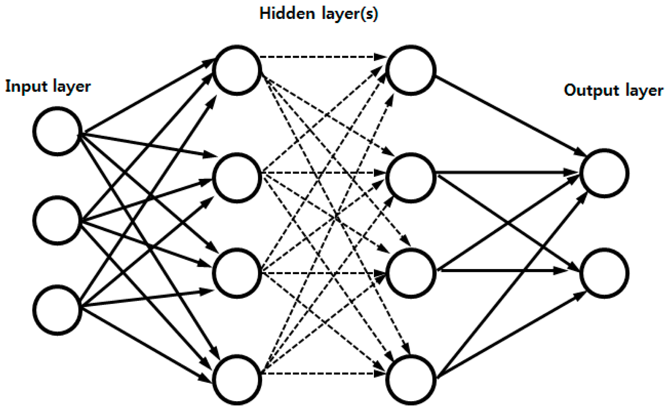
Predicting Attacks instead of which MTDs to deploy
Current
Architecture
Potential
Architecture
Input
State
Prediction
Which MTD
Input
State
Prediction
Which Attack
Simple Mapping between
Attacks and MTDs
Attack | Mitigation
ransomware_poc | file_extension_hiding
bdvl | rootkit_sanitizer
beurk | rootkit_sanitizer
the_tick | cnc_ip_shuffle
backdoor_jakoritar | cnc_ip_shuffle
data_leak_1 | cnc_ip_shuffle
data_leak_2 | cnc_ip_shuffle
learning which attack
learning which MTD
learning which attack
Notes:
I wanted to calculate the f1 score and print the confusion matrix for each attack in order to be able to fine tune hyperparameters.
Sadly this is not possible right now, since we are predicting which MTD to deploy.
The mapping between attack and which mtd to select is a very simple surjektive mapping.
The danger might be that we see a big degrade in performance since now the output size

Slide 8
Next Steps (Ideas)
Investigate and implement different weight aggregation strategies (besides FedAvg)
Refactor the DQN architecture to predict attacks instead of MTDs
Hyperparameter tuning
Investigate overfitting of DQNs
Round based training in online prototype
Check the performance of the federated prototype 2 (\w anomaly detector)
Notes:
Check the performance of the federated prototype 2 (\w anomaly detector)
=> Proceed one step further and see how the federated version of timos second prototype would perform.
2. Investigate and implement different weight aggregation strategies (besides FedAvg)
3. Refactor the DQN architecture to predict attacks instead of MTDs
4. Hyperparameter tuning
=> So far i have only used Timos DQN architecture. But i have the feeling that it is overfitting a lot in the federated case since we only try to predict 3 different classes as output. And in the case of client exclusive classes (when the clients only see a distinct set of attacks) each client learns to perfectly
predict the seen attacks (nearly 100%) but has detrimental performance for unseen attacks (all 0%) on the test set.

Slide 9
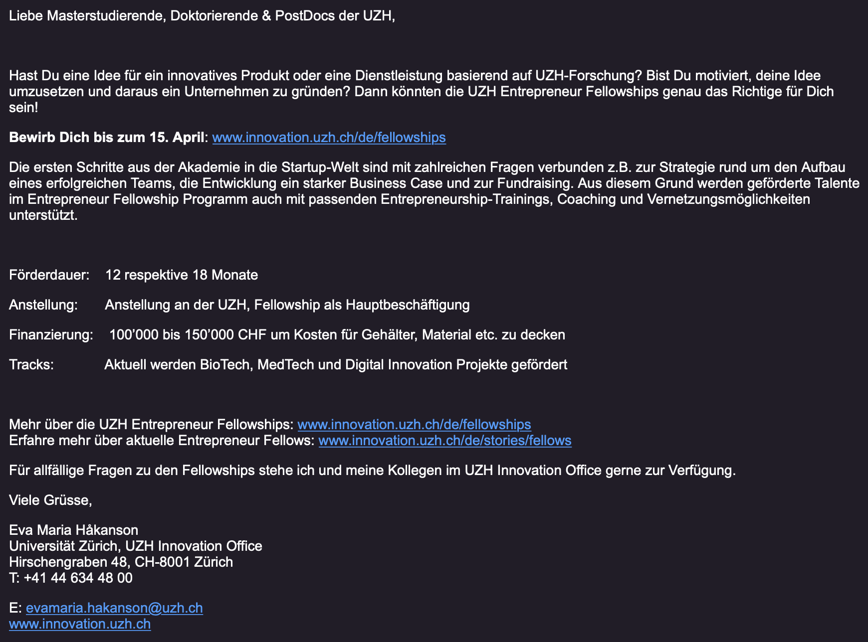
UZH Entrepreneur Fellowship
Notes:
The training data is split equally between n devices

Slide 10
Prototype 01
Uses gathered device behaviour for different states
A sampler is used to generate episodes
Acts as a baseline under ideal conditions
Behaviour transitions for each State-MTD combination are kown with perfect certainty.

Slide 11
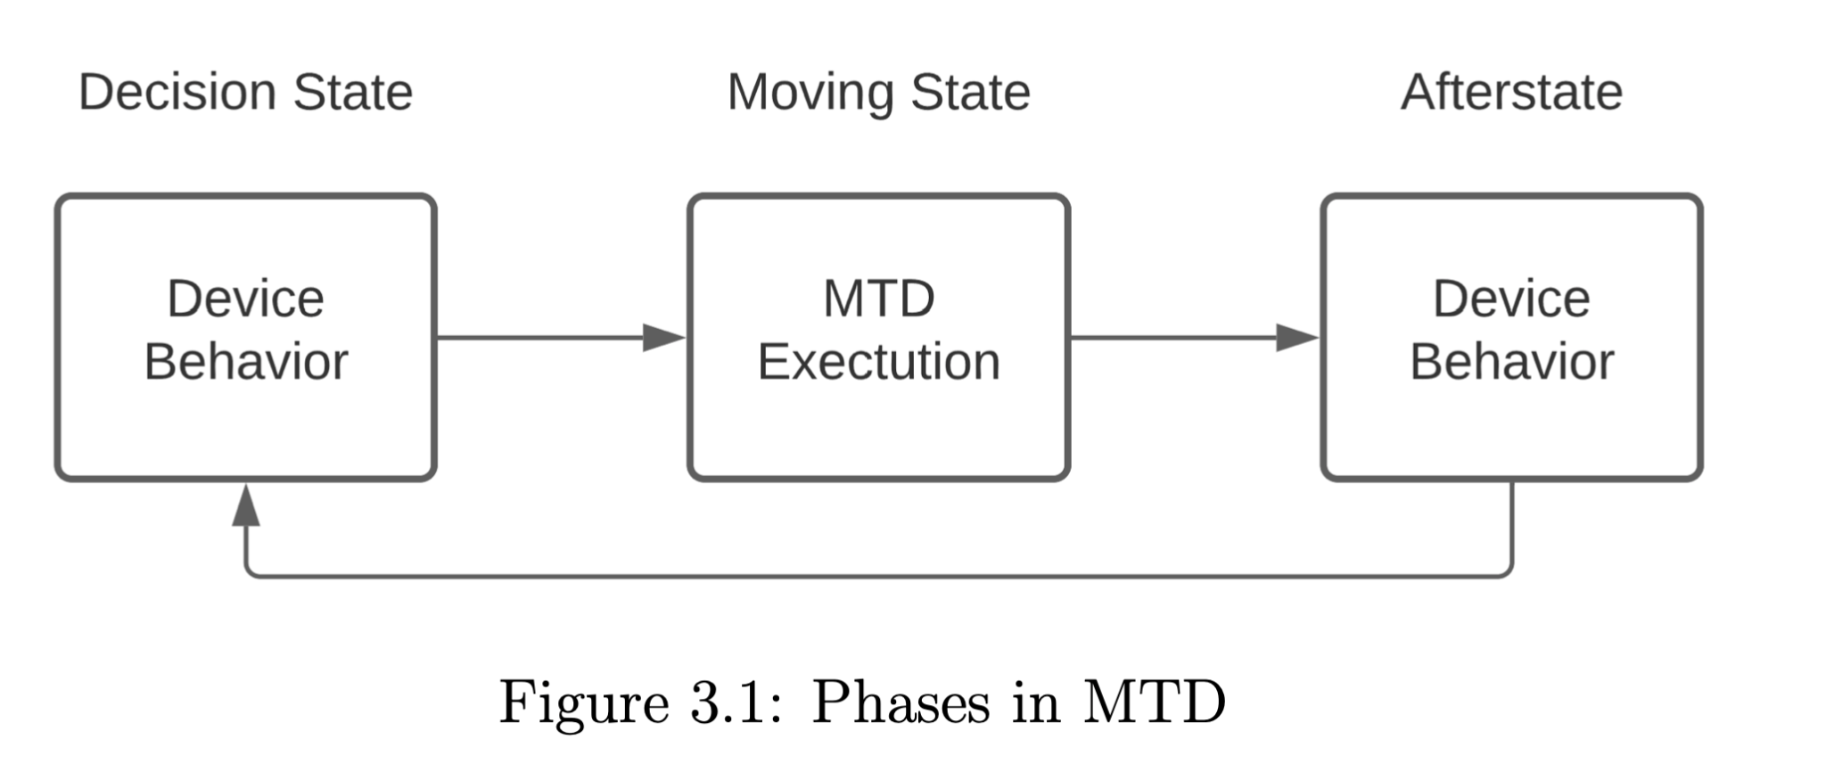
Reward Calculation
The afterstate of the device (after MTD execution) is used to calculate the reward
A trained autoencoder checks the state for normality
Two Cases
1. The chosen MTD was correct for the decision state leading to a normal afterstate behaviour.
2. An incorrcect MTD was chosen in the decision state leading to an non-normal afterstate.
Notes:
Only the normality of the afterstate matters for the reward calculation.

Slide 12
Kernfarben
Blau
Grau
Ockerrot
100%
0R 40G 165B
163R 173G 183B
220R 96G 39B
80%
51R 83G 183B
181R 189G 197B
227R 128G 82B
60%
102R 126G 201B
200R 206G 212B
234R 160G 125B
40%
153R 169G 219B
218R 222G 226B
241R 191G 169B
20%
204R 212G 237B
237R 239G 241B
248R 223G 212B

Slide 13
Ergänzungsfarben
Türkis
Flaschengrün
Lindengrün
Warmgelb
100%
11R 130G 160B
42R 127G 98B
145R 195G 74B
254R 222G 0B
80%
60R 159G 182B
86R 157G 133B
170R 212G 112B
251R 230G 81B
60%
107R 183G 199B
128R 182G 164B
191R 223G 148B
252R 236G 124B
40%
158R 208G 217B
171R 206G 194B
213R 233G 183B
253R 243G 168B
20%
207R 232G 236B
213R 231G 225B
234R 244G 219B
254R 249B 211B

