Slide 1
Federated Reinforcement Learning for Private and Collaborative Selection of Moving Target Defense Mechanisms in IoT Devices
Midterm Presentation by Jan Kreischer
Notes:
Hello everyone.
Welcome to the midterm presentation of my master thesis on
“Federated Reinforcement Learning for Private and Collaborative Selection of Moving Target Defense Mechanisms in IoT Devices”

Slide 2
Outline
Objectives
Theoretical Background
Related Work
Scenario
Reinforcement Learning for MTD Selection
System Architecture
Prototype 01
Notes:
This is the outline of my presentation.
First of all i want to talk about the goals and objectives of my master thesis.
Then i will give you an introduction to the necessary theoretical background
and talk about the related work
Afterwards i will introduce you to the the scenario we are dealing with
and explain how reinforcement learning can be used for mtd selection.
The federated learning and reinforcement learning aspects are shown in the proposed system architecture
which was then implemented as a first prototype.

Slide 3
Objectives
Understanding the state of the art of IoT Security (with respect to MTDs, FL and RL)
Design a FRL system for MTD selection
Development of a Prototypical Solution
Evaluation in Real World Scenario
Notes:
So first of all i had to analyse the current state of IoT security.
While doing so i checked which works were making use of Moving Target Defense, Federated Learning or Reinforcement Learning.
Based on the findings a federated reinforcement system capable of learning to select the correct mtd has to be designed.
A prototypcial implementation of this architecture is then supposed to be evaluated in a real world scenario.

Slide 4
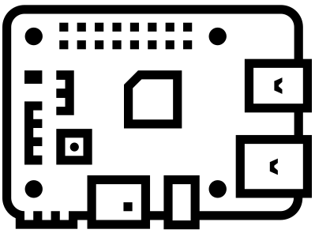



IoT Security
IoT Devices
Explosive Growth
Unsecure
Design
Recent
Attacks
Notes:
First of all, let’s explore why security in the context of IoT is such a complex issue.
The Internet of Things has seen an explosion in the number of devices in recent years.
The majority of these devices are consumer grade and rather cheap.
According to Statista in 2023, there is 15 billion IoT devices on the planet right now, (already more than humans on the planet)
Not every vendor sees the necessity to spend a lot of money on security,
since the individual device should be affordable for end customers.
Therefore, many IoT devices are already unsecure design.
This is amplified by the low IT security knowledge of end customers.
Due to the high number of devices, devices types, models, manufacturers and technologies in use, Iot security is very difficult. The mirai botnet from 2016, was created by simply targeting IoT devices (like IP cameras) and trying out if the standard admin name and password have been changed or not. It is estimated that around 500.000 devices were captured by this simple approach and the botnet was then used to launch DDoS attacks on multiple targets. One attack was powerful enough to take down a DNS service, making websites like Twitter and Github unavailable via DNS for some hours.
This work is using Raspberry Pis that are configured to be sensors in the Electro Sense crowd sensing network as an exemplary IoT device.

Slide 5
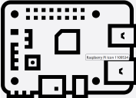
How Moving Target Defense (MTD) Mechanisms can help?
MTD-Paradigm
Attack Surface
What to adapt?
(e.g local IP address)
Malware
When to change?
Observe
device state
(e.g periodically)
How to transition?
(e.g shuffle through list of ip addresses)
Notes:
Much could be done in order to make IoT devices more secure (for example forcing the user to change the default username and password or already shipping the device with randomized credentials).
But even if more effort is spend on making these devices more secure, perfect security will never be reached.
Not every attack (for example the ones using zero day exploits) can be stopped right at the system boundary.
Therefore, IT security needs to think about defense-in-depth.
Each device has certain attack surface that attackers need to break through at a certain point.
The attack surface is mostly static since (ip adresses, port numbers, installed software versions) does not frequently change.
The attacker can take his time to gather enough data, plan and then execute his attack.
The idea of Moving Target Defense (MTD) is to thwart off adversaries by proactively or reactively altering the attack surface of the target device.
In order to design an MTD you need to specify what parameters to change as well as when and how to change them.

Slide 6

Reinforcement Learning (RL)
Notes:
Although i assume most of you are familiar with the basic idea behind reinforcement learning i will give a quick introduction.
The idea behind reinforcement learning is your decision making agent learns by interacting with its environment.
Each action that the agent peforms in the environment alters its state.
Furthermore, the agent receives a positive or negative reward telling him how good or bad his choice of action was.
By repeating this agent environment interaction over 1000s of episodes and propagating back the error, the agent can learn on
how to optimally interact depending on the current state of the environment he is observing.

Slide 7

Federated Learning (FL)
Coordinating Server
Client A
Client B
Client C
Notes:
Federated Maschine Learning is a paradigm where multiple machine learning client want to train a global model together without centralizing or exchanging their private training data.
This is achieved by repeatedly exchanging the model parameters instead of training data and aggregating them on the coordinating server.
We want to make use of federated learning for multiple reasons.
By using federated learning we want to decrease the pre training time, but also later on the time it takes to defend against unseen attacks.
Since all clients are of the same type (ElectroSense sensors) but show slightly different behavior, we hope to achieve more robust results compared to a single client architecture.
Furthermore, FL allows us to use the experience of multiple clients while still preserving the privacy.
Especially if the devices would be owned by different operators it would be difficult to centralize the behaviour data.

Slide 8
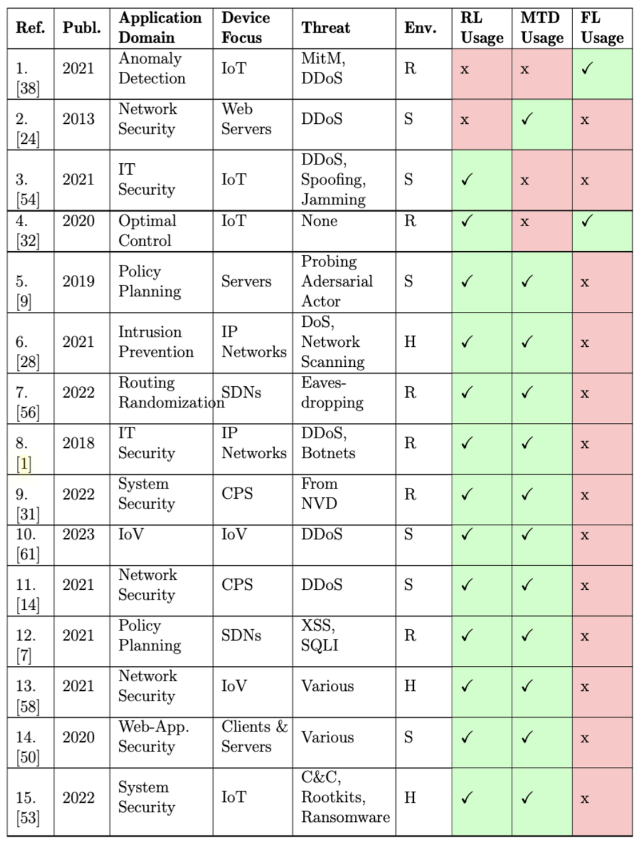
Related Work
Classification of related works along 7 dimensions
One work combining RL and FL
Related works using RL for MTD selection
Notes:
For the literature review i searched for all types of papers that use reinforcement learning to optimized mtd deployment or works that combine federated learning with federated learning in any domain.
Overall 15 papers were considered in the literature review
Some works focus on specific threats or vulnerabilities (but not all) and they are listed in the third column.
Furthermore, we also classify if the experiments done are conducted in a Real, Hybrid or Simulated Environment
The last three columns classify if RL, MTDs or FL was used in the paper.
As you can see only one related work combining RL and FL was considered.
This work had a completely different focus than our work.
They tried to train an optimal control policy for multiple inverted rotary pendulums that were connected via a network using reinforcement learning.
Since the physical dynamics of each rotary pendulum are usually slightly different, it is unfeasible to simply copy a mature control policy model to multiple devices. They showed that by using federated learning across multiple devices, they were able to learn a more stable control policy and the convergence was faster. This is also interesting for us, since we hope to observe similar results.
Multiple works could be found that apply RL to learn a policy for MTD deployment (also the work of my predecessor Timo Schenk)
A work combining FL and RL in the domain of IT Security (or for MTD deployment) could not be found.

Slide 9
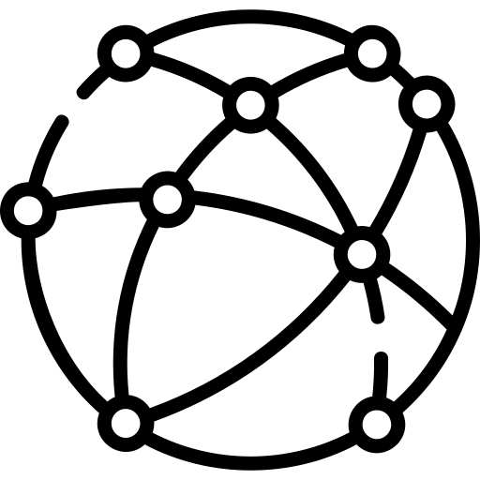

Scenario
Attacker
Internet
ElectroSense
Sensors
Notes:
Imagine a system administrator that owns a set of IoT devices (ElectroSense Sensors).
Your task is it to make sure that these devices which are constantly connected and available from the internet are protected from attacks.

Slide 10
Matching Malware and MTDs
Types of Malware | Mitigating MTDs
Command and Control & Botnets 4 specific C&C implementations | - Private IP Address Shuffling
Rootkits 2 specific rootkit implementations | - Rootkit Purging
Ransomware 1 specific ransomware implementation | - Encryptor Trapping with Dummy Files - File Ending Randomization
Notes:
The three common types of malware targeting IoT devices are command and control malware, rootkits and ransomware.
We selected 4 command an control malwares, 2 rootkits and 1 ransomware for our experiments.
For each specific malware a moving target defense, capable of mitigating the attack is available (as shown in the column on the right).
So for example the ransomware that we are dealing with can be neutralized by the encryptor trapping mtd.
This basically traps the ransomware in a directory and expands the file tree downwards with dummy files.
In the meantime the encrypting process can be identified by the number of file write operations (which is naturally very large for ransomware) and then terminated and blocked.

Slide 11
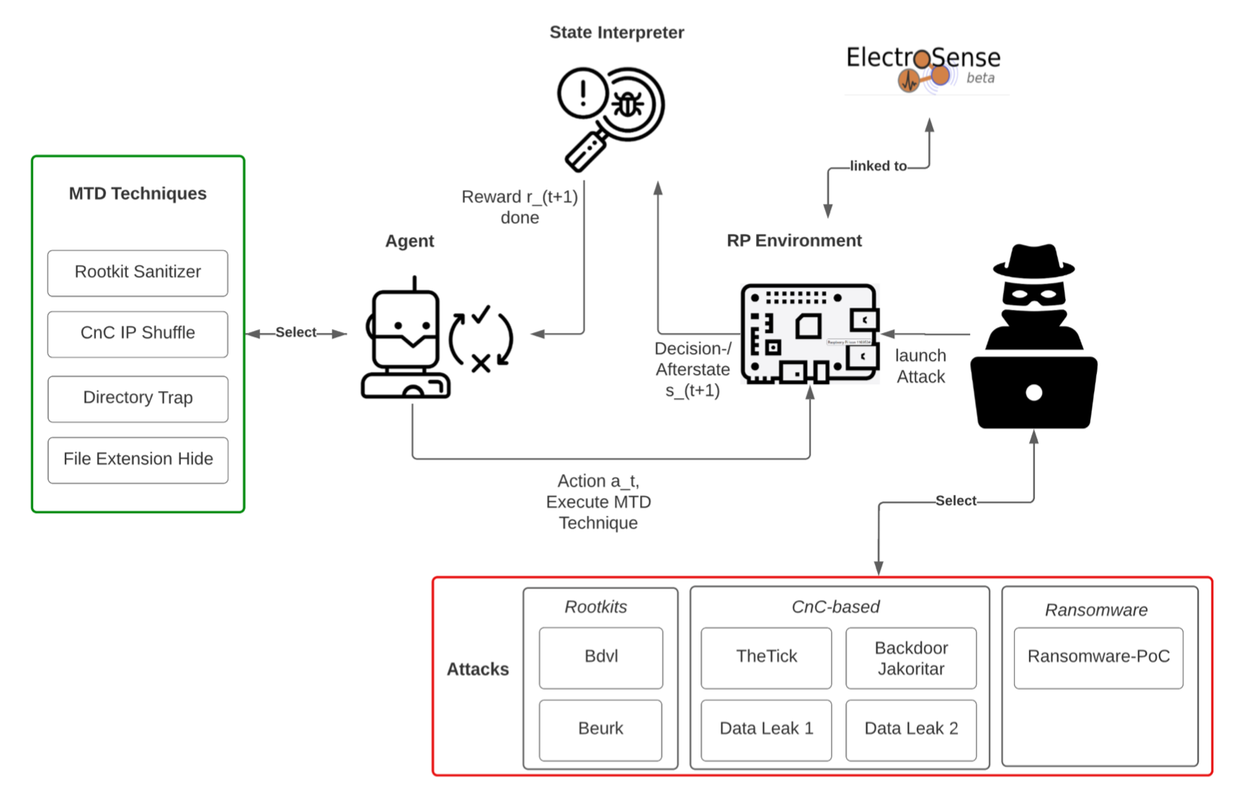
Single Client Architecture
Client
Notes:
Here you can see a single client architecture.
The federated architecture comprises multiple such clients.
In the center you can see the raspberry pi that is part of the electro sense crowd sensing platform.
The attacker selects and launches a specific attack targeting the device.
The agent uses the linux system tools in order to monitor 100 features that represent the current state of the device.
Active malware will alter the features.
The agent goal is to select and deploy the correct MTD in order to mitigate the attack.
The state interpreter is used to generate the feedback signal.
It can classify if the devices current behavior can be considered to be normal or unnormal.
If the current attack was successfully mitigated by the chosen MTD then the agent receives a positive reward.

Slide 12
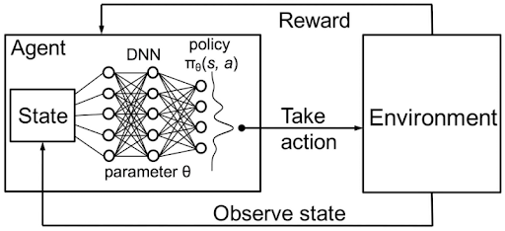
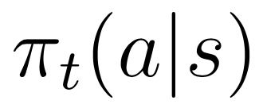
Reinforcement Learning (RL) for MTD-Selection
Goal: Learning a Policy π representing probability of selecting action a when being in state s.
Notes:
This training training loop already hints that reinforcement learning can be used to solve this task.
The goal is to find a mapping between the current state of the device and which MTD should get deployed (called policy Pi)
So the agent should autonomously learn this probability distribution Pi by interacting with the environment, while trying to maximize the reward he receives in the long-term.
If the agent choses the right action to take according to the state of the device then he receives a positive reward and otherwise a negative one.
If our case, if the correct MTD has been selected keeping the device state normal a reward of +1 is received otherwise negative feedback of -1 is received.
Hereby the agent is supposed to learn which mtd to select depending on the state of the IoT device (environment) that he is observing.
Traditional tabular reinforcement learning algorithms like SARSA or Q-learning do not work well in this scenario since the device state is high dimensional (100 features).
Therefore, we are using Deep Q learning in order to approximate the policy via a deep neural network.
The neural network receives the state vector as input and predicts a probability distribution over which actions to take.

Slide 13
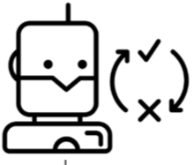

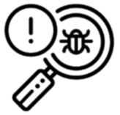
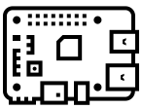
Federated System Architecture
Global Agent
Coordinating
Server
Receive global model
Receive global model
Return locally updated model
Return locally updated model
Client 01
Client 02
State Interpreter
State Interpreter
Local Agent
Environment
Local Agent
Environment
Notes:
Let’s take a look at a federated version of the previous architecture.
In this case we assume to have n different clients participating in the training process, that are all connected the the coordinating server.
The training is performed in multiple rounds and in each round a certain amount of episodes are passed.
For example you could do 10 training rounds a 1000 episodes each or 100 rounds a 100 episodes each.
Each round follows the same procedure.
First of all the coordinating server sends the weights of the current global model to each client.
Each client then runs the training for the specified number of episodes.
then the weights of each locally updated DQN model is send back to the server.
We hope to see a linear decrease in training time with the number of participating clients increasing.
Furthermore we would like to decrease the time it takes to learn how to defend agains newly seen attacks (asuming a suitable MTD for this new attack is available).
Imagine if only one worker sees a and learns how to defend against a specific attack. Will it be possible that he passes on the knowledge onto all other workers and enable them to defend against the attack when encountering it for the first time?

Slide 14
Prototype 01
A sampler and gathered device data is used to generate episodes
Behaviour transitions for each State-MTD combination are known with perfect certainty.
Acts as a baseline under ideal conditions
5 participating clients
10 training rounds à 1000 episodes
Simple linear epsilon decay over all 10000 episodes.
Notes:
This architecture was implemented in our first prototype.
First of all data was gathered for all different device states (normal behaviour, under attack by each malware).
A sample was then used to generated episodes from this data.
So for example if the device was under attack by malware A and the correct MTD was chosen the afterstate would then be normal.
Since every State-MTD combination is known with perfect certainty this prototype acts as a baseline under ideal conditions.

Slide 15
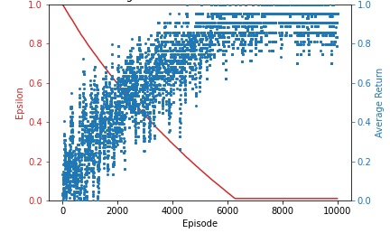
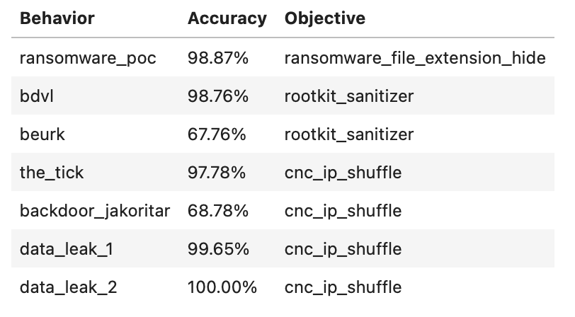
Prototype 01 Results
Learning Curve
Performance Evaluation
Notes:
As you can see the average received reward per episode increases episode by episode.
During this process the epsilon is also constantly decreasing.
The lower epsilon the higher is the likelihood of favoring exploitation over exploration, meaning the greedy action will get selected.
As you can see on
and then motivate what are we proposing (mention the limitations of timos work). Then mention what FL can help to improve the limitations of the previous work. Then objectives. Then literature review. Then talk about our specific scenario.
Mention in the related work that timo already worked on this
Present the objectives after the literature review. (indicate what is old, what is new and what we want to solve)
Intro Background
Related Work
Contributions
Results

Slide 16
Next Steps
Prototype with Anomaly Detector
Run training directly on a RPi cluster
(Build a full online version of the system/ agent)
Notes:
This concludes my presentation and I am happy to answer your questions now.

Slide 17
APPENDIX

Slide 18



Attack-Defense Learning Cycle
Observe device behaviour under attack
Launch attack
IoT Device
Select and Execute MTD
Attacker
Observe device behaviour after MTD execution
Run next iteration?
Receive positive or negative reward
Notes:
We use linux system tools in order to monitor 100 features that represent the current state of the device.
Active malware will alter the features.
Our goal is it to select and deploy the correct MTD in order to mitigate the attack.
If the current attack was successfully mitigated by the chosen MTD then the agent receives a positive reward.

Slide 19
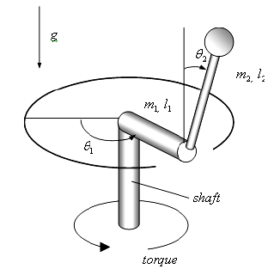
Federated Reinforcement Learning for Training Control Policies on Multiple IoT Devices
by Hyun-Kyo Lim et al. in 2020
Application Domain:
Optimal Control
Device Focus:
Rotary Inverted Pendulum Devices
Techniques:
Deep Federated Reinforcement Learning
Actor–Critic Proximal Policy Optimization
Results:
Accelerated Learning Process (~38%)
Higher Training Stability
Increased Generalization Capability
Notes:
The goal of their work was to train an optimal control policy for multiple inverted rotary pendulums that were connected via a network and a switch.
For such tasks where you need to find a non linear and non trivial control strategy it is very beneficial to refine the strategy through trial and error experimentation.
The emphasize that usually in a domain (e.g a factory) many IoT devices of the same type are usually installed (for example robotic arms that are assembling cars).
However the physical dynamics are usually slightly different, making it unfeasible to simply copy a mature control policy model to multiple devices.
The collaboration between the devices can help to learn the optimal control policy faster.

Slide 20
Deep reinforcement learning based
adaptive moving target defense
by Taha Eghtesad et al. in 2019
Application Domain:
Policy Planning
Device Focus:
Servers
Threats
Adverserial actor trying to gain control
Techniques:
Deep Q-Learning
Results:
Outperformed heuristic and random strategies
Finding good policies is computationally feasible even in analytically complex environments
Notes:
In this work a game theoretic model exists, with a set of n servers and a defender and an attacker.
The goal of the defender is to retain control over the servers and protect them from being taken over by the attacker.
In this work the attacks are modeled as followed.
The adversary can launch a probe against the server at any time, which either compromises the server or increases the success probability of subsequent probes
To keep the servers safe, the defender can “reimage” a server at any time, which takes the server offline for some time, but cancels the adversary’s progress and control.
The use Deep-Q-Learning to find optimal strategies for defenders in this moving target defense model
. The policies found using Deep-Q-Learning outperform heuristic and random strategies.
It was proven that finding such policies is computationally feasible even in analytically complex environments.
However, the experiments only consider a single defending agent in a synthetic environment.

Slide 21
Which Malware and MTDs
Types of Malware | Mitigating MTDs
Command and Control & Botnets THETICK BACKDOOR_JAKORITAR CNC_OPT1 CNC_OPT2 | - Private IP Address Shuffling
Rootkits BDVL BEURK | - Rootkit Purging
Ransomware PoC | - Encryptor Trapping with Dummy Files - File Ending Randomization

Slide 22
DQN Architecture
4
neurons
30
neurons
47
neurons
60
neurons

Slide 23

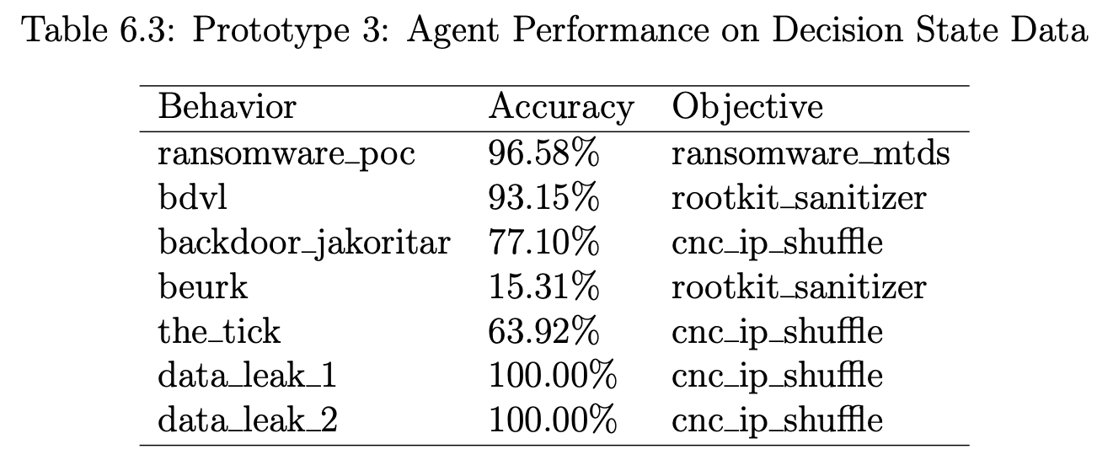
Performance & Limitations
“the time required to learn new attacks may impair viability.”
Notes:
As we can see according to the achieved performance of the RL agent, it is able to select the right MTD with high success rate.
Some malware (e.g ransomware or data leaking malware) alters the behaviour of the device a lot and
Thus it is easier to be recognized by the anomaly detection as malicious behaviour.
The rootkit is harder to detect since it does not really alter the normal device behaviour that much
and thus is not often recognized as unnormal behavour.
And then no MTD is deployed.
=> Anomaly detection on device state is critical to success
Another issue that Timo Mentions in the end of his work is that “the time required to learn how to defend against new unseen attacks migh impair viability”
Therefore, we would like to see if we could decrease this learning time or transfer the knowledge between devices.

