Slide 1
FedRL for IT Sec /
Meeting 06
11.04.2023
Jan Kreischer

Slide 2
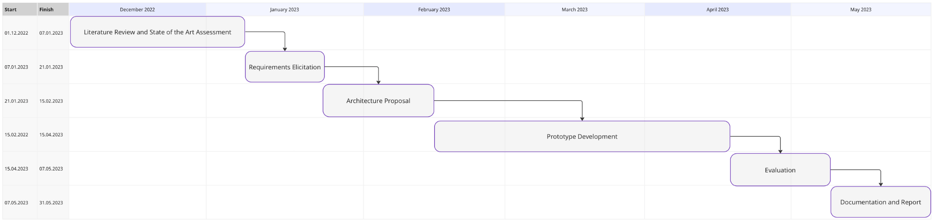
(11.04.2023)
Now

Slide 3
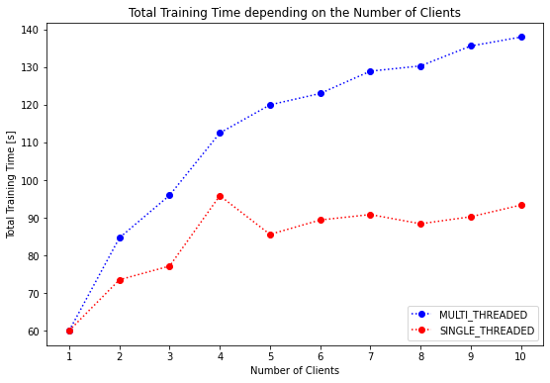
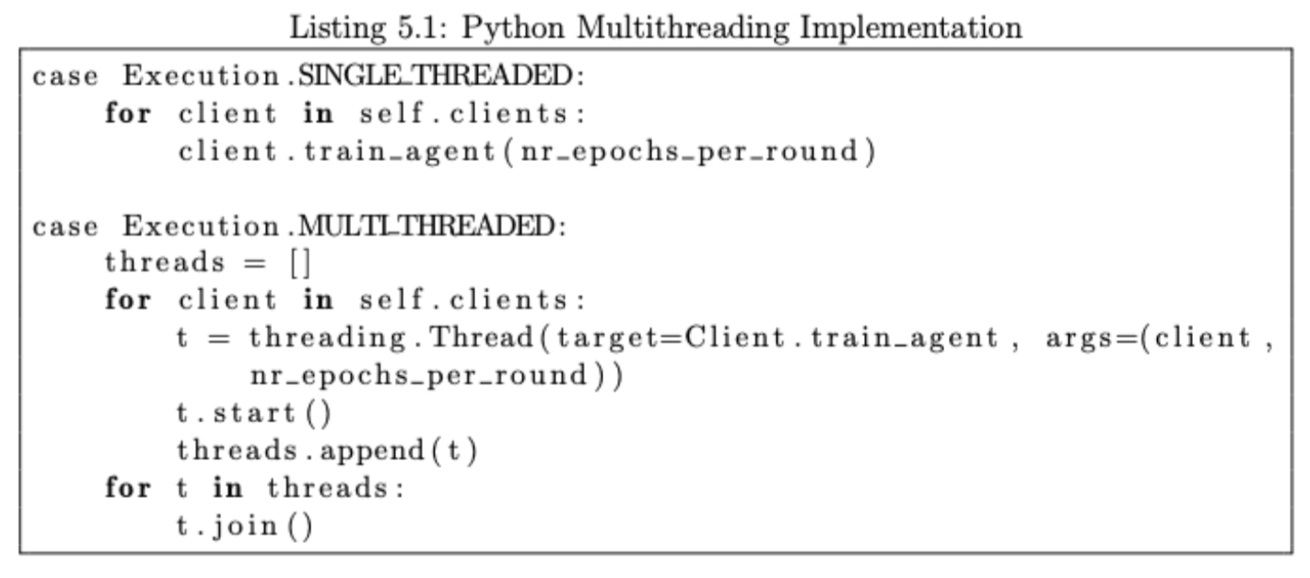
Single vs Multi-Threadding Performance Comparison

Slide 4
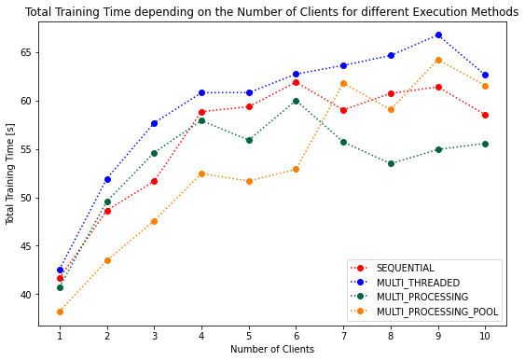
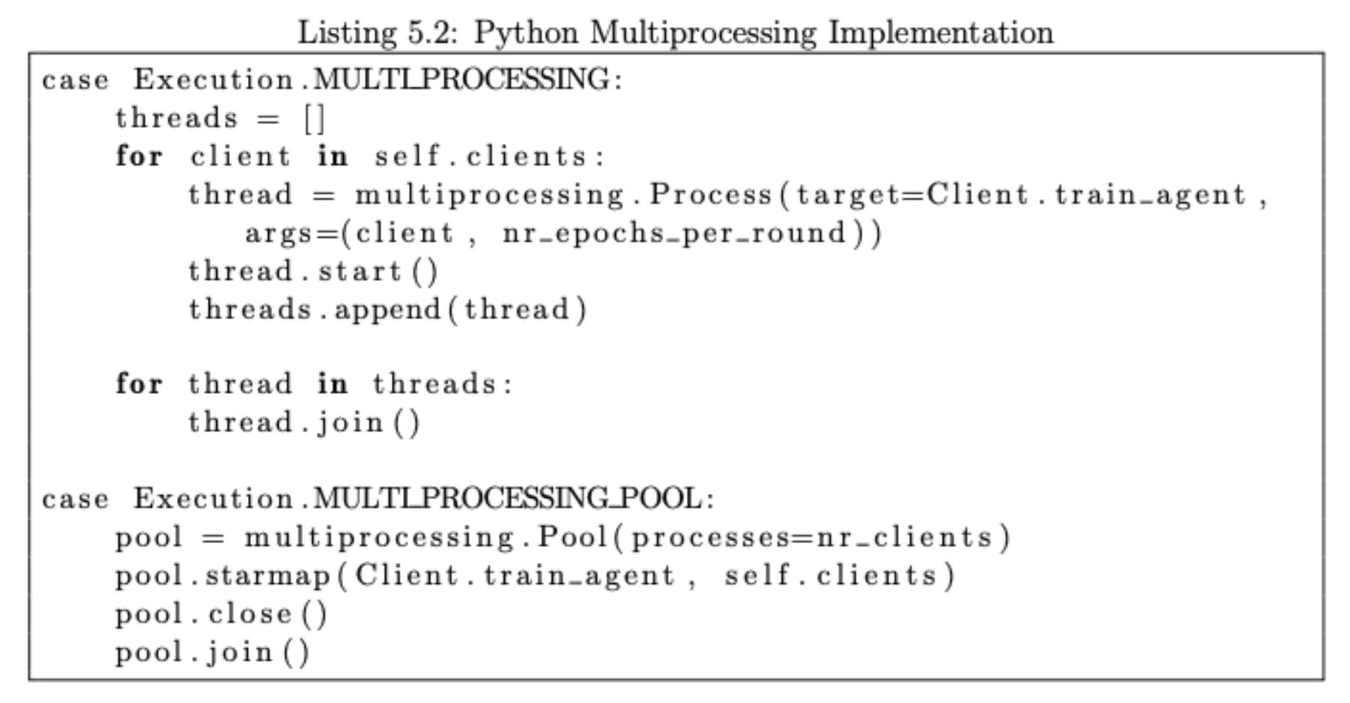
Multiprocessing (Pool) Performance Comparison

Slide 5
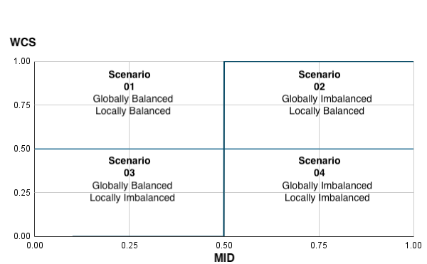
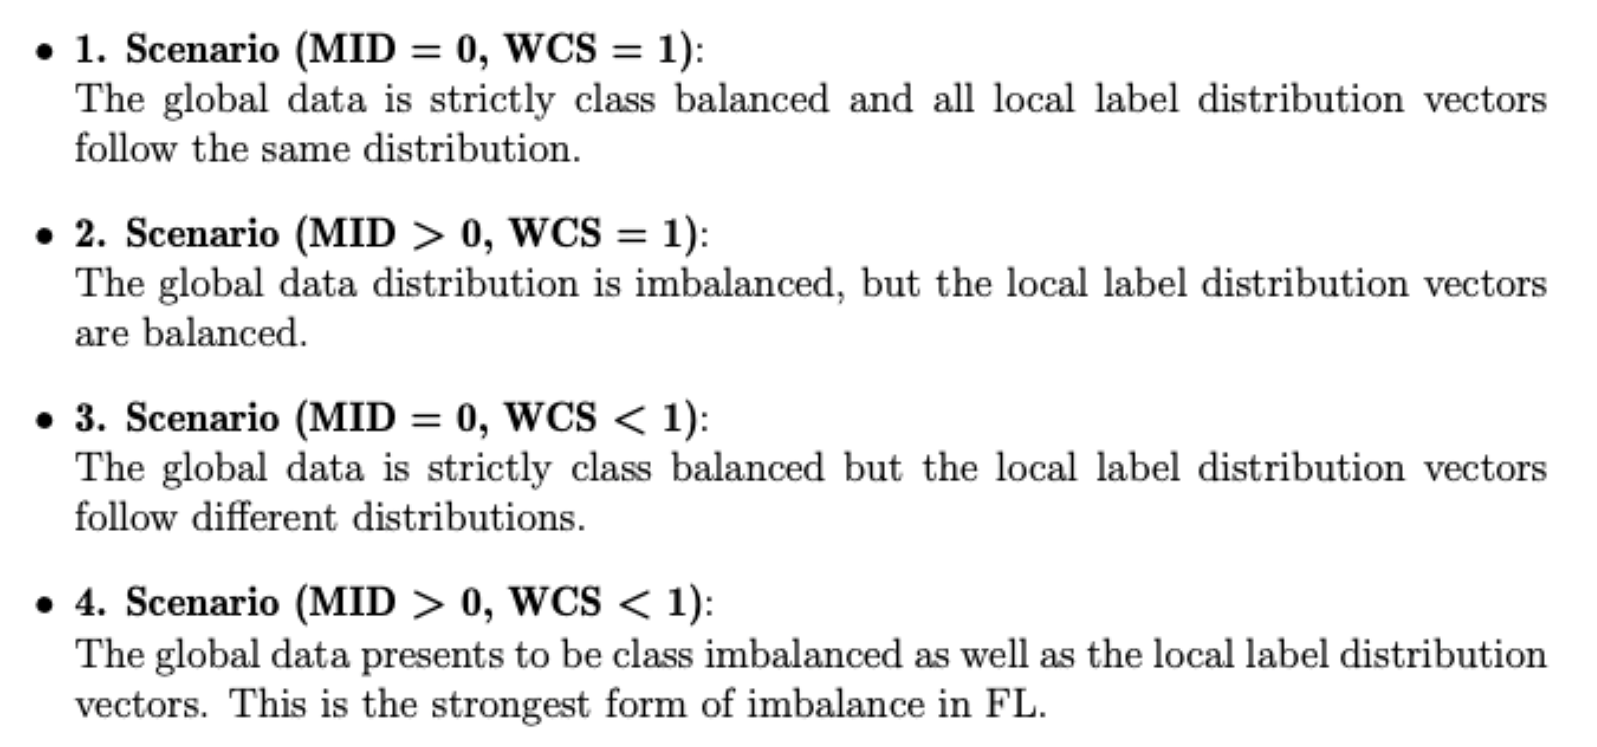
Four scenarios of class imbalance

Slide 6
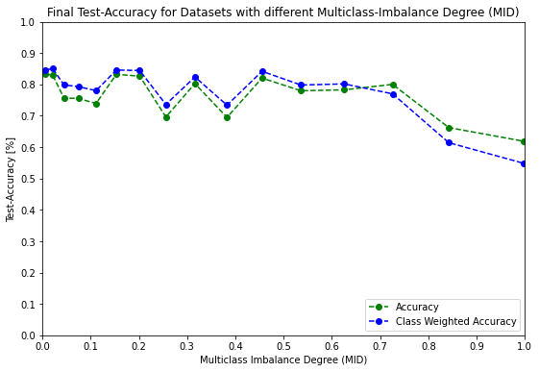
Scenario 02 (MID > 0, WCS = 1)
Final training performance starts to decrease with increasing global class imbalance.
Strongly negative effect and bad performance for MID > 0.7
Class weighted accuracy starts to be worse than regular accuracy for high global imbalance due to overfitting of the majority class.

Slide 7
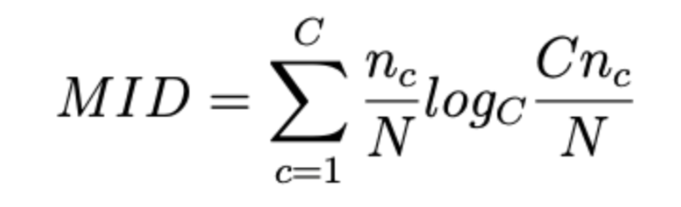
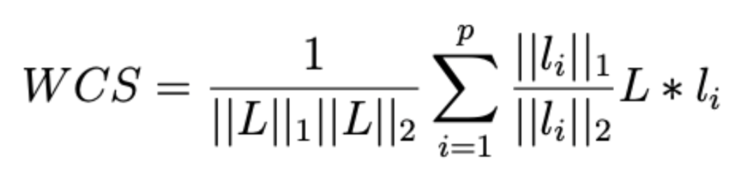
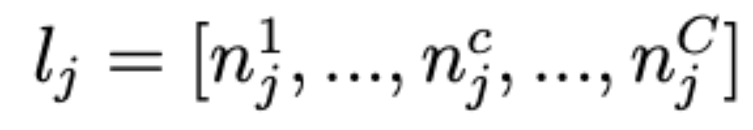
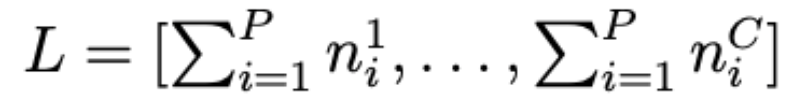
How to measure and quantify class imbalance
When dealing with multiple datasets, local and global class imbalance can occur
Multiclass Imbalance Degree (MID)
Weighted Cosine Similarity (WCS)
n_{c}… number of samples with label class c
N … total number of samples
C … Number of classes
local sample distribution vector
l_{j} … number of samples on client j with class c ∈ {1, …, C}
=> used to measure global class balance
ranges from [0 - 1]
[globally totally balanced - globally totally unbalanced)
global sample distribution vector
n_{i}^{c} … number of samples with label class c on client i
=> used to measure global class balance
ranges from [0 - 1]
[locally totally unbalanced - locally totally balanced)

Slide 8
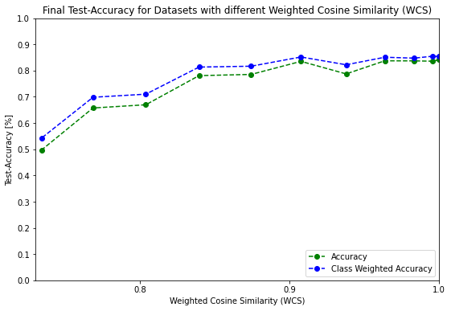
Scenario 03 (MID = 0, WCS < 1)
Final training performance starts to decrease with decreasing WCS.
Strongly negative effect and bad performance for WCS < 0.85.
Stronger overall effect than on the final performance than MID.

Slide 9
Evaluation of different FL Aggregation Strategies
There are countless papers on possible aggregation strategies
FedAvg
FedPA
FedDC
FedProx
Federated Distance (FedDist)
Federated Learning with Restricted Softmax (FedRS)
Federated Learning with Matched Averaging (FedMA)
Federated Learning with Personalization Layers (FedPer)
Notes:
FedAvg works fine with slightly locally and globally skewed data, but not for extreme distributions.
In case we dont want to look into other FL Aggregation Strategies, we could exclude to unbalanced and to stronlgy non-IID datasets.

Slide 10
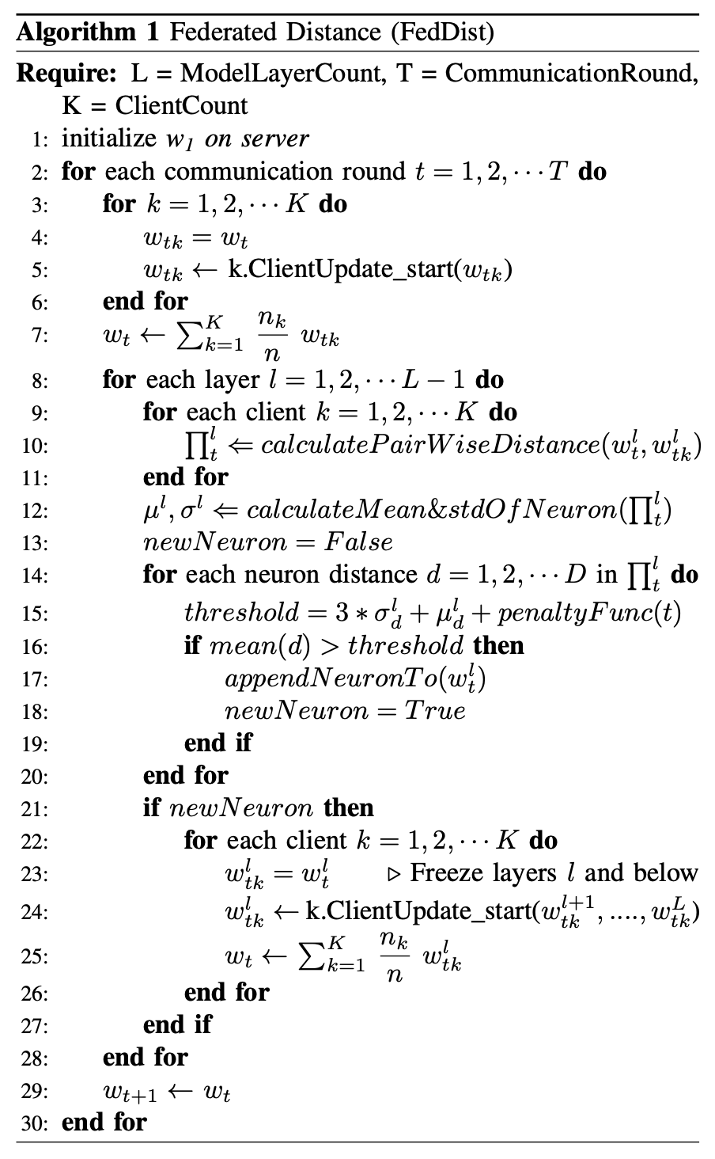
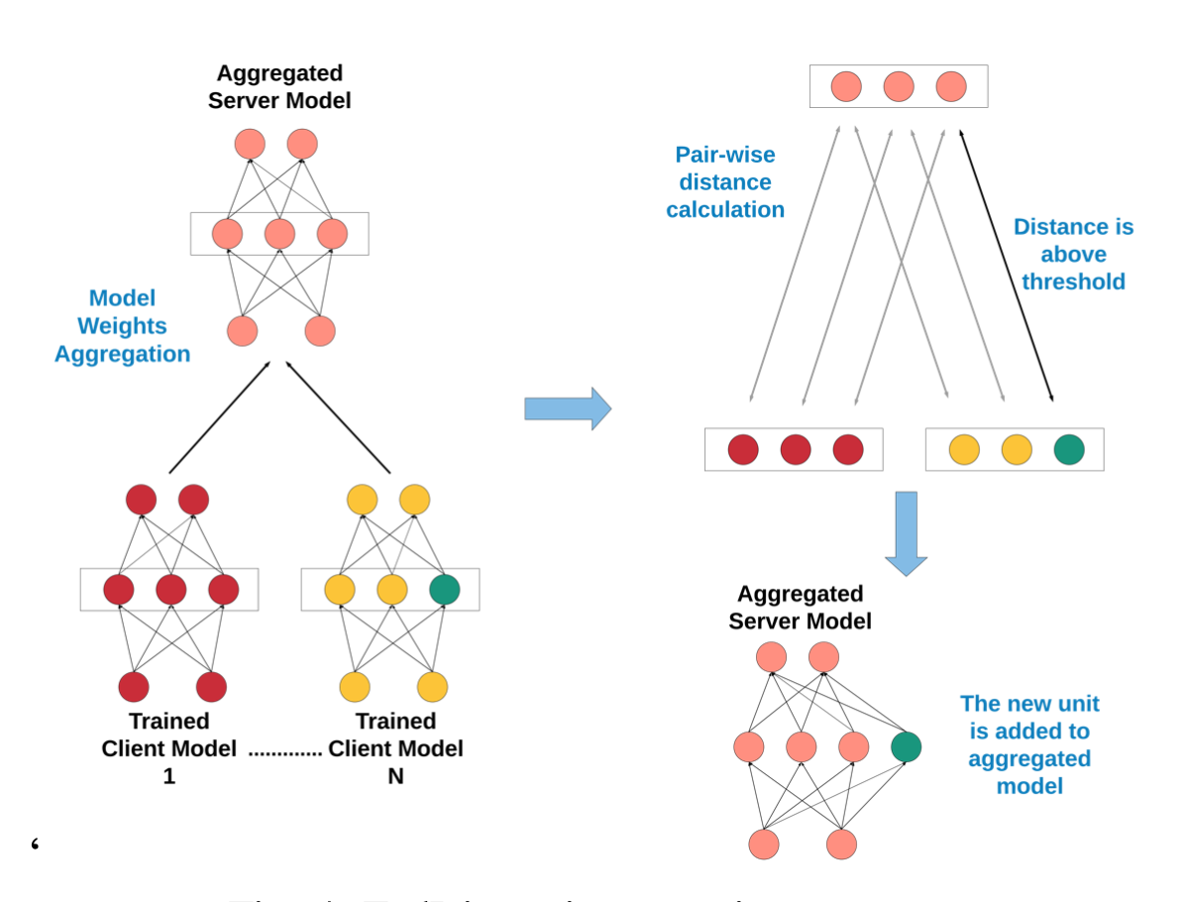
FedDist (Federated Distance)
Some are quite difficult to implement compared to others

Slide 11
Next Steps?
Spend more time on evaluating FL Aggregation Strategies
Either following in line with Timos work
(adding Anomaly Detector and using more real world dataset for training)
Try to run the federated learning directly on a RPi cluster using a framework or simple scp copy of PyTorch models

