Slide 1
FedRL for IT Sec /
Meeting 07
25.04.2023
Jan Kreischer

Slide 2
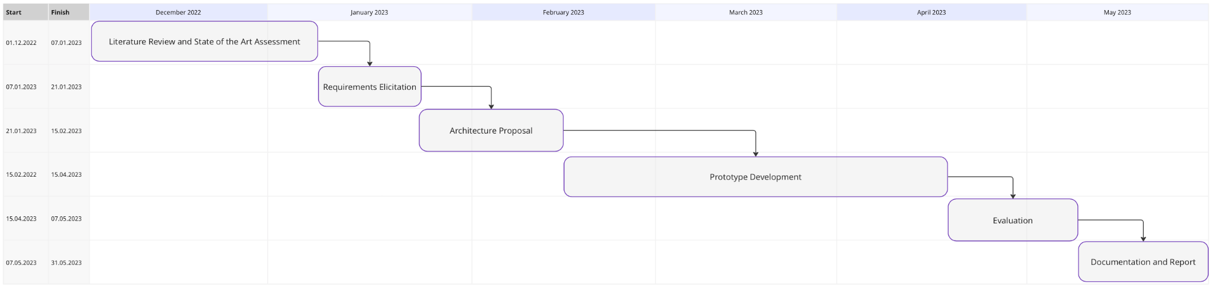
Hours Invested
598/900
25.04.2023

Slide 3
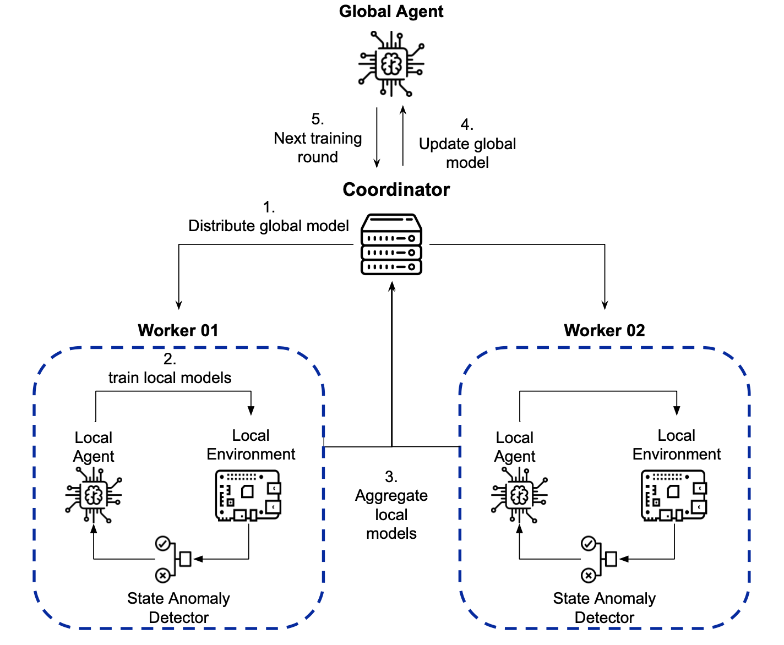
Architecture of Prototype 2

Slide 4
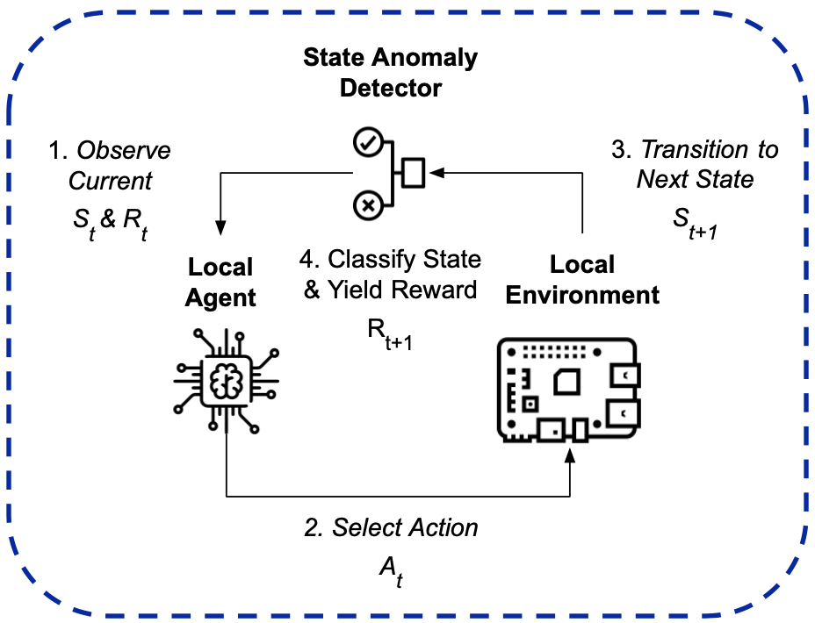
Prototype 02 - Single Client

Slide 5
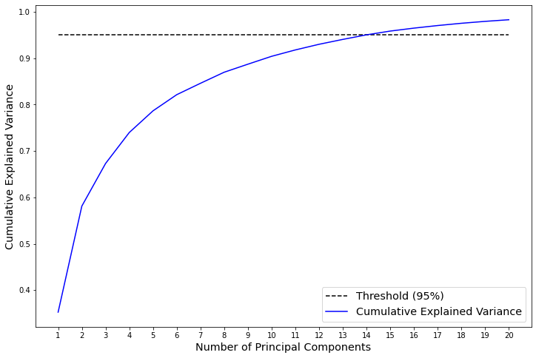
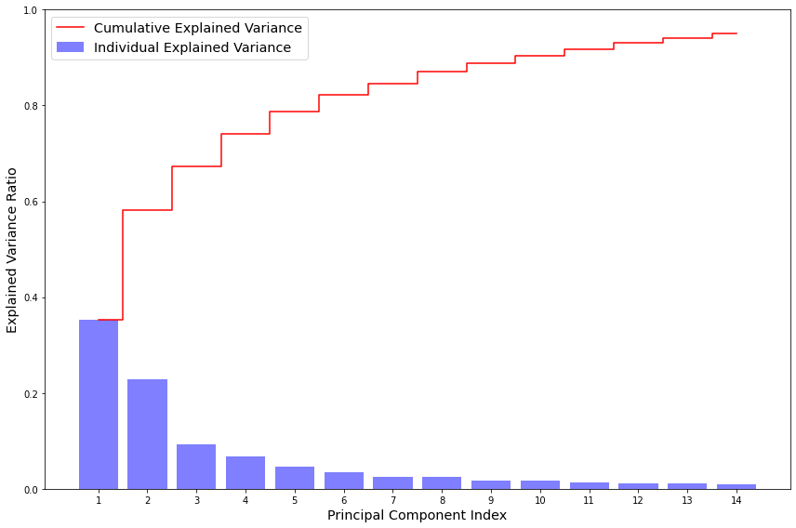
PCA to determine Bottleneck Size
Cumulative Explained Variance
Explained Variance by individual Principal Components
Notes:
I used PCA in order to determine the approximate size of the bottleneck of the autoencoder.
Depending on how well the training data was able to be compressed the lower the bottleneck size could be chosen.
I decided to use a threshold of 95% explained variance.

Slide 6
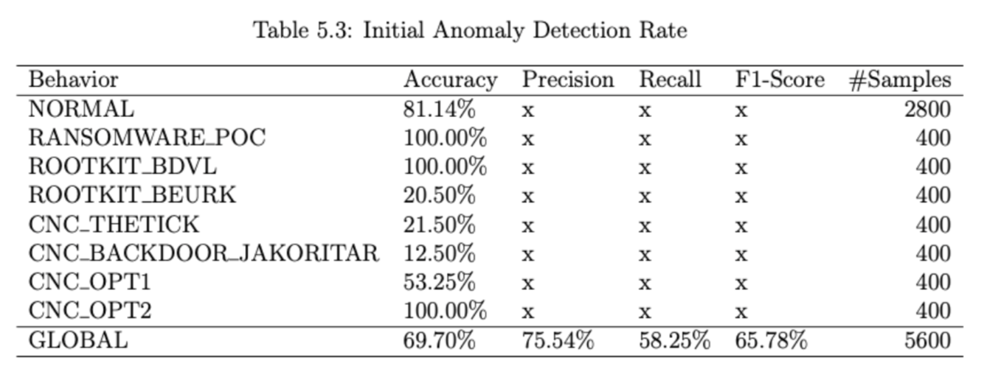
Initial Estimators Performance

Slide 7
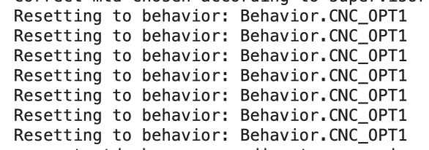
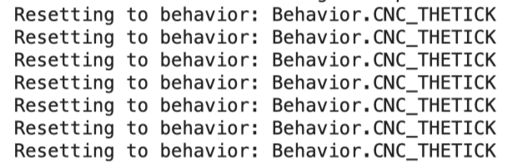
Problems with False Negatives
=> This output is caused by False Negatives, where a malicious behavior was not recognized correctly by the Anomaly Detector.

Slide 8
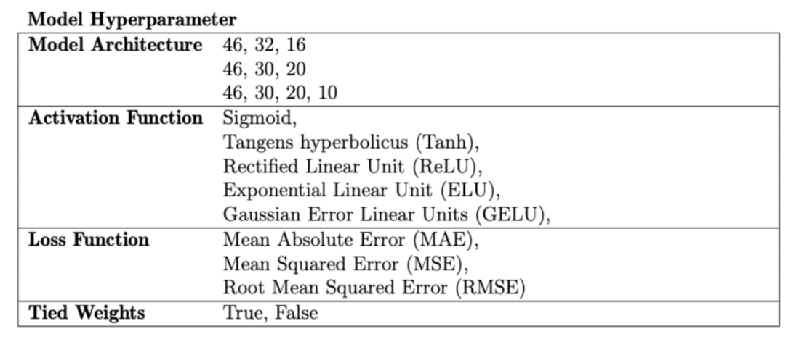
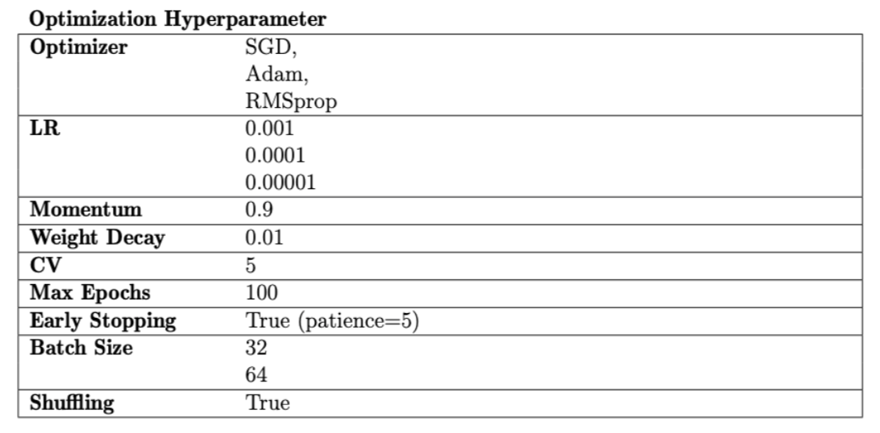
Hyperparameter Search
Notes:
I had to use the skorch library in order to wrap my pytorch model and make it available to sklearns grid search cv.
Probably it is important to note that early stopping with patience of 5 was used in order to prevent overfitting

Slide 9
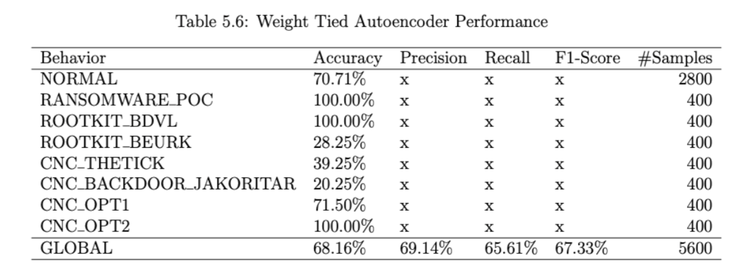
Autoencoder with Tied Encoder and Decoder Weights
Notes:
I had to use the skorch library in order to wrap my pytorch model and make it available to sklearns grid search cv.

Slide 10
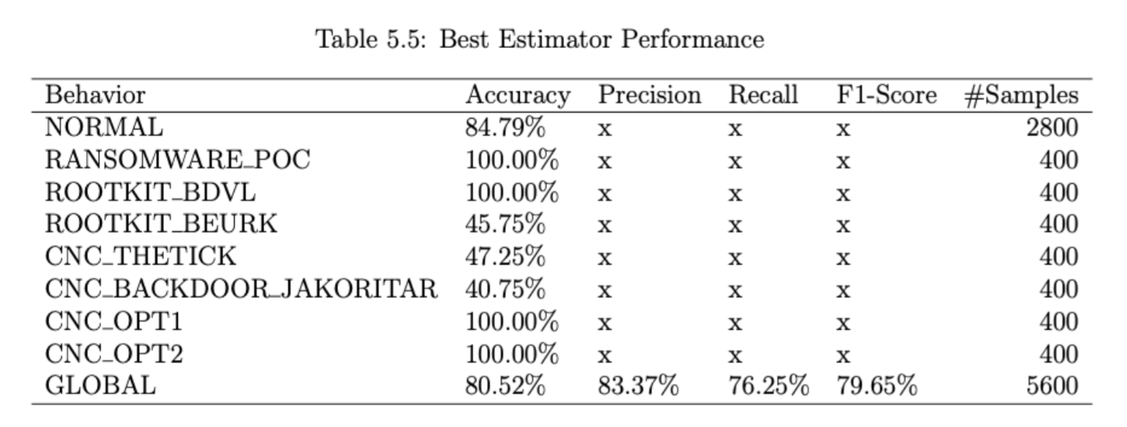
Anomaly Detector - Best Estimator Performance
Notes:
I had to use the skorch library in order to wrap my pytorch model and make it available to sklearns grid search cv.
Without tied encoder decoder weights.
The problem with beurk, thetick and backdoor jakoritar is that they are often confused for normal behavior.
However, the more sensitive you make the autoencoder to these attacks, you increase the chance of misclassifying normal behavior as malicious.
The performance between these classes is in a tug war and i think this is a reasonable trade off.

Slide 11
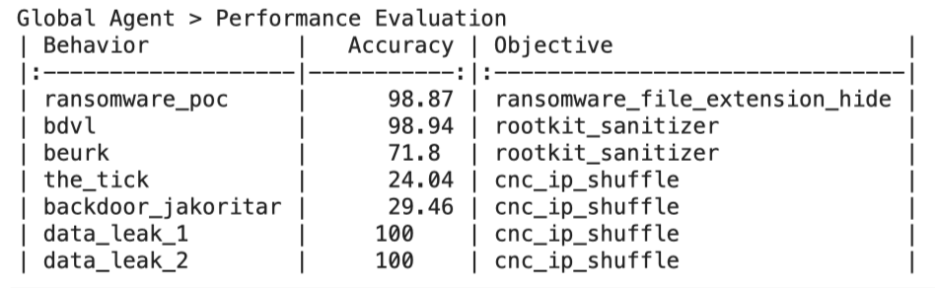
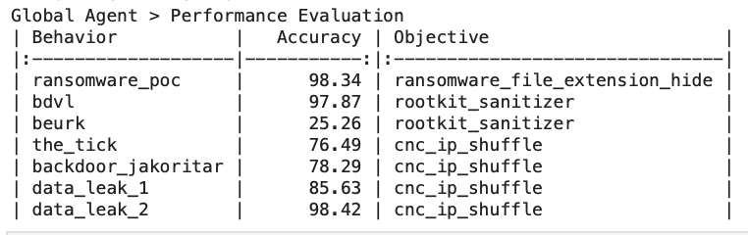
RL Agent Performance Comparison
5 participating clients
Trained with initial State Anomaly Detector
Trained with optimized State Anomaly Detector
Notes:
I had to use the skorch library in order to wrap my pytorch model and make it available to sklearns grid search cv.
Without tied encoder decoder weights.
The problem with beurk, thetick and backdoor jakoritar is that they are often confused for normal behavior.
However, the more sensitive you make the autoencoder to these attacks, you increase the chance of misclassifying normal behavior as malicious.
The performance between these classes is in a tug war and i think this is a reasonable trade off.

Slide 12
Potential Next Steps
2.
Follow in line with Timos work
and use the realistic dataset
from his prototype 03
1.
Try out alternative models
for anomaly detection?
3.
Try to implement more
robust aggregation strategy
Notes:
I assume there might be unsupervised models where the tug war between the performance of detecting the rootkit and not misclassifying normal behavior is not that strong.
So i could try out alternative models

Slide 13
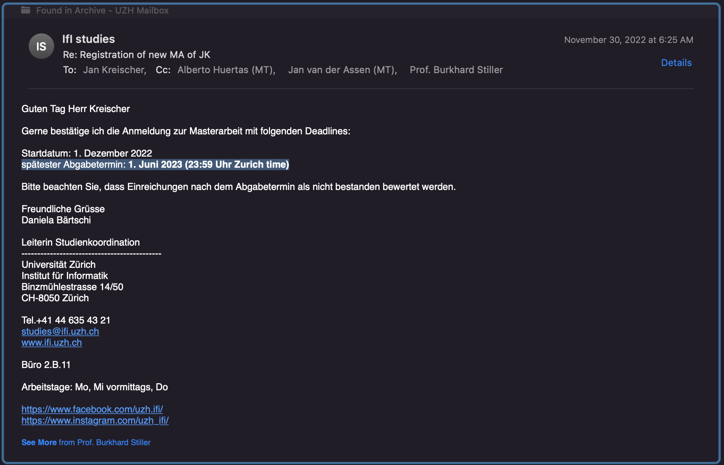
Submission Deadline 01.06 until 23:59 PM not 31.05?

