Slide 1
FedRL for IT Sec /
Meeting 08
05.05.2023
Jan Kreischer

Slide 2
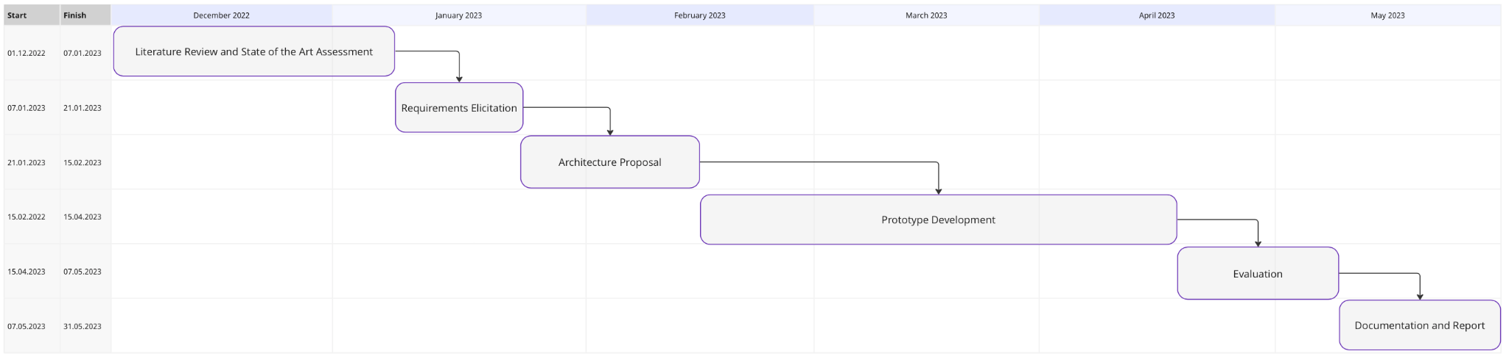
(05.05.2023)
Now

Slide 3
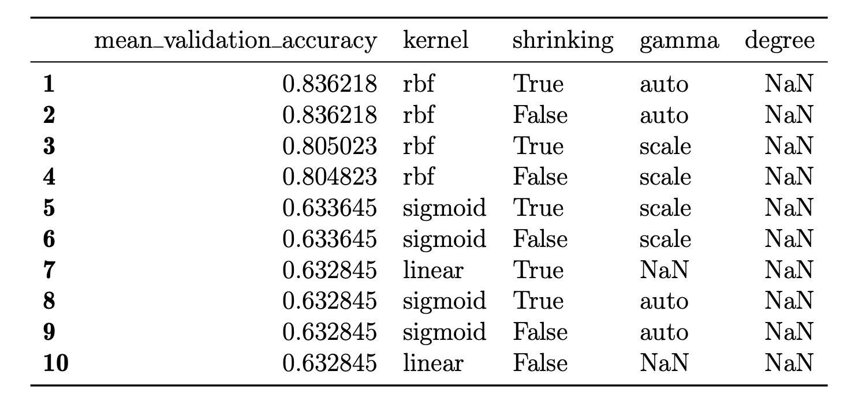
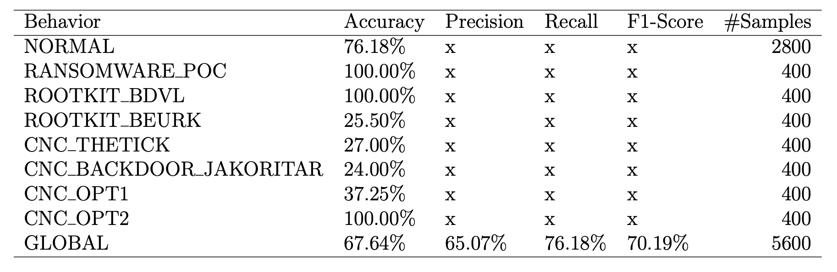
Evaluation of One-class SVMs for State Anomaly Detection
Hyperparameter Search Result
Test Evaluation

Slide 4
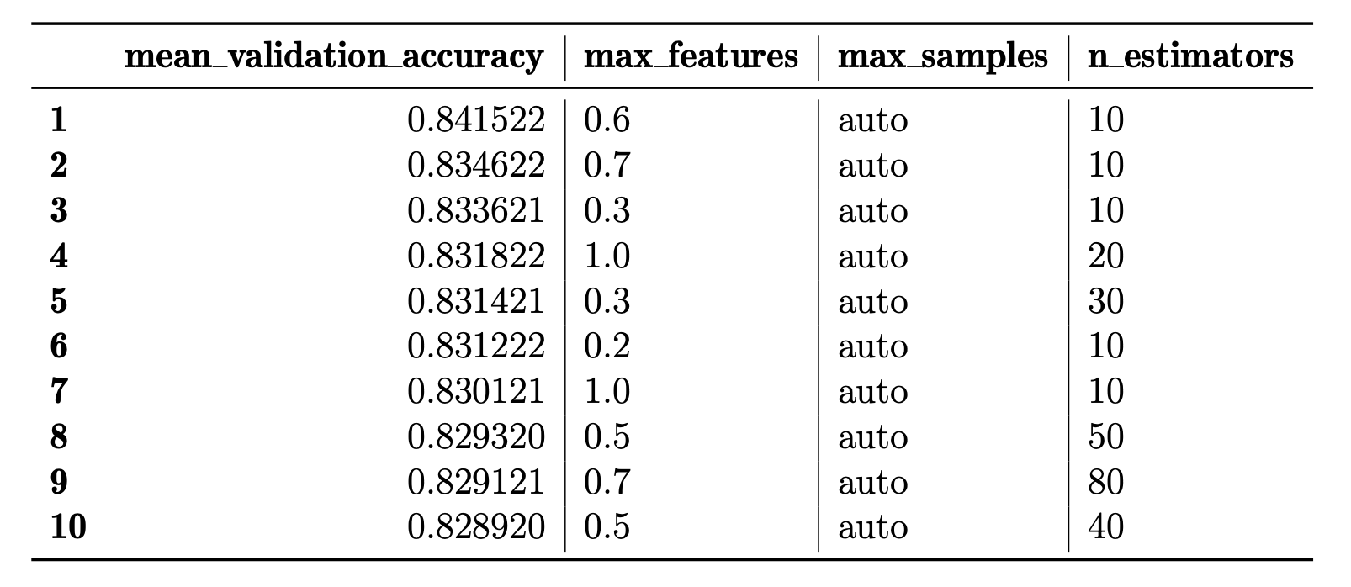
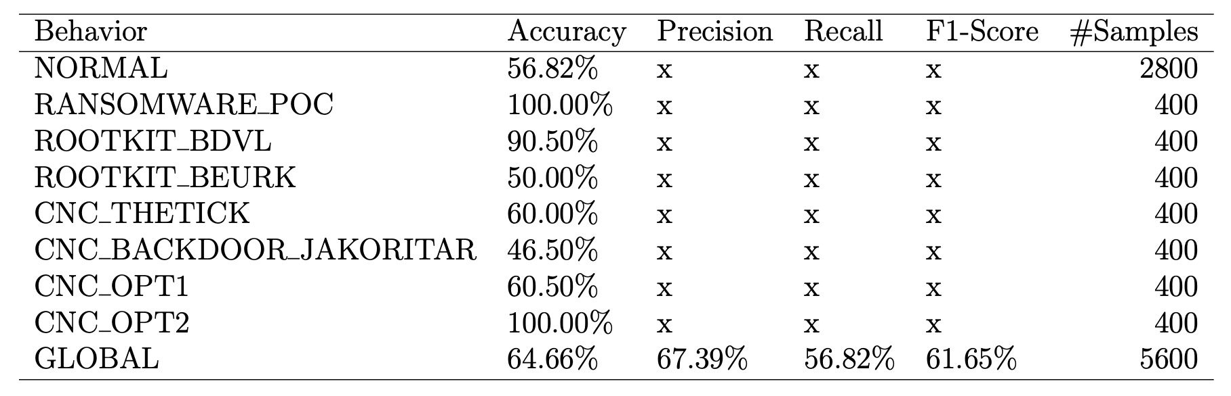
Evaluation of Isolation Forests for State Anomaly Detection
Hyperparameter Search Result
Test Evaluation

Slide 5
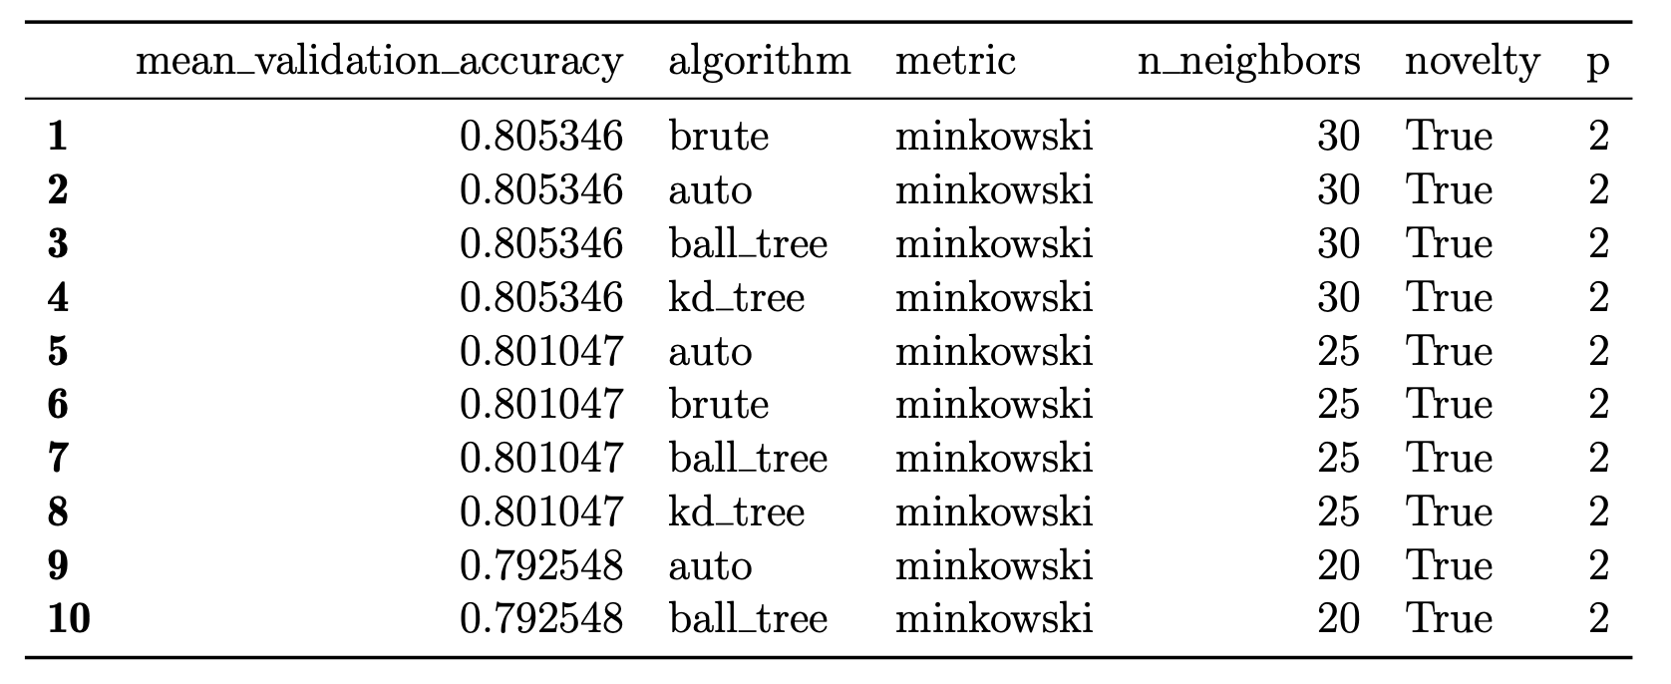
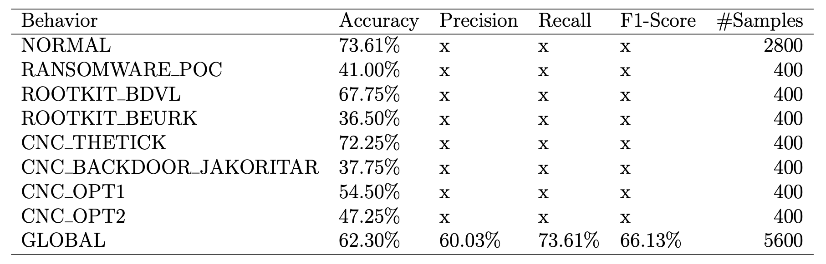
Evaluation of Isolation Forests for State Anomaly Detection
Hyperparameter Search Result
Test Evaluation

Slide 6
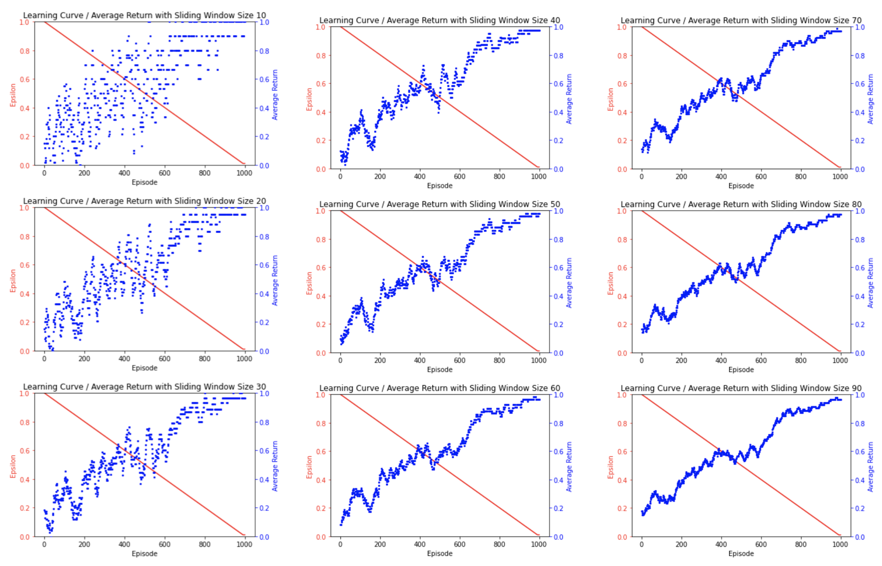
Learning Curve
The learning curves shows the received return averaged over the last N episodes
here with N in [10, 20, 30, 40, 50, 60, 70, 80, 90]
Timo used
N=20
The larger the window size, the smaller the fluctuations.
Which window size is considered good?

Slide 7
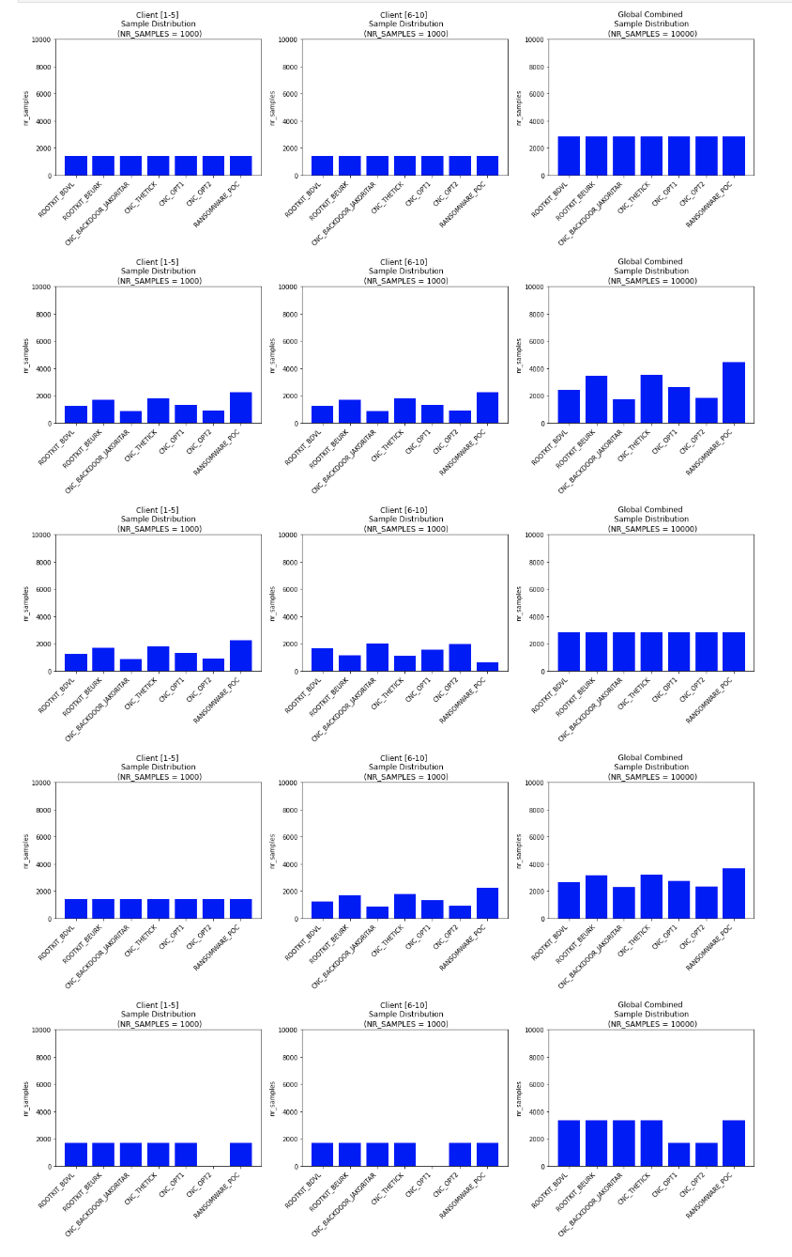
Data Splits
Globally and locally balanced (MID=0.0 and WCS=1.0)
Globally imbalanced but locally balanced (MID=0.0267 and WCS=1.0)
Globally balanced but locally imbalanced (MID=0.0 and WCS=0.9516)
Globally and locally imbalanced (MID=0.0066 and WCS=0.9878)
Client Exclusive Classes
(MID=0.0198 and WCS=0.9574)

Slide 8
Prototype 2 / Experiment 1
10 clients,
10 rounds,
100 episodes per round
1000 episodes total per client
10000 episodes in total
5 different data distributions
Approximated online learning time
Centralized: 10000 episodes/client * 10s/episode * 1client = 100000s ≈ 1667 min ≈ 27.78h
Federated: 1000 episodes/client * 10s/episode * 1 client + PEO = 10200s ≈ 170 min ≈ 2.83h
Parameter Exchange Overhead (PEO) = (1s sending params + 1s params receiving) per round and client = 200s
=> Potential calculatory speedup of 89.8 percent.

Slide 9
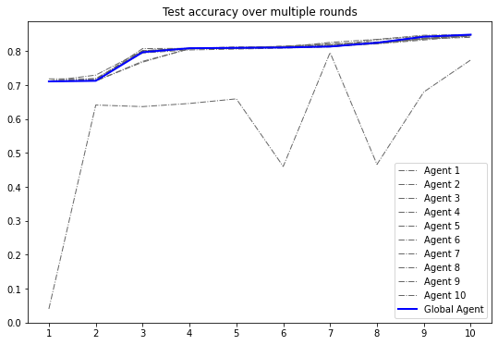
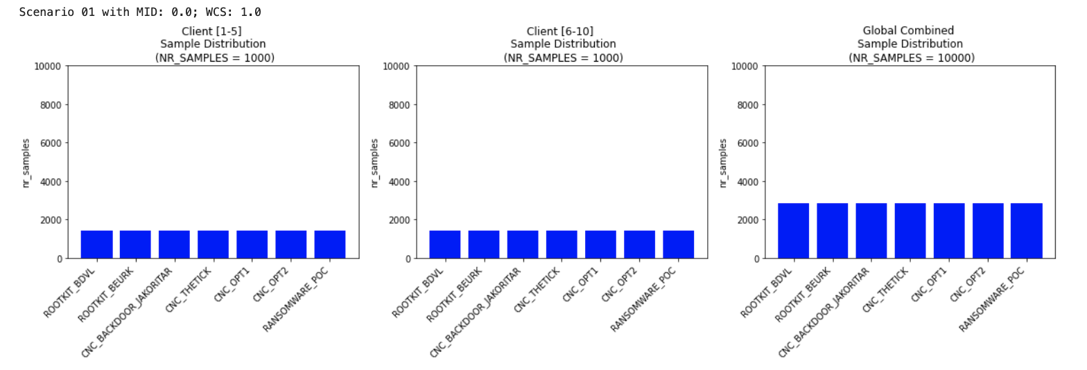
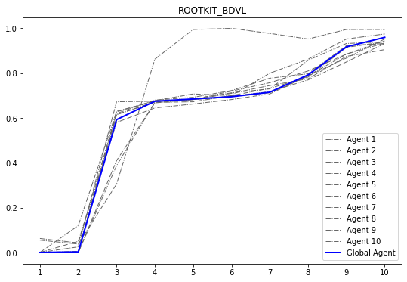
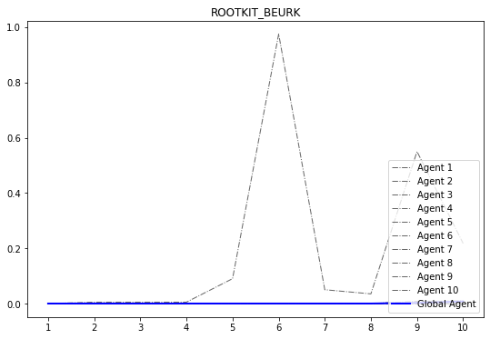
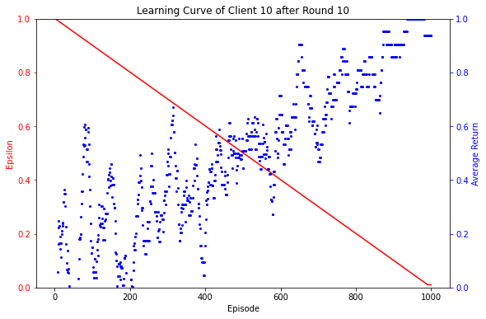
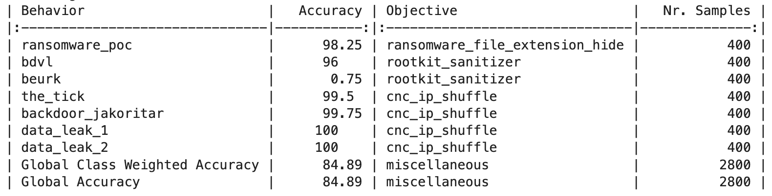
Experiment 1 / Scenario 1 (globally balanced MID=0.0 and locally balanced WCS=1.0)
Global Attack Mitigation Performance
Training Data Split for Client [1-5] and Client [6-10]
Rootkit BDVL MitigationPerformance
Rootkit Beurk Mitigation Performance
Learning Curve of Client 10
Final Global Test Performance
Notes:
How should i deal with the fact that we always have n learning curves one for each client.
Which one should i show?

Slide 10
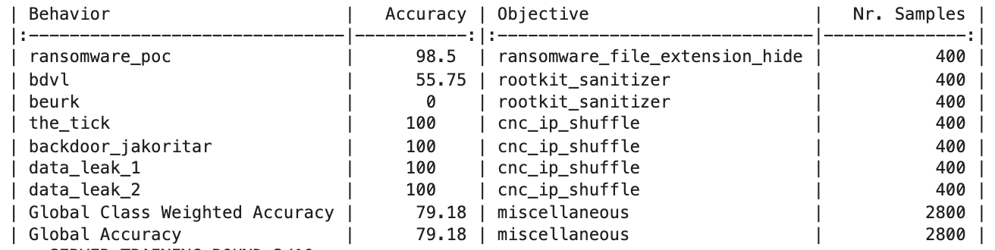
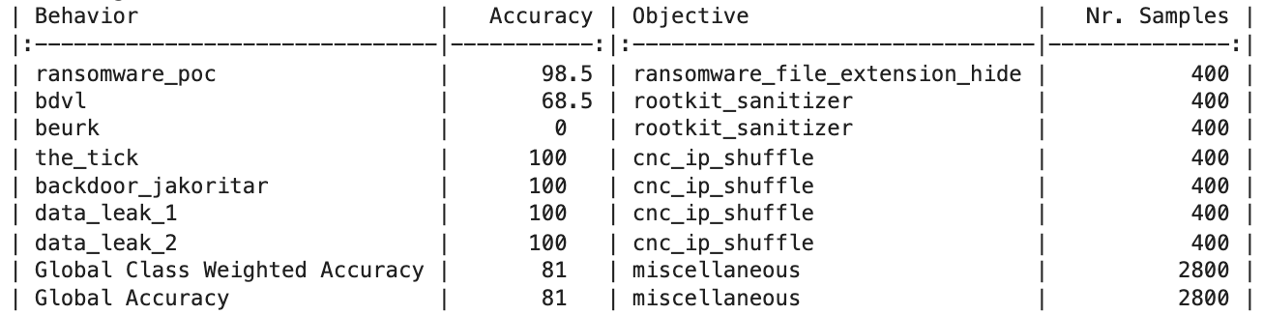
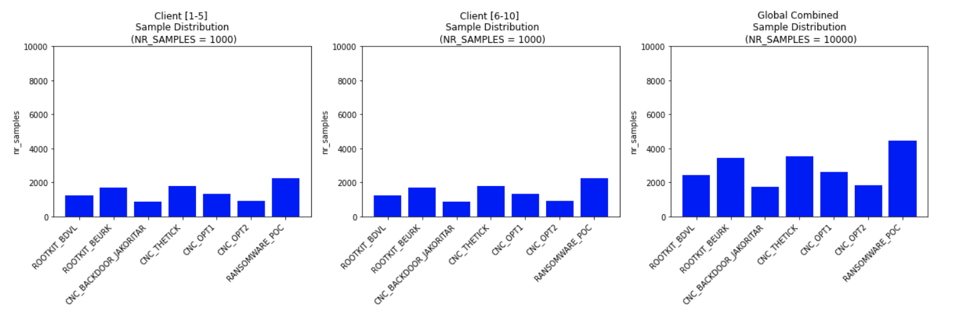
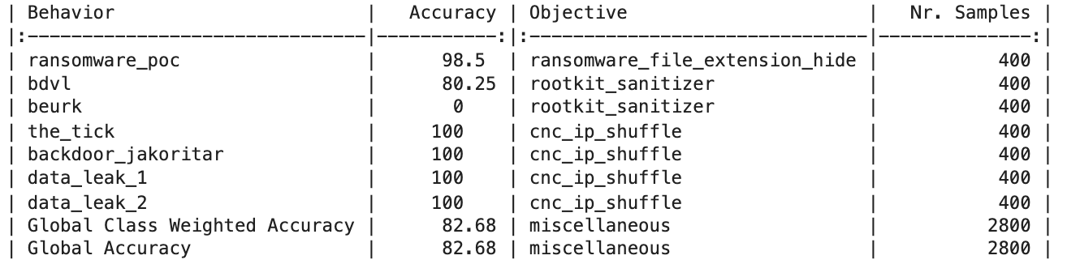
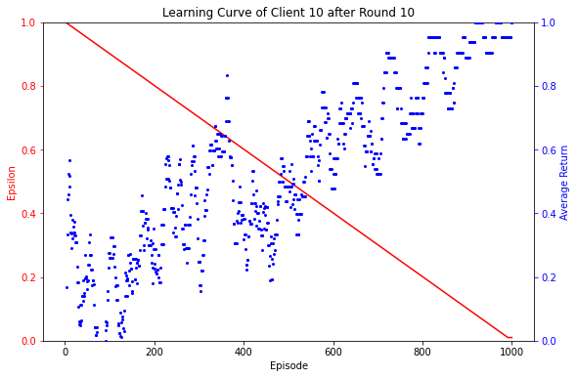
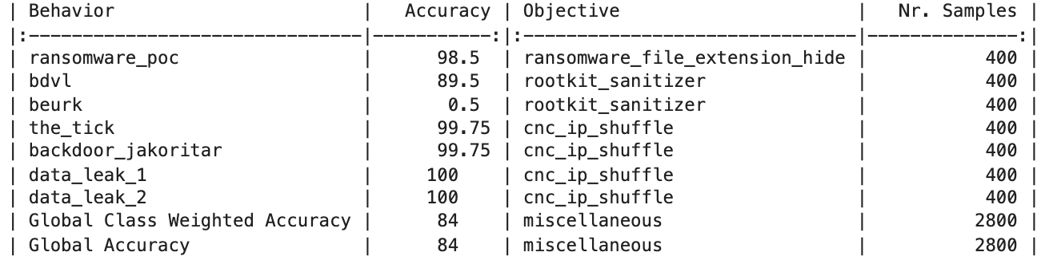

Experiment 1 / Scenario 2 (globally imbalanced MID=0.0267 and locally balanced WCS=1.0)
Global Test Performance Evaluation after each Even Round
Training Data Split for Client [1-5] and Client [6-10]
Learning Curve of Client 10
Final Test Accuracy: 85.07%

Slide 11
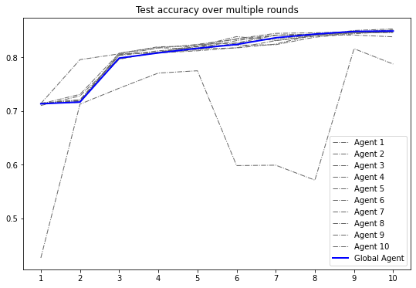
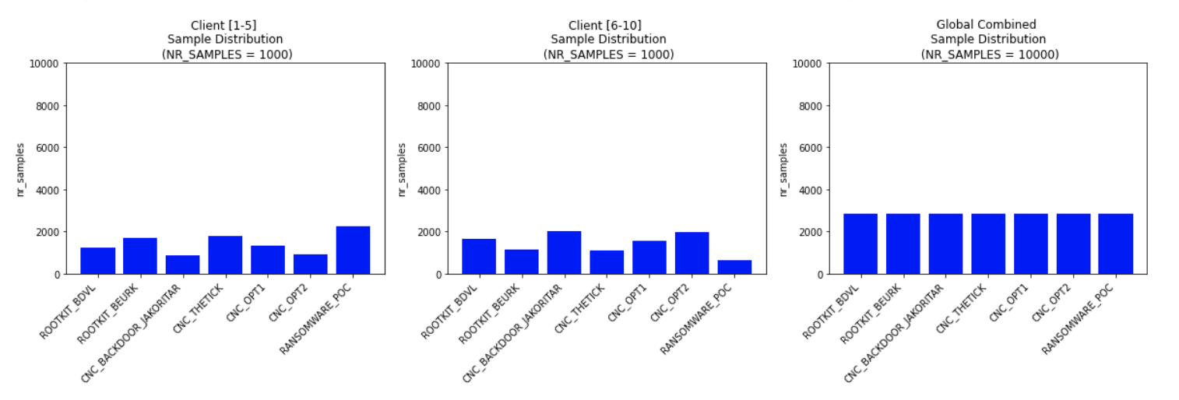
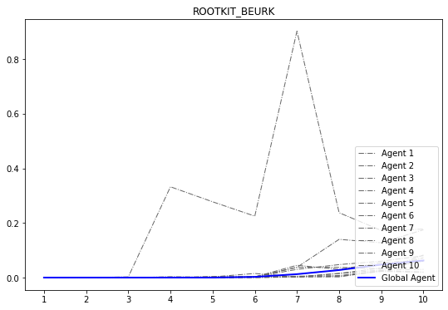
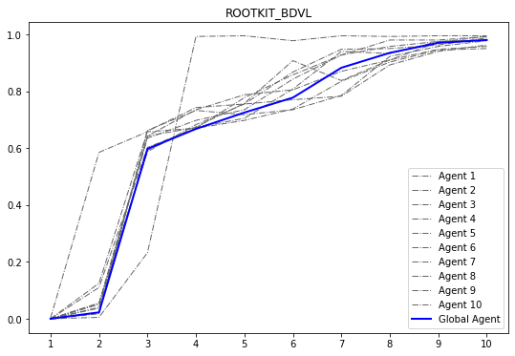
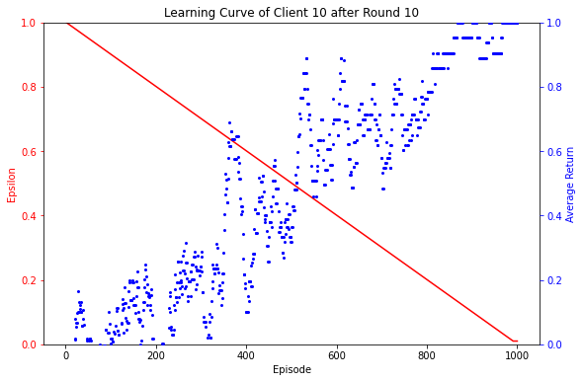
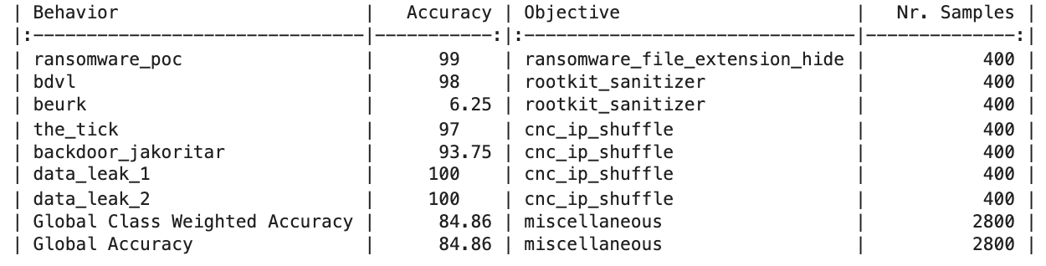
Experiment 1 / Scenario 3 (globally balanced MID=0.0 but locally imbalanced WCS=0.9516)
Global Attack Mitigation Performance
Training Data Split for Client [1-5] and Client [6-10]
Rootkit BDVL MitigationPerformance
Rootkit Beurk Mitigation Performance
Learning Curve of Client 10
Final Global Test Performance
Final Test Accuracy: 84.86%

Slide 12
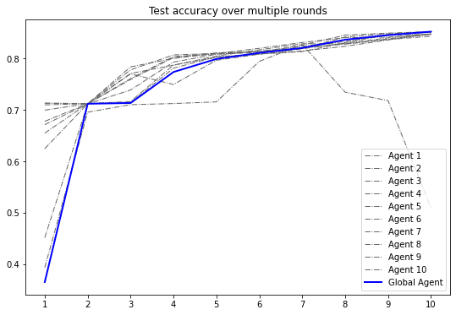
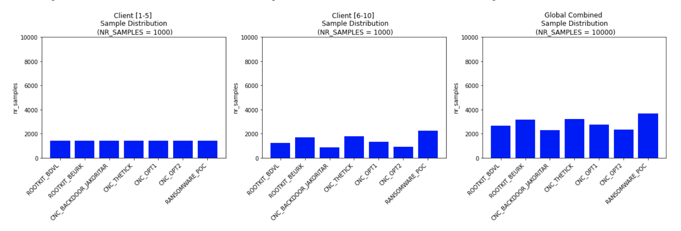
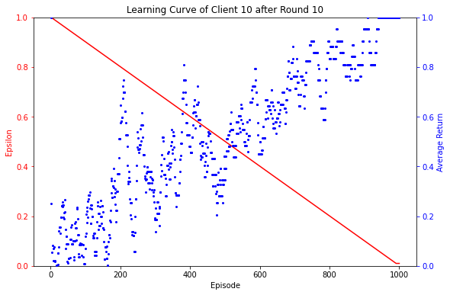
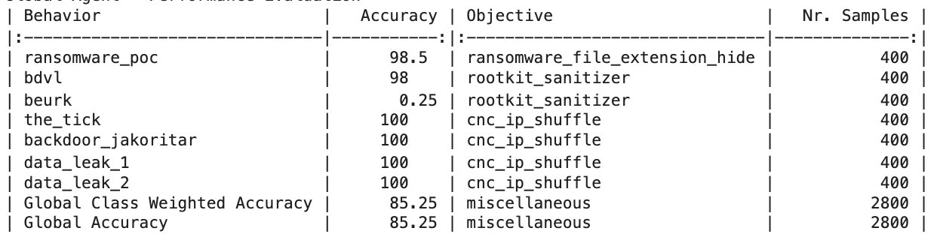
Experiment 1 / Scenario 4 (Globally MID=0.0066 and locally imbalanced and WCS=0.9878)
Global Attack Mitigation Performance
Training Data Split for Client [1-5] and Client [6-10]
Learning Curve of Client 10
Final Global Test Performance
Final Test Accuracy: 85.25%

Slide 13
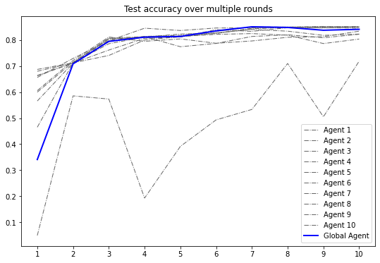
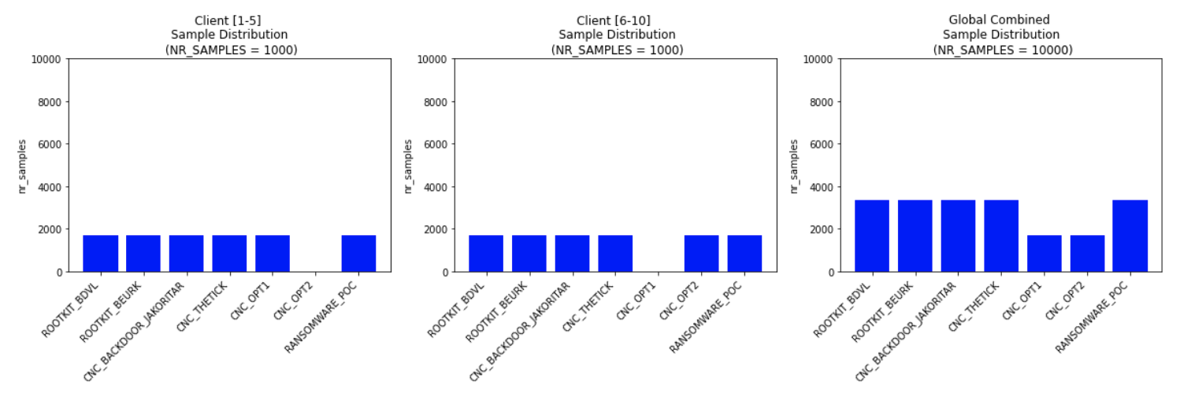
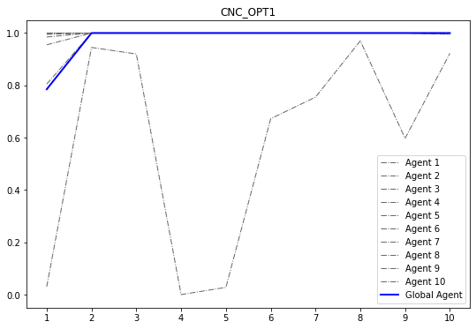
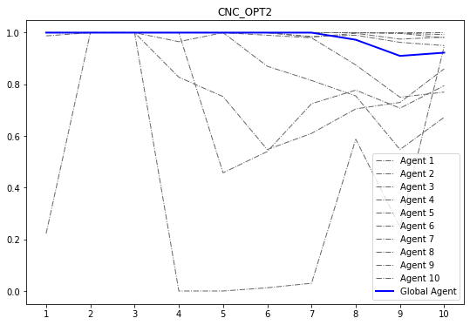
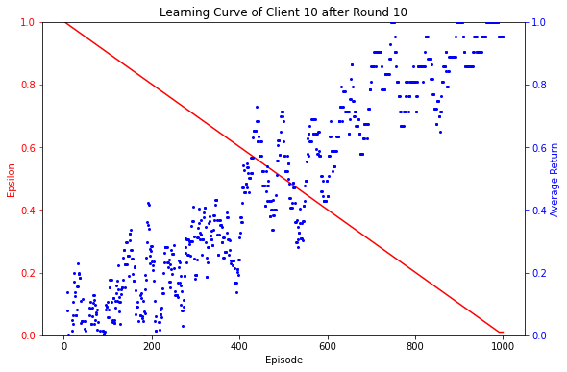
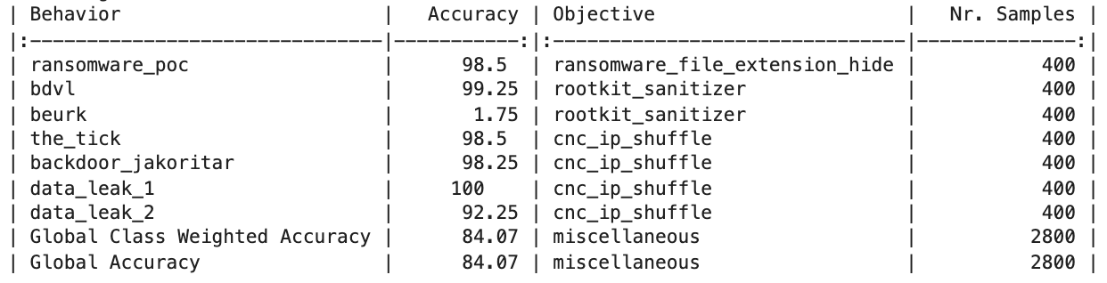
Experiment 1 / Scenario 5 (Client Exclusive Classes; MID=0.0198 and WCS=0.9574)
Global Attack Mitigation Performance
Training Data Split for Client [1-5] and Client [6-10]
CNC Opt 1 MitigationPerformance
CNC Opt 2 MitigationPerformance
Learning Curve of Client 10
Final Global Test Performance
Final Test Accuracy: 84.07%
Notes:
For this experimental setting the data split is less influential than the type of attack. Only the beurk rootkit could not be mitigated properly.
But you can run the rootkit sanitizer periodically in order to cover this.

Slide 14
Experiment
I repeated the previous experiment with 2 other configurations
10 clients, 100 rounds, 10 episodes per round => did never converge
10 clients, 100 rounds, 100 episodes per round => similar results to experiment 1
Notes:
You could compare how the ratio between episoder per round, nr rounds and nr clients has to be in order to result in a converging system.

Slide 15
Next Step
Try to increase the mitigation
performance for rootkit beurk
Perform sweep over MID and WCS
and measure final test performance
and display it in a graph.
(as done for prototype 01)

