Slide 1
FedRL for IT Sec /
Meeting 09
23.05.2023
Jan Kreischer

Slide 2
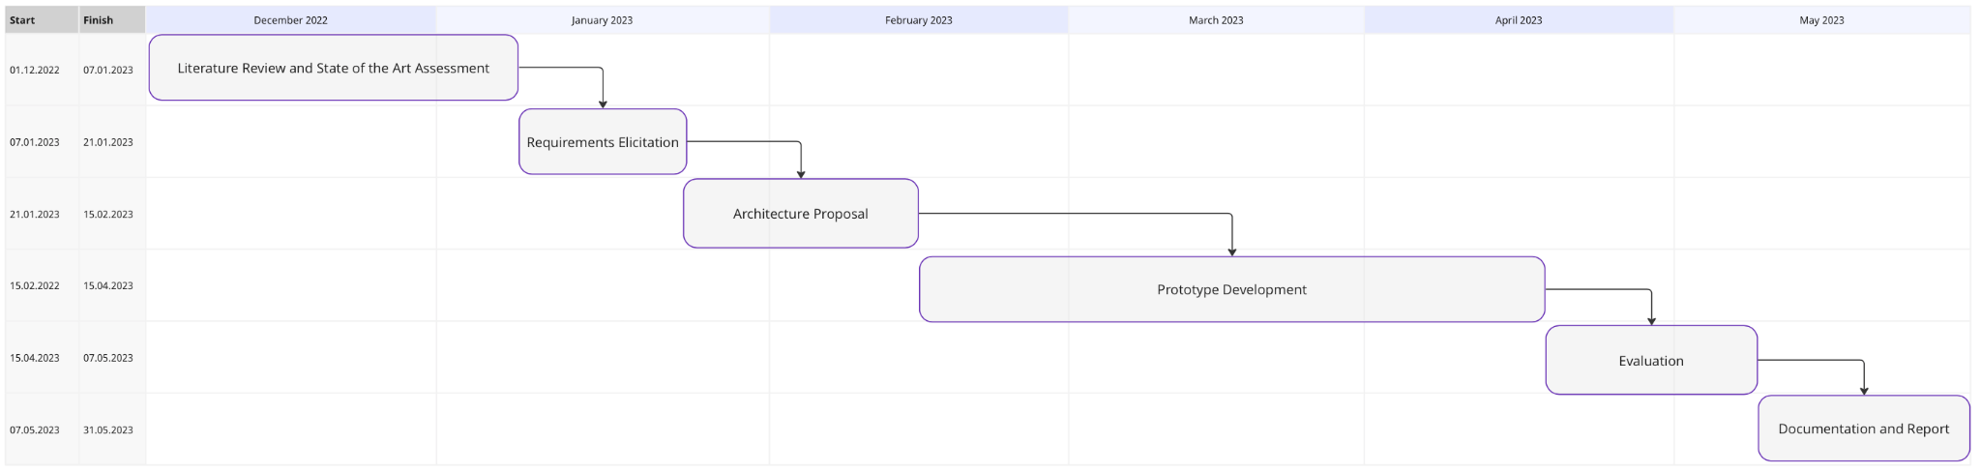
(23.05.2023)
Now

Slide 3
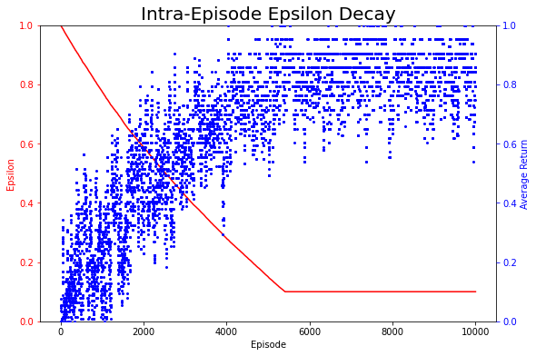
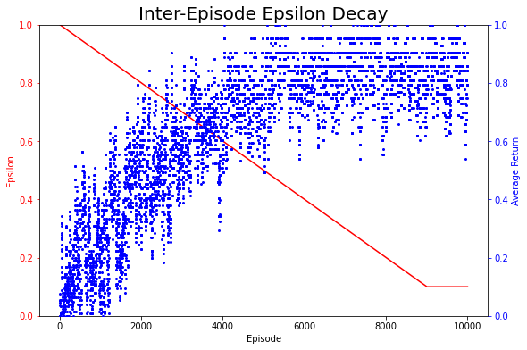
Optimization 01: Epsilon Decay Strategy
Notes:
Timo used an intra episode epsilon decay (after every step) and therefore if plotted as a curve the epsilon decay is not linear (compare the red line in the left and right diagram)
Therefore i changed it to only decaying epsilon after every episode has

Slide 4
Optimization 02: Feature Engineering
Removing time status columns (e.g timestamp)
Removing constant features
Removing some correlated features
Removing outliers and samples influenced by external events
Min Max Scaling of Feature Values
Notes:
Removing outliers increases the accuracy but potentially diminishes the realism of the prototype.
Min Max scaling works much better than standard scaling

Slide 5
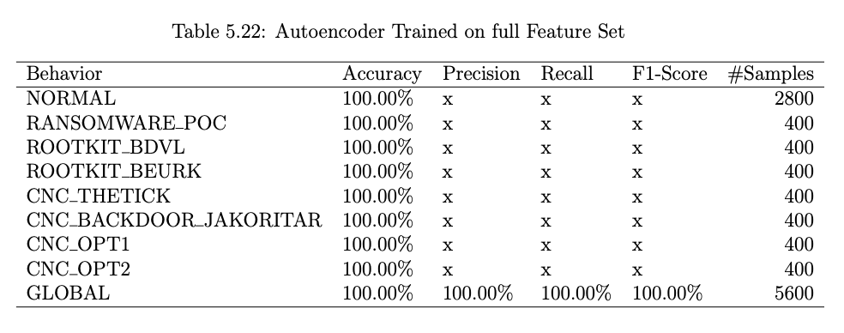
Prototype 02 - Training AutoEncoder on Full Feature Set
=> this performance is achieved even after removing the multi sampling on afterstates
Notes:
Since timos autoencoder was not good with recognizing abnormal afterstates he had to do majority voting with multisampling on the afterstate

Slide 6
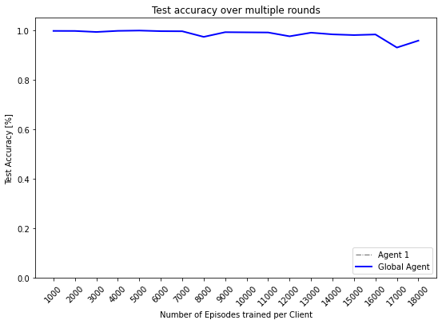
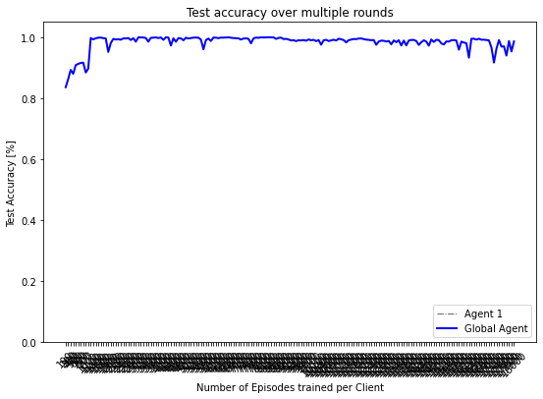
Prototype 02 - Single Client Training (including correlated features)
18000 Episodes in Total
distributed over 18 rounds à 1000 episodes per round
distributed over 180 rounds à 100 episodes per round

Slide 7
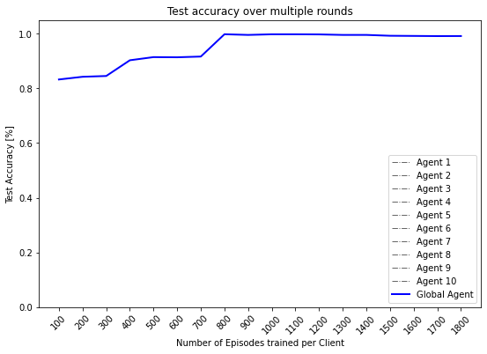
Prototype 02 - Federated Training (10 Clients)
18000 Episodes in Total
distributed training on 10 clients over 18 rounds à 100 episodes per round

Slide 8
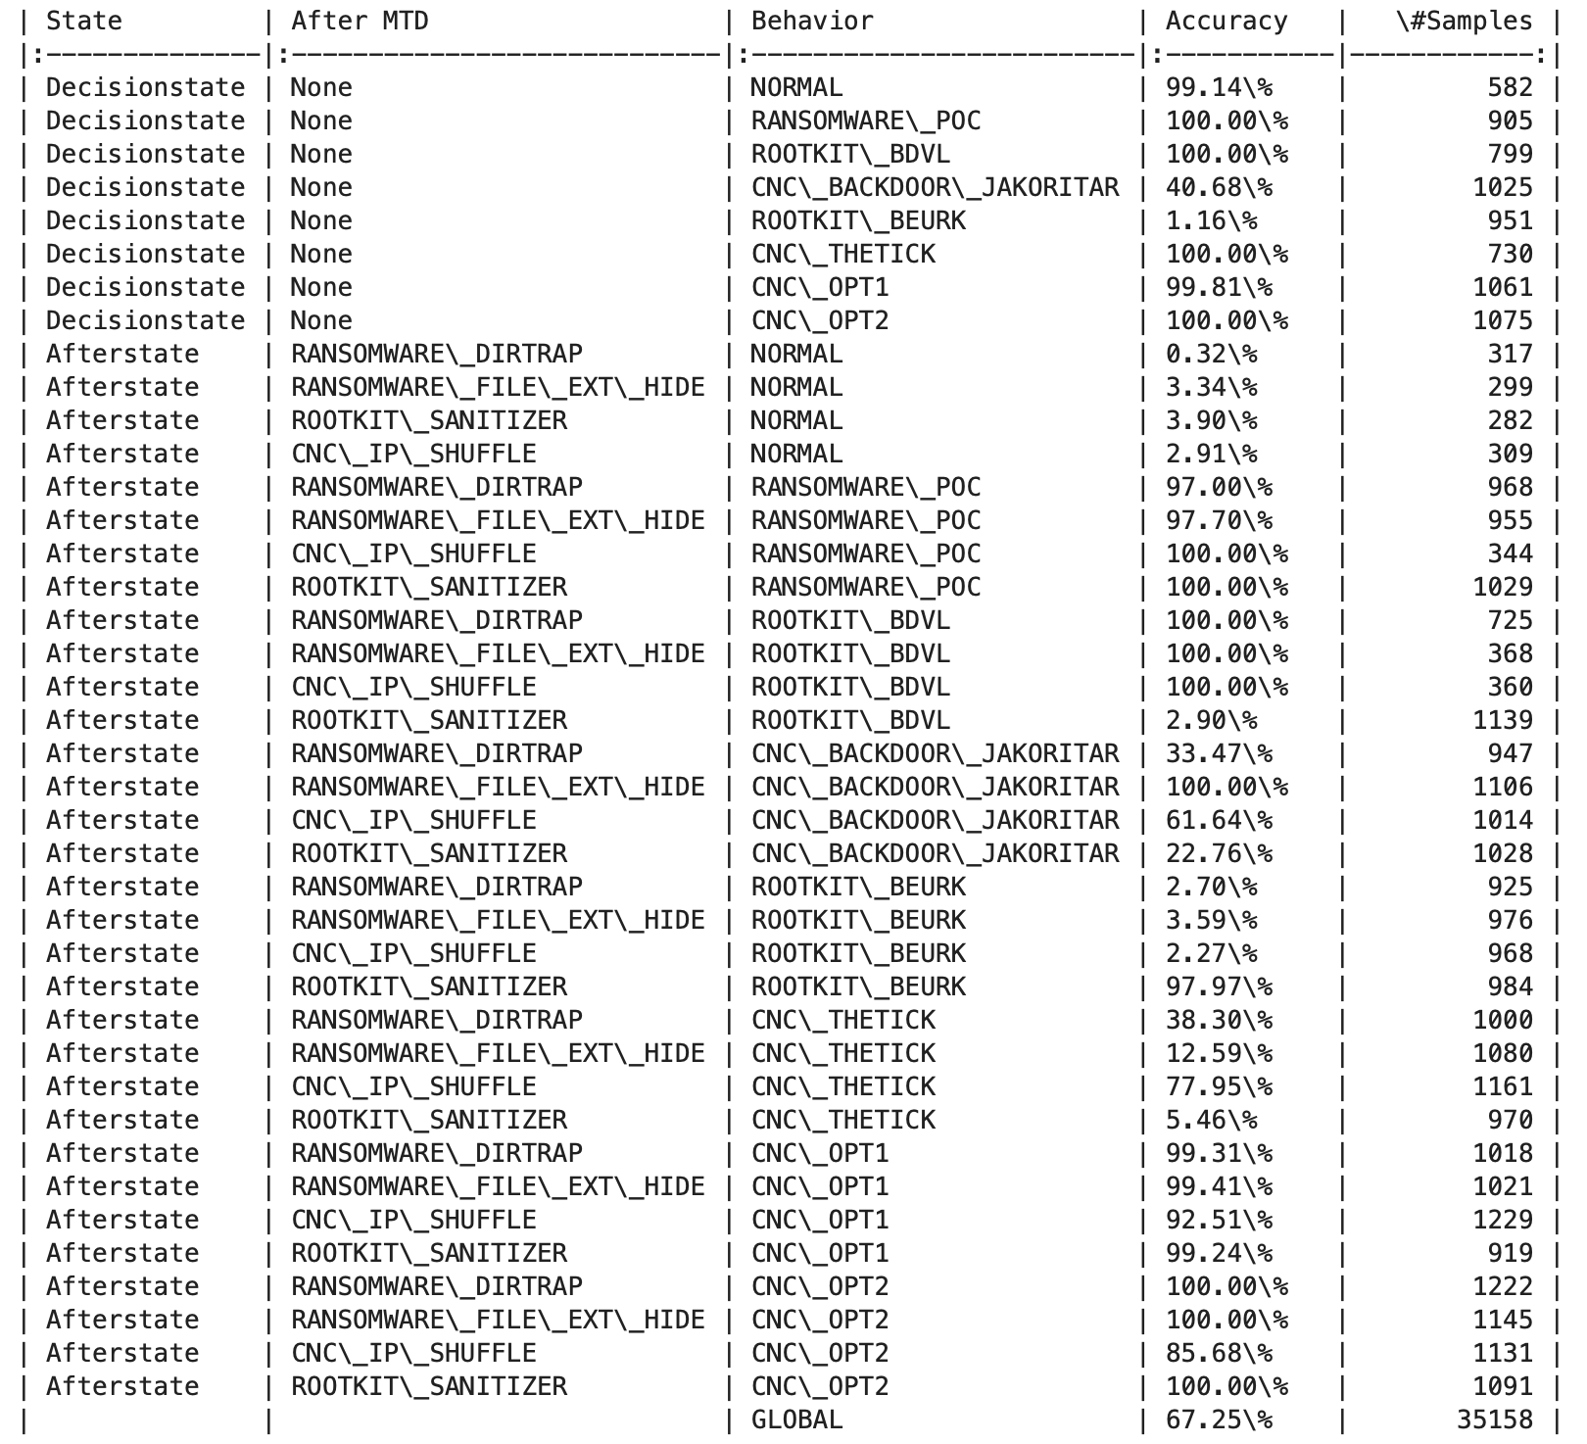
Prototype 03 -
Autoencoder trained on
Decision and Afterstates
Final accuracy 67.25%
did not yet find enough time
to perform a hyperparameter search here

Slide 9
Prototype 03 - Federated Training
18000 Episodes in Total
distributed training on 10 clients over 18 rounds à 100 episodes per round

