Slide 1
Federated Reinforcement Learning for Private and Collaborative Selection of Moving Target Defense Mechanisms for IoT Device Security
Master Thesis by Jan Kreischer
Notes:
Hello everyone.
Welcome to the final presentation of my master thesis on
“Federated Reinforcement Learning for Private and Collaborative Selection of Moving Target Defense Mechanisms in IoT Devices”

Slide 2
Outline
Scenario
System Architecture
Experiment 01
Experiment 02
Experiment 03
Summary & Conclusions
Limitations & Future Work
Notes:
Let’s take a look at the outline of the presentation,
First of all i will introduce you to the specific application scenario, that this work was focused on.
Then, I will show you the system architecture of the proposed and implemented prototype,
which is then followed by three experiments and their results.
In the end there will be some final words regarding conclusions, limitations and future work

Slide 3
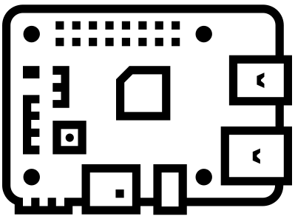
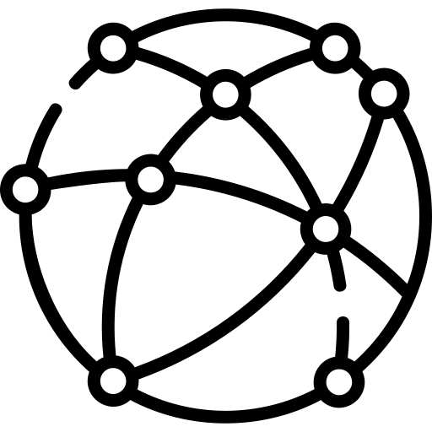

Scenario
Attacker
Internet
ElectroSense
Sensors
Notes:
As a specific application scenario, the ElectroSense Crowd Sensing Project was chosen. In this project individual users can setup and Electro Sense Sensor based on an RPi with a Radio Frequency antenna, in order to collect and provide spectrum data to the community.
The challenge behind this work, was to defend a set of Electro Sense devices from a predefined set of malware.
The goal is to ensure that the sensors can operate normally and constantly deliver data.
Moving target defense was used in order to defend against the different attacks.

Slide 4
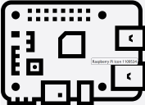
How Moving Target Defense (MTD) Mechanisms can help?
MTD-Paradigm
Attack Surface
What to adapt?
(e.g local IP address)
Malware
When to change?
Observe
device state
(e.g periodically)
How to transition?
(e.g shuffle through list of ip addresses)
Notes:
The attack surface that is exposed by an IoT device is mostly static since (ip adresses, port numbers, installed software versions) does not frequently change dont change that frequently.
Normally the attacker can take his time to collect enough information about a static system for planning his attack.
Moving target defense means periodically shifting certain system parameters in order to create dynamic attack surface
It is a bit like creating a digital shell game for the attacker.
MTDs can either be used proactively in order to increase uncertainty or reactively to counter attacks.
On the next slide you will see the seven attacks and four mtds used by this work.

Slide 5
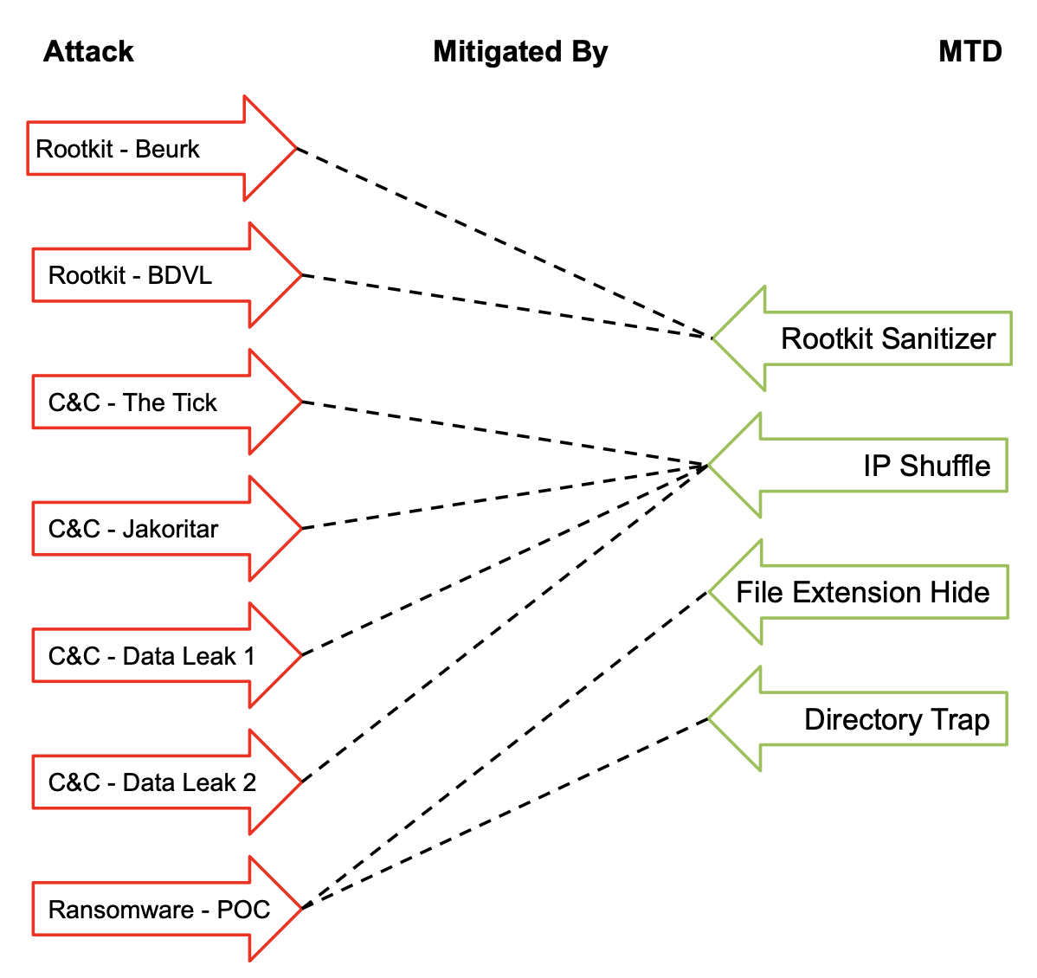
Matching Malware and MTDs
7. Malwares
4.
MTDs
Notes:
The three common types of malware targeting IoT devices are command and control malware, rootkits and ransomware.
We selected 4 command and control malwares, 2 rootkits and 1 ransomware for our experiments.
For each specific malware a moving target defense, capable of mitigating the attack is available (as shown in the column on the right).
So for example the ransomware that we are dealing with can be neutralized by the directory trapping mtd.
This basically traps the ransomware in a directory and expands the file tree downwards with dummy files, such that the ransomware never reaches valuable user information.
In the meantime the encrypting process can be identified by the number of file write operations (which is naturally very large for ransomware) and then terminated and blocked.

Slide 6
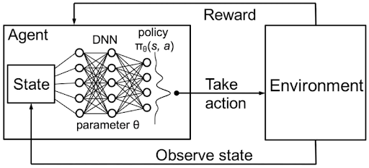
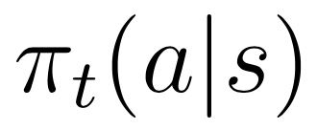
Reinforcement Learning (RL) for MTD-Selection
Goal: Learning a Policy π representing probability of selecting action a when being in state s.
Notes:
The goal is to find a mapping between the current state of the device and which MTD should get deployed (called policy Pi)
This can be achieved using reinforcement learning with DQNs.
If the RL agent selected the correct MTD he receives a reward of +1 and otherwise a negative reward of -1 is yielded.
Through repeated interaction with the environment, the agent is capabale of learning a suitable mapping between observed device state and which mtd to deploy.

Slide 7
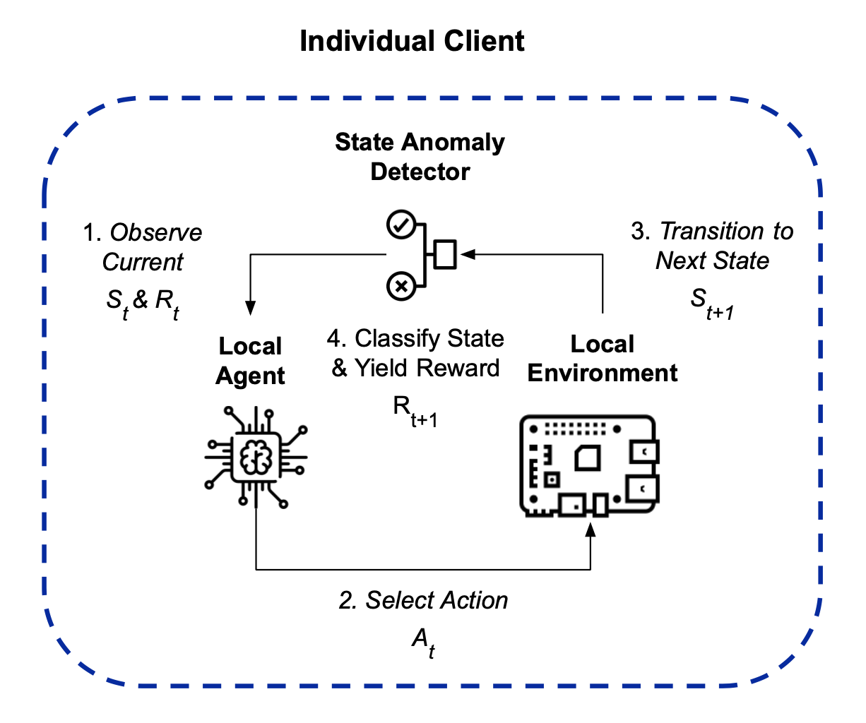
Single Client Architecture
Notes:
To make it bit easier to understand the federated version of the system architecture, I am going to start out with explaining the single client architecture. The training proceeds as follows. The state of the host environment ist observed and the state anomaly detector has to classify if the observed state can be considered normal or if the device is currently abnormally influenced for example by a malware attack. If this is the case then the RL agent gets invoked in order to select a mitigating MTD. This MTD is then executed on the host device and the state S_{t+1} and the state anomaly detector has to classify again, if the state of the device has been broad back to normal by the selected MTD. If this is the case then a positive reward is yielded to the agent, that will be used to update his local policy. Otherwise a negative reward is yielded. This cycle is repeated for many episodes, in order to learn a mapping between input state and which mtd to select.

Slide 8
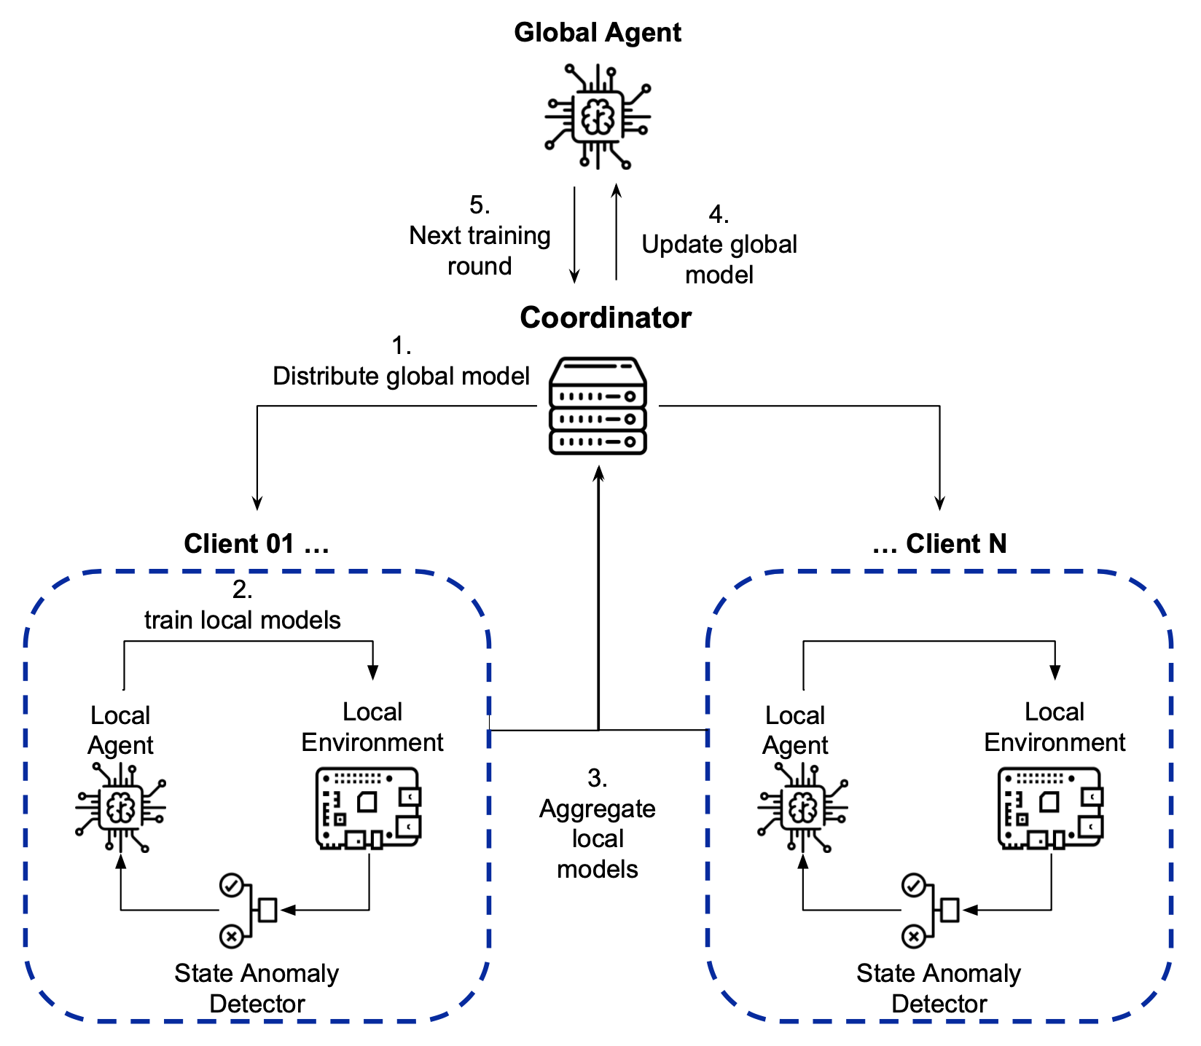
Federated System Architecture
Notes:
The collaborative version incorporates multiple of such clients into one federated framework.
Hereby, the first step is to distribute the current global model to each local client.
The N local Deep Q Network models are then trained for a certain number of episodes (in our experiments always 100 episodes per round) before they are being send back to the central server.
The parameters of these architecturally equal models are then averaged in order to construct the next version of the global model. This process is repeated for a certain number of global training rounds (usually 30 in our experiments).

Slide 9
Experiment 01
Establishing a Baseline
Centralized vs Federated Training (with 10 Clients)
Notes:
The idea behind the first experiment was to create a baseline comparison between centralized and federated training.
We wanted to see if the use of federated learning could show some benefits.
On the following slides the graph on the left always shows centralized training, while the graph on the right shows the test accuracy of the federated training procedure. We had 30.000 state samples that were collected from Electro Sense sensors influenced by one of the seven different attacks and during normal device operation.
For the federated learning, these 30k samples were distributed over 10 clients and then the training was run for 30 rounds with 100 episodes per round.

Slide 10
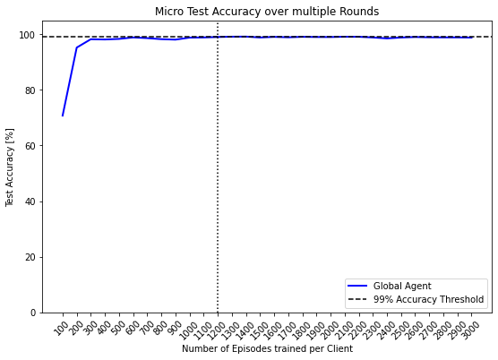
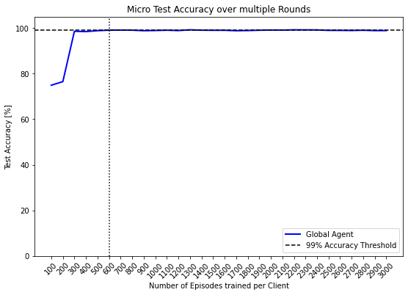
Experiment 1.1
Test Performance of the System for …
… Centralized Training
… Federated Training
Notes:
In the two graphs you can see the test accuracy after each training round (100 episodes).
We defined that achieving a test accuracy of 99% was our learning goal.
The vertical dotted line shows the first time this threshold has been exceeded.
Please look at the two red circles.
You can see that in the centralized training setting it took 12 rounds, while it only took 6 rounds in the federated setting.
However, I have to admit that the x axis shows the number of episodes trained per client. Which means that the total number of episodes on the right side after 6 rounds is 6000 while it is only 1200 after 12 rounds on the left. However, in case the training samples would be collected online, this would still mean
that the federated training achieves a calculatory speedup of 50% over centralized training.

Slide 11
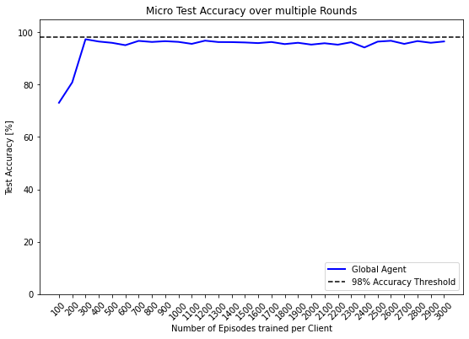
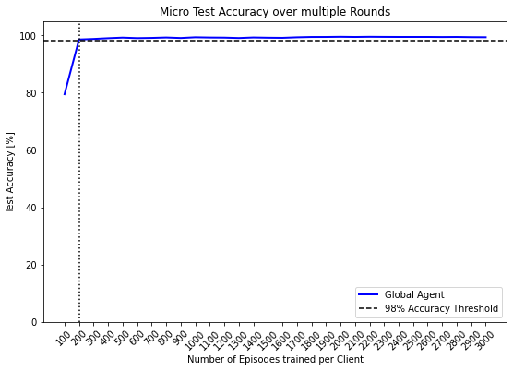
Experiment 1.2
Test Performance of the System for …
… Centralized Training
… Federated Training
Best Test Accuracy: 97.34%
Best Test Accuracy: 99.49%
Notes:
Experiment 1.2 uses the same setting as experiment 1.1 except the fact that anomaly detection on the afterstate was used in order to generate the reward signal for the reinforcement learning agents. The final test accuracy of the system that was trained by federated learning was consistently 2% higher than the baseline system. Furthermore, the baseline system did not pass the 99% accuracy threshold. So we can say that the performance of the federated version can exceed centralized training under certain conditions.

Slide 12
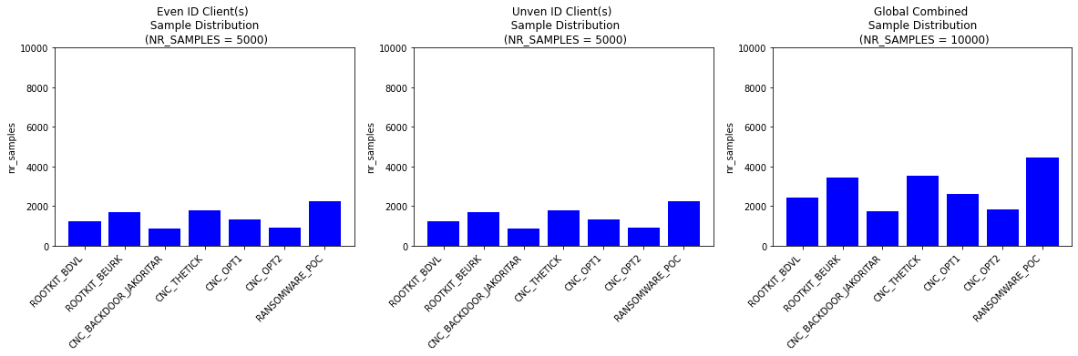
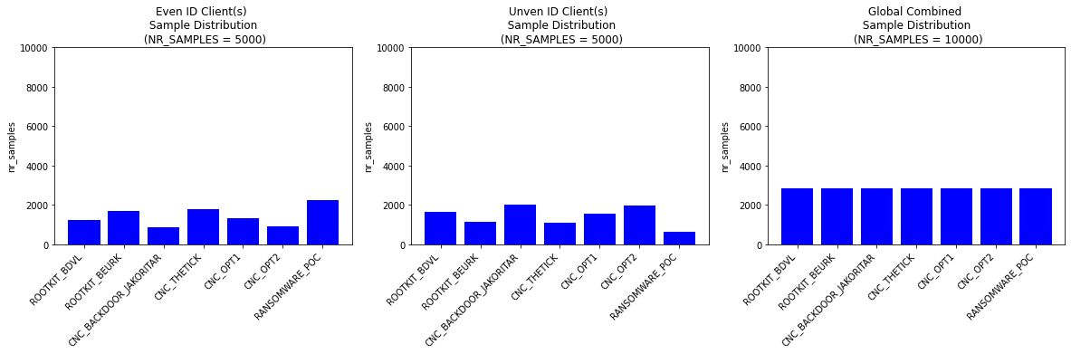
Experiment 02
Checking the effect of different local/ global sample distributions
Locally Balanced Setting
Globally Balanced Setting
Attack Distribution for ...
Attack Distribution for ...
... first Subset
of Clients
... second Subset
of Clients
… Global Combined
... first Subset
of Clients
... second Subset
of Clients
… Global Combined
both local distributions are the same
global distribution is uniform
Notes:
We are dealing with a set of multiple clients / sensors, where each of them has its own training data. In centralized learning there is only one dataset, where the labels or classes follow a certain distribution. In our case there is 10 clients, equals 10 local trainings datasets, where each of them can follow its own sample distribution. This makes it interesting to investigate how training behaves under different sample distributions.
Local class imbalance is concerned with comparing the individual local sample distributions with each other.
In our scenario the 10 clients are divided into two groups. Subset one and two.
The two left most diagrams (in the red circle) show the sample distributions for these two subsets and it can be seen that the two local distributions are exactly the same. This means that the sample distributions are locally balanced (or equal).
Global class balance on the other hand considers the used training data as a whole. This would be like aggregating all the data into one global dataset and then computing the class distribution. We call the global sample distribution balanced if it is a unit distribution, as shown in the red circle on the right.
We found two interesting metrics (called Multiclass Imbalance Degree and Weighted Cosine Similarity) that can be used to quantify local and global class imbalance. For experiment 02 an individual sweep over sample distributions with different values for MID and WCS was performed.

Slide 13
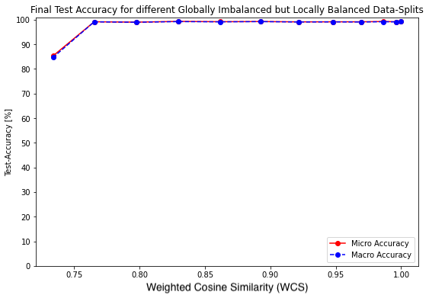
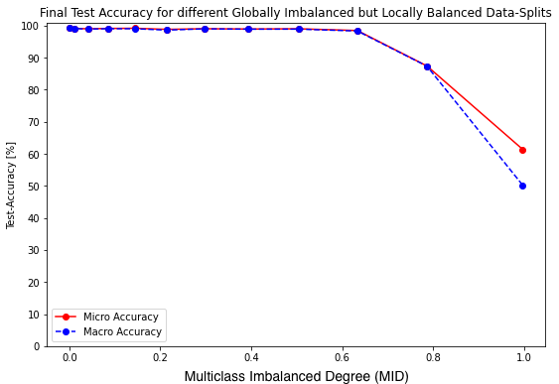
Experiment 2.1
Test Performance of the System for different …
Locally Imbalanced Settings
Globally Imbalanced Settings
Notes:
For the locally imbalanced setting the value of weighted cosine similarity of 1 represents the most balanced setting.
When the local distributions are becoming more imbalanced then the wcs value diminishes.
If the WCS gets below approx 0.75 then the final system performance starts to drop.
This means that the system can handle a wide range of local class imbalances.
The MID to quantify the global class imbalance, ranges from [0 to 1] (0 represents global balance and the MID value increases with increasing global imbalance). It can be seen that until MID of 0.6 the final system performance is still around 99%. For a higher degree of global imbalance the final system performance degrades quickly.
However, values of WCS < 0.75 and MID > 0.6 are somewhat unlikely in our scenario and therefore it can be concluded
that the system has a reasonable robustness against class imbalance.

Slide 14
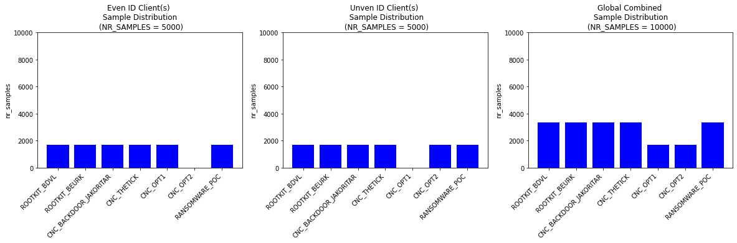
Experiment 03
Investigating the effect of client distinct attacks
Attack Distribution for …
... first Subset
of Clients
... second Subset
of Clients
… Global Combined
Notes:
The third experiment was supposed to investigate the effect on training, if certain attacks are only launched on or encountered by a subset of devices.
You can see on the left that cnc malware 1 is only seen by device subset 01, and cnc opt 2 only by device subset 2 (digram in the middle).

Slide 15
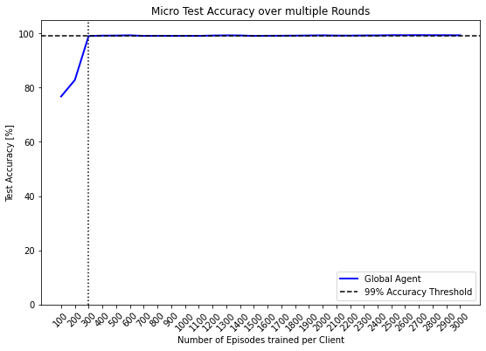

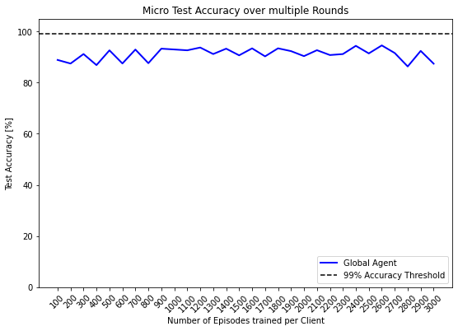
Experiment 3
When some attacks are only seen by a subset of clients
1 Client Exclusive Class
2 Client Exclusive Classes
3 Client Exclusive Classes
Notes:
The left graphic shows the test accuracy after each of the 30 rounds with 1 client exclusive class.
It can be seen that training progresses quickly and exceeds the threshold of 99% already after the third round.
In contrast to this, for two client exclusive classes (graph in the middle) training progresses fast until the third round, but then the learning curve becomes shallow. After the last training round an accuracy of around 95% is reached.
The scenario with 3 client exclusive attacks is also called client distinct setting, because the two subset of clients, both see a distinct of set attacks (there is no overlap anymore). In this case you can see in the rightmost graph that training fluctuates a lot and does not really converge to stable values.
So I concluded that the system can handle a certain degree of client exclusive attacks or classes, but only to a certain extent.

Slide 16
Conclusions
Experiment 1
=> Calculator Speedup and potentially higher Performance.
Experiment 2
=> Certain Robustness against Local and Global Class Imbalance.
Experiment 3
=> Able to deal with some Client Exclusive Attack Settings.
Notes:
To conclude i would say that we have been able to proof with this work, that it is possible to learn a MTD selection policy in a collaborative and private way using federated learning.
Experiment 1 has shown that a good calculatory speedup of around 50% and a potentially higher performance can be achieved.
Experiment 2 proofed that there is a certain robustness against local and global class imbalance.
According to experiment 03, even in a setting of client exclusive attacks it is possible for the system to learn a reasonable good defense policy.

Slide 17
Limitations
Checking different Aggregation Functions (than FedAvg).
MTDs do net yet consider Adaptive Attacks and Timing Effects.
Use even more realistic Training Data.
Optimize the over 20 Hyperparameters.
Build an online Prototype?
Notes:
Checking different Aggregation Functions (than FedAvg).
MTDs do net yet consider Adaptive Attacks and Timing Effects.
Use even more realistic Training Data.
Optimize the over 20 Hyperparameters.
Build an online Prototype?
This concludes my presentation and I am happy to answer your questions now.

Slide 18
APPENDIX

Slide 19
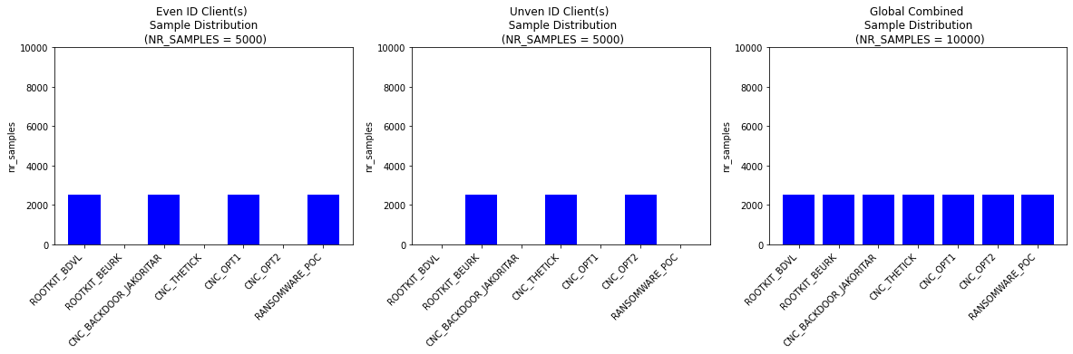
Experiment 3.3
Sample Distribution
Performance Evaluation

Slide 20



IoT Security
IoT Devices
Explosive Growth
Unsecure
Design
Recent
Attacks
Notes:
First of all, let’s explore why security in the context of IoT is such a complex issue.
The Internet of Things has seen an explosion in the number of devices in recent years.
The majority of these devices are consumer grade and rather cheap.
According to Statista in 2023, there is 15 billion IoT devices on the planet right now, (already more than humans on the planet)
Not every vendor sees the necessity to spend a lot of money on security,
since the individual device should be affordable for end customers.
Therefore, many IoT devices are already unsecure design.
This is amplified by the low IT security knowledge of end customers.
Due to the high number of devices, devices types, models, manufacturers and technologies in use, Iot security is very difficult. The mirai botnet from 2016, was created by simply targeting IoT devices (like IP cameras) and trying out if the standard admin name and password have been changed or not. It is estimated that around 500.000 devices were captured by this simple approach and the botnet was then used to launch DDoS attacks on multiple targets. One attack was powerful enough to take down a DNS service, making websites like Twitter and Github unavailable via DNS for some hours.
This work is using Raspberry Pis that are configured to be sensors in the Electro Sense crowd sensing network as an exemplary IoT device.

Slide 21
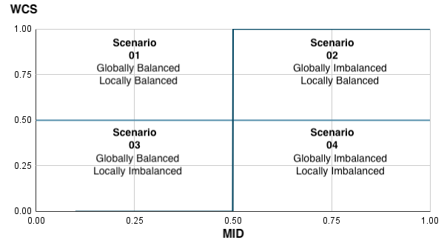
Different sample distributions

Slide 22
Experiment 3.1
Sample Distribution
Performance Evaluation

Slide 23
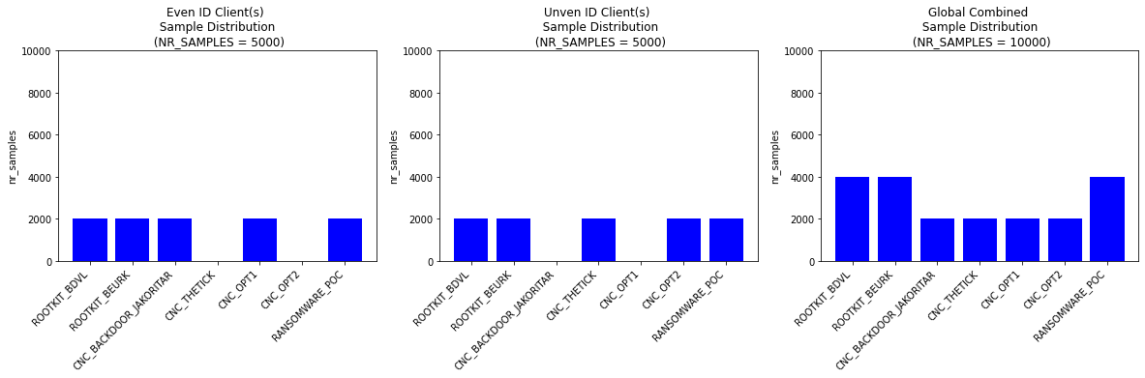
Experiment 3.2
Sample Distribution
Performance Evaluation

Slide 24



Attack-Defense Learning Cycle
Observe device behaviour under attack
Launch attack
IoT Device
Select and Execute MTD
Attacker
Observe device behaviour after MTD execution
Run next iteration?
Receive positive or negative reward
Notes:
We use linux system tools in order to monitor 100 features that represent the current state of the device.
Active malware will alter the features.
Our goal is it to select and deploy the correct MTD in order to mitigate the attack.
If the current attack was successfully mitigated by the chosen MTD then the agent receives a positive reward.

Slide 25
Which Malware and MTDs
Types of Malware | Mitigating MTDs
Command and Control & Botnets THETICK BACKDOOR_JAKORITAR CNC_OPT1 CNC_OPT2 | - Private IP Address Shuffling
Rootkits BDVL BEURK | - Rootkit Purging
Ransomware PoC | - Encryptor Trapping with Dummy Files - File Ending Randomization

Slide 26
DQN Architecture
4
neurons
30
neurons
47
neurons
60
neurons

