Slide 1
Graphics
by Jan Kreischer

Slide 2
Attack Mitigated By MTD
Rootkit - Beurk
Rootkit - BDVL
Rootkit Sanitizer
C&C - The Tick
IP Shuffle
C&C - Jakoritar
File Extension Hide
C&C - Data Leak 1
Directory Trap
C&C - Data Leak 2
Ransomware - POC
Notes:
The training data is split equally between n devices

Slide 3

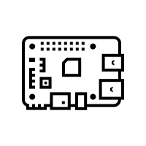
Prototype 01 / Single Client Architecture
1. Observe Current
S_{t} & R_{t}
3. Observe Next
S_{t+1} & R_{t+1}
Local
Agent
Local Environment
2. Select Action
A_{t}
Notes:
The training data is split equally between n devices

Slide 4

Prototype 01 / Federated System Architecture
Global Agent
5.
Next training round
4.
Update global model
1.
Distribute global model
Coordinator
Client 1 …
… Client N
2.
train local models
Local
Agent
Local Environment
Local
Agent
Local Environment
3.
Aggregate
local
models
Notes:
The training data is split equally between n devices

Slide 5
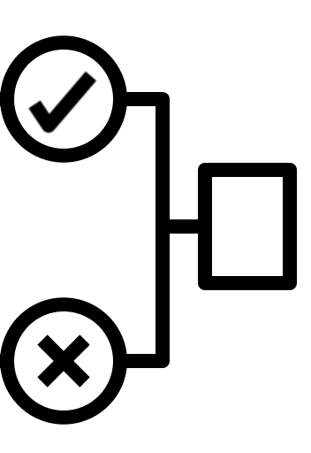
Prototype 02 / Single Client Architecture
Individual Client
State Anomaly
Detector
1. Observe Current
S_{t} & R_{t}
3. Transition to Next State
S_{t+1}
Local
Agent
4. Classify State & Yield Reward R_{t+1}
Local Environment
2. Select Action
A_{t}
Notes:
The training data is split equally between n devices

Slide 6
Global Agent
Prototype 02 / Federated System Architecture
5.
Next training round
4.
Update global model
1.
Distribute global model
Coordinator
Client 01 …
… Client N
2.
train local models
Local
Agent
Local Environment
Local
Agent
Local Environment
3.
Aggregate
local
models
State Anomaly
Detector
State Anomaly
Detector
Notes:
The training data is split equally between n devices

Slide 7


Prototype 03 (with four Clients)
Coordinator
Switch
ElectroSense
Sensor 01
ElectroSense
Sensor 02
ElectroSense
Sensor 03
ElectroSense
Sensor 04

Slide 8
Prototype 03 (with five Clients)
Coordinator
Switch
ElectroSense
Sensor 01
ElectroSense
Sensor 02
ElectroSense
Sensor 03
ElectroSense
Sensor 04
ElectroSense
Sensor 05

