Slide 1

Quantifying the Trustworthiness Level of Artificial Intelligence Models and Decisions
Agenda
Motivation
Taxonomy
Trusted AI Algorithm
Validation Scenarios
Demo
Notes:
Welcome to the presentation of our project about
“Quantifying the Trustworthiness Level of Artificial Intelligence Models and Decisions”
The project was done by me and two other students from UZH.

Slide 2




Motivation
Credit
Scoring
Medical Diagnostics
Applicant Screening
Autonomous Driving
Notes:
We all know that narrow artificial intelligence and machine learning are increasingly used in everyday products.
AI based systems are used for credit scoring, helping to make medical diagnoses, scan applicants for a job and enable semi to maybe one day fully autonomous cars.
How should we decide whether we should trust these systems or not?
As humans we base our trust on empirical evidence gained from past behavior or based on certifications like diplomas.
For the adoption of AI It is key that all stakeholders relying on the models decisions can trust these.
Our project goal was to make it possible to automatically calculate the trustworthiness of machine learning models

Slide 3
Thesis Goals
1. Identify metrics and key dimensions of trust
2. Compile a general taxonomy
3. Develop an algorithm to automatically compute the trust score of machine learning models
4. Prototypical implementation
5. Validation of the proposed solution
Notes:
So the main goals of our projects were to
At first, review scientific literature and state of the art to identify the key dimensions and metrics for trust in AI.
Compile our findings into a unified general taxonomy (which you will see later)
Design and implement an algorithm capable of automatically computing the level of trustworthiness for trained machine learning models.
Validate the proposed solution on two application scenarios.

Slide 4

Pillars of Trust
Trust in AI
Fairness
Methodology
Explainability
Robustness
Notes:
Usually the analysis of ML models is based on simple performance metrics, like accuracy, micro and macro f1 and maybe the confusion matrix.
However, a purely performance based assessment can be too one-dimensional.
By analyzing scientific literature and the current state of the art, we identified that models need to be fair, explainable, robust in order to be trustworthy.
Furthermore, it is essential that the model creation process is well documented and transparently communicated to downstream stakeholders.
We call these four dimensions - the pillars of trust in AI - namely Fairness, Robustness, Explainability and Methodology.

Slide 5
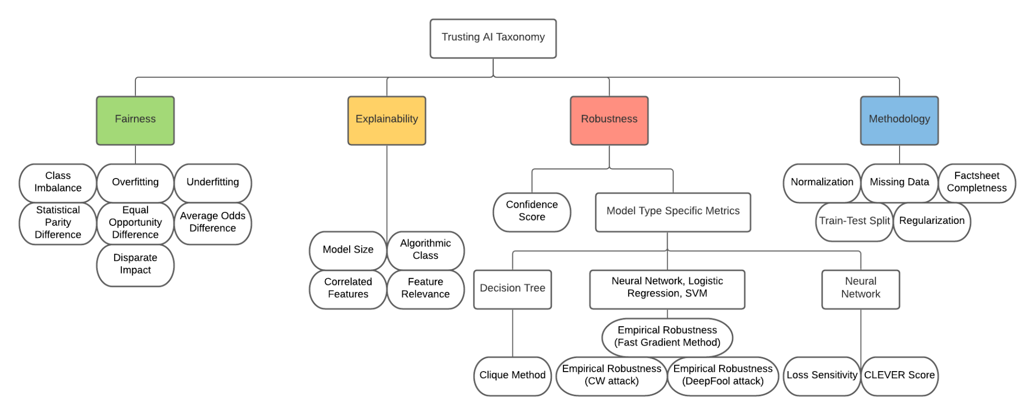
Taxonomy - Trusted AI Metrics
Notes:
So this brings us to our taxonomy, where all pillars and metrics are shown in a structured way.
For every pillar we identified the most important metrics from scientific literature.
Fairness is about checking if the models decisions are impartial and just without discrimination of protected groups.
Statistical parity, equal opportunity, average odds and disparate impact are the most important metrics here

Slide 6
Taxonomy - Trusted AI Metrics
Notes:
Explainability in the context of AI is concerned with understanding how a model came to its conclusion.
In total four explainability metrics are considered and the model type is the most important metric as it has the strongest impact on the functionality of decision making process.
For example, a decison tree is more explainable than a deep neural network.

Slide 7
Taxonomy - Trusted AI Metrics
Notes:
Checking the models robustness is about resilience against adversarial inputs and attacks.
For the robustness we separate metrics according to the model type.

Slide 8
Taxonomy - Trusted AI Metrics
Notes:
The fourth pillar is the training methodology.
It is assesses the training pipeline, whether the best practices were followed and if the training process was documented accordingly.
It considers for example if regularization and normalization was used.
This is now our full taxonomy showing all pillars and metrics we consider.

Slide 9
Metric Dependencies
ML Model
Training Data
Test Data
Factsheet
Notes:
Every metric takes four artefacts as input.
The model, the training and test data and a factsheet serve as input to every individual metric.
The factsheet contains the most important information about the model
(for example the name of the target column that you want to predict)

Slide 10
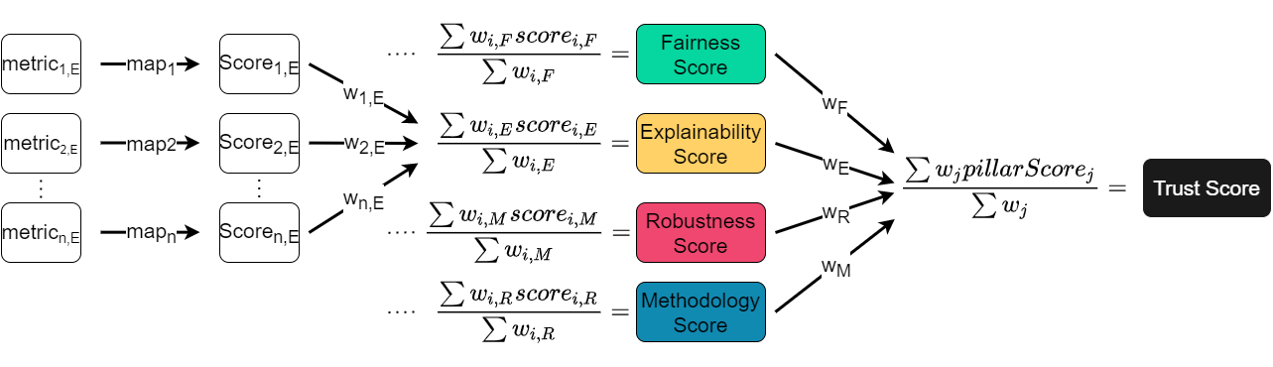
Trusted AI Algorithm Design
Pillar Specific Metrics
Notes:
As mentioned every metric receives the model, the training and test data and the factsheet as input.
Using this information the metric value is computed.
However, each metric values can be on a different range.
For example statistical parity difference is on a range from 0 to 1
The model type is a string.
The heterogeneous metric values need to be normalized and set into a relation to trust by mapping them to a unit score from 1 to 5.
Where 5 reflects the most trustworthy score for a metric.
—---
For every pillar we have a set of metrics. On the left you can see the metric values of a specific pillar. There two different kinds of metrics those that have a well known underlying equation which is used to calculate its value like the Loss sensitivity or statistical parity differnce. Or properties which have been identified as important in the literature like the algorithm class for example or the train-test split. The metric values have different ranges or even datatypes. So we need to normalize the values and set them in a relationship to trust which is done with giving a score from 1 to 5.

Slide 11
Trusted AI Algorithm Design
Metric Scores between 1-5

Slide 12
Trusted AI Algorithm Design
Aggregate
Metric Scores

Slide 13
Trusted AI Algorithm Design
Aggregate
Pillar Scores

Slide 14

Validation Scenario 1
IoT Attack Classification:
Multiple client devices
Collecting status information
Classify if device is subject to attack
Classify the type of attack
Fakepsd attack
Sendout attack
Write attack
Random attack
Exchange attack
Hide attack
Type of attack
Not under attack
Under
attack
Notes:
To demonstrate the usefulness of the proposed algorithm, we implemented it as a proof of concept and we deployed it as a web application. For validation of the algorithm and implementation we picked 2 main scenarios. For each of the scenarios we trained multiple models and compared their outputs. The first scenario we are focusing is from the IT security context. We are having multiple raspberry pis and we collect their status information. [CLICK] First we are trying to classify if the device is subject to attack or not and in a second step [CLICK] we also try to classify the specific type of attack.

Slide 15

Validation Scenario 2
Credit Card Approval:
Personal user information
Credit scoring
Classify if a credit card can be given
Credit card approved
Credit card rejected
Notes:
Our second scenario is approval of credit cards. In theory and practice, there are many examples where machine learning models have shown discriminatory behavior for credit scoring. Here the task is to decide, based on data about the applicant, whether to accept or reject the application for a credit card. The scenario is based on a synthetic Kaggle dataset.

Slide 16
Demo Prototype
https://www.csg.uzh.ch/trusted-ai/
Notes:
Explain the meaning of a scenario here.
Explain better why we need the factsheet and what information is within the factsheet.
Only mention briefly

Slide 17
Conclusion and Future Work
Compile a general taxonomy
Develop an algorithm to automatically compute the trust score of machine learning models
Validation of the proposed solution
Add a new pillar (e.g. Privacy)
Extend the set of metrics
Add support for regression model
Add support for other ML libraries
Notes:
So to conclude our work.
At first we analyzed the literature and identified the most important metrics for trust in AI.
Based on these we developed an algorithm to automatically assess the trustworthiness of a trained model
And validated the proposed solution based on two application scenarios.
But there is still a lot of possible future work that can be done
You can analyze the literature and the state of the art further to identify even more pillars and even more metrics to add.
So far our solution only supports classification models that have been build with sklearn or tensorflow.
Therefore, support for regression models still needs to be added and other ML libraries like PyTorch
This concludes our presentations and now we are happy to answer the questions you might have.

Slide 18
Questions?

Slide 19
Backup Slides

Slide 20
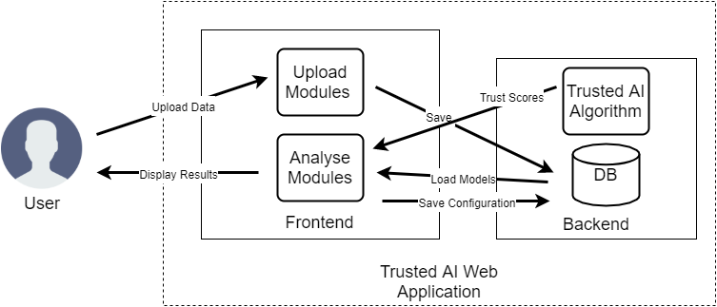
App Architecture
Notes:
BACKUP SLIDE

Slide 21
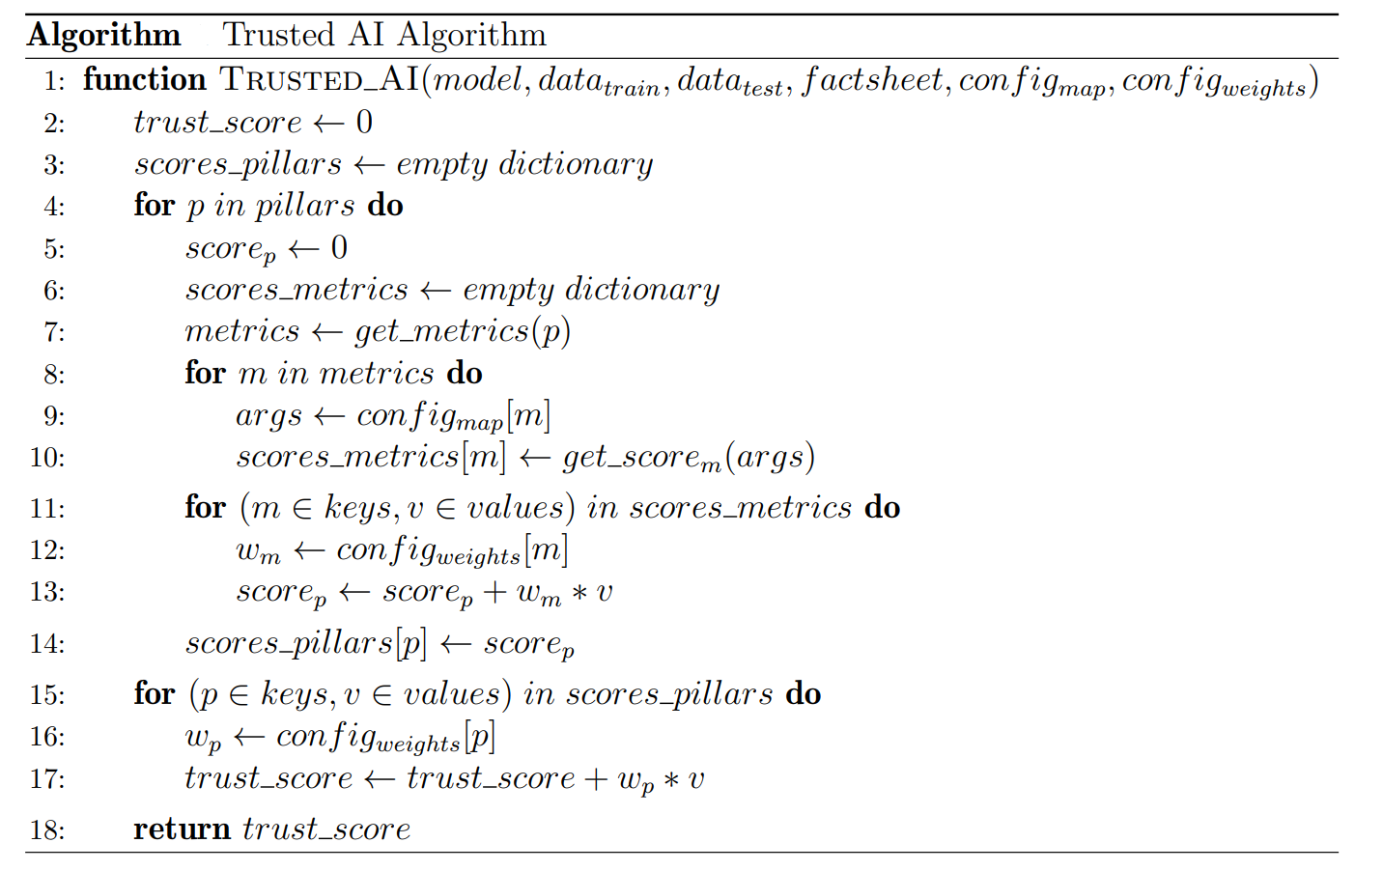
Trusted AI Algorithm
Notes:
BACKUP SLIDE

Slide 22
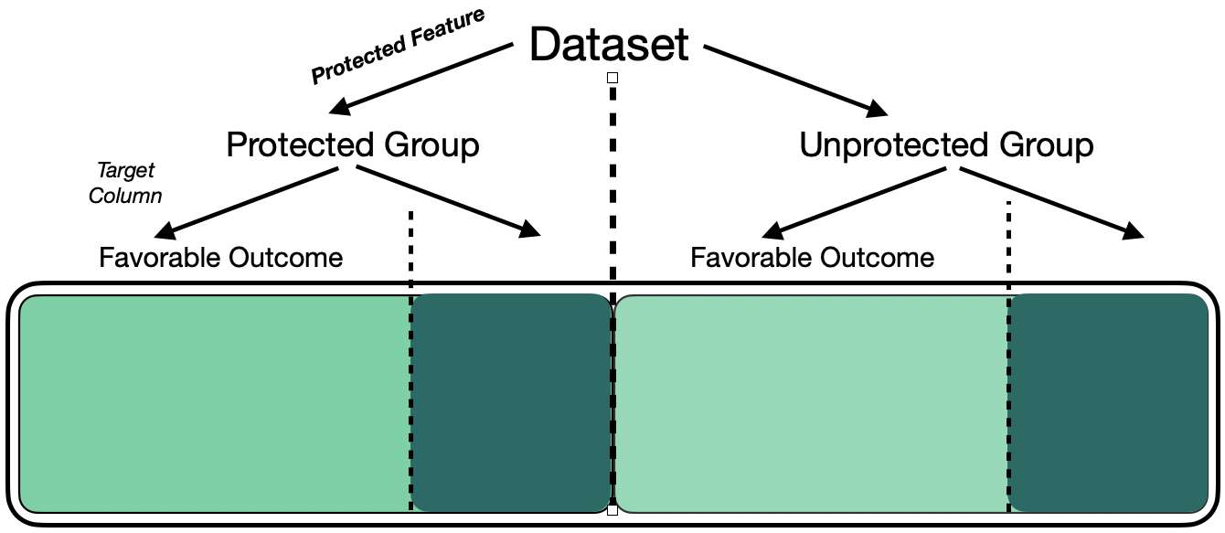
Fairness Computation
Notes:
BACKUP SLIDE

Slide 23
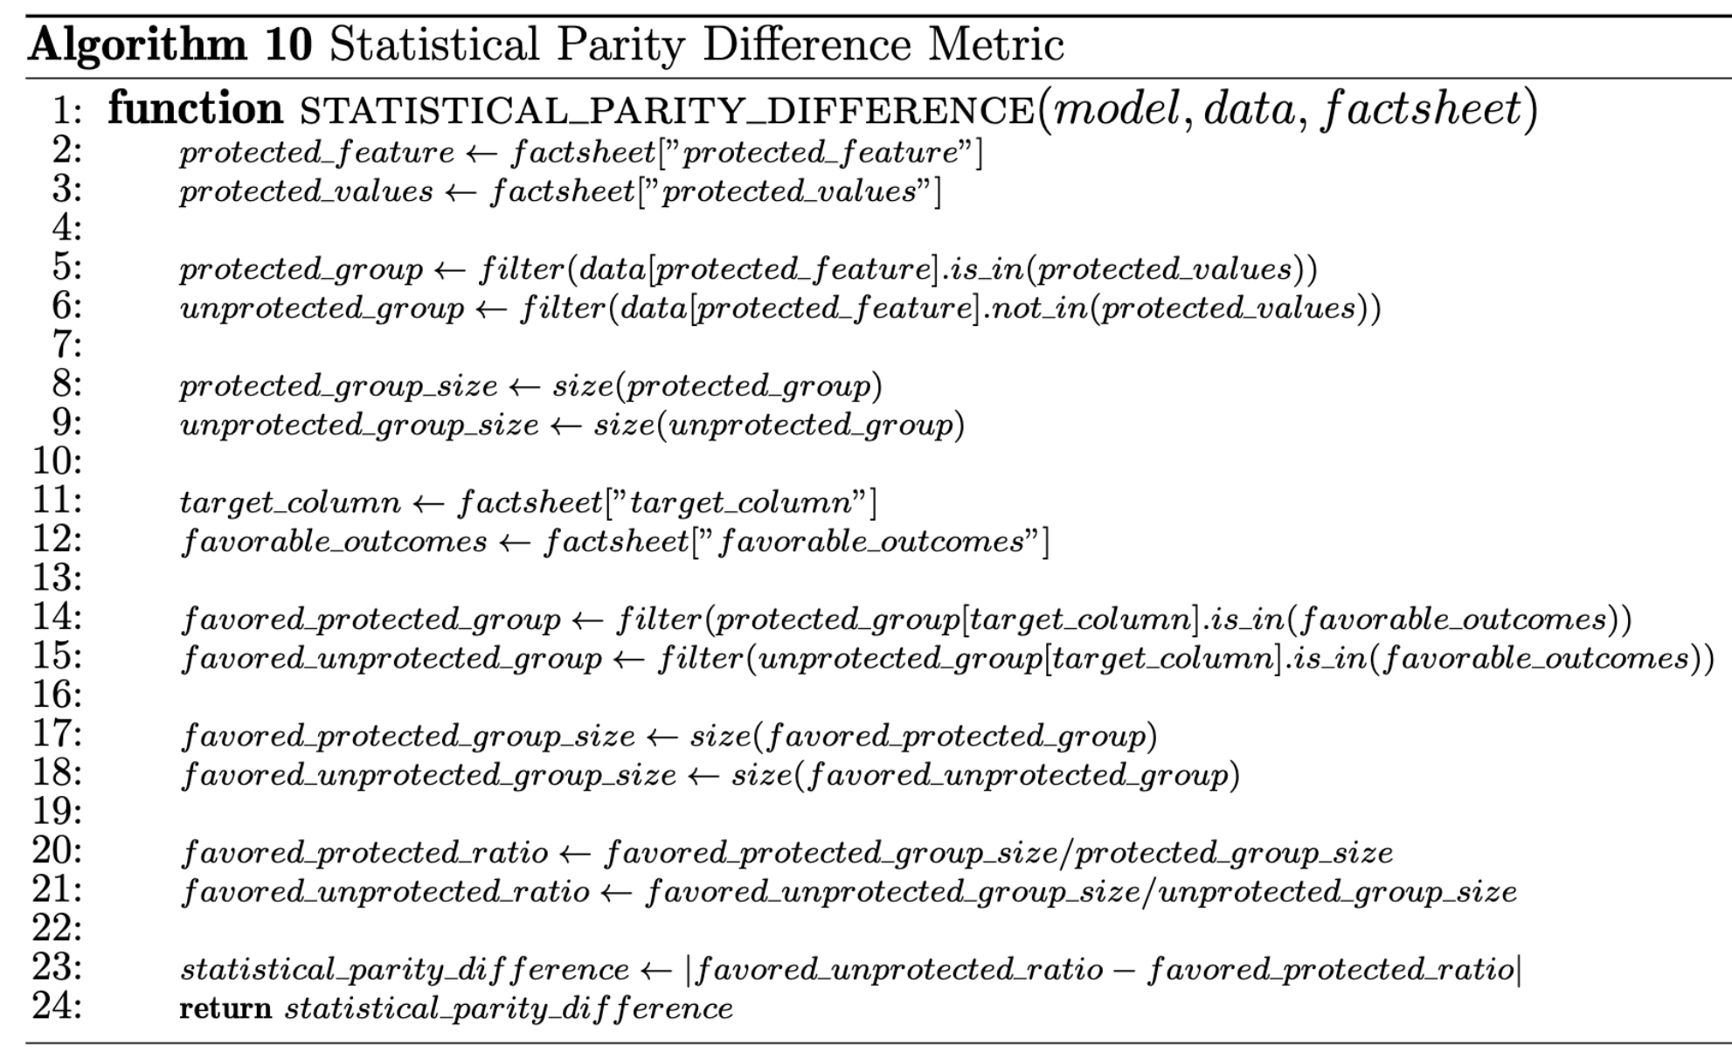
Statistical Parity Difference
Notes:
BACKUP SLIDE

Slide 24
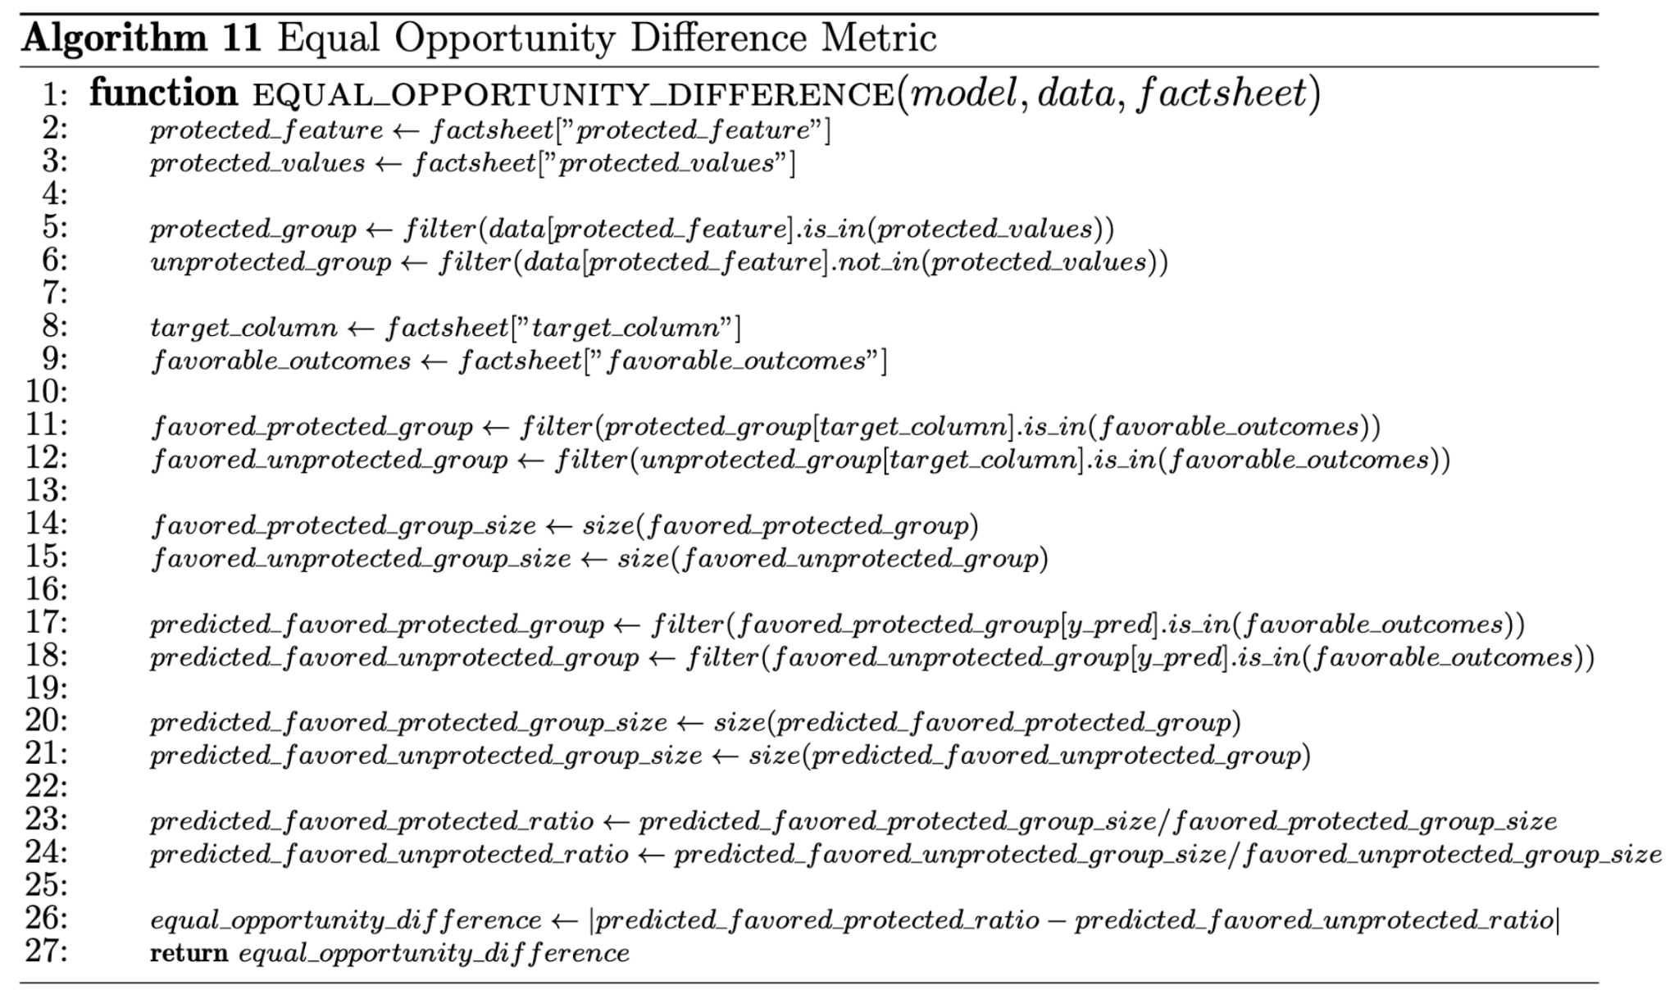
Equal Opportunity Difference
Notes:
BACKUP SLIDE

Slide 25
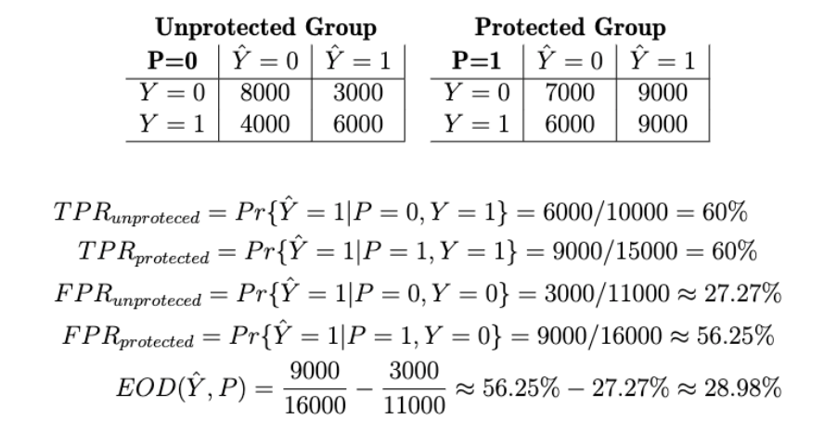
Equal Opportunity Computation Example
Notes:
BACKUP SLIDE

