Slide 1
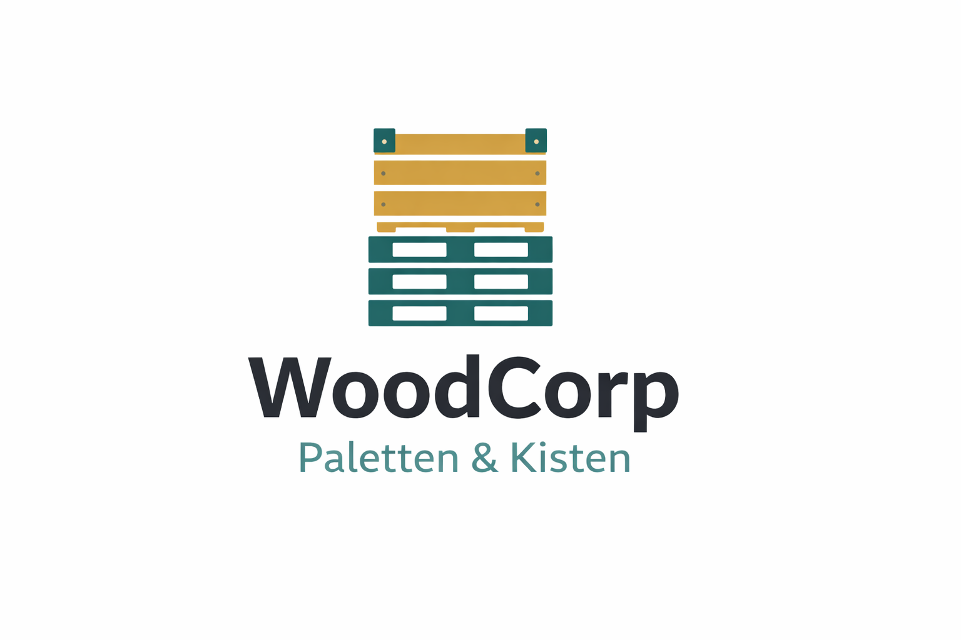
Execution Deviations in the Order-to-Cash Process
From Planned Flow to Execution Risk

Slide 2
Woodcorp’s operating model structurally amplifies O2C execution deviations
Evidence from Order-to-Cash execution data (≈20k orders)
Company Overview
German mid-sized industrial manufacturer
Make-to-order with limited finished-goods buffers
€210.1M total revenue
~19,953 sales orders
Top customers generate a significant share of revenue.
Brand AG (€19.5M), Götz (€17.0M), Jürgens (€12.4M)
Operational Footprint
Multi-plant production network
Mixed automation levels
Multiple external logistics providers
This setup increases coordination effort after order release
(order release = the point in the Order-to-Cash process where a confirmed sales order is handed over to production and logistics for execution)
Product Catalog
Product Type | Description | Typical Use Case | Operational Characteristics
Pallets | Standardized wooden pallets | Transport, storage, logistics | High volume, lower unit price, tolerance-sensitive
Crates | Custom wooden crates | Industrial goods, heavy equipment | Make-to-order, higher variability, higher unit price
Why This Matters
Woodcorp’s operating setup leads to frequent post-release changes in the Order-to-Cash process, directly affecting delivery reliability and planning stability for key customers.

Slide 3
O2C Execution Deviations Undermine Planning Stability and Require Targeted Management Action
Executive Objective
The objective of this analysis is to support operational decision-making by:
Creating transparency on actual O2C execution behavior
Identifying systematic execution gaps with operational impact
Translating insights into prioritized management actions
Executive Focus
Decision support for operations and process owners
No tool demonstration or technical deep dive
Key Stakeholders
Primary Audience
O2C Process Owner – end-to-end accountability for execution performance
Relevance for the O2C Process Owner
visibility into where execution breaks down
clear link between execution behavior and planning instability
fact-based basis for targeted action, not blanket initiatives
Why This Matters
Without a fact-based view on execution behavior, improvement initiatives often focus on symptoms instead of underlying execution patterns.

Slide 4
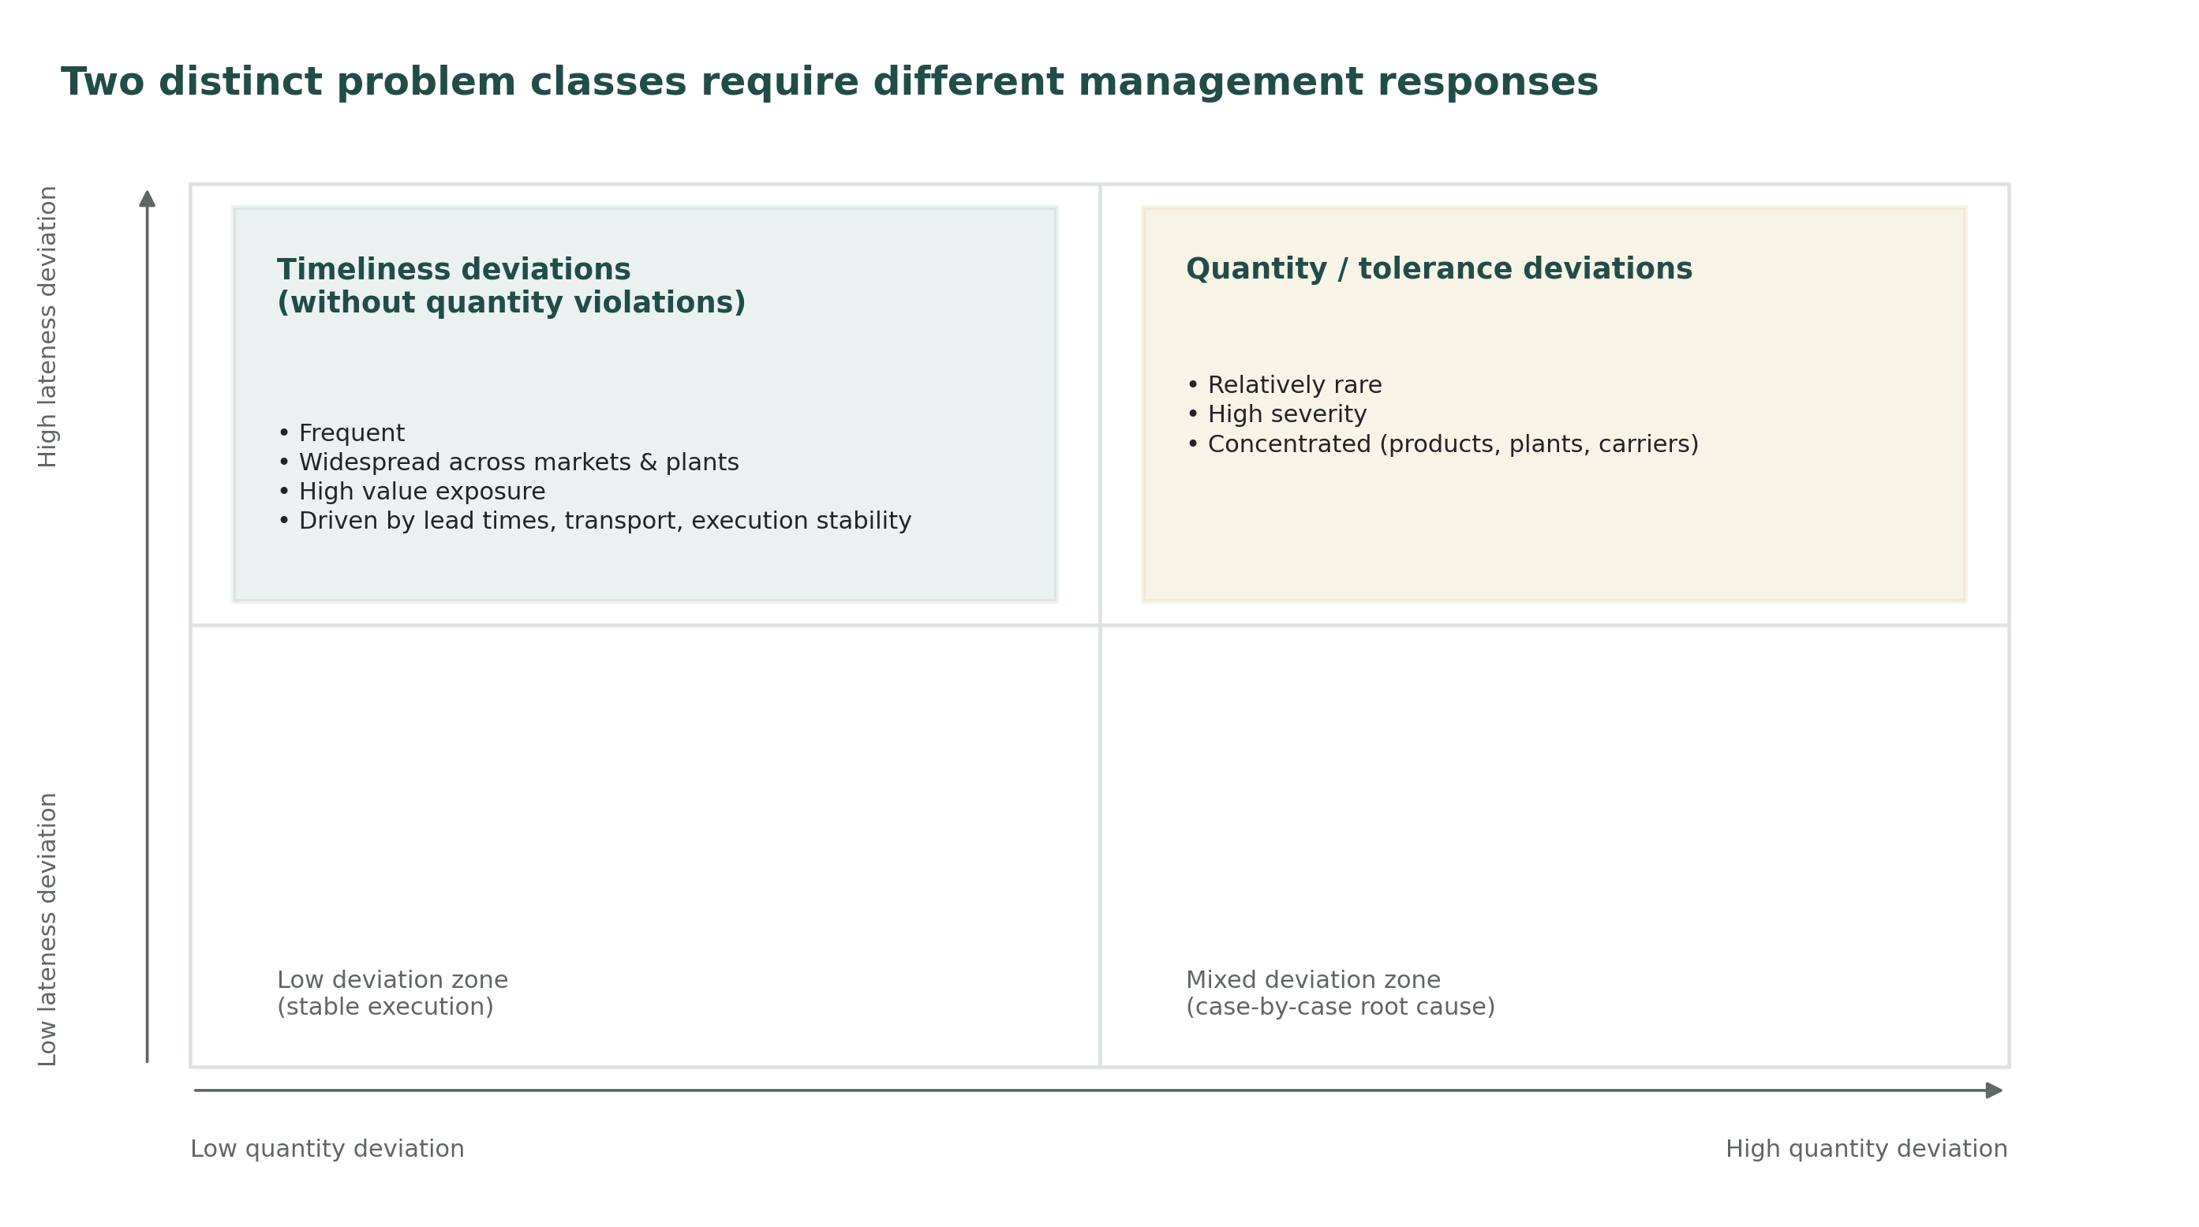
Operational Issue Requires Two Different Management Responses
Observed Core Patterns
The analysis shows recurring execution gaps in the O2C process. Delays and deviations are not driven by a single root cause, but by two distinct execution patterns with very different operational and value impact.
Key observations:
Quantity tolerance violations are rare but high-impact and highly concentrated.
A large share of late deliveries occurs without quantity violations.
Value exposure is mainly driven by systemic lateness, not by extreme quantity errors.
How to read:
Quantity deviations (x-axis) vs. delivery lateness (y-axis). The chart separates systemic lateness issues from concentrated, high-severity quantity deviations.
Why This Matters
These patterns imply that improving O2C performance requires differentiated, problem-specific management actions rather than broad process changes.

Slide 5
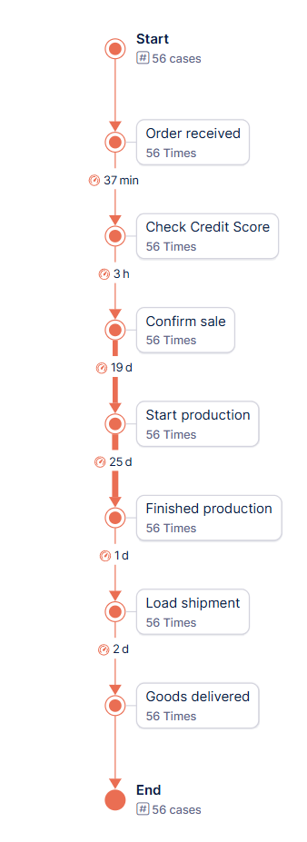
Execution Deviations After Order Release Drive ~4 Days of Delay
Happy Path – Analytical Reference
The Happy Path represents the intended best-case execution flow of the Order-to-Cash (O2C) process without rework or change loops.
It is used exclusively as an analytical baseline to identify, compare, and quantify execution deviations and to derive targeted improvement actions.
Happy Path
(based on internal business sorting logic):
Order received
Check credit score
Confirm sale
Start production
Finished production
Load shipment
Goods delivered
Post-release deviation affected area
Quantitative reference:​
All orders contain these core activities​
Typical Order process variations (top 30) with post-release deviations: → Median throughput time: 45.6 days​
Orders that follow the exact Happy Path​: → Median throughput time: 41.5 days​
The Happy Path is intentionally rare and serves as a performance benchmark, not as a realistic target state.
Share of orders following exact Happy Path: <1%
Why This Matters
Orders following the exact Happy Path are ~4 days faster, showing that delays are primarily associated with post-release deviations from the Happy Path.

Slide 6
A Small Number of Post-Release Rework Patterns Drives Most O2C Delays
Execution Gaps Identified
Late Quantity Changes After Load Shipment
Occur after physical execution has started
Affect a small but highly impacted subset of orders
Trigger rework after shipment, causing disproportionate delays
Interpretation: Late order changes introduce operational rework beyond the controllable execution window.
Repeated Production Start Date Changes after Production Start
Occur in the vast majority of orders
Low impact per case, but systematic and recurring
Primary driver of planning instability, not physical failure
Interpretation: Frequent replanning erodes schedule reliability across the network.
Credit Blocks With Downstream Rework
Affect a relevant majority of cases (~10%)
Create significant cycle time increases once triggered
Interpretation: Payment-related controls introduce downstream process friction beyond order release.
Sales price rework after Sale confirmation
Affect a relevant minority of cases
Affect a relevant majority of cases (~13%)
Create significant cycle time increases once triggered
Interpretation: Sales prices are renegotiated and reprocessed after order receipt and sale confirmation, causing additional approval steps, rework loops, and execution delays in O2C.
Timestamp inconsistencies
Timestamps do not reliably reflect business execution order
Root cause: technical logging effects (e.g., retrospective reporting)
Analytical handling:
Process order defined by business logic (sorting column)
plausible Timestamps used for durations only
Why This Matters
A small number of recurring execution gaps explains a large share of cycle time variance and planning effort, making them high-leverage targets for management action and improvement potential.

Slide 7
Two Post-Release Execution Gaps Require Immediate Management Attention
1
Rank (Importance) | Gap | Per Case | % of Orders | Δ Cycle TPT vs. Happy Path median of 41.5d | Business Risk
1 | Post-loading quantity correction | 1-13 1 2 3 | 27.9% 12.5% 11% 3.6% | +11 d +8.9 d +10.9 d +10.5 d | VERY HIGH
2 | Credit order block | 1 | 10% | +19.5 d | VERY HIGH
3 | Post-confirm sale price rework | 1-9 1 2 3 | 13% 6.4% 5.5% 0.8% | +19.9d +19.9d +16.5d +32.8d | HIGH
4 | Repeated Production Re-Scheduling After P-Start | 1-9 1 2 3 | 48.2% 38.3% 7.5% 2% | -13.5 d -16.5 d +5.5 d +11.5 d | MEDIUM
High
Immediate Management Actions
Structural Improvement Initiatives
2
Business Risk
3
Low
Monitor
Not Economically Justified
4
Low
High
Implementation Effort
How to read:
Top-left gaps require immediate management action, while others are monitored or addressed structurally based on effort–impact trade-off.
Execution gaps are ranked by frequency, delay impact (Δ TPT vs. Happy Path), and business risk.
The matrix positions gaps by business risk (Y-axis) and implementation effort (X-axis); numbers refer to the ranked gaps.

Slide 8
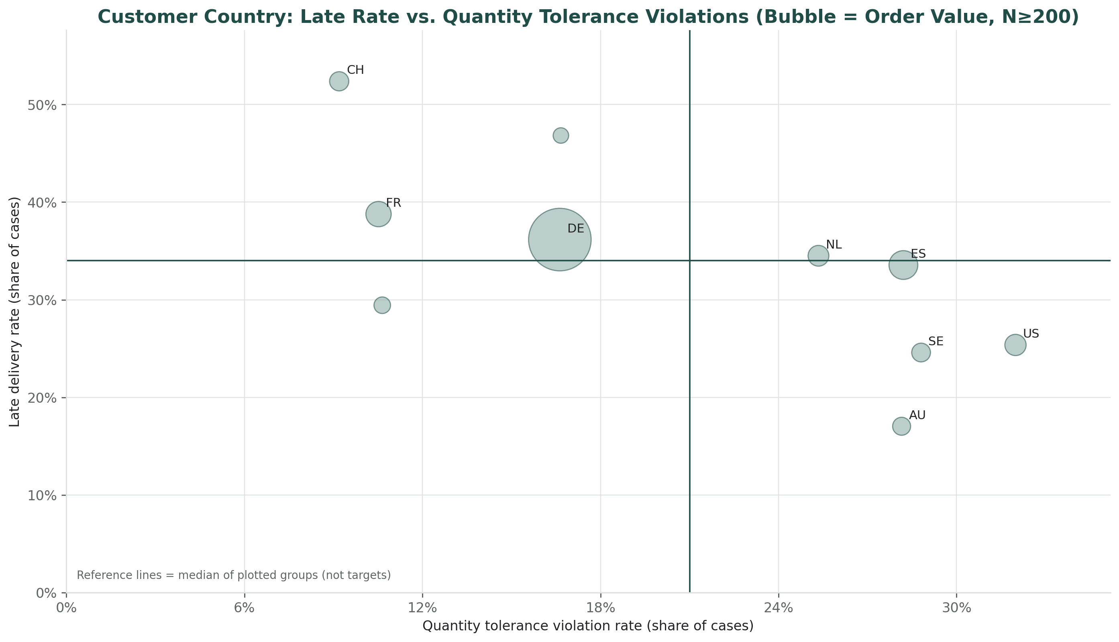
Combining lateness, quantity deviations, value exposure, and frequency enables impact based prioritization
Analytical Approach
We focus on attributes that jointly explain operational risk and business impact:
Delivery timeliness Identifies systemic execution instability and planning reliability issues.
Quantity tolerance deviations Indicates late order changes and post-release rework beyond the controllable execution window.
Value exposure Ensures management focus on deviations with material business impact.
Frequency across orders Distinguishes isolated exceptions from recurring execution gaps.
These attributes allow us to separate stable execution from high-impact deviation patterns and prioritize management action.
Identified Assessment Priority Markets
Timeliness-driven instability
High severity deviations
Stable execution
Quantity-driven corrections
Assessment Priority Example: Customer Country
CH: extreme late-rate outlier → timeliness-driven execution instability
NL / ES: elevated late rates with high value exposure → economically relevant patterns
US: high quantity deviation + delay exposure → post-release quantity corrections
(DE/FR appear sizeable mainly due to baseline volume; they are treated as reference segments)
How to read:
X = Qty deviation rate, Y = Late rate, Bubble = value exposure;
lines = median of plotted segments

Slide 9
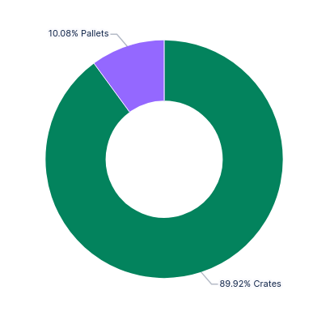
Post loading quantity corrections affect few orders but drive disproportionate delay and value exposure
GAP DEFINITION: Quantity is changed after shipment was loaded.
Urgency
affects ~28% of processes
represents ~46% of ordered value
Difference in median TPT: + 11 days
Hits high-value orders harder
Product type distribution of post-loading quantity corrections
Factory
Mostly in Essen (63,61%)
Bonn is also overrepresented (10,77% vs. 5,84%)
Customer
Brand AG is overrepresented (20,63%)
Key Message
This execution gap is very impactful and mostly rooted in high value orders, concentrated on both particular customers and factories.
How to read: Post-loading quantity corrections mainly affect crate production and the transportation customer segment.

Slide 10
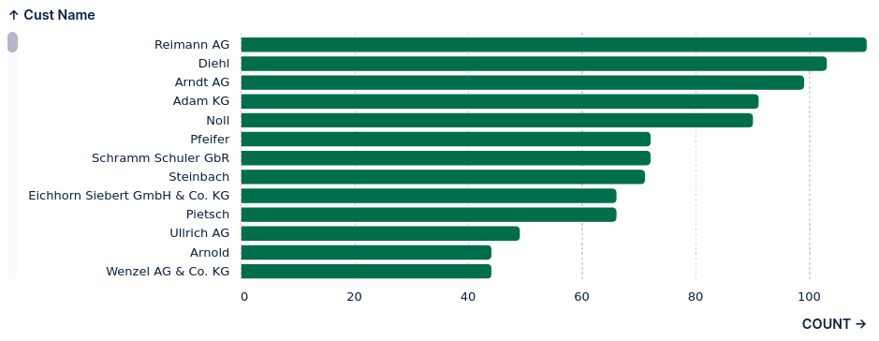
Credit blocks create severe delays for a relevant share of orders but lack a single dominant root cause
GAP DEFINITION: Credit order is being blocked at least once.
Urgency
Affects ~10,05% of all processes
Difference in median TPT: + 19,5 days
Customer distribution for orders with credit order blocks
Customer Country
Nothing unusual, except for some slight overrepresentations (France, Netherlands). Generally everything outside the EU is slightly overrepresented.
How to read: Customer impact is broadly distributed with no dominant customer segment.
Key Message
This execution gap is impactful but lacks a clear root cause.
The broad customer distribution points to a systemic issue affecting smaller or infrequent buyers.

Slide 11
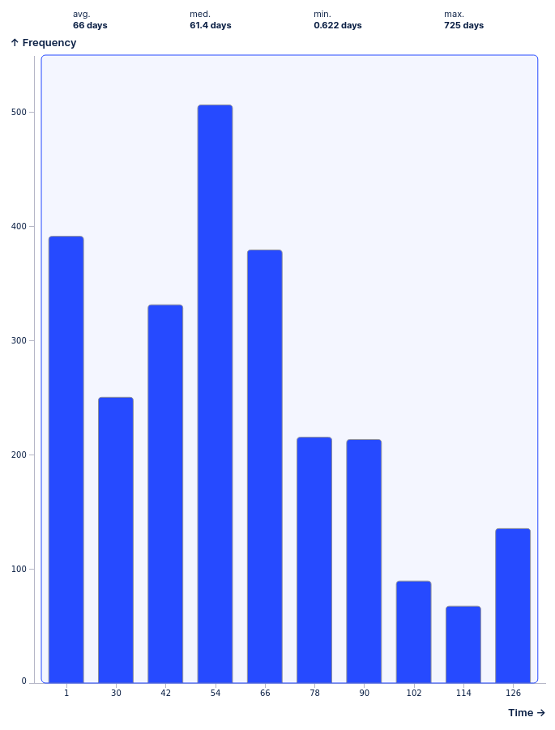
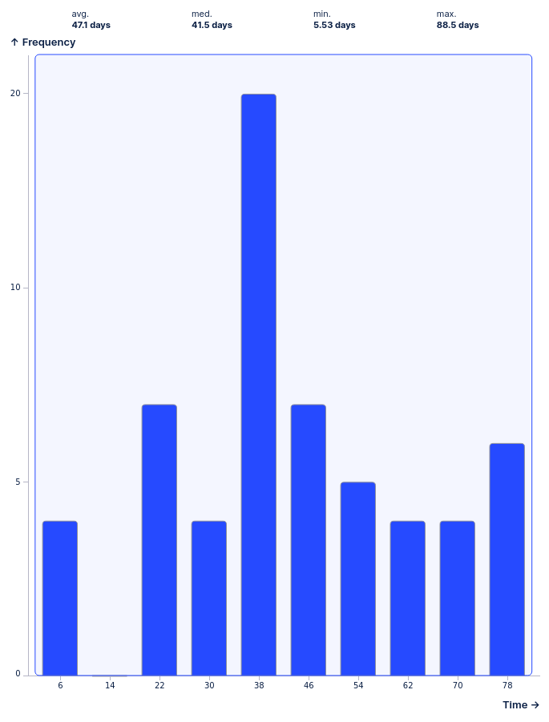
Price changes after sale confirmation introduce significant rework and increase throughput time
GAP DEFINITION: Price is changed any time after sale confirmation.
Throughput time distribution with and without post-confirmation price changes
Orders with post-confirmation price changes
Happy Path
Urgency
Affects ~13% of all processes
Difference in median TPT: ~20d
Missing price stability and governance after order confirmation leads to downstream rework and execution delays.
Key Message
Post-confirmation price changes create systemic rework that significantly increases throughput time and planning instability.

Slide 12
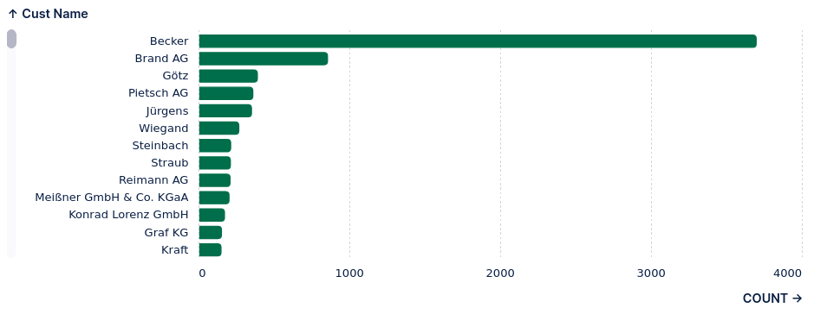
Repeated production rescheduling is a systemic planning issue rather than an isolated execution failure
GAP DEFINITION: Production start date is changed after start of production.
Urgency
Affects ~48,3% of all processes
Customer distribution for orders with repeated production rescheduling
Factory
Relatively stable across all factories, nothing unusual.
Unstable production planning and weak schedule freeze allow repeated replanning after production start.
How to read: Each bar represents the number of orders with repeated production rescheduling per customer
Key Message
This execution gap affects nearly half of all processes and reflects a systemic planning issue rather than isolated execution failures.

Slide 13
Targeted Management Actions
Identified Gap | Gap Category | Management Action | Action Type | Business Impact | Implementation Effort | Control KPI
Late quantity changes after load shipment | Execution Gap | Standardize and enforce pre-loading quantity validation at affected sites (Essen, Bonn) to eliminate late shipment corrections. + Introduce mandatory pre-load checks (digital checklist / scan-based validation) at shipment release. | IMMEDIATE | HIGH | LOW | % qty changes post-shipment
Credit blocks with downstream rework | Control / Compliance Gap | Introduce a tiered credit approval model to reduce unnecessary post-release credit blocks. Auto-approve low-value orders for established EU customers; restrict manual checks to new or high-risk accounts. | IMMEDIATE | HIGH | MEDIUM - HIGH | % of orders blocked by credit checks
Sales price rework after confirmation | Commercial / Policy Gap | Increase transparency on post-confirmation price changes and actively monitor their frequency and impact. Introduce soft approval thresholds only if price rework remains frequent or value-relevant. | MONITOR | (HIGH) | LOW - MEDIUM | % prices changes post sale conformation
Repeated production start date changes after production start | Planning & Coordination Gap | Establish visibility on post-start rescheduling and its drivers before introducing stricter change controls. Escalate to formal approval rules only if repeated rescheduling continues to destabilize planning reliability. | MONITOR | MEDIUM | MEDIUM | % production start date changes after start production
Timestamp inconsistencies | Data / Technical Artifact | Handle timestamp inconsistencies analytically rather than operationally. Use business-based sequencing logic and plausibility checks; document logging limitations as a future IT enablement topic. | AVOID | LOW | MEDIUM | Data Quality checks
How to read:
The table links identified O2C execution gaps to issue based categories, prioritized management actions, and control KPIs based on impact and implementation effort.
Key Message
Differentiated, gap-specific actions deliver higher impact and lower effort than broad, end-to-end process redesign.

Slide 14
Thank you
Key Takeaway for Management Execution variability is not a data problem.
It is a governance problem.
Woodcorp – Order-to-Cash Process Analysis
· Tools: Celonis (process mining platform), Python
· Analyst: Jan Krings
Fictitious company · Data synthesized

