Slide 1
On My Algorithmic Trading
Jan Marek
jan.x.marek@gmail.com

Slide 2
There are two basic rules about winning in trading as well as in life:
(1) If you don’t bet, you can’t win.
(2) If you lose all your chips, you can’t bet.
- Larry Hite, Market Wizards

Slide 3
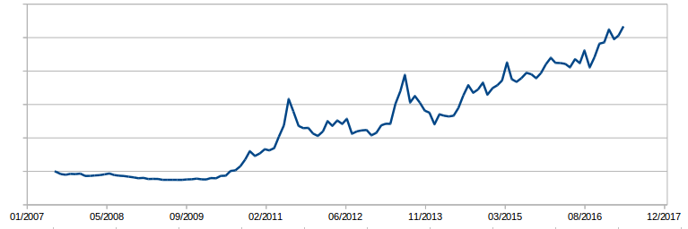
A few words about myself
Programmer by trade
10 years of retail trading experience, 8 years pure algo trading
500-1000 trades a year in commodity futures and US stocks
Gross profits (commissions and data fees subtracted, before taxation)

Slide 4
What Would Be My Edge? (1)
Arbitrage?
Unshakable economic fundament, but fierce competition for liquidity/speed – high cost of running the business.
Strategic investing?
Easy to execute, but little action, slow feedback loop.

Slide 5
What Would Be My Edge? (2)
Efficient Market Hypothesis
vs.
The Misbehavior of Markets
(Benoit Mandelbrot, 2004)
Markets do not follow random walk, there are measurable anomalies which can be exploited.
Momentum Trading vs Mean Reversion - pure speculation on price direction, based on datamining. Relatively easy to execute, rapid feedback loop.

Slide 6
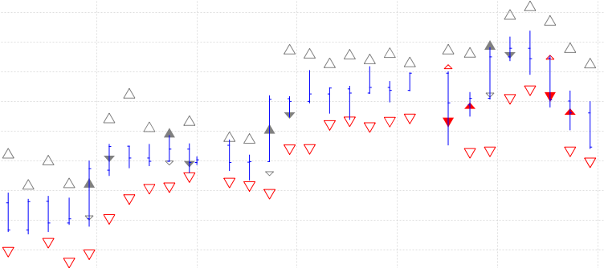
A Real Algorithm Example (1)
Enter if the market deviates from the previous close by 1 ATR (stop order)
Exit at the next open (market order) or at a 1 ATR loss (stop order)

Slide 7
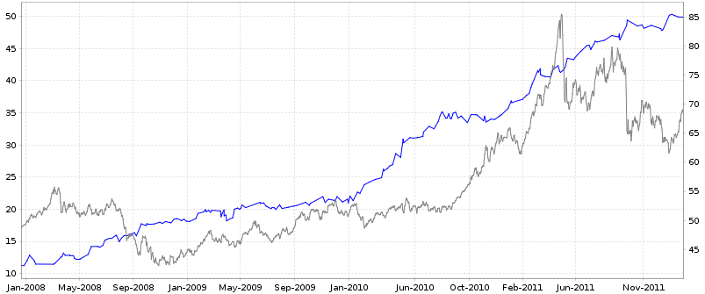
A Real Algorithm Example (2)
Results on COMEX Silver futures 2008-2011. 50 trades a year, 60% profitable, average profit 20 cents per every dollar bet. Looks like a private money-printing machine.

Slide 8
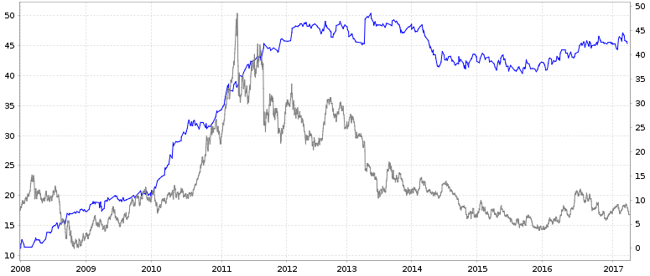
A Real Algorithm Example (3)
The same algorithm 2008-now.
What the **** happened?

Slide 9
Mine Your Edge (1)
Maybe we can learn something about market dynamics from the history...
Pick a lot of historical data series (market prices, macroeconomic fundaments, moon phases, baseball league results), combine them into lots of random formulas, and see what would have been the best predictor of price moves in a particular market in the past.
Even better: Pick a pseudo-random number generator, try to initialize it with millions of different seeds, and see which seed produces a pseudo-random sequence that predicts price moves in a particular market in the past.
… and lose.

Slide 10
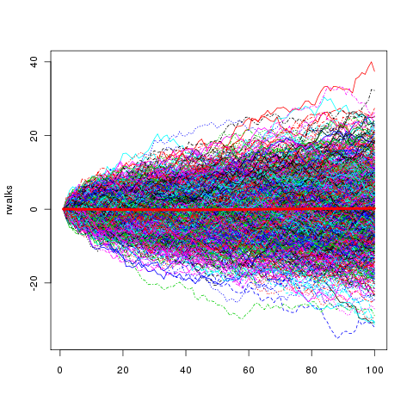
Mine Your Edge (2)

Slide 11
Mine Your Edge (3)
A great book on how to design and verify mechanical trading properly: David Aronson - Evidence-Based Technical Analysis.
Also check https://www.quantopian.com/
Out-of-sample validation
Bootstrap verification
Simple rules, few parameters
Common sense
Diversification
Bet sizing

Slide 12
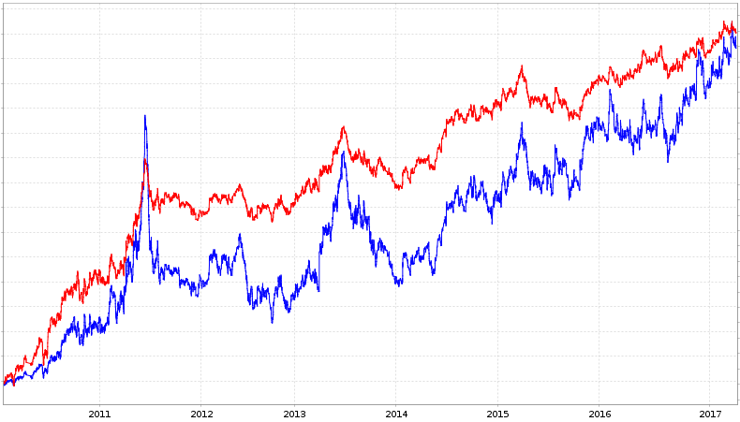
The Importance Of Bet Sizing

Slide 13
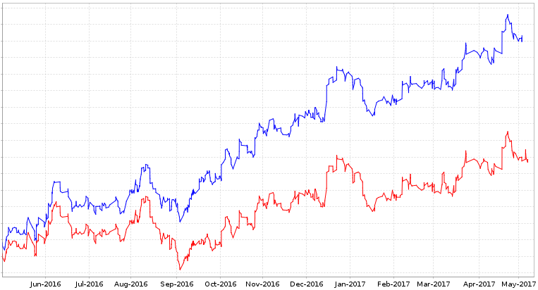
The Importance Of Transaction Costs
Can limit orders help at all?

Slide 14
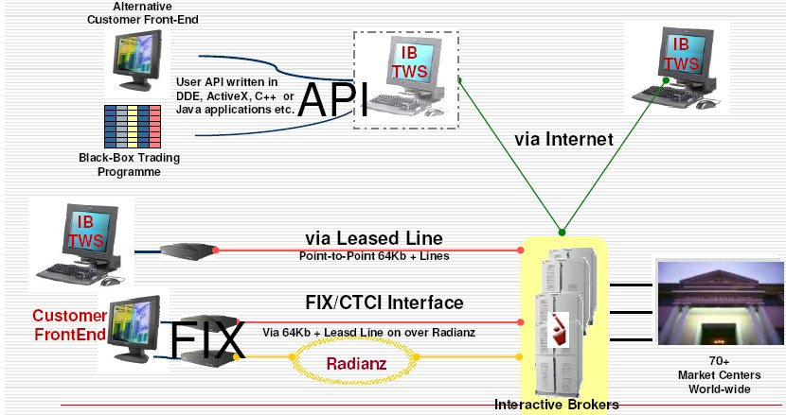
Interactive Brokers – The Big Picture

Slide 15
Interactive Brokers Java API (1)
EClientSocket
Single entry point for sending requests to IB
placeOrder(reqId, contract, price, …)
reqHistoricalData(reqId, contract,
timeframe, …)
reqMktData(reqId, contract, details)
…
cancelMktData(reqId)
EWrapper
Callback interface for receiving any responses or updates.
orderStatus(reqId, status, fillPrice, …)
error(id, errorCode, errorMsg)
historicalData(reqId, data)
error(reqId, errorCode, errorMsg)
historicalDataEnd(reqId)
tickGeneric(reqId, tickType, value)
error(id, errorCode, errorMsg)

Slide 16
Interactive Brokers Java API (2)
EclientSocket s =
new EclientSocket(
new MyEWrapper())
s.eConnect(“127.0.0.1”, 7497)
Contract aaplStock = new Contract();
contract.symbol("AAPL");
contract.secType("STK");
contract.currency("USD");
contract.exchange("SMART");
client.reqHistoricalData(
42, aaplStock,
"20170101 00:00:00",
"1 M", "1 day",
"MIDPOINT", 1, 1, false, null);
class MyEWrapper
implements EWrapper {
public void historicalData(
int reqId, Bar bar)
{
System.out.println(“Bar ”+bar);
}
public void historicalDataEnd(int reqId)
{
System.out.println(“End”);
}
public void error(id, code, msg)
{
System.out.println("Error: "+msg);
} … }

Slide 17
Interactive Brokers Java API (3)
Pros
Access to many exchanges all over the world, and wide range of instruments (stocks, forex, futures, options, bonds, …)
Full broker functionality available: order management, advanced order types, market data access (historical and realtime), account balance, current portfolio, market news, fundamental data, etc, etc...
Several programming languages supported
Large community, lots of online resources
Lot's of third-party tools based on the API
Cons
Non-trivial programming skills required. Multi-threaded environment, management of concurrent requests/responses, dealing with service failures...
Access to market data is severely restricted. Limited number of realtime data streams, limited frequency of historical data requests.
Difficult (automated) testing
Custom mapping to IB domain objects
Non-compatible API updates

Slide 18
Implement Your Own Trading Platform (1)
Is it a good idea? Probably not for most people, definitely yes for some. Depends on your needs, free time, interests, skills...
Commercial Platform
Easy to start with. Lots of fancy functions readily available. Can be useful, but also misleading.
Ready, documented functions.
Bugfixing: you have to wait for the next release, which may impact your trading.
Handcrafted Solution
Start start from zero, play around, discover what you need. Lots of great libraries are freely available, it can be surprisingly easy after all. But it definitely takes some time.
One can learn a lot of useful details about markets by implementing the functions on his own.
Bugfixing: you can fix it immediately.

Slide 19
Implement Your Own Trading Platform (2)
Commercial Platform
New features: wait till they get implemented, or implement them yourself (as far as the platform's language and openness allows it).
Custom programming experience: often a weird proprietary language and a second-grade IDE. May hold you back if you need to code something non-trivial.
Reliability: Good enough, at least.
Handcrafted Solution
New features: Implement anything as you need it.
Custom programming experience: you can use any language that suits you and use first-grade development tools.
Reliability: it's easy to make something simple to prototype and test ideas. It requires quite some professional skill, effort and judgement to make it good enough for trading with real money.

Slide 20
Thank You.
Discussion...

