Slide 1
Secure Data Hiding in Images Using Steganography
CAPSTONE PROJECT
Presented by :
V.JANJITHA B.Tech (ECE) Vel Tech Rangarajan Dr. Sagunthala R&D Institute of Science and Technology

Slide 2
OUTLINE
Problem Statement
Technology used
Wow factor
End users
Result
Conclusion
Git-hub Link
Future scope

Slide 3
Problem Statement
With rising cyber threats, securing sensitive data while keeping its existence hidden is crucial. Traditional encryption protects data but makes it detectable, increasing the risk of attacks. Steganography hides information within images, making it less likely to be noticed. However, existing techniques often lack robustness against compression, noise, and tampering. This project focuses on developing a more secure and resilient method for data hiding in images.

Slide 4
Technology used
1.Programming Language:
Python (for implementation and automation)
2.Image Processing Libraries:
OpenCV (image handling and pixel manipulation)
3. Steganography Techniques:
Least Significant Bit (LSB) Substitution
4.Security & Cryptography:
AES Encryption
Hashing

Slide 5
Wow factors
Dual-Layer Security (Steganography + Encryption) :
Unlike basic steganography, this system encrypts data with AES before embedding,ensuring double protection even if the image is intercepted.
Invisible & Tamper-Proof Embedding
Uses Least Significant Bit (LSB) and Discrete Cosine Transform (DCT) to hide data without visible distortion, making it undetectable by human eyes and resistant to steganalysis
Support for Multiple File Types
Can hide not just text but also files (PDFs, documents, or even another image) inside an image, increasing versatility.
Metadata Protection & Integrity Check ✅
Uses hashing (SHA-256) to ensure the hidden message is not altered or corrupted, making it tamper-proof.

Slide 6
End users
Cybersecurity Professionals & Ethical Hackers
Journalists & Whistleblowers
Law Enforcement & Intelligence Agencies
Military & Government Organizations
Researchers & Academicians
Digital Watermarking & Copyright Protection Companies
Forensic Experts

Slide 7

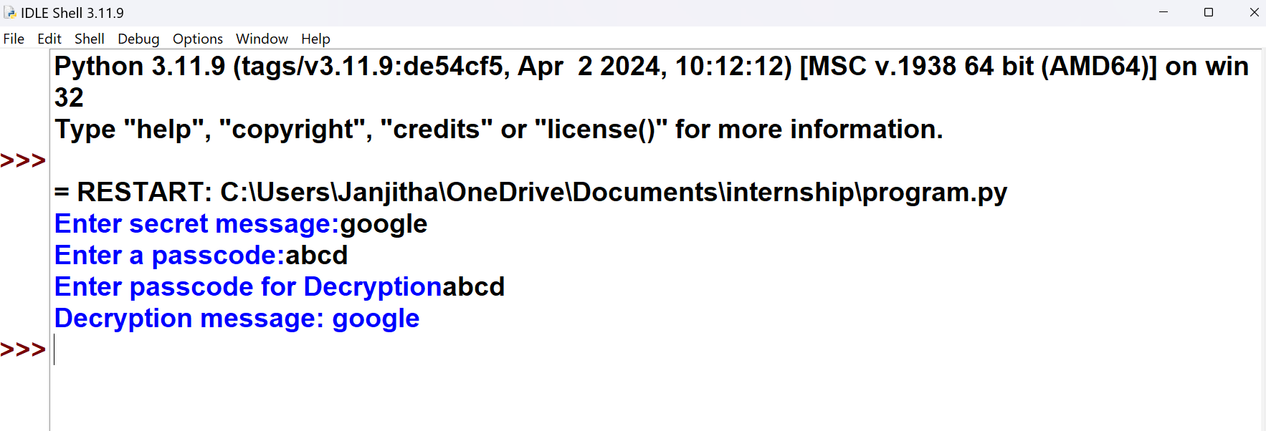


Results
Encrypted Image
Original Image

Slide 8
Conclusion
This project ensures secure and undetectable data hiding using steganography, addressing the limitations of traditional encryption. By implementing LSB with AES encryption, it enhances confidentiality, integrity, and resistance to detection. The system provides a robust solution for covert communication and secure data transmission, making it valuable for cybersecurity and privacy protection.

Slide 9
GitHub Link
https://github.com/jan08-ux/Stegano_-graphy.git

Slide 10
THANK YOU

