Slide 1
Booking Package

Slide 2
Requirements
Booking Creation
- House
- Event
- Price
- Account Role
- Timeframe (startDate & endDate)
Booking Management
- Cancel Booking (User + Landlord)
- Confirm Booking (Landlord)
- Pay Booking (User)
- Report Booking (User)

Slide 3
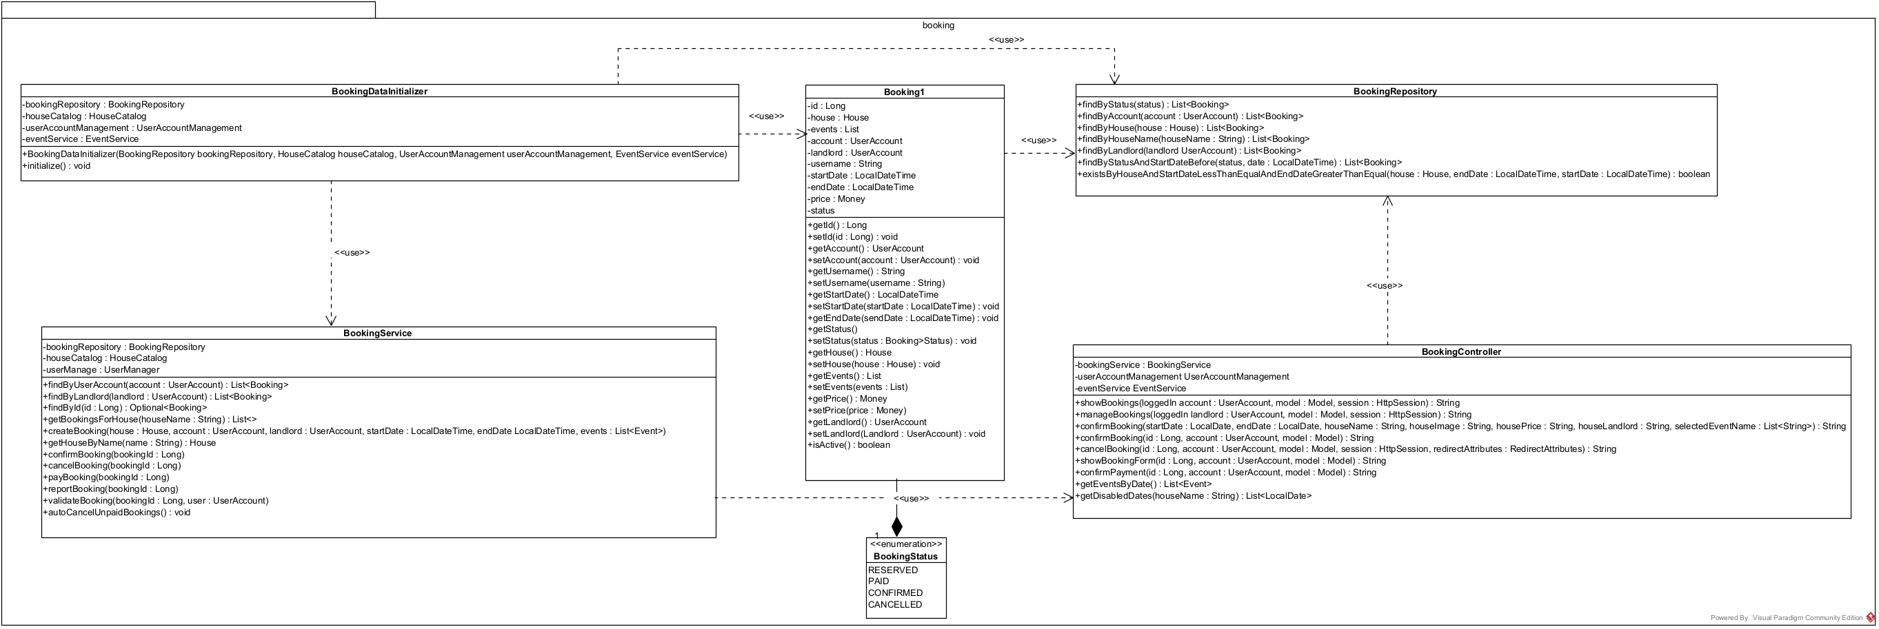
Booking Package Design

