Slide 1
Softwaretechnologie-Projekt (WS24/25)
Last name, first name
Chair of Computer Graphics and Visualization
there is still space for a subtitle
Context of the presentation (or type of the work)
Place or occasion of the presentation // date

Slide 2
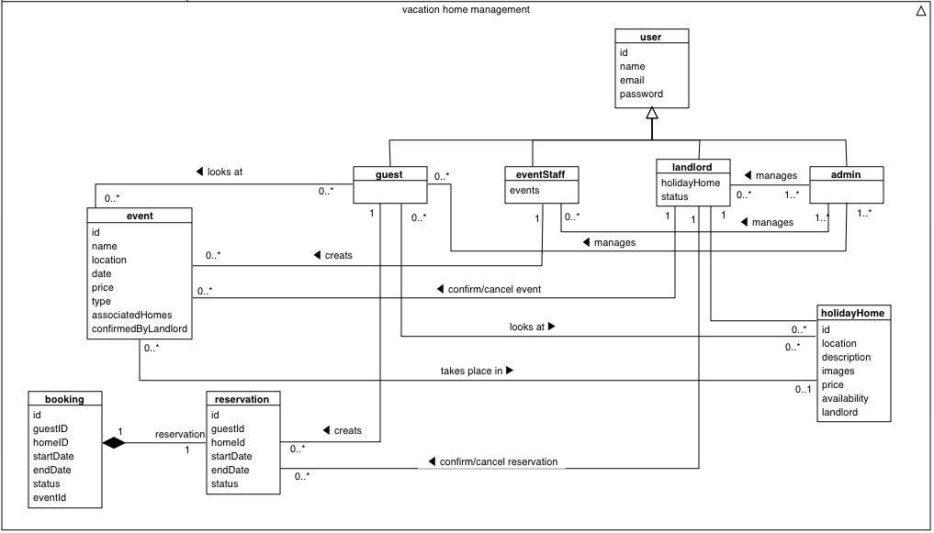
Analyse-Klassen-Diagramm

Slide 3
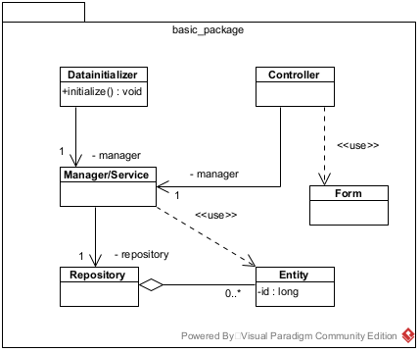
Basic Package Desgin
Frameworks:
Java Spring
- Service
- Transactional
- Model
- CrudRepository
- Controller
- Assert, Errors
Salespoint
- AbstractAggregateRoot
- DataInitializer

Slide 4
House Package

Slide 5
Requirements
House Creation
- Name, Price
- Type, Landlord
- Location, District
- Description, Images, Equipment
House Management
- modify
- delete
Usage
- providing houses that can be booked by customers

Slide 6
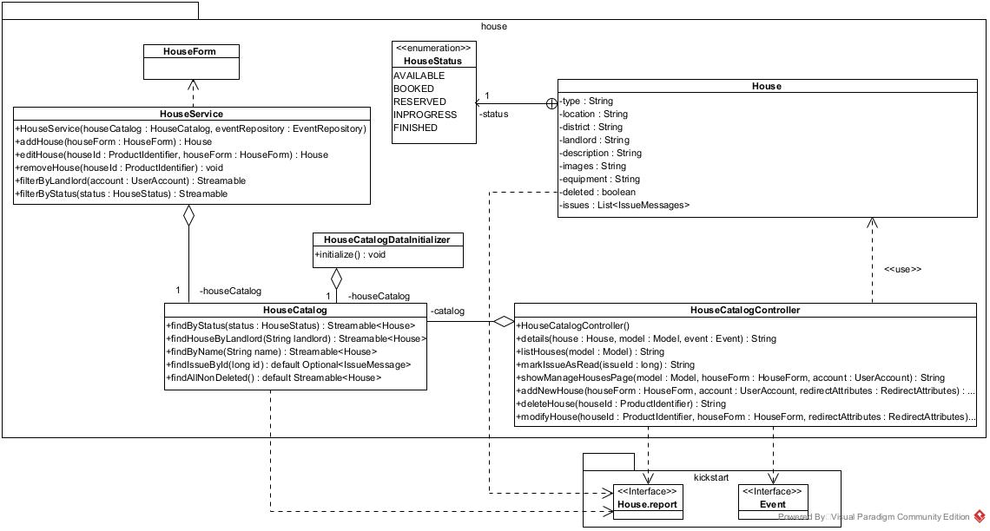
House Package Design

Slide 7
Event Package

Slide 8
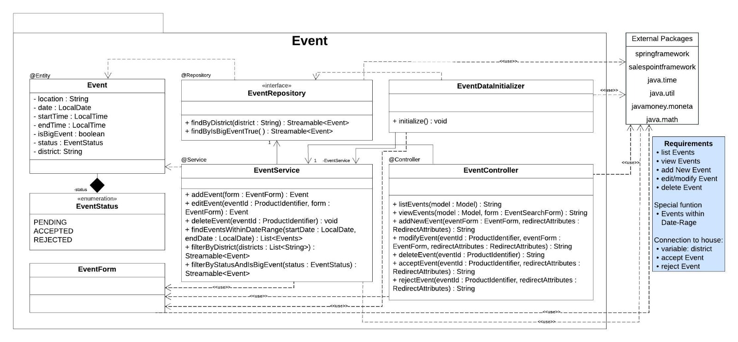
Event Package Design

Slide 9
Booking Package

Slide 10
Requirements
Booking Creation
- House
- Event
- Price
- Account Role
- Timeframe (startDate & endDate)
Booking Management
- Cancel Booking (User + Landlord)
- Confirm Booking (Landlord)
- Pay Booking (User)
- Report Booking (User)

Slide 11
Booking Package Design
Diagramm fehlt noch bzw sieht naja aus

Slide 12
User Package

Slide 13
Requirements
Account Creation
- Name
- Password
- Email
- Account Role
Account Management
- Change Password (User + Admin)
- Change Email (User)
- Confirm new Provider (Admin)
- Un-/Lock Account (Admin)
Usage
- Login/Logout (User)
- List Accounts + Search by Property (Admin)

Slide 14
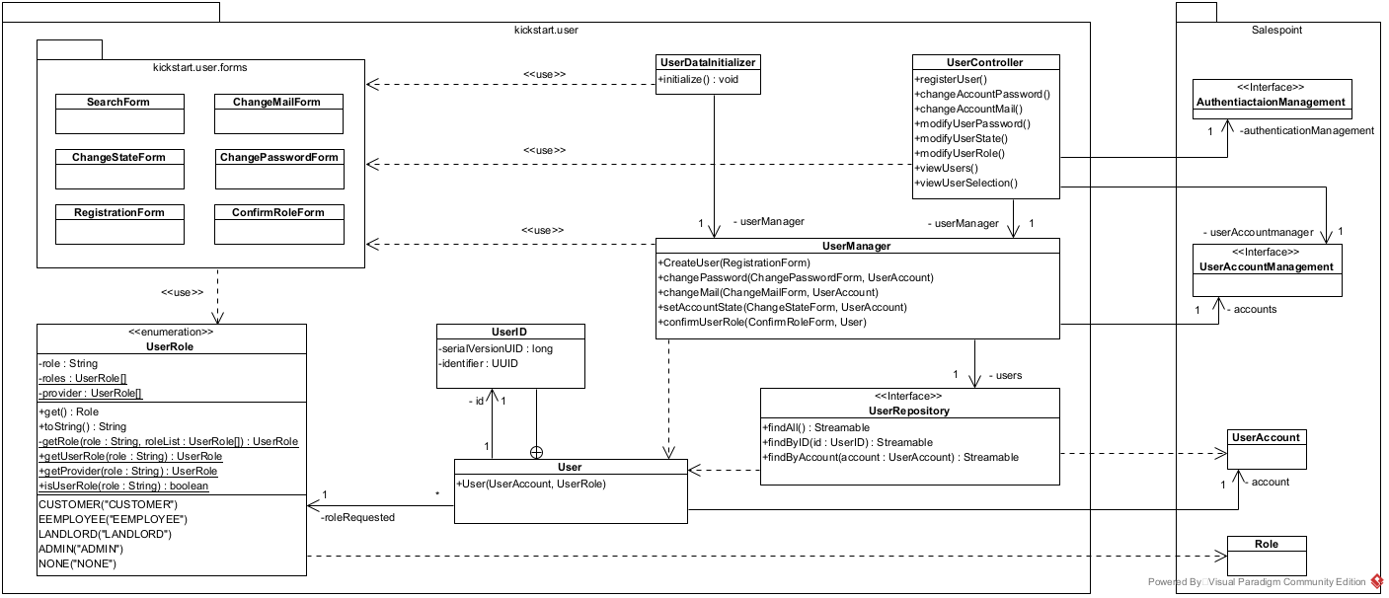
User Package Design

Slide 15
Issue Package
(Late Client Request)

Slide 16
Task
Enable customers to inform Landlords about issues with the currently rented object:
Customers can send messages to the Landlord, owning the rented property during their stay
Landlords can see if they received new messages
Landlords can read and manage messages
Messages are tied to the property they refer to and need to have a time stamp

Slide 17
Requirements
Message Creation (User only)
- Content
- Header
- Read Status
- Time Stamp
- Booking Reference (includes a reference to the related property and the user who sends the message)
Message Management (Landlord only)
- Read, Delete Messages
- View + Search Messages by properties
Usage
- Landlord Home Page alerts user if some messages are unread

Slide 18
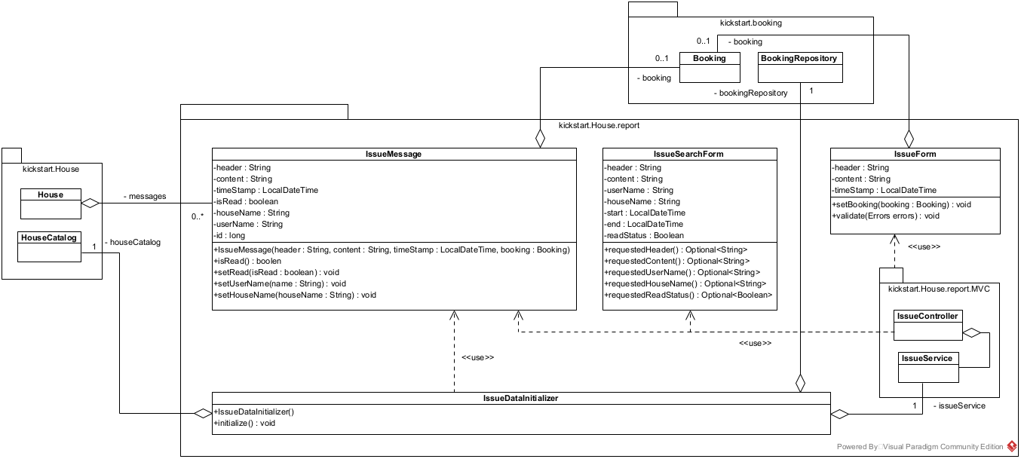
Issue Package Design

Slide 19
title in large letters must not be longer than one line
Wasinieski, Jan
Chair of Computer Graphics and Visualization
there is still space for a subtitle
Context of the presentation (or type of the work)
Place or occasion of the presentation // date

Slide 20

Title of the presentation
Use a picture that is appropriate to your project
Last name, first name
Chair of Computer Graphics and Visualization
Some space for a subtitle
Context of the presentation (or type of the work)
Place or occasion of the presentation // date

Slide 21
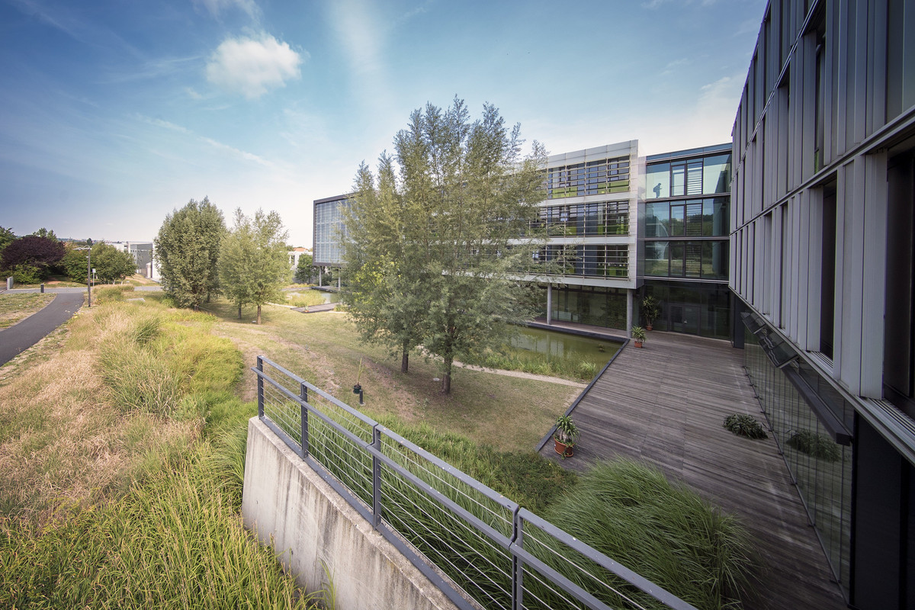

title in large letters must not be longer than one line
Use a picture that is appropriate to your project
Last name, first name
Chair of Computer Graphics and Visualization
there is still space for a subtitle
Context of the presentation (or type of the work)
Place or occasion of the presentation // date

Slide 22
This is a chapter title
Some space for subtitle

Slide 23
chapter or section title
Use an appropriate picture
Title in bold letter (standard font if no indent is used), one-column layout with figure on the right
This is the first indent level (don‘t use bullet points!)
This is the second indent level
This is the third indent level

Slide 24
chapter or section title
Title in bold letter (standard font if no indent is used), two-column layout
This is the first indent level (don‘t use bullet points!)
This is the second indent level
This is the third indent level
Here is the second column (indent level 1)
Indent level 2
Indent level 3

Slide 25




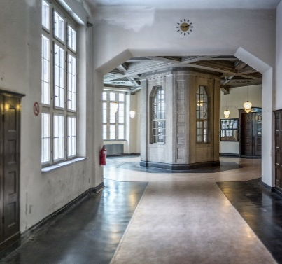

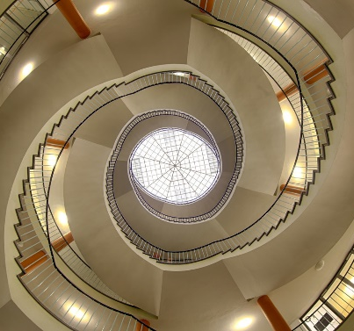
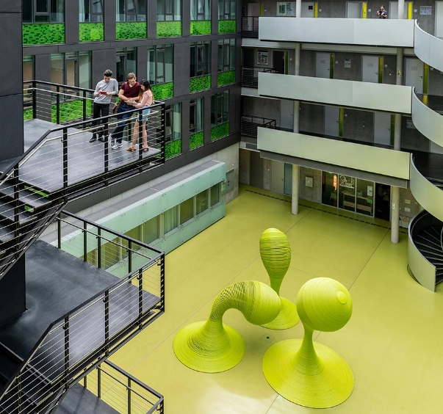
chapter or section title (image grid)
Use appropriate pictures

Slide 26
chapter or section title (single big image)
Use an appropriate picture

Slide 27
colors
DRESDEN-concept colors
Colors of SINS (Studieninformationssystem der TUD)

Slide 28




example slide with cooperation partners or funders
Diese Maßnahme wird mitfinanziert durch Steuermittel auf der Grundlage des vom Sächsischen Landtag beschlossenen Haushaltes.

