Slide 1
WP4 Scrum of Scrum needs
München, 15.10.2014
Karsten Falk Deutsches Zentrum für Luft- und Raumfahrt e.V.
Institut für Verkehrssystemtechnik
Notes:
Guten morgen! Ich freue mich, Ihnen heute morgen den aktuellen Stand der Aktivitäten zum Aufbau der Anwendungsplattform Intelligente Mobilität am Institut für Verkehrssystemtechnik darstellen zu können.
Ich möchte Ihnen vorstellen,
was AIM eigentlich ist.
Wie gemeinsame Forschung verschiedener Partner in AIM funktionieren soll.
Welche Bandbreite an Bausteinen AIM zur Verfügung stellt. Ich möchte dies an einigen Beispielen exemplarisch erläutern.

Slide 2
Inputs
PBL
Toolchain should enable:
automated extraction and reporting
+ defined Syntax for github issues and sub-issues (check-box) [ ] ⇨◻
1st version
Product Backlog
Peter Mahlmann
features assigned to WPs priorized in PMB (Fr.)
ITEA efforts
ITEA planned/
spent effords
Manual extraction and reporting
update
all partners
WP Backlog
groom
Github Issues
all partners within WP
poker
Story Points
Issues with SP

Slide 3
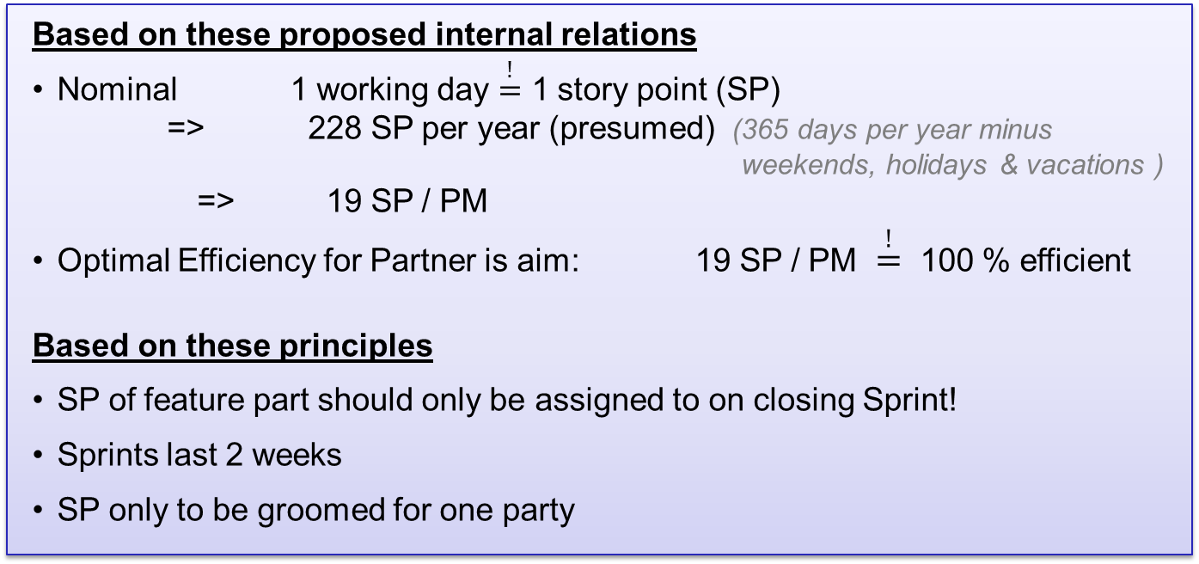
Needs
Automatically generated statistics on planned and spent efforts (e.g. of ITEA tables)
Automatically generated reports on gained SPs (e.g. from closed github issues)
Based on these proposed internal relations
Nominal 1 working day $\overset{!}{=}$ 1 story point (SP)
=> 228 SP per year (presumed) (365 days per year minus weekends, holidays & vacations ) => 19 SP / PM
Optimal Efficiency for Partner is aim: 19 SP / PM $\overset{!}{=}$ 100 % efficient
Based on these principles
SP of feature part should only be assigned to on closing Sprint!
Sprints last 2 weeks
SP only to be groomed for one party

Slide 4
Queries:
Daily: How many story points (SP) are planned for each feature part on
WP level?
Project level?
Based on closed issues or subtasks: How many story points (SP) were achieved for each feature part?
Daily: How many story points (SP) for each Partner
are planned ?
are achieved?
External Reports
Reached SP per Partner
Representing potential capacity for future Sprints
Internal Reports (non public)
Indicating planed and spent effort (ITEA table)
calculating agile efficiency for each partner
a cumulated overall WP efficiency on
How many days spent for earning 1 SP

Slide 5
WP4 Scrum of Scrum needs
München, 15.10.2014
Karsten Falk Deutsches Zentrum für Luft- und Raumfahrt e.V.
Institut für Verkehrssystemtechnik

