Slide 1
Case Web & App Analytics Manager (m/f/d)

Slide 2
student journey and my campus
My campus
Student prospect
Sign up for studies
Study
(take courses, learn, interact with other students / management)
Graduate
(successfully pass all tests)
Goal in general:
As many students as possible should successfully graduate within the regular time
Goal Platform:
Support students during study phase
Give access to needed courses
Support self- learning
Simplify admin tasks
Metrics for general goal:
Amount students
Successful graduates / Amount students
Duration between sign up and successful graduation

Slide 3
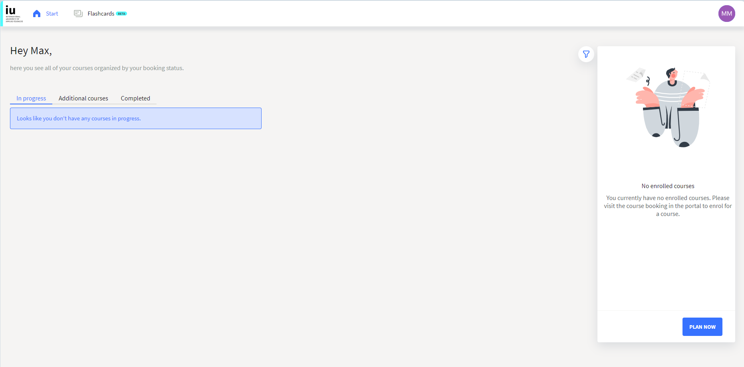
Structure of Platform
Main sections:
n Course section
n Admin section
n Flashcards
User interaction:
Course section
Plan a course
Start / continue an existing course
Get an overview about students status
n Admin section
Find solutions / answers (Help section)
Information about UX / design preferences
n Flashcards
Create flashcards
Use questioning function
Technical construct:
My campus admin + flashcards within web app
Courses links to old webiste, responsive website implementation
To combine all information tracking via Google Analytics 4
Usage of standard reports / Google Looker
For more details integration of student data necessary

Slide 4
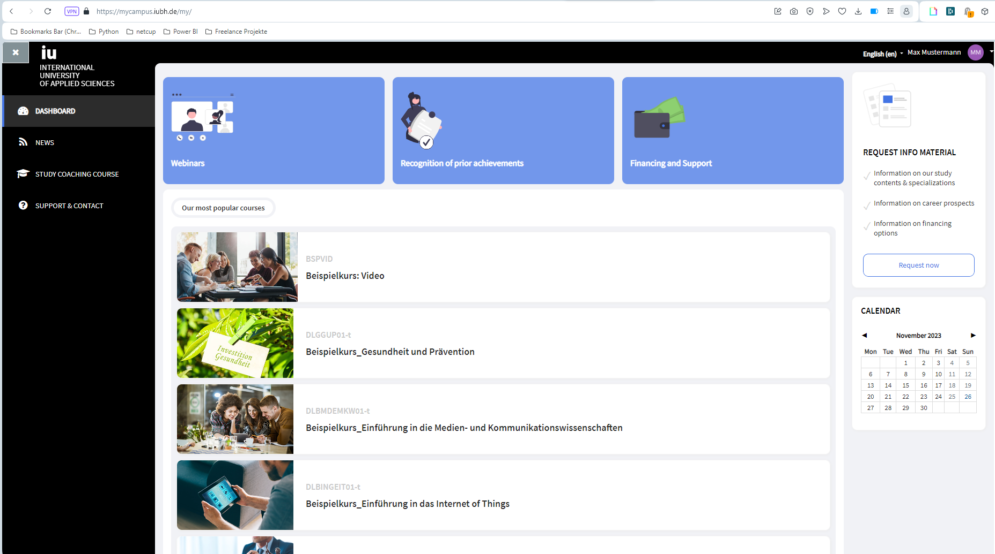
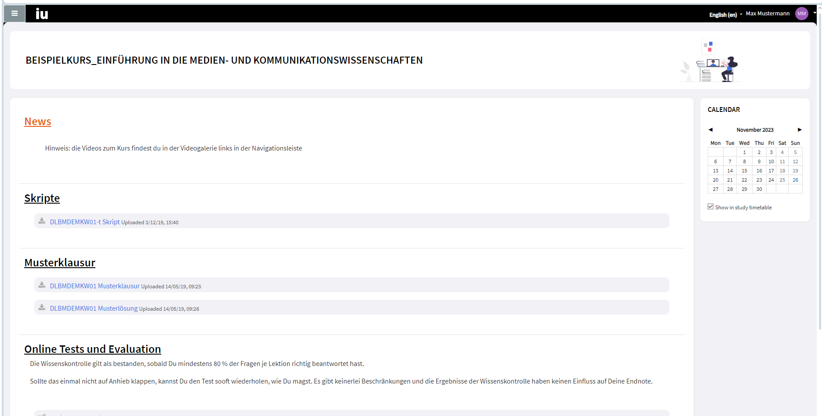
Course planning | quality of course offer
Background:
Students expect a structured overview, find their relevant courses fast
Maintaining courses needs resources
=> goal should be to have as many courses as needed but as few as possible
To maintain high quality of the education process, courses should be completed successfully by the students
=> Aiming for a high rate of successful tests
Leading questions:
Which courses are used the most?
Which courses are irrelevant for students?
Which courses need quality improvement?
Key metrics:
Course interaction rate
Test success rate
1. Course interaction rate
Defined as interactions with course material / registered active students with online access to course
scripts, example tests, solutions = downloads
Online test = new url
measured via standard event tracking in GA4 (page view + download event)
2. Test success rate
Defined as: Avg grade per online test
Manual event push with achieved grade
trigger: confirmation submit button
Page tracking on test sites
Additional optional implementations for quality measurement:
Students survey on courses
General survey about course offering
1
Course overview
2
Course detail page

Slide 5
Mock Report | quality of course offer
requirements:
Event tracking on course content
Page tracking on testing pages
Event tracking for test submission
Information on student ID (userID) about subject
Depending on test structure event tracking on testing pages for grades
Insights interaction rate:
Identifying most used courses:
Prominent placement of these courses on the page for better usability
Use structure of the courses as blue print (if possible)
Identify most used features of the courses (to add these features in other courses as well)
Identifying less used courses:
Discussion if courses are needed at all (clean up for better overview)
If so either adjusting content to improve them or change positioning on website to make them more prominent)
Insights test success rate:
Insights about how often a course has to be repeated
Funnel or success rate on pages give insights about breaking points in the test
Goal is to pass tests at first try, if not check if test matches the course content and adjust either test or course content
Course quality
Control panel:
Time frame 1
Comparison time frame
Subject of study
Course interaction rate
Course interaction rate
Comparison time
Change in %
Test success rate
Test success rate
Comparison time
Change in %
Top 5 courses (courses with highest interaction rate)
Course 1 interaction rate current (comparison)
Course 2 interaction rate current (comparison)
Course 3 interaction rate current (comparison)
Course 4 interaction rate current (comparison)
Course 5 interaction rate current (comparison)
Funnel testing pages
Or
success rate on different pages
Flop 5 courses (courses with lowest interaction rate)
Course 1 interaction rate current (comparison)
Course 2 interaction rate current (comparison)
Course 3 interaction rate current (comparison)
Course 4 interaction rate current (comparison)
Course 5 interaction rate current (comparison)
Deep dive option on interactions
Can be filtered by click on course on the left

Slide 6
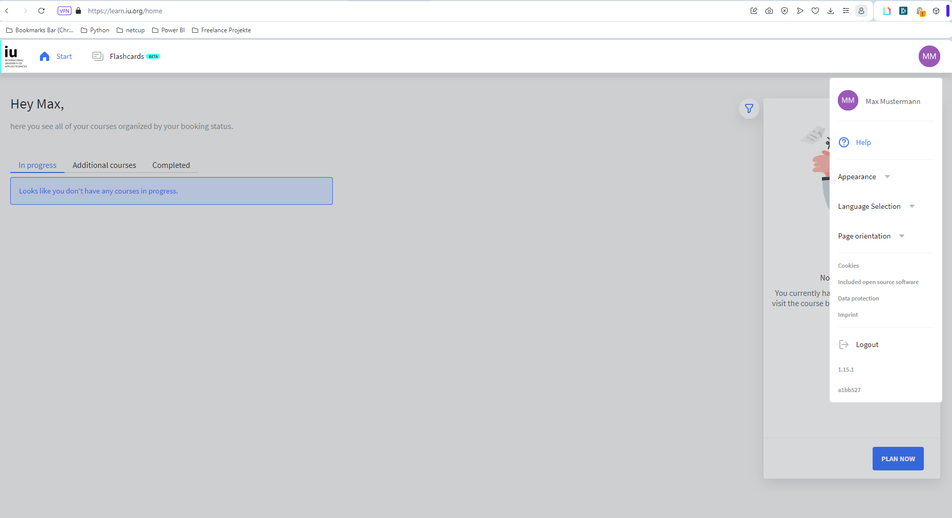
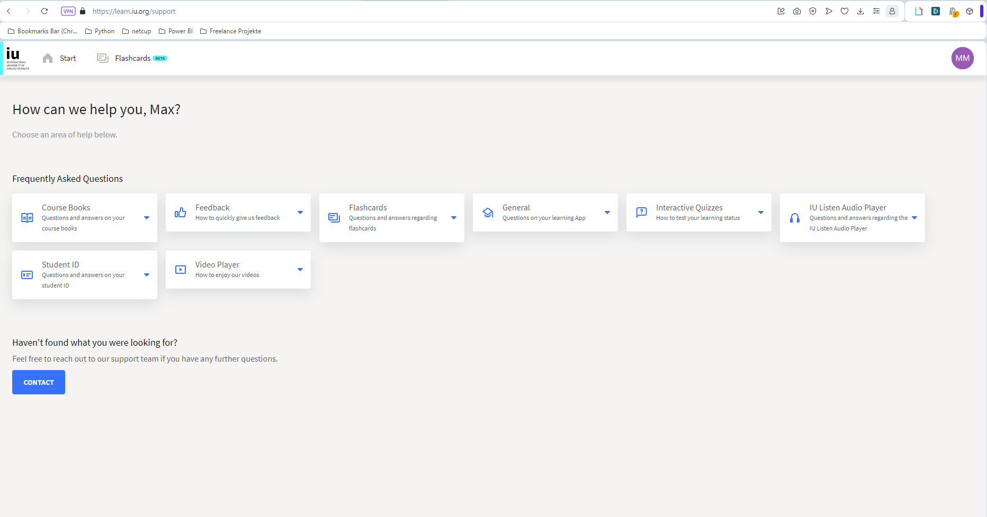
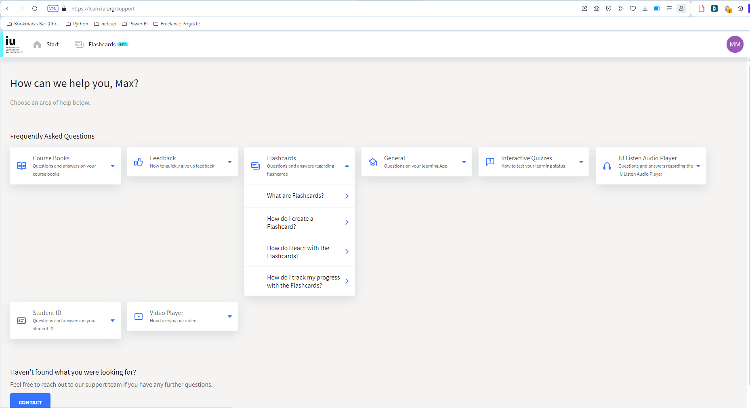
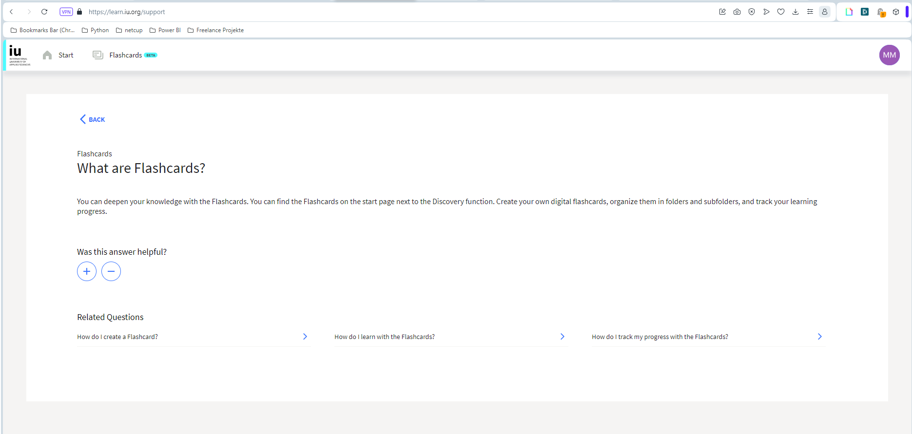
Userflow |Admin Help Section
Background:
Tool is one of the basics for online students, so it should be easy to handle and self explaining to students
Next to user surveys information about difficulties can also be interpreted by the usage of help section
The help section itself should provide answers to open questions fast and satisfy the students need
1
2
3
4
Open side menu
Select topic
Select question
Read answer
Goal student: Answer question
Goal company side: provide relevant information fast / easily accessible
Key metrics:
Search rate
Defined as number of searches / number sessions
Amount of searches per search topic / keyword
defined as sessions per keyword
Quality search result
defined as positive rating search result / all rating search results
Search duration
defined as duration between time to click help section in side menu and open search result

Slide 7
Mock Report | search function
Depending on other tracking discussion if event defined as a page view
Pro: session context
Con: influences basic metrics like page views / session, page duration
requirements:
Interaction at the same url / within app
=> Event tracking on help section
On click event request for all menus and sub menus
On click event request for rating function search result page
Insights search rate:
The lower the search rate the more self explaining the tool / functions
Insights search results:
Identifying pain points of students
Insights search rating / search funnel:
Quality of help texts
Positive rating: information / tool part itself is helpful but wrongly placed / not well enough explained in intro of tool function
Negative rating: tool itself is not easy to use / help text are not user-friendly
Insights search duration:
Technical issues when very long time until search result
Search function usage
Control panel:
Time frame 1
Comparison time frame
Students type (full online vs hybrid)
Search rate
Search rate
Comparison time
Change in %
Search rating
Search rating
Comparison time
Change in %
Top 5 search topics / keywords:
Keyword 1: number searches + search rating
Keyword 2: number searches + search rating
Keyword 3: number searches + search rating
Keyword 4: number searches + search rating
Keyword 5: number searches + search rating
Search funnel (event flow):
Page 1 nnnnnnnnnn
Page 2 nnnnnn
Page 3 nnnnn
Page 4 nn
AVG search duration
AVG session duration

Slide 8
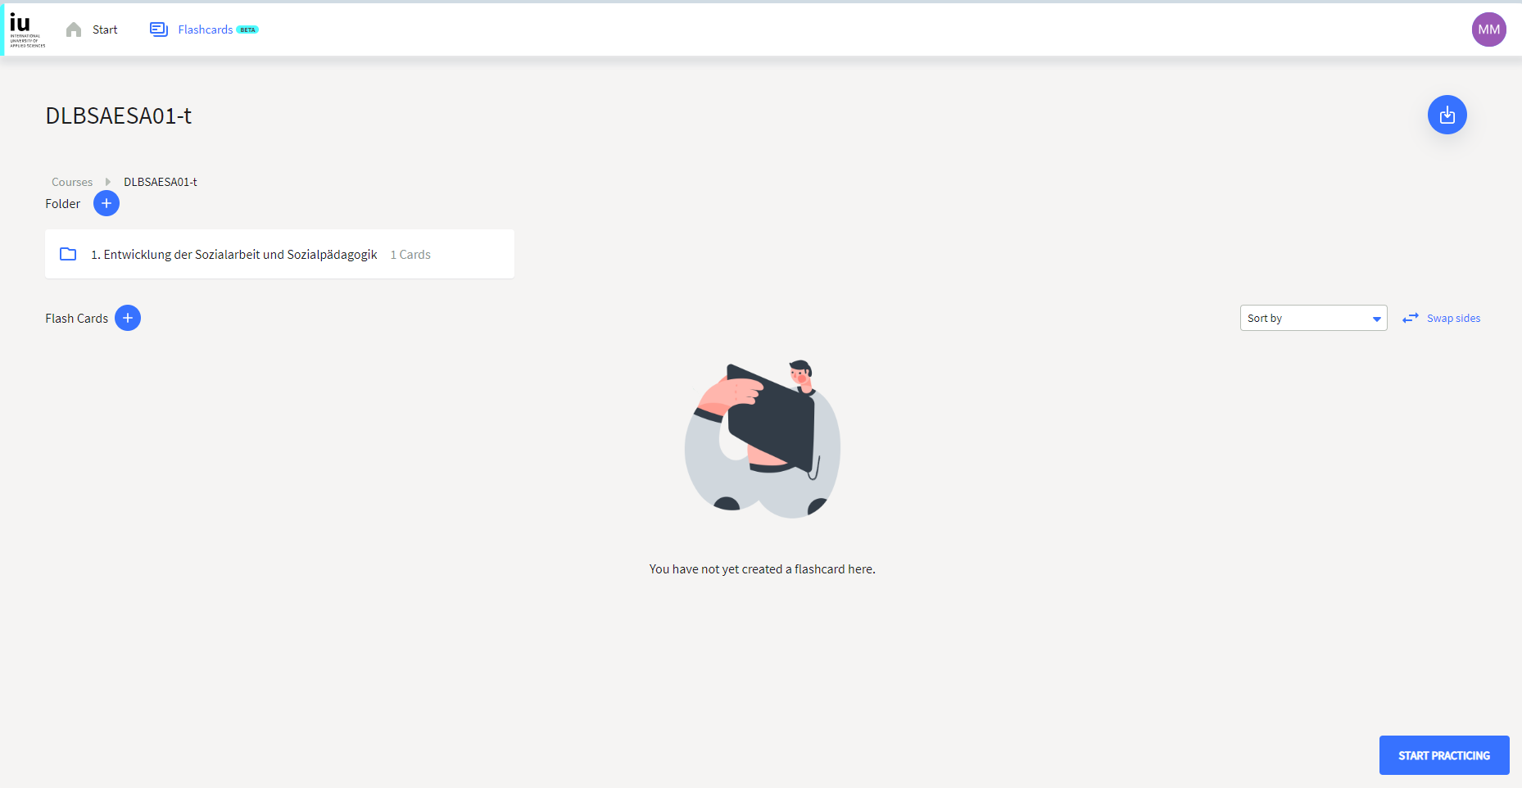
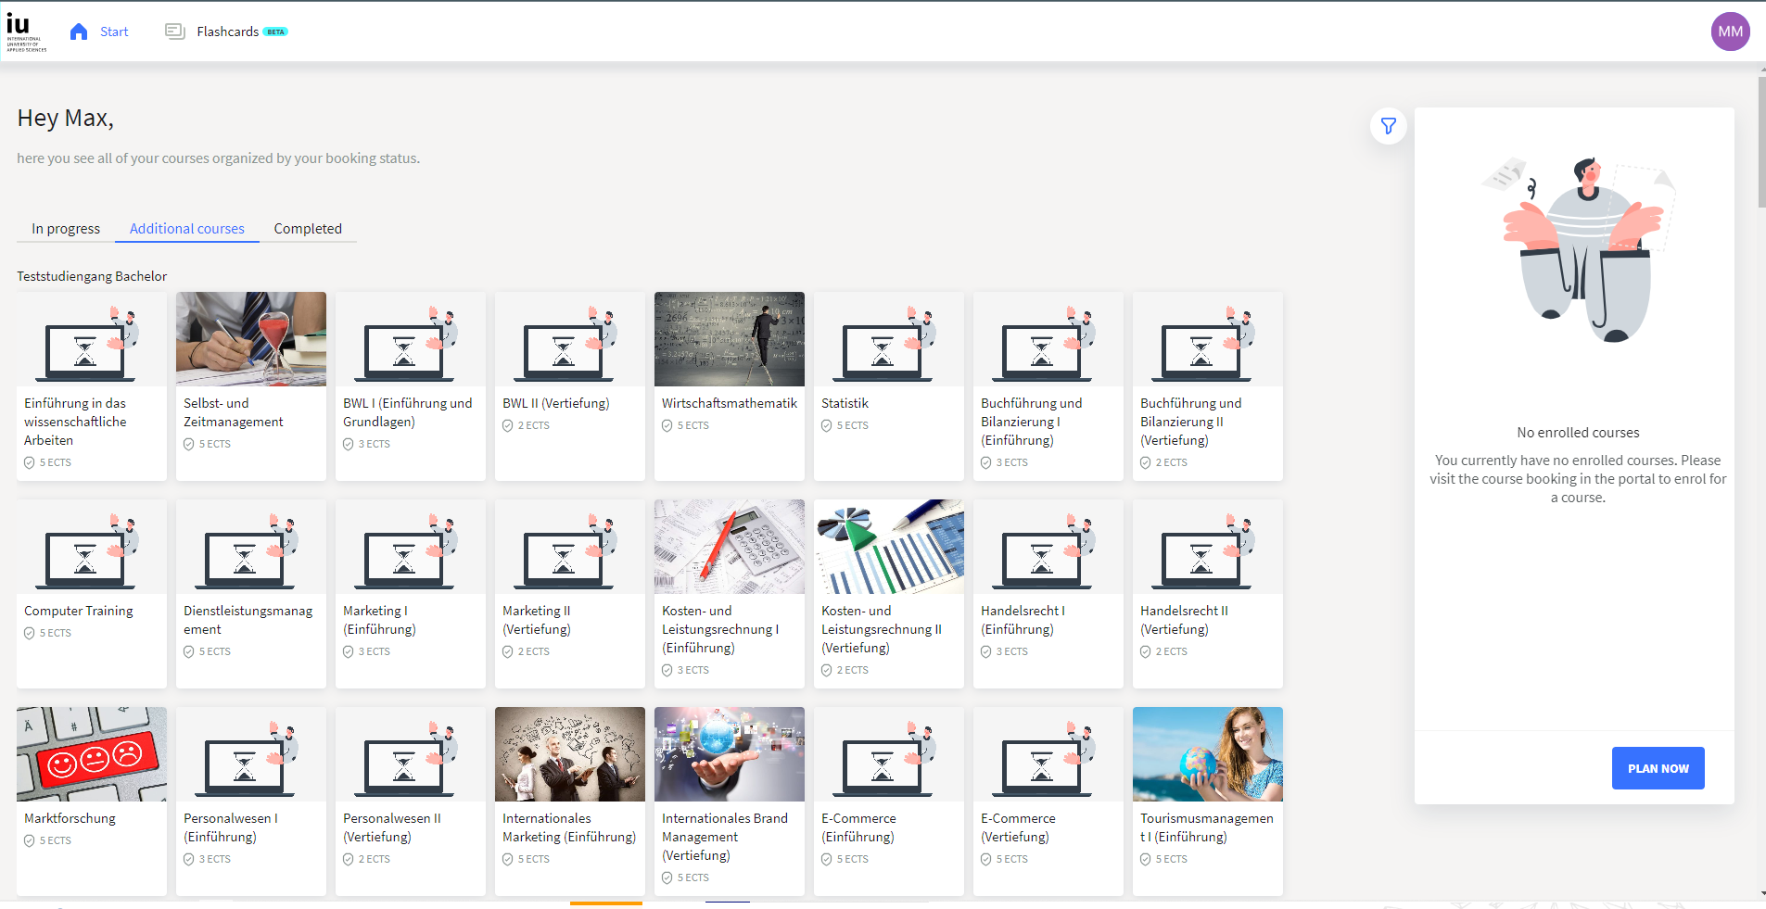
Additional analysis
General:
Students engagement: sessions / student / week
Identify inactive students: last session > 1month ago => activate students per mail
Education duration: first course sign up to last taken test, comparison with estimated times
Targeting prospects: login for my campus but no pageview in this area
FlashCard Section:
Area for creating / structure / use vocabulary cards
Analyze user flows:
Creating cards (event tracking save card vs. close card window)
Categorize cards along specific subjects (amount main folders + sub folders)
Learn with cards (funnel analysis on card learning process – page tracking)
Export cards for offline learning (amount downloads – event tracking triggered by download button
Course Section:
Usage of app vs. old version
Clicks on “plan now” vs. “additional courses”
Within courses:
Duration between first page view and last page view per student
Video tracking => media tracking (start video, markers on chapters, end video)
Scroll depth on written content
Quizzes success rate analogous page 4
Usage overview: path analyses on page views, starting with overview page

