Slide 1
Youtube-like application
Analysing and design document

Slide 2
Introduction
video has vastly become the primary way the world consumes content. With its increased popularity, digital video can be used to connect with and captivate an audience, develop user trust and engage people.

Slide 3
Problem statement
sharing video, uploading it electronically, and interacting with it, face a lot of challenges in browsing and obtain them
needing to a special platform that provides these services easily.

Slide 4
Background
YouTube is a video sharing and social media platform
California, United State,2005

Slide 5
Proposed Solution
YouTube application has been proposed to work on various mobile devices, eliminating the need for a video playback program or application in ad

Slide 6
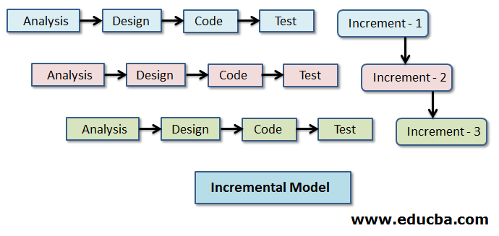
Work plan
Using incremental process model:
increment1: Determine the main requirements that the system must initially meet.
Increment2 and Later required increments:
Determine the new requirements and changes and repeat previous increment

Slide 7
Requirements specification
Functional requirements
Create account
Search and browsing
Video playback
Commenting and interaction
Sharing a video
Delete a shared video
Subscribing
downloading

Slide 8
Requirements specification
Non-Functional requirements
Compatible with Operating System
Security
Scalability
Bandwidth

Slide 9
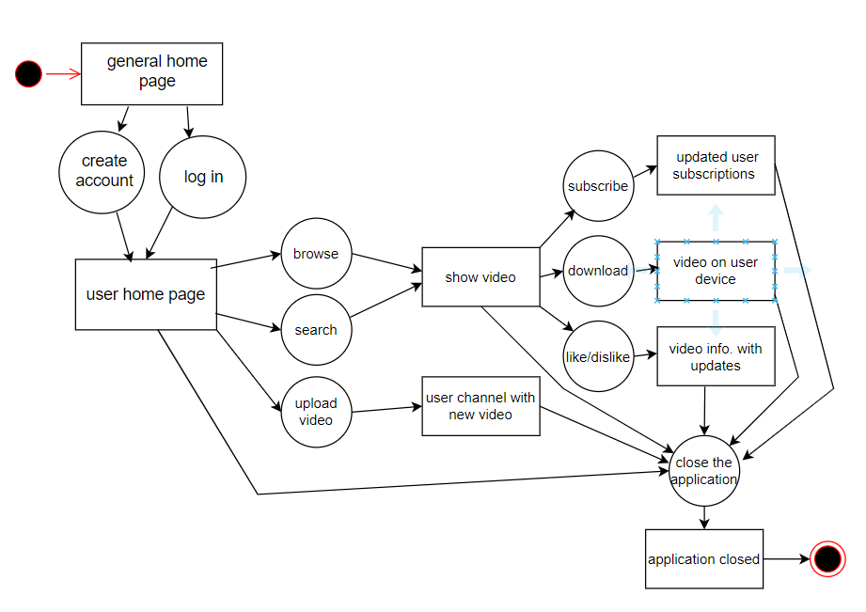
Activity diagram

Slide 10
Usecase modelling - Actors
Actor | role
Viewer | Browse videos Search for videos Watch videos Like/dislike video Comment on video Subscribe to channel
Video creator | (all previous roles of viewer) Upload videos view video analytics (e.g., views, likes manage uploaded videos

Slide 11
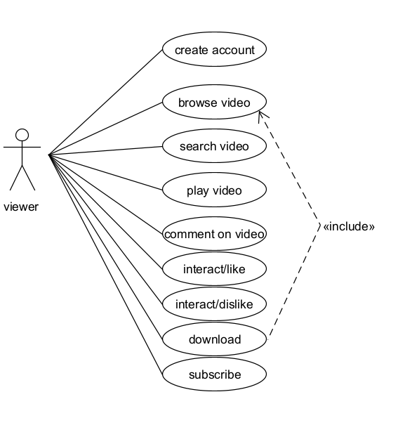
Usecase modelling – usecase diagram1
Usecase diagram that represent viewer interact with the application

Slide 12
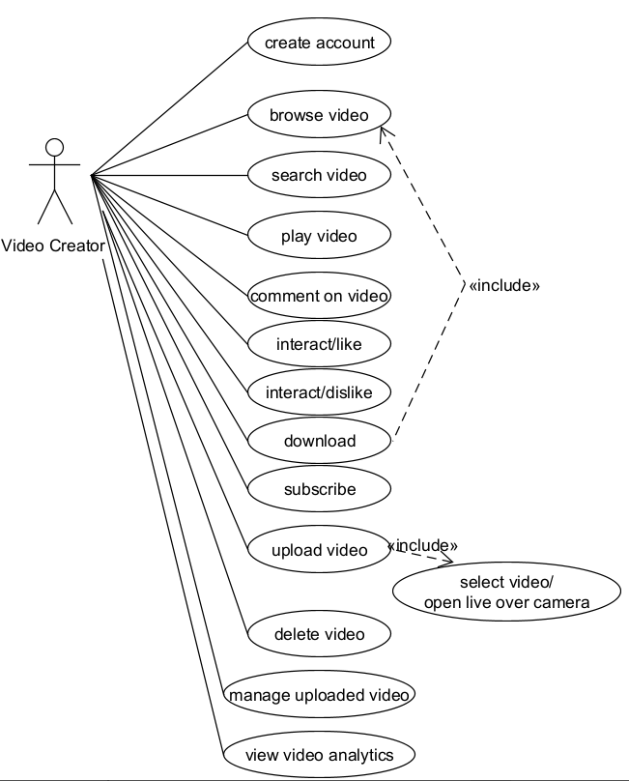
Usecase modelling – usecase diagram2
Usecase diagram that represent viewer interact with the application

Slide 13
Create account table
Actors | Viewer, video creator
Description | When the user requests creating account: System view the required information (name, google account, birthday, gender, password) If the user need a google account to create an account System adds the new account to the database and allocate updatable personalization content to him.
Data | Name, email, password, gender, birthday, profile picture
Stimulus | Viewer wants to create an account to login to the application
Response | Create viewer account with information(Name, email, password, gender, birthday, profile picture)
Comment

Slide 14
Sharing a video table
Actors | Video creator
Description | User can share a video to his channel through the following steps: User uploads video from his gallery or camera recording directly for live appearing. Then he adds a title and description for the video. User selects a thumbnail for video or suggested options by the system User chooses the privacy setting for the video (public, unlisted, private, downloadable or not) User can add relevant tags or keywords to help viewers find the video and insure uploading operation
Data | Video, title, privacy setting(public, unlisted, private, downloadable or not)
Stimulus | Video creator wans to share a video with people through his channel in the application
Response | Sharing the video in video creator’s channel
Comment

Slide 15
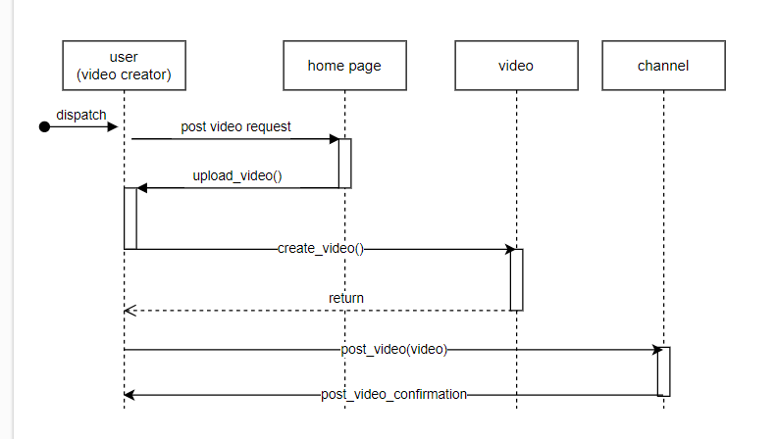
Sequence diagram: (Uploading and posting a video to video creator channel)

Slide 16
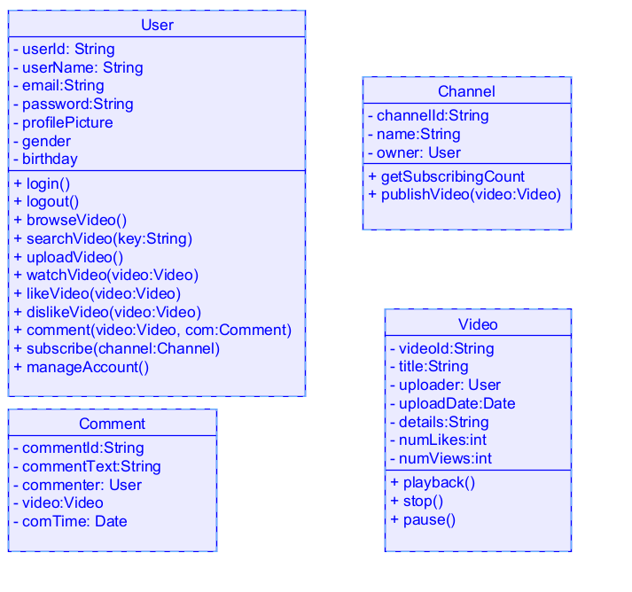
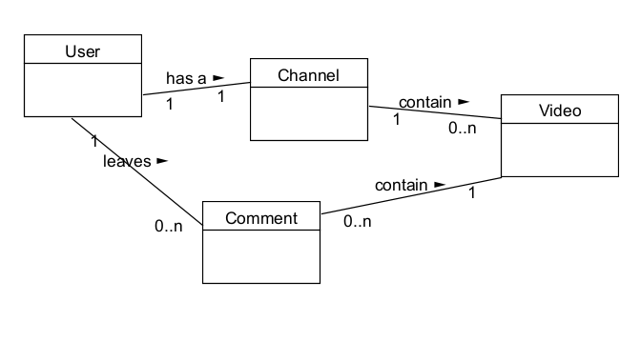
Class diagram

Slide 17
References
Lectures of the course
draw.io (diagrams.net) website.

Slide 18
Presented by: Jana Abdulaziz Alajalen

Slide 19
The End

