Slide 1

Serverless Resume Hosting System on AWS
A Summer Internship Project in Cloud Computing
Janaranjani M (810023205097)
B.Tech Information Technology, University College of Engineering (BIT Campus), Anna University, Tiruchirappalli
Internship at Fantasy Solution, Trichy
S3 • Lambda • API Gateway
Notes:
This project hosts a resume online without maintaining any server, using Amazon S3, AWS Lambda, API Gateway and IAM. It was built during my summer internship at Fantasy Solution, Trichy.

Slide 2
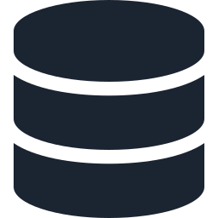




Introduction & Objectives
Project objectives
Internship objectives
Serverless platform for resumes
Resume files in Amazon S3
Understand cloud computing fundamentals
Gain practical AWS knowledge
Learn EC2, S3, IAM, Lambda and API Gateway
Deploy serverless applications
Manage cloud storage and resources
Study security, scalability and cost
Backend logic on AWS Lambda
Requests via API Gateway
Less server maintenance
Secure, scalable, low cost
Notes:
Cloud computing delivers storage and processing over the internet, so there is no physical infrastructure to buy or maintain. The left side lists what the internship aimed to teach; the right side lists what the project itself set out to build.

Slide 3
Company & Internship Journey
COMPANY
1
Days 1–5
Fantasy Solution, Trichy
Cloud basics, AWS console, IAM
FOCUS
Software, web design, hosting, training
2
Days 6–10
EC2 and S3 hands-on
LOCATION
Melapudur, Trichy
3
Days 11–15
DOMAIN
Lambda and API Gateway
Cloud Computing
DURATION
4
Days 16–30
15 June – 15 July 2026 (30 days)
Build, test and document
Notes:
Fantasy Solution is a Trichy-based IT solutions provider offering software development, web design, web hosting and IT training, with a focus on real-time project experience for students. The 30 days moved from cloud basics, to EC2 and S3, to Lambda and API Gateway, then to building and testing the project.

Slide 4


Existing vs Proposed Solution
Existing: server-based
Proposed: serverless on AWS
Needs a server or hosting environment
Runs even with very few users
Manual scaling is difficult
Ongoing server maintenance
Security settings managed by hand
S3 stores resumes and site files
Lambda runs backend, no idle server
API Gateway handles requests
IAM gives controlled access
Scales automatically, pay per use
Trade-offs: AWS service dependency, internet required, IAM and S3 setup complexity, cost monitoring
Notes:
Traditional hosting needs a server that stays on, must be scaled by hand and has to be secured and maintained. The serverless approach hands that work to AWS. The trade-offs are dependence on AWS, the need for internet access, configuration complexity and the need to watch costs.

Slide 5
Serverless Architecture on AWS
Visitor
Route 53
CloudFront
S3 Bucket
Browser
DNS
CDN, HTTPS
HTML, CSS, JS
ACM
API Gateway
Lambda
DynamoDB
TLS certificate
REST / HTTP API
Backend logic
Visitor count
GitHub
CodePipeline
CodePipeline deploys each build to S3 and refreshes the CloudFront cache
Resume source
CI/CD build
Core services used in this project
Notes:
A visitor reaches the site through Route 53 and CloudFront, which serves the static pages from S3 over HTTPS using an ACM certificate. When the page needs backend logic, such as the visitor counter or contact form, it calls API Gateway, which invokes Lambda, which reads and writes DynamoDB. GitHub and CodePipeline automate deployment.

Slide 6



Core Modules
Access control
Resume storage
Serverless processing
IAM roles and policies: Administrator, Developer, User
Resume files kept as S3 objects, scalable and durable
Lambda runs backend logic on demand, no servers
API management
Static website
Access and monitoring
HTTP endpoints connect the frontend to Lambda
HTML, CSS and JS hosted from an S3 bucket
Tracks operations and flags access issues
Notes:
The system is split into six modules: IAM-based access control, S3 resume storage, Lambda processing, API Gateway management, static website hosting, and access monitoring.

Slide 7
How a Request Flows
Resume upload and storage
Select resume file
Validate type and size
Store as S3 object
Save file metadata
Confirm to user
Resume retrieval
User requests resume
API Gateway receives it
Lambda checks access
Fetch object from S3
Display to user
On failure: the user sees a clear error message; stored resumes stay safe in S3
Notes:
Upload: the file is validated, stored as an S3 object, its metadata is recorded and the user gets a confirmation. Retrieval: the frontend calls API Gateway, which invokes Lambda; Lambda verifies access, fetches the object from S3 and returns it through API Gateway.

Slide 8
Code Highlights
Resume retrieval from S3
AWS Lambda (Node.js)
exports.handler = async (event) => {
const params = {
Bucket: "your-resume-bucket",
Key: "resume.pdf" };
try {
const data = await s3
.getObject(params).promise();
return { statusCode: 200,
isBase64Encoded: true,
body: data.Body.toString("base64") };
} catch (e) { return { statusCode: 500 }; }
};
Lambda health check
exports.handler = async () => ({
statusCode: 200,
body: JSON.stringify({
status: "Success" })
});
Frontend API call
async function getResume() {
const r = await fetch(url);
const data = await r.json();
}
Notes:
The retrieval Lambda reads resume.pdf from the S3 bucket and returns it base64-encoded, or a 500 error if it fails. A simple health-check Lambda confirms the system works, and the frontend calls the API Gateway URL with fetch.

Slide 9
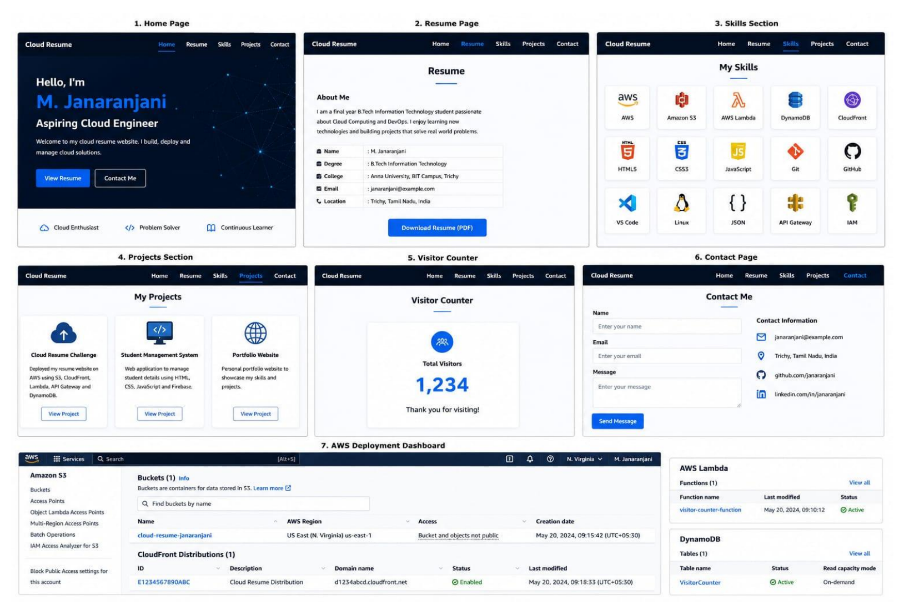
Sample Output
Home page with name and role
Resume page with PDF download
Skills grid for AWS and web tools
Projects section
Visitor counter backed by DynamoDB
Contact form
AWS console: S3, CloudFront, Lambda, DynamoDB
Notes:
Seven views of the finished system: home, resume, skills, projects, visitor counter, contact page, and the AWS dashboard showing the S3 bucket, CloudFront distribution, Lambda function and DynamoDB table.

Slide 10
Analysis, Conclusion & Future Work
Analysis
Conclusion
Future work
Storage: S3 holds resumes and site files
Compute: Lambda scales on demand
Security: IAM with least privilege
Cost: pay per use, monitor usage
30 days covering AWS, serverless and deployment
Hands-on S3, Lambda, API Gateway and IAM
Better prepared for cloud roles
Two-factor authentication
Role-based access control
Real-time audit logs
AI anomaly detection and automatic backup
Thank you
Notes:
The analysis covered storage, serverless compute, API communication, security, scalability, availability and cost. The project gave practical experience of deploying a serverless web application on AWS. Future work includes two-factor authentication, role-based access control, audit logs, anomaly detection and automatic backup.

